Slide 1
Welcome to Fox Class 20223-2024

Slide 2
Introductions
Most of the curriculum is taught by Mr Jackson. Mrs Oddie is with our class throughout the week.
Our class are also taught by some others teachers.
Miss Hernandez - Music/Big Band
Mr Sidhu - PE

Slide 3
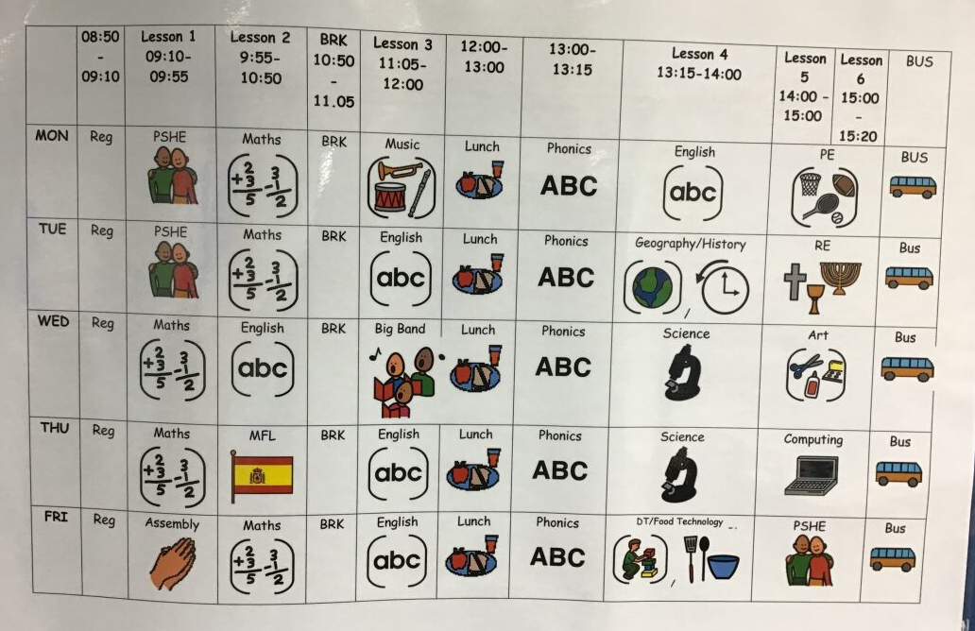
Timetable

Slide 4
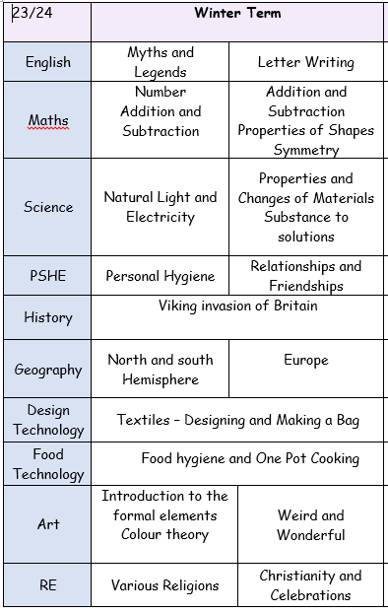
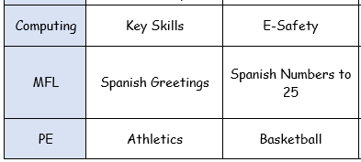
Our Curriculum

Slide 5
What should pupils bring to school daily?
Students each have a home/school diary, which you have been using so far. Anything you need us to know, pop in here!
Reading books are given in line with pupil assessments. We aim to read with your child on a 1:1 basis once a week and sometimes more when we can. Please record in the reading record when you have read with your child at home.​
​
Books will be changed as required.
Water bottles – most of our students are bringing them in. We do have cups in class for our students too.

Slide 6
Homework and Spelling
Homework
We will give homework out each Friday and it will be due back the following Thursday.
This will be either related to work that we will be doing in class that week or spelling based.
Spellings
We will give class a list of up to 10 words each to learn that week. We will do our test each Friday.

Slide 7
General information
Lunches
Hot dinners are taken down in the school hall. Anyone having packed lunch will join packed lunch club upstairs in the Food Technology room.
Clubs
This year we have a range of clubs including:
Art clubs, football club, games club, litter picking club and more!

Slide 8
Evidence for Learning (EFL)
This is used to share evidence of some of the work/activities we do in class.
Has everyone been able to access it?

Slide 9
Any Questions?
Happy to answer any general questions!
If it is specific to your child then I am happy to chat to you individually.

