Slide 1
Adding Fractions

Slide 2
Adding Fractions
There are 3 Simple Steps to add fractions:
Step 1: Make sure the bottom numbers (the denominators) are the same.
Step 2: Add the top numbers (the numerators), put the answer over the denominator.
Step 3: Simplify the fraction (if needed).

Slide 3
Adding Fractions
Step 1. The bottom numbers (the denominators) are already the same. Go straight to step 2.
Step 2. Add the top numbers and put the answer over the same denominator:
Step 3. Simplify the fraction:

Slide 4
Adding Fractions

Slide 5
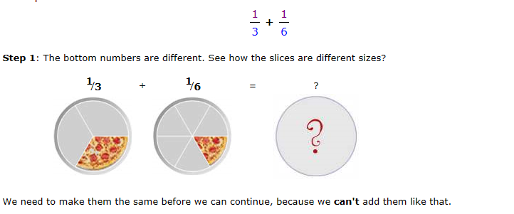
Adding Fractions

Slide 6
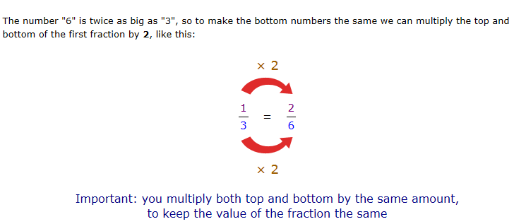
Adding Fractions

Slide 7
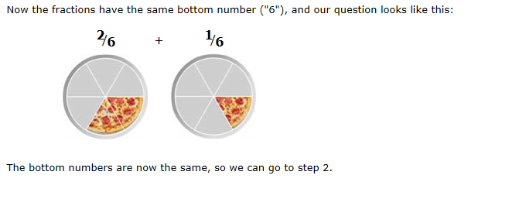
Adding Fractions

Slide 8
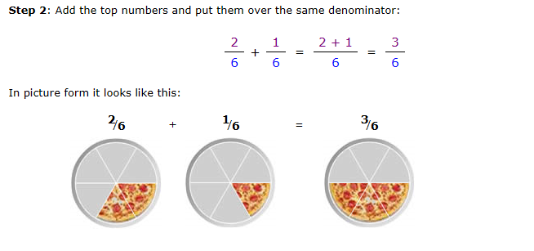
Adding Fractions

Slide 9
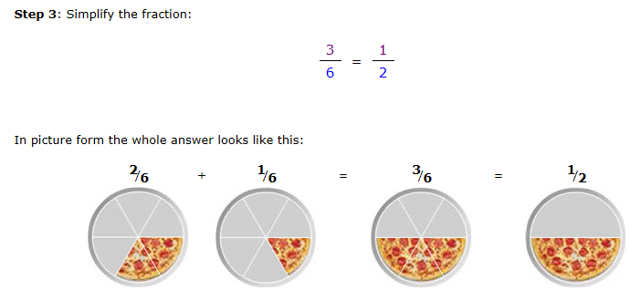
Adding Fractions

Slide 10
Adding Fractions

