Slide 1
Welcome to BADGER CLASS!

Slide 2
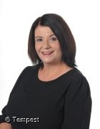
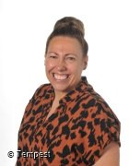
Meet the Staff.
Ms. White – Teacher Ms. Forrest - TA

Slide 3
The School Day
8.50 a.m. – Start of school Day
10.40 – 10.55 – Break
12 p.m. – Lunch break
12.30 – Lunch
1.00 p.m. – Afternoon lessons
3.15 p.m. – Finish lessons ready for home time.

Slide 4
 | Monday | Tuesday | Wednesday | Thursday | Friday
1 | Music - DH | Art - JF | History/Gog - JS | Maths | Assembly
2 | English (Word level – spelling and phonics) | D.T. - JF | R.E. - JS | English (Writing) | Maths
3 | Maths | Science English (Text level) | Big Band | Science | English (Writing)
4 | Science | Maths | English (Sentence level) | PE - Wolves | M.F.L
5 & 6 | P.S.H.E. & My Happy Mind | Computing | Maths | P.S.H.E. | Tutorial/Spelling Test and Homework

Slide 5
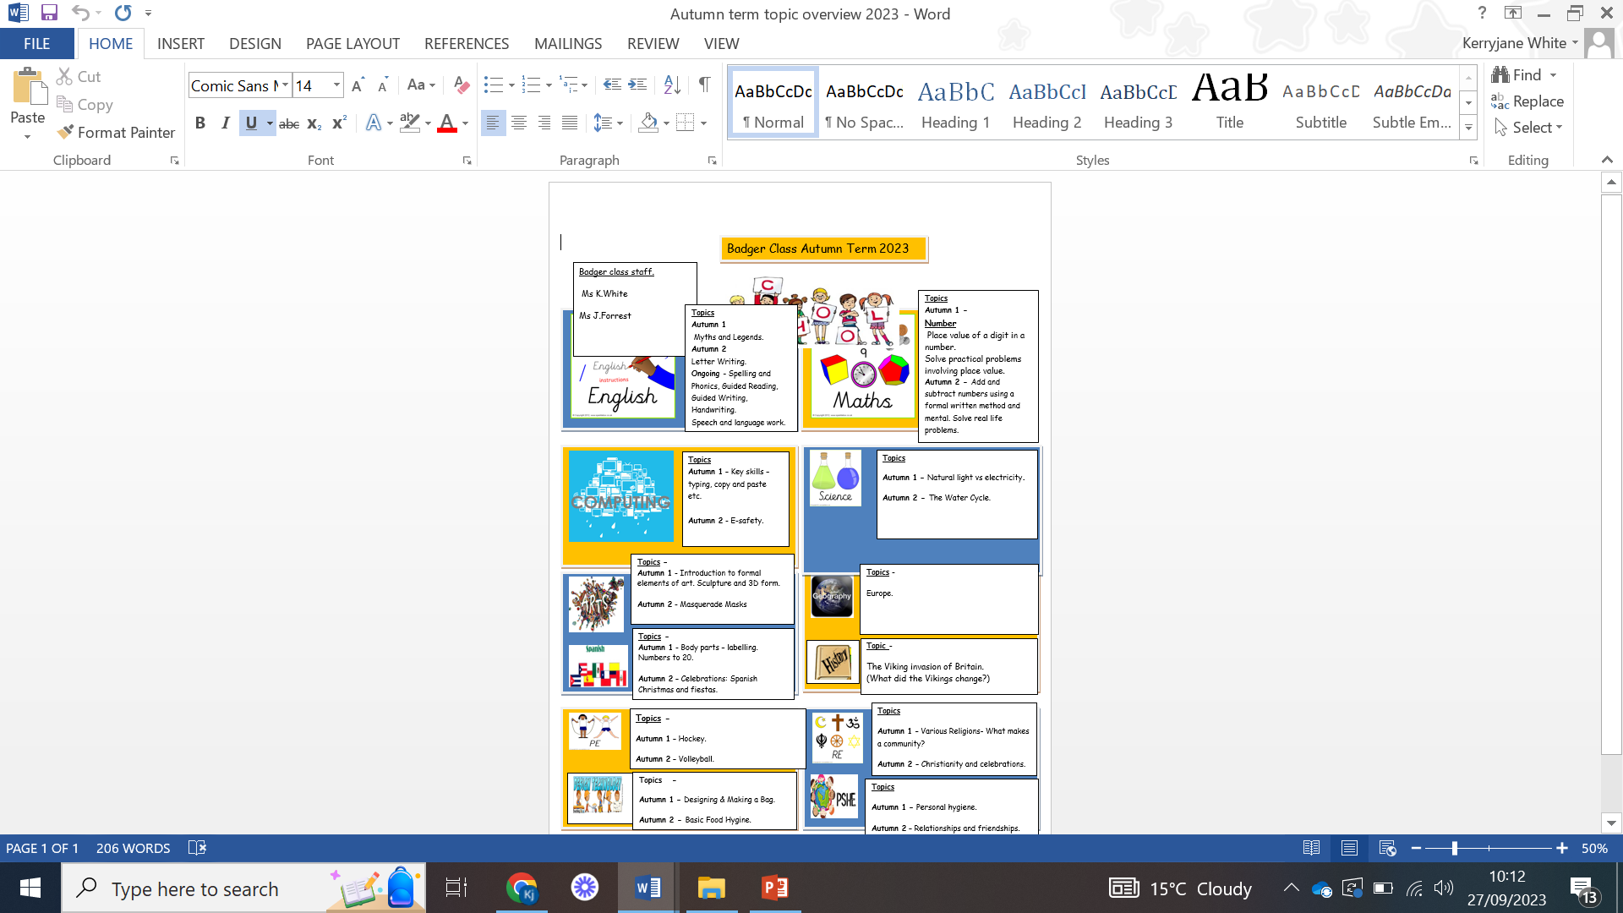

Slide 6
Lunch time arrangements
School lunch – There are usually 1 or 2 hot menu options each day. There is also a jacket potato option or pupils can order a packed lunch.
Home packed lunch – There is a packed lunch club for Key Stage 3.

Slide 7
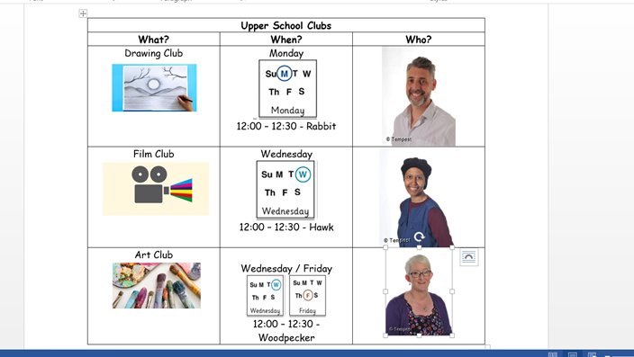

Slide 8
Equipment
All equipment is provided by school. Pupils each have their own pencil case which contains everything that they could possibly need in class.
MOBILE PHONES
Pupils are allowed to bring their phone to school as some pupils like to use these on transport. Phones must be locked in the class cupboard and switched off during the day.

Slide 9
What should pupils bring to school daily?
Pupils have all been given a home/school link book.
These are used for school/home communication. Please feel free to write any notes to class staff in here. Staff will also use planners to pass on any messages home, please check these daily.
Reading books and records are given in line with pupils phonics assessments and reading/spelling ages. We aim to read with your child on a 1:1 basis 2x each week. Please record in the reading record when you have read with your child at home.
Books will be changed as required.
Water bottles can be sent in from home.

Slide 10
Key Information
Spellings will be sent home every week and there will be a test on a Friday.
Homework will be sent home each Friday and should be returned on a Monday/Tuesday by the latest.
We are completing assessments so reading books etc. may change.
P.E. kit needs to be worn on a Thursday and this should be a white top and dark coloured shorts or joggers. No football club tops or bright hoodies please.

Slide 11
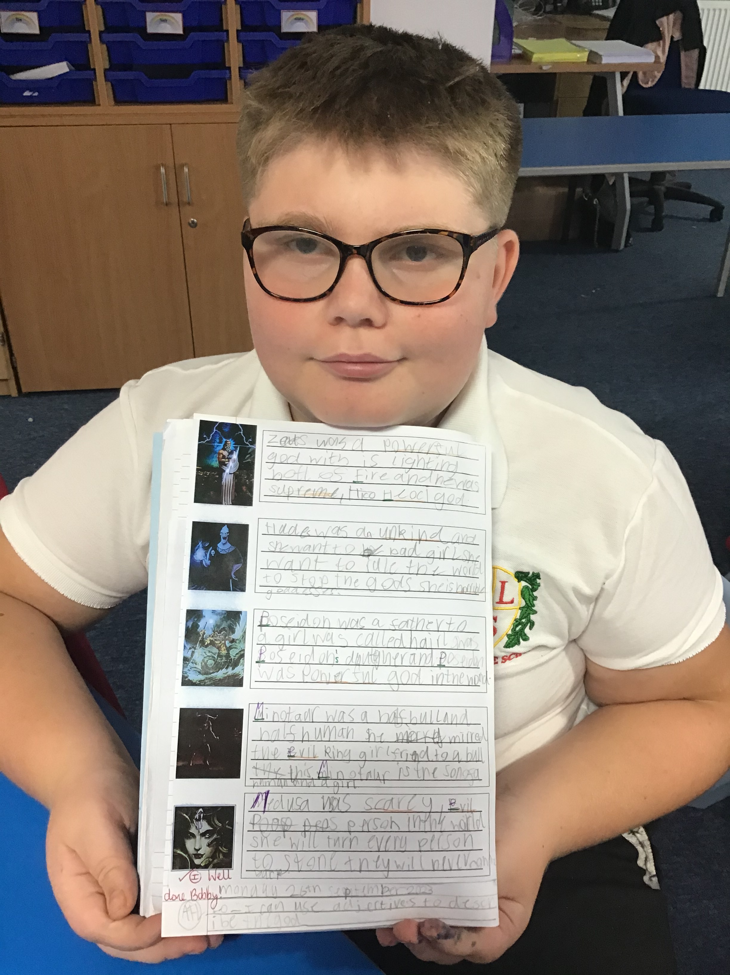
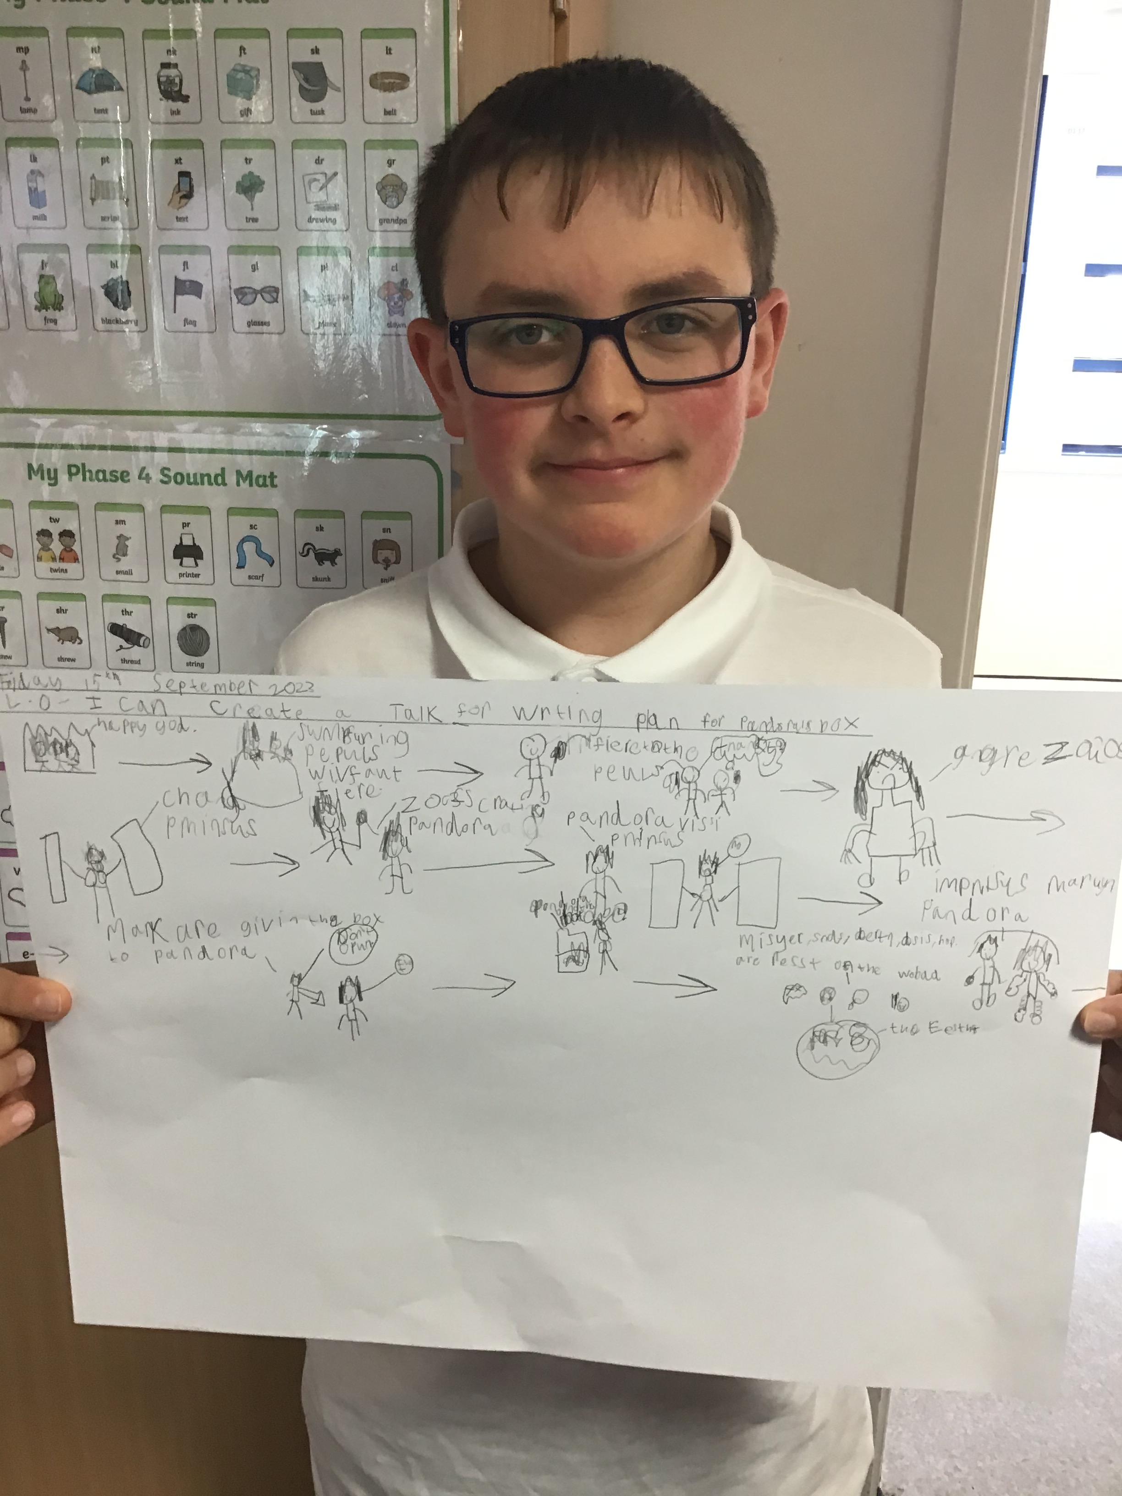
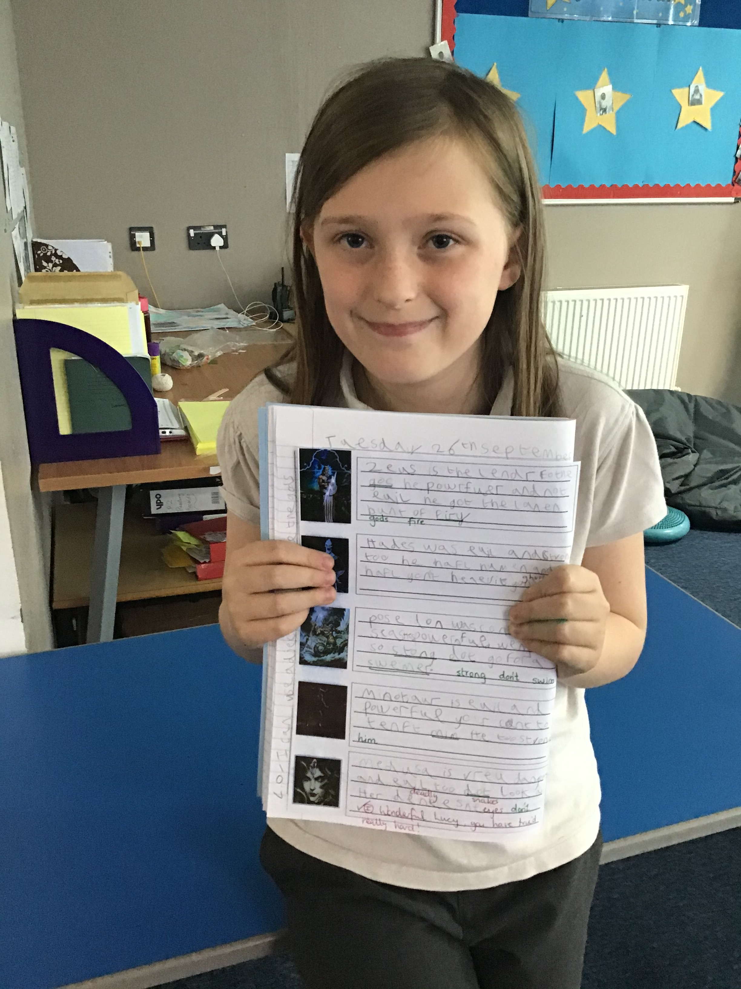
Class
News
A few pictures of some of our work so far.
Our topic in English is Myths and Legends. Here are our fabulous Talk for Writing plans all about the Greek Myth Pandora's Box and our brilliant use of adjectives when describing Greek Gods.

Slide 12
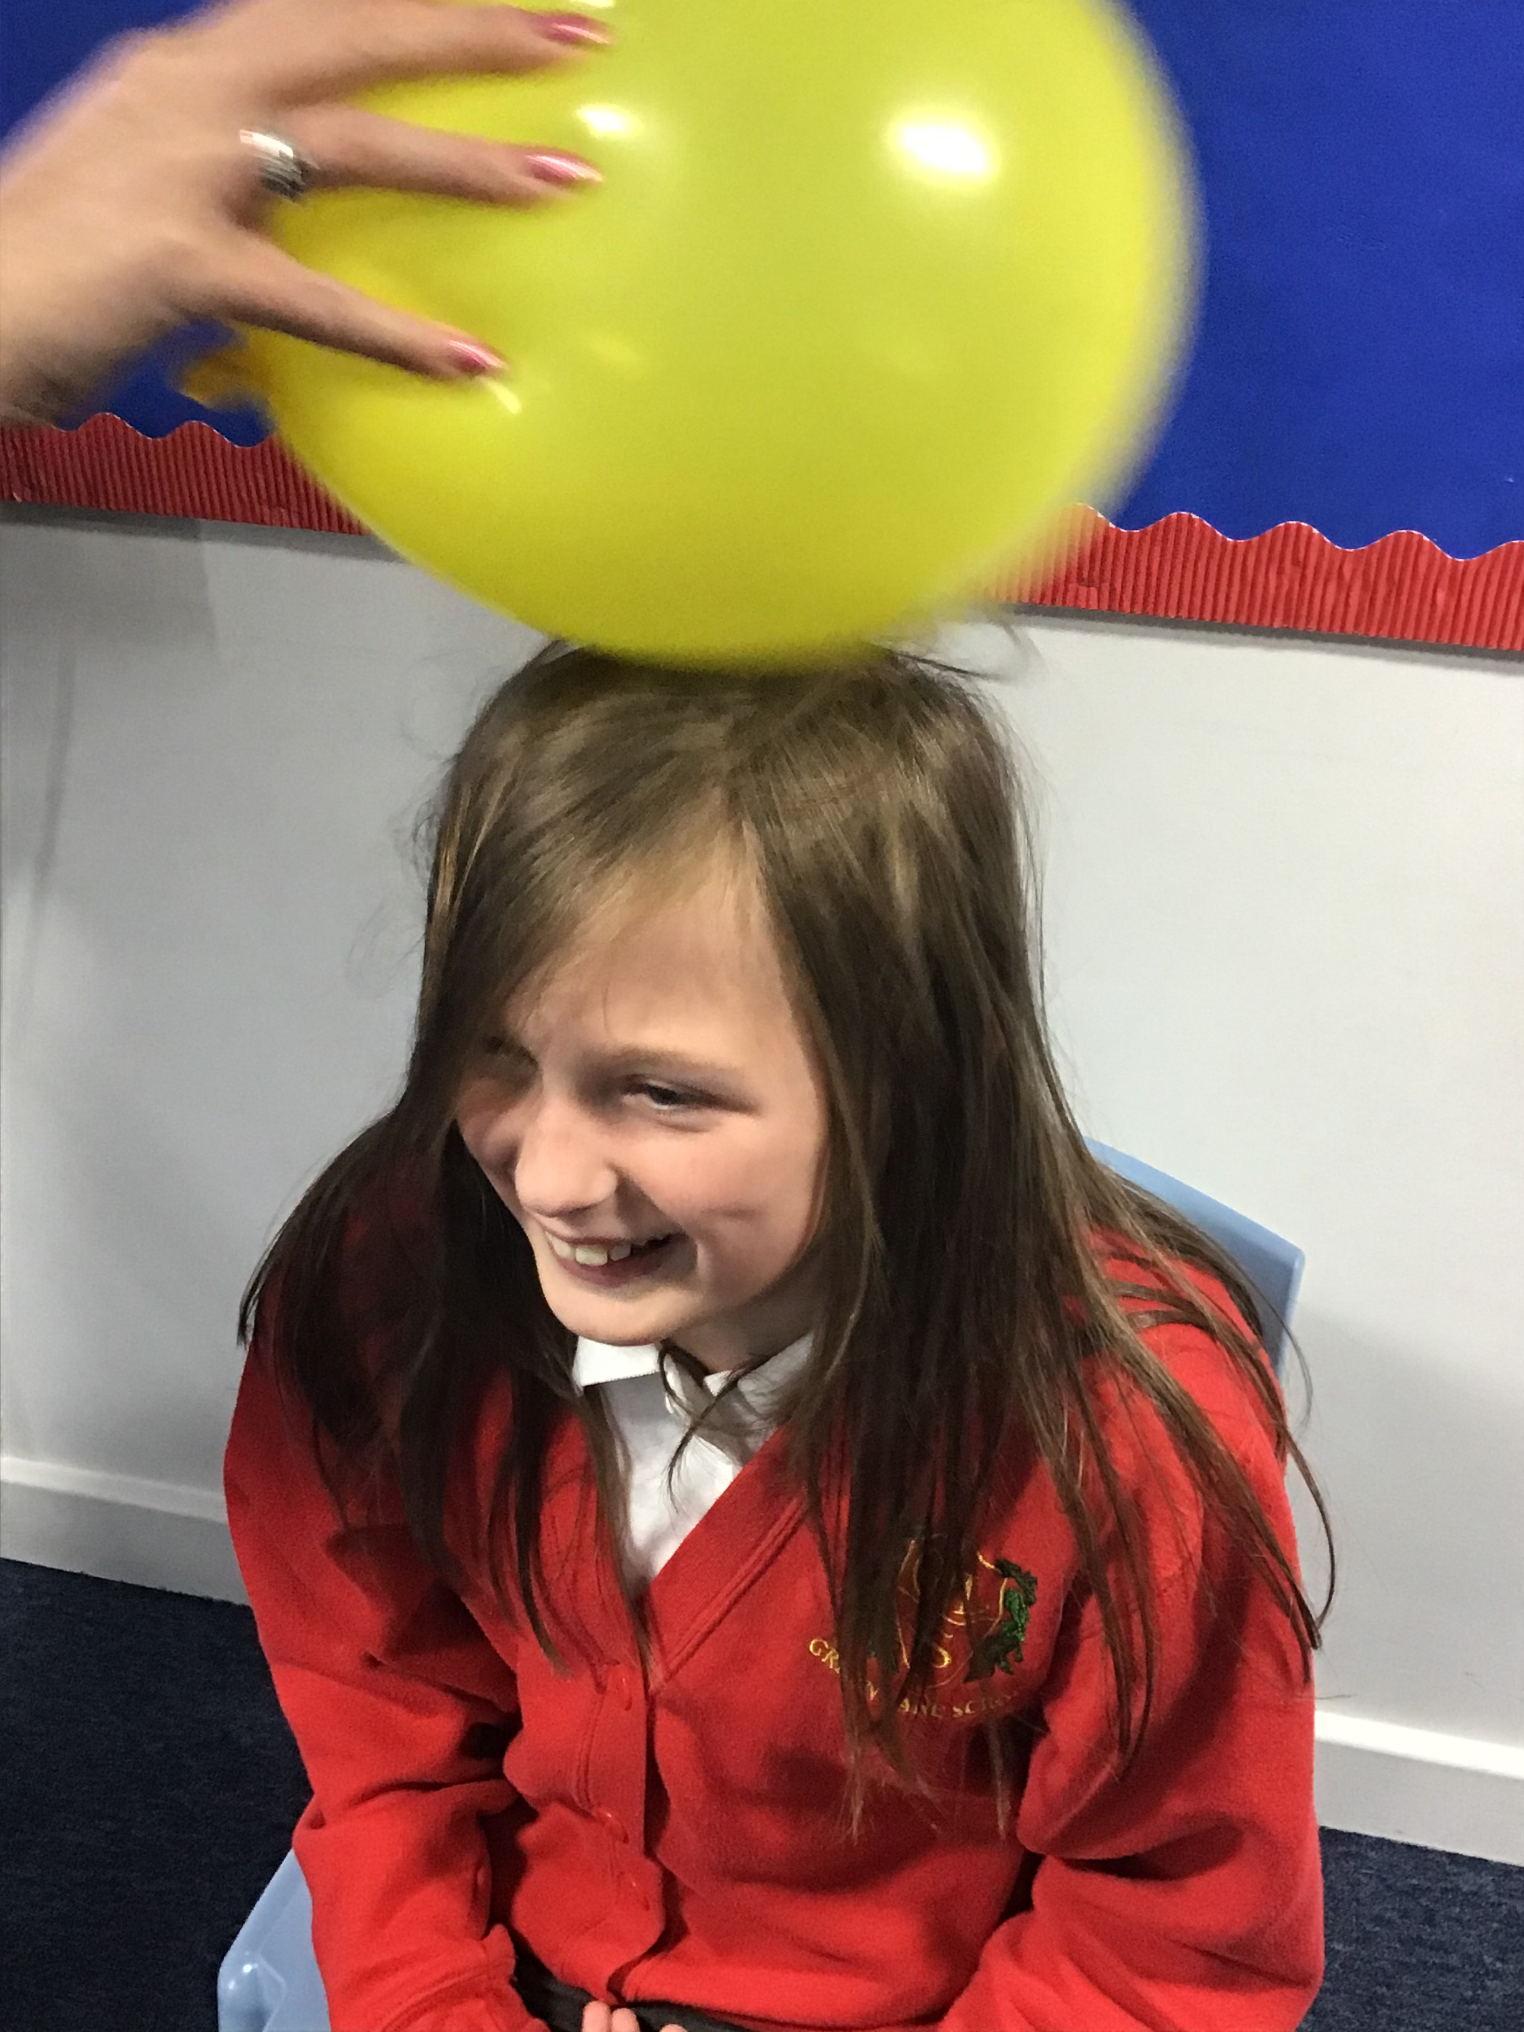
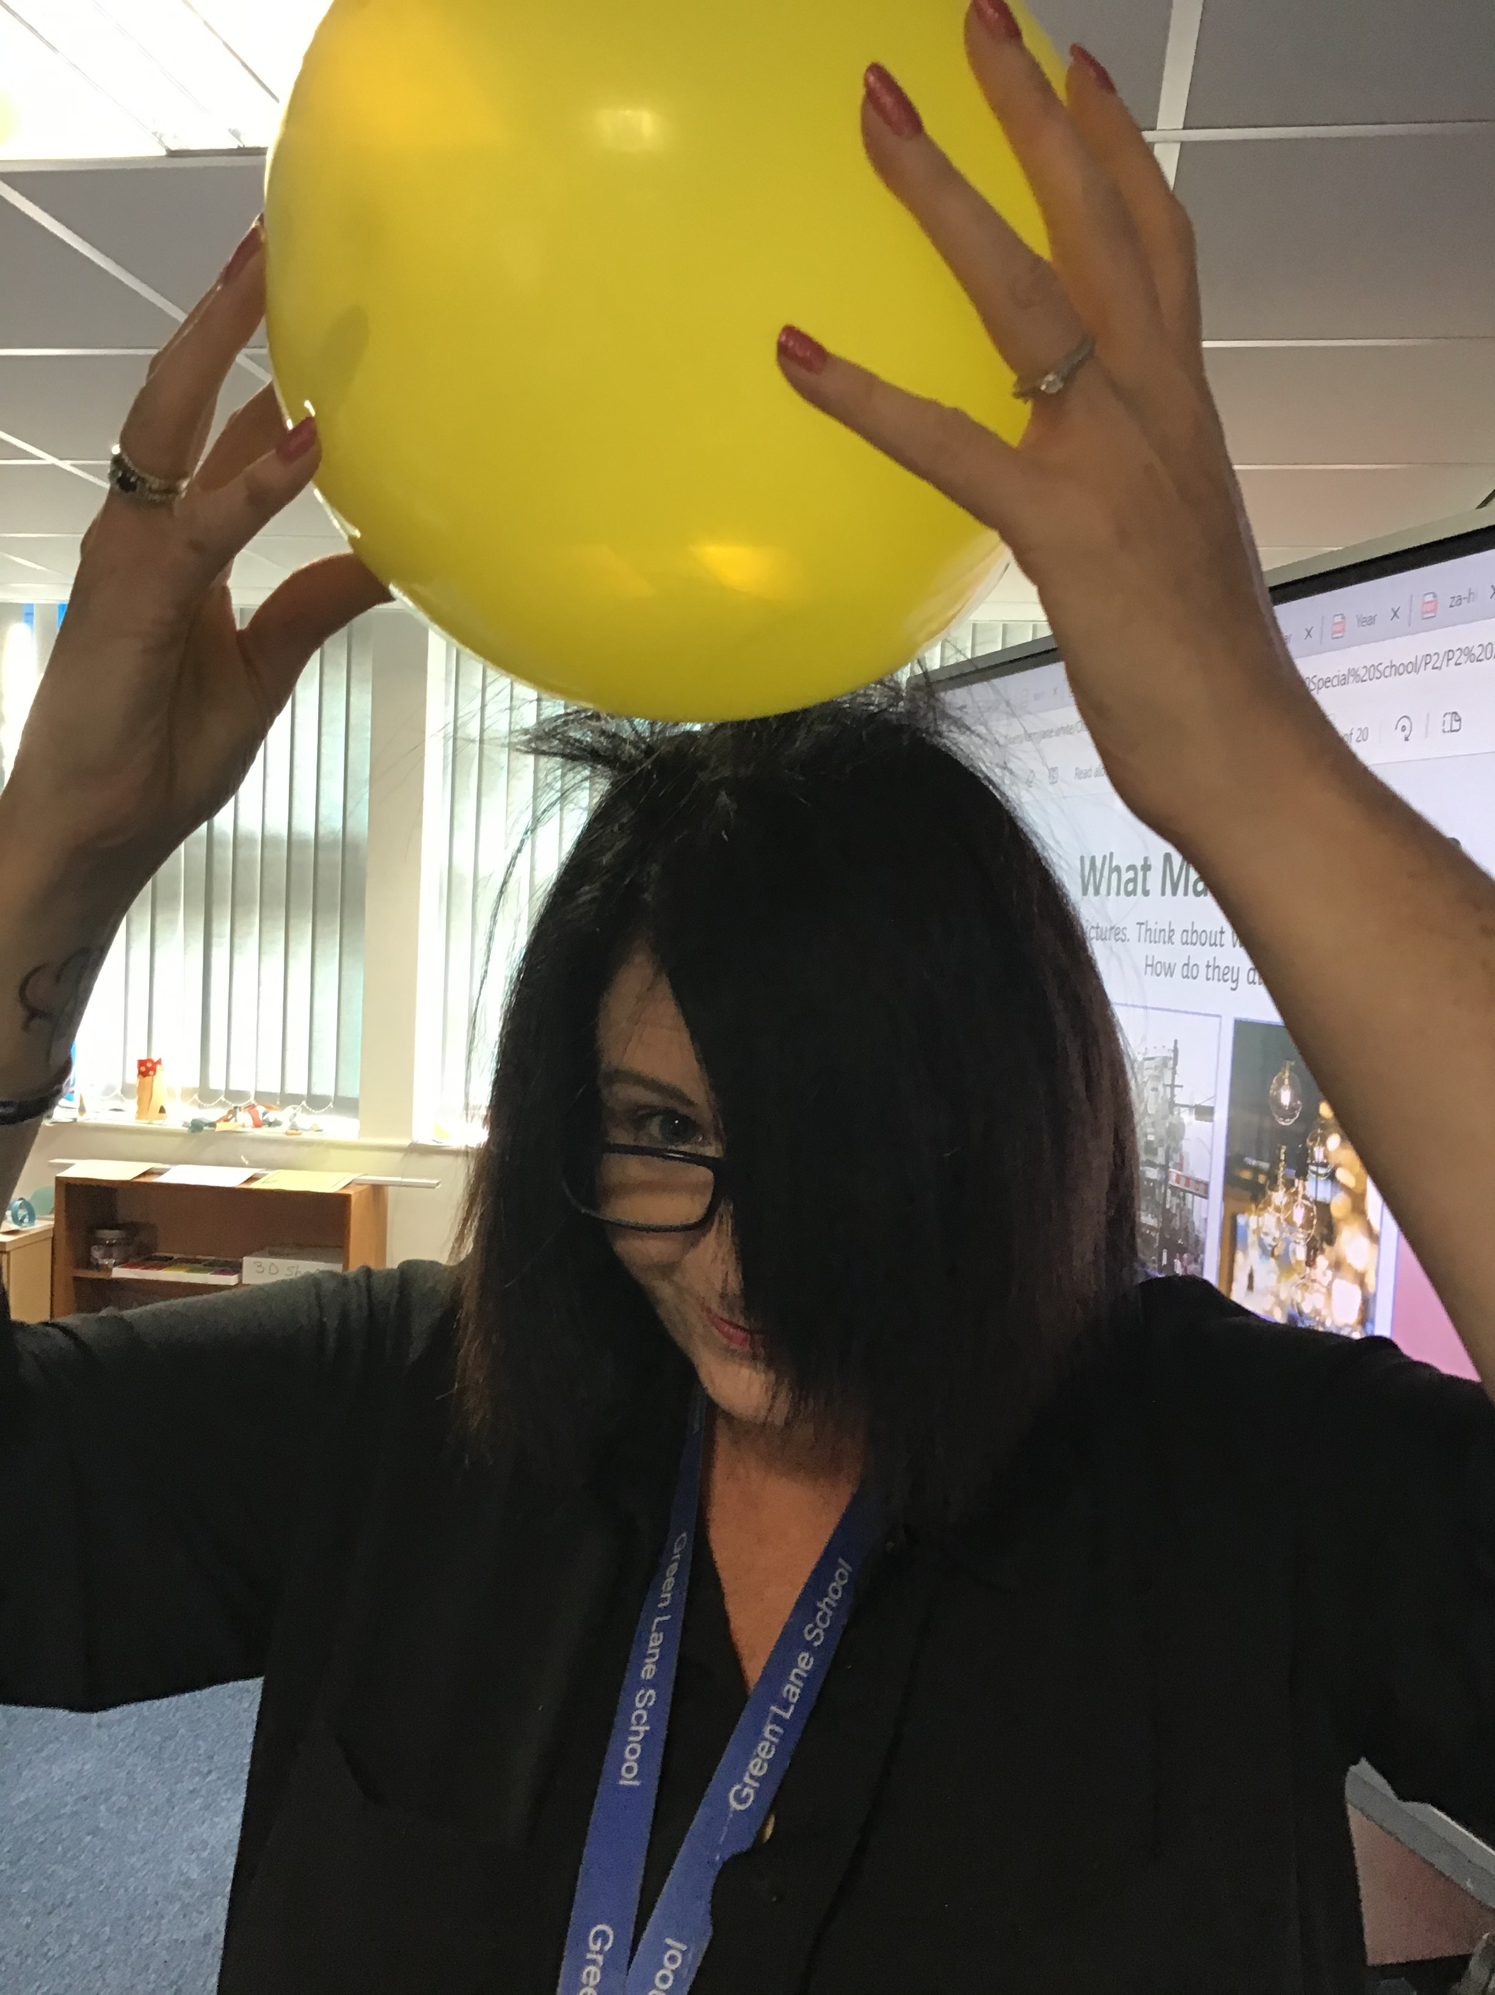
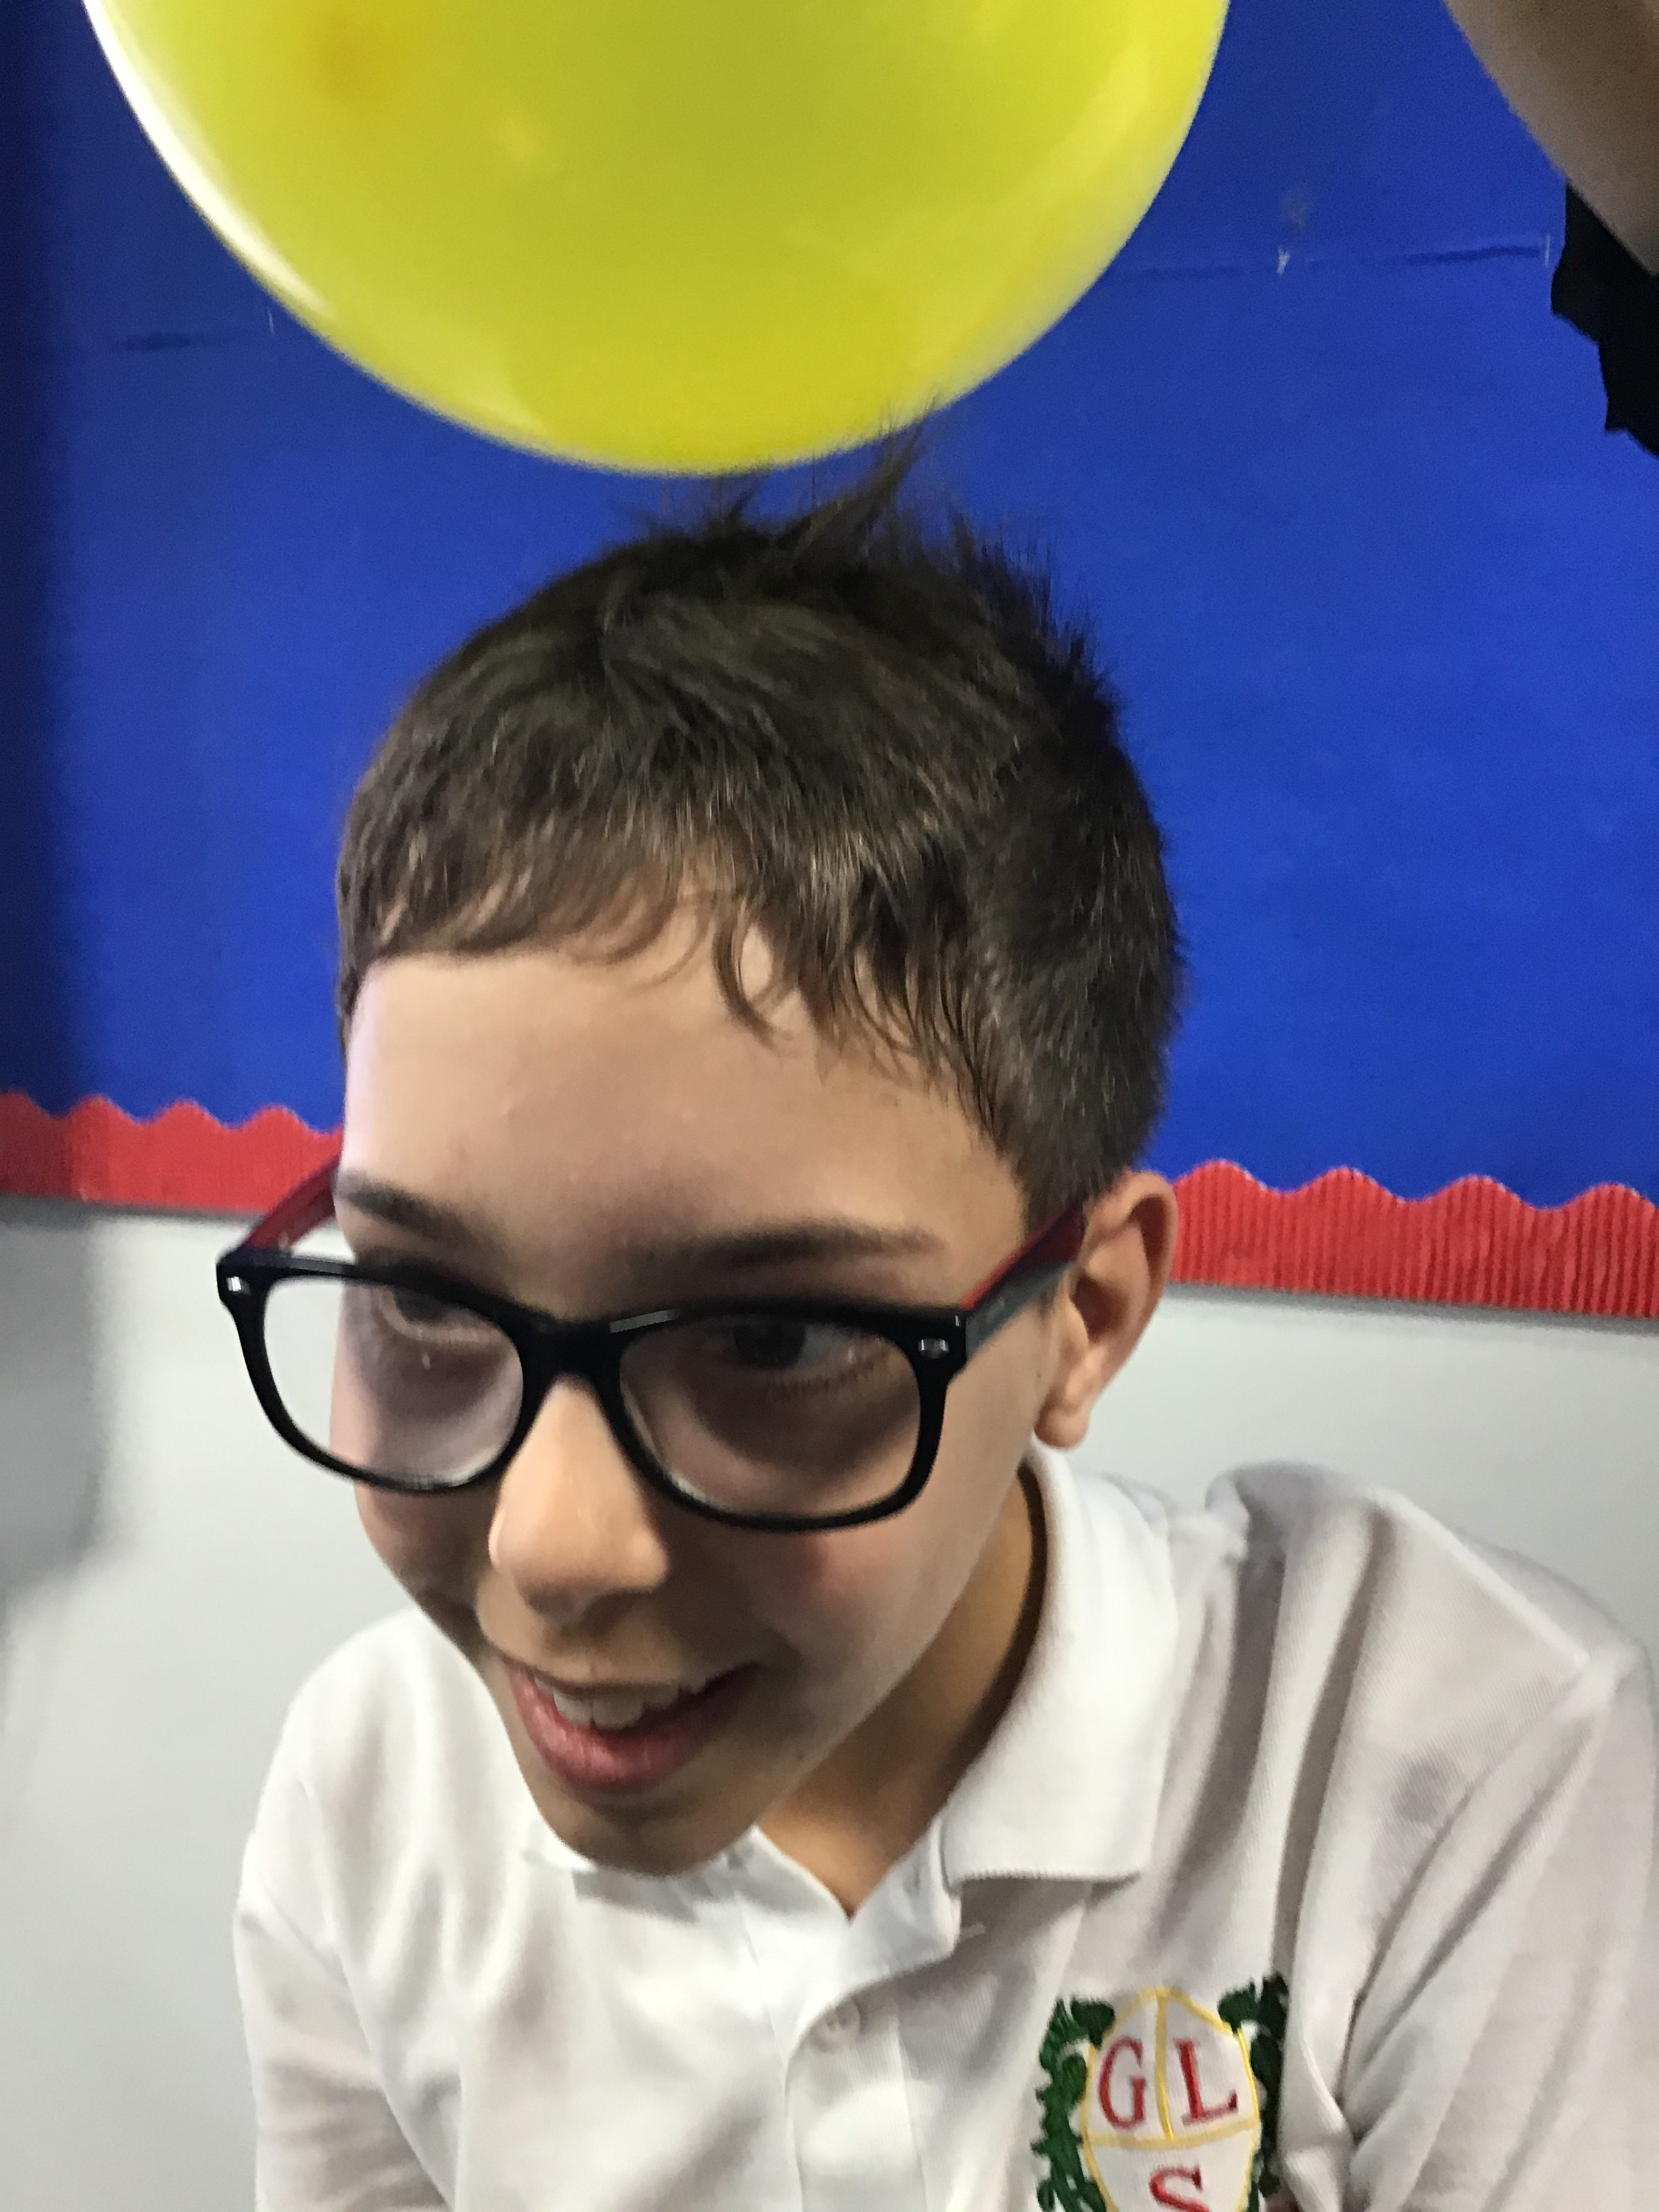
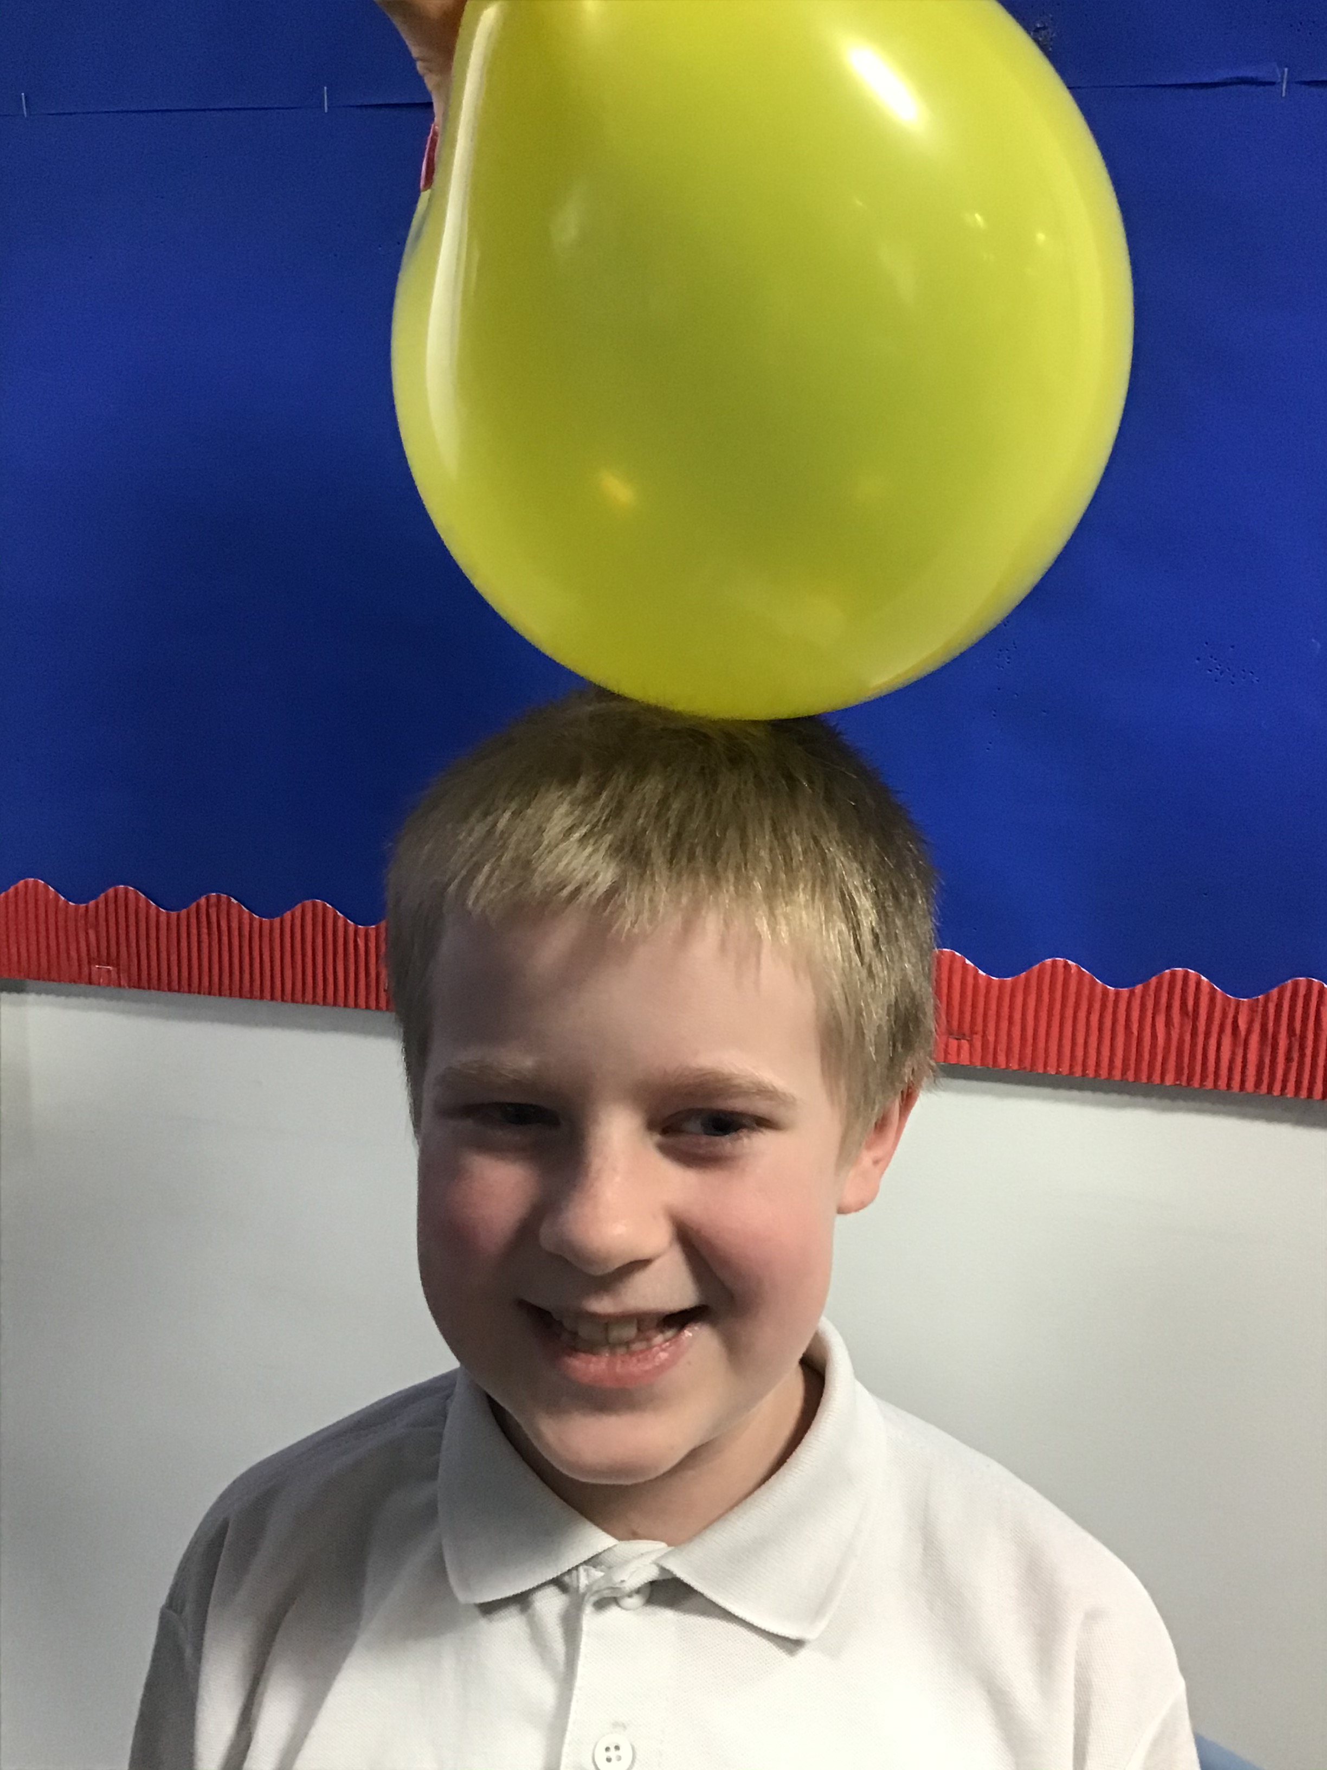
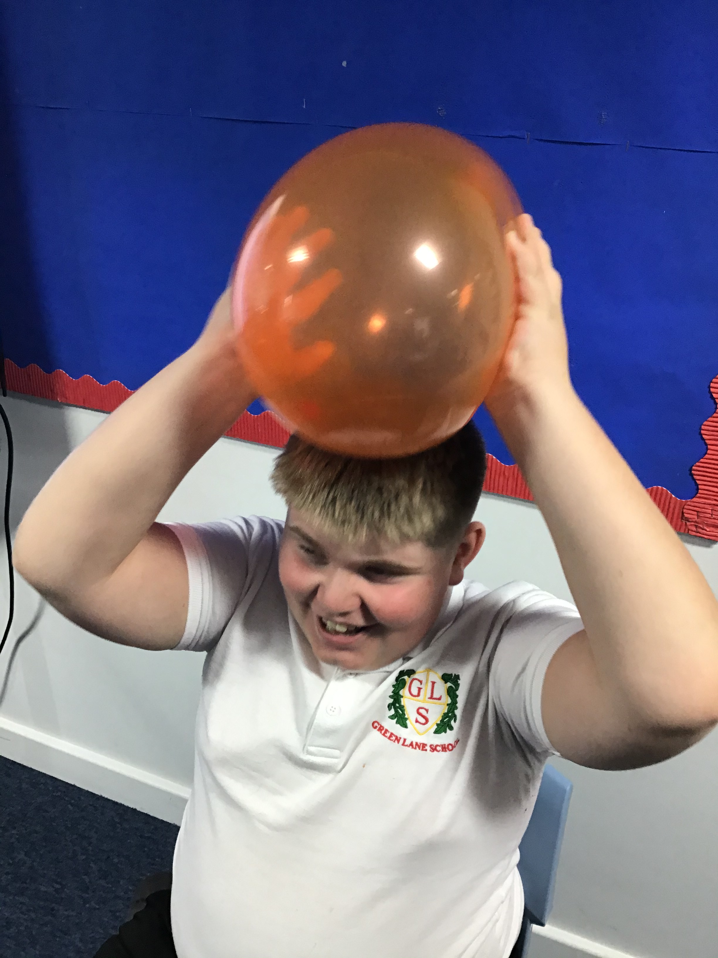
Class
News
We had lots of fun finding out about the effects of static electricity as part of our work in Science!

Slide 13
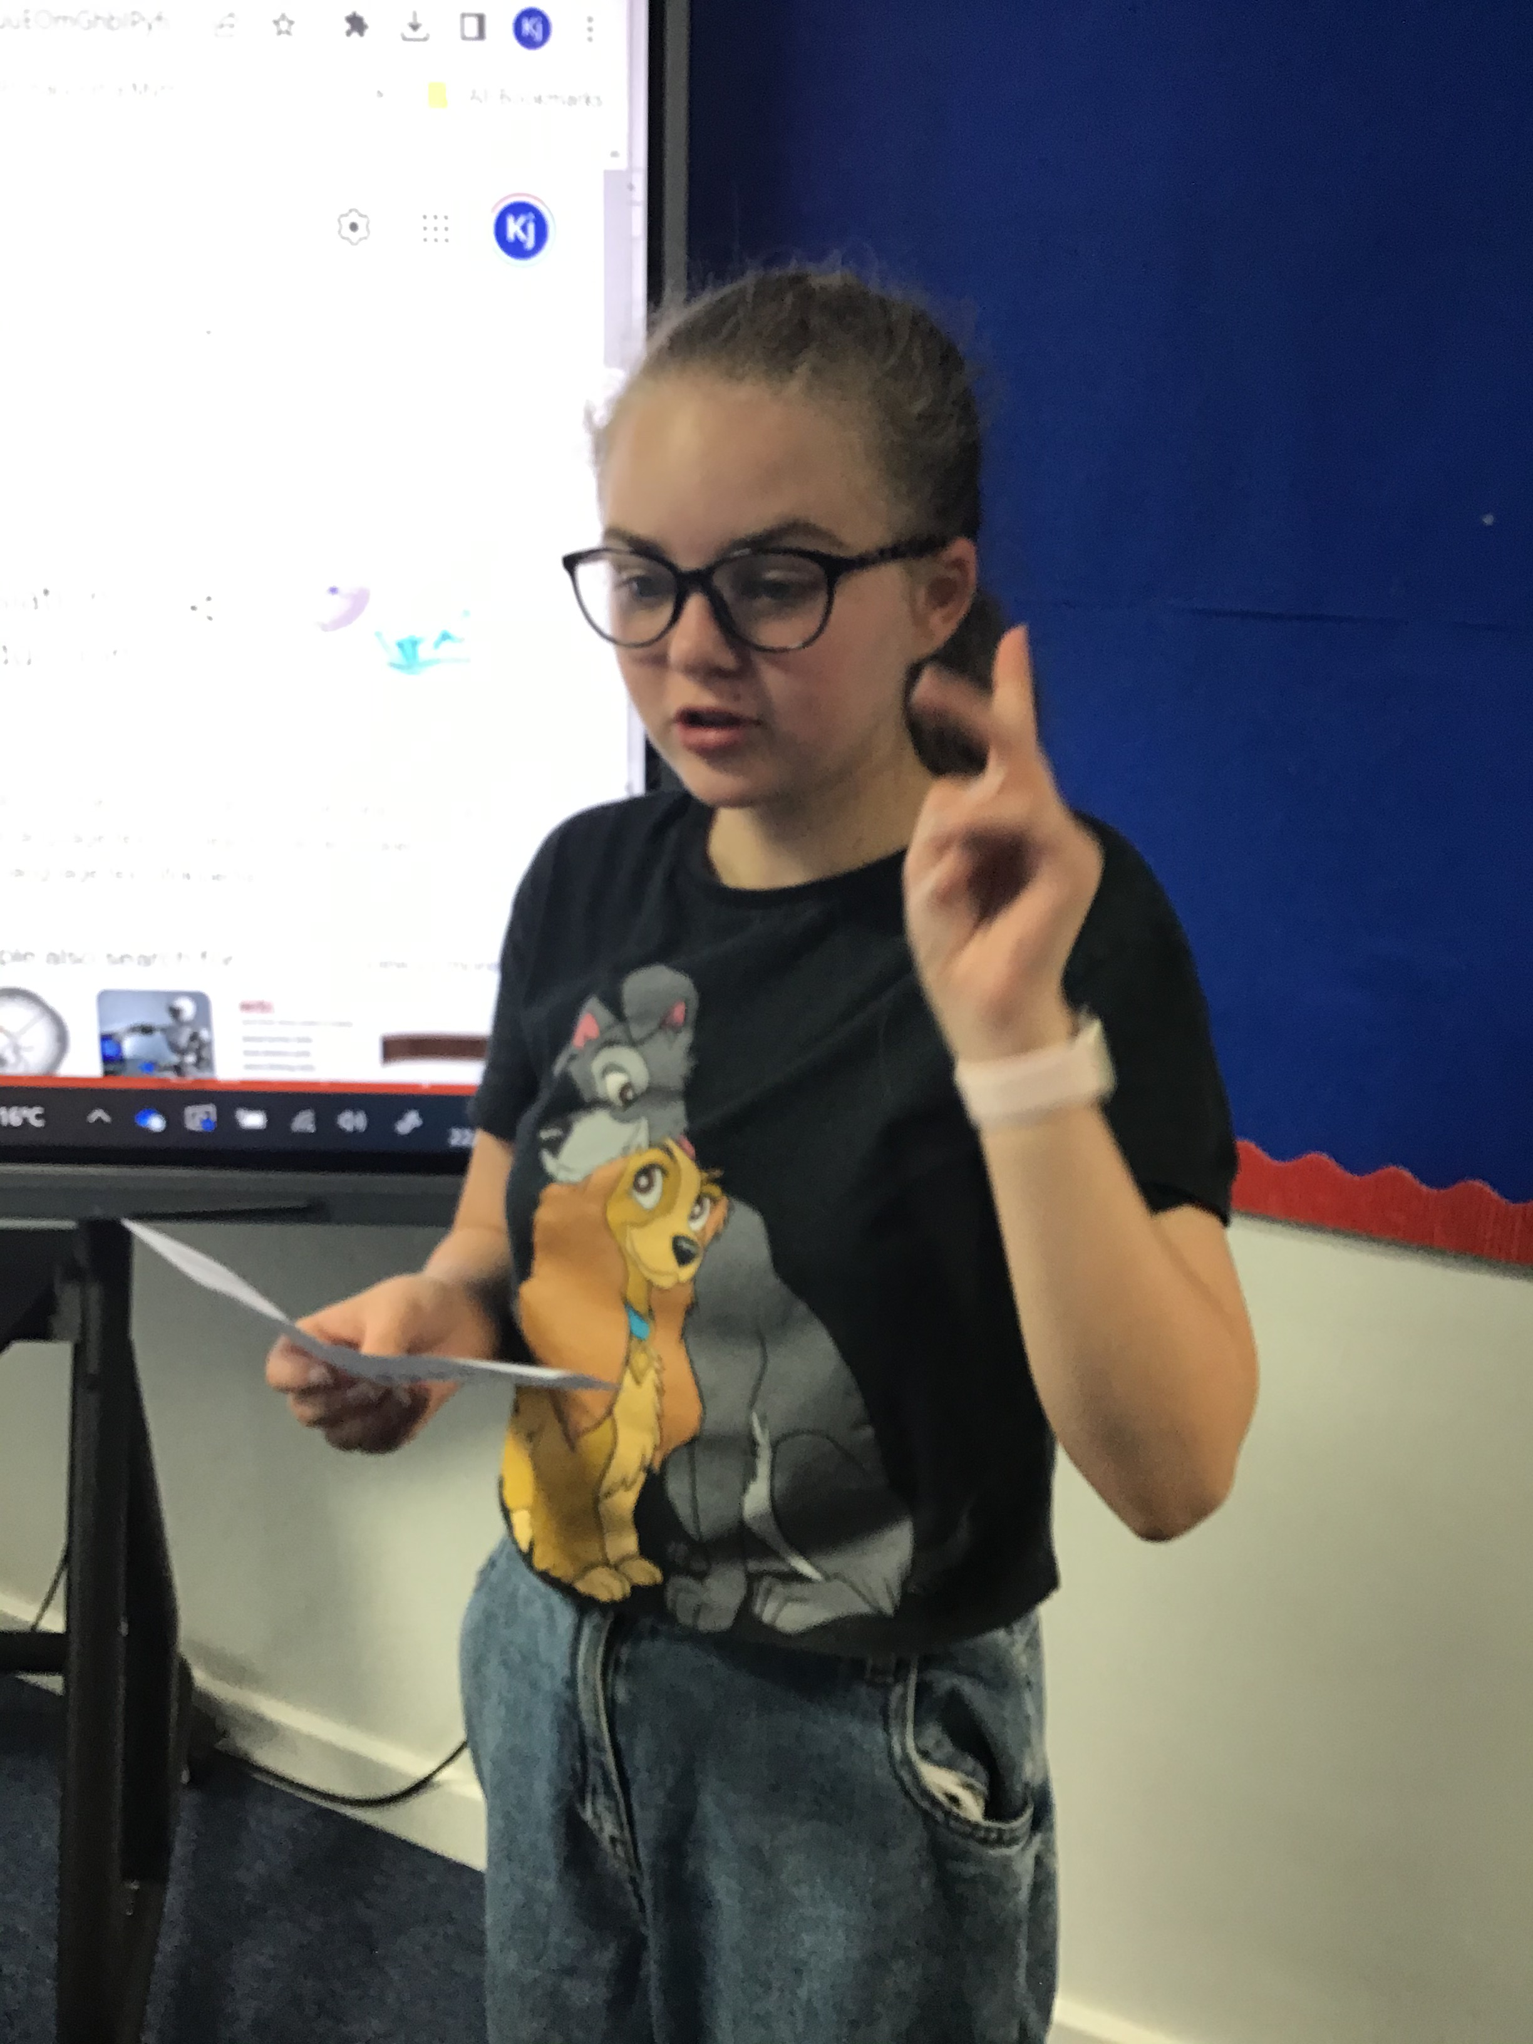
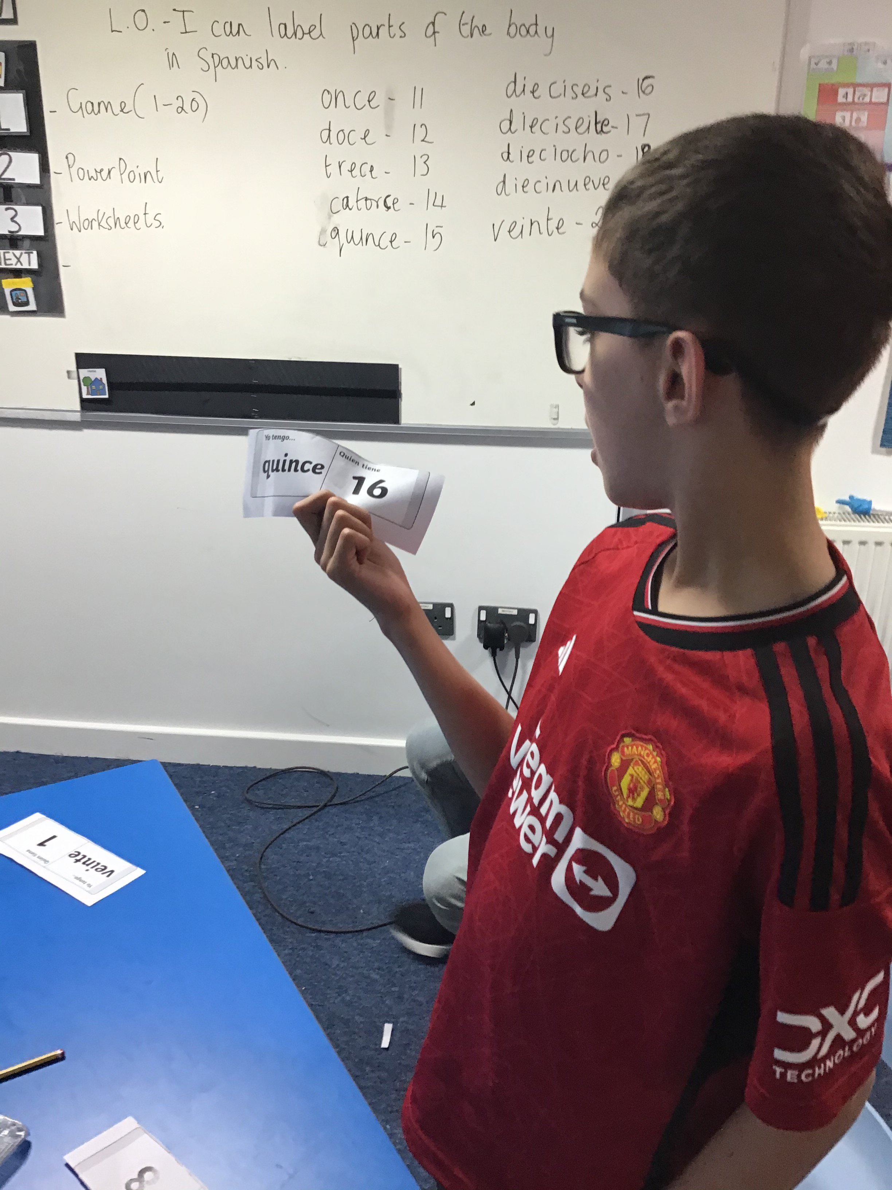
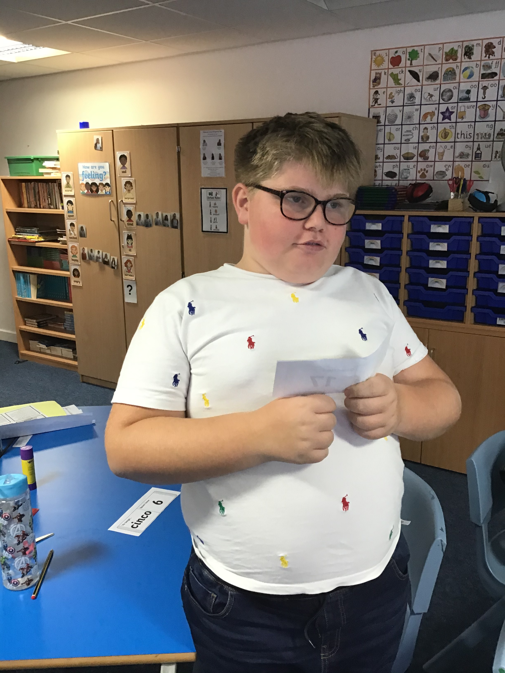
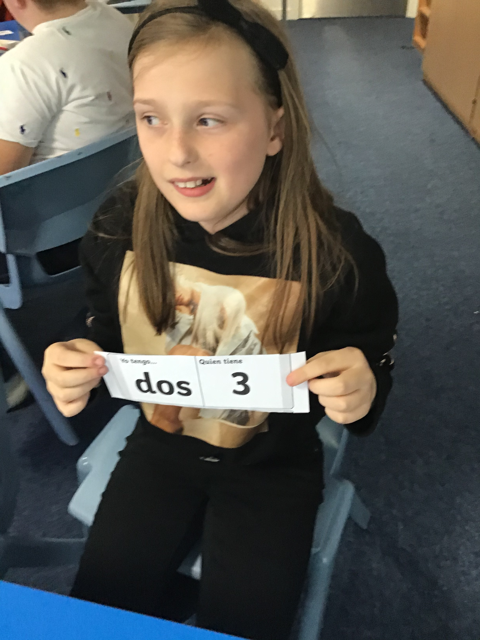
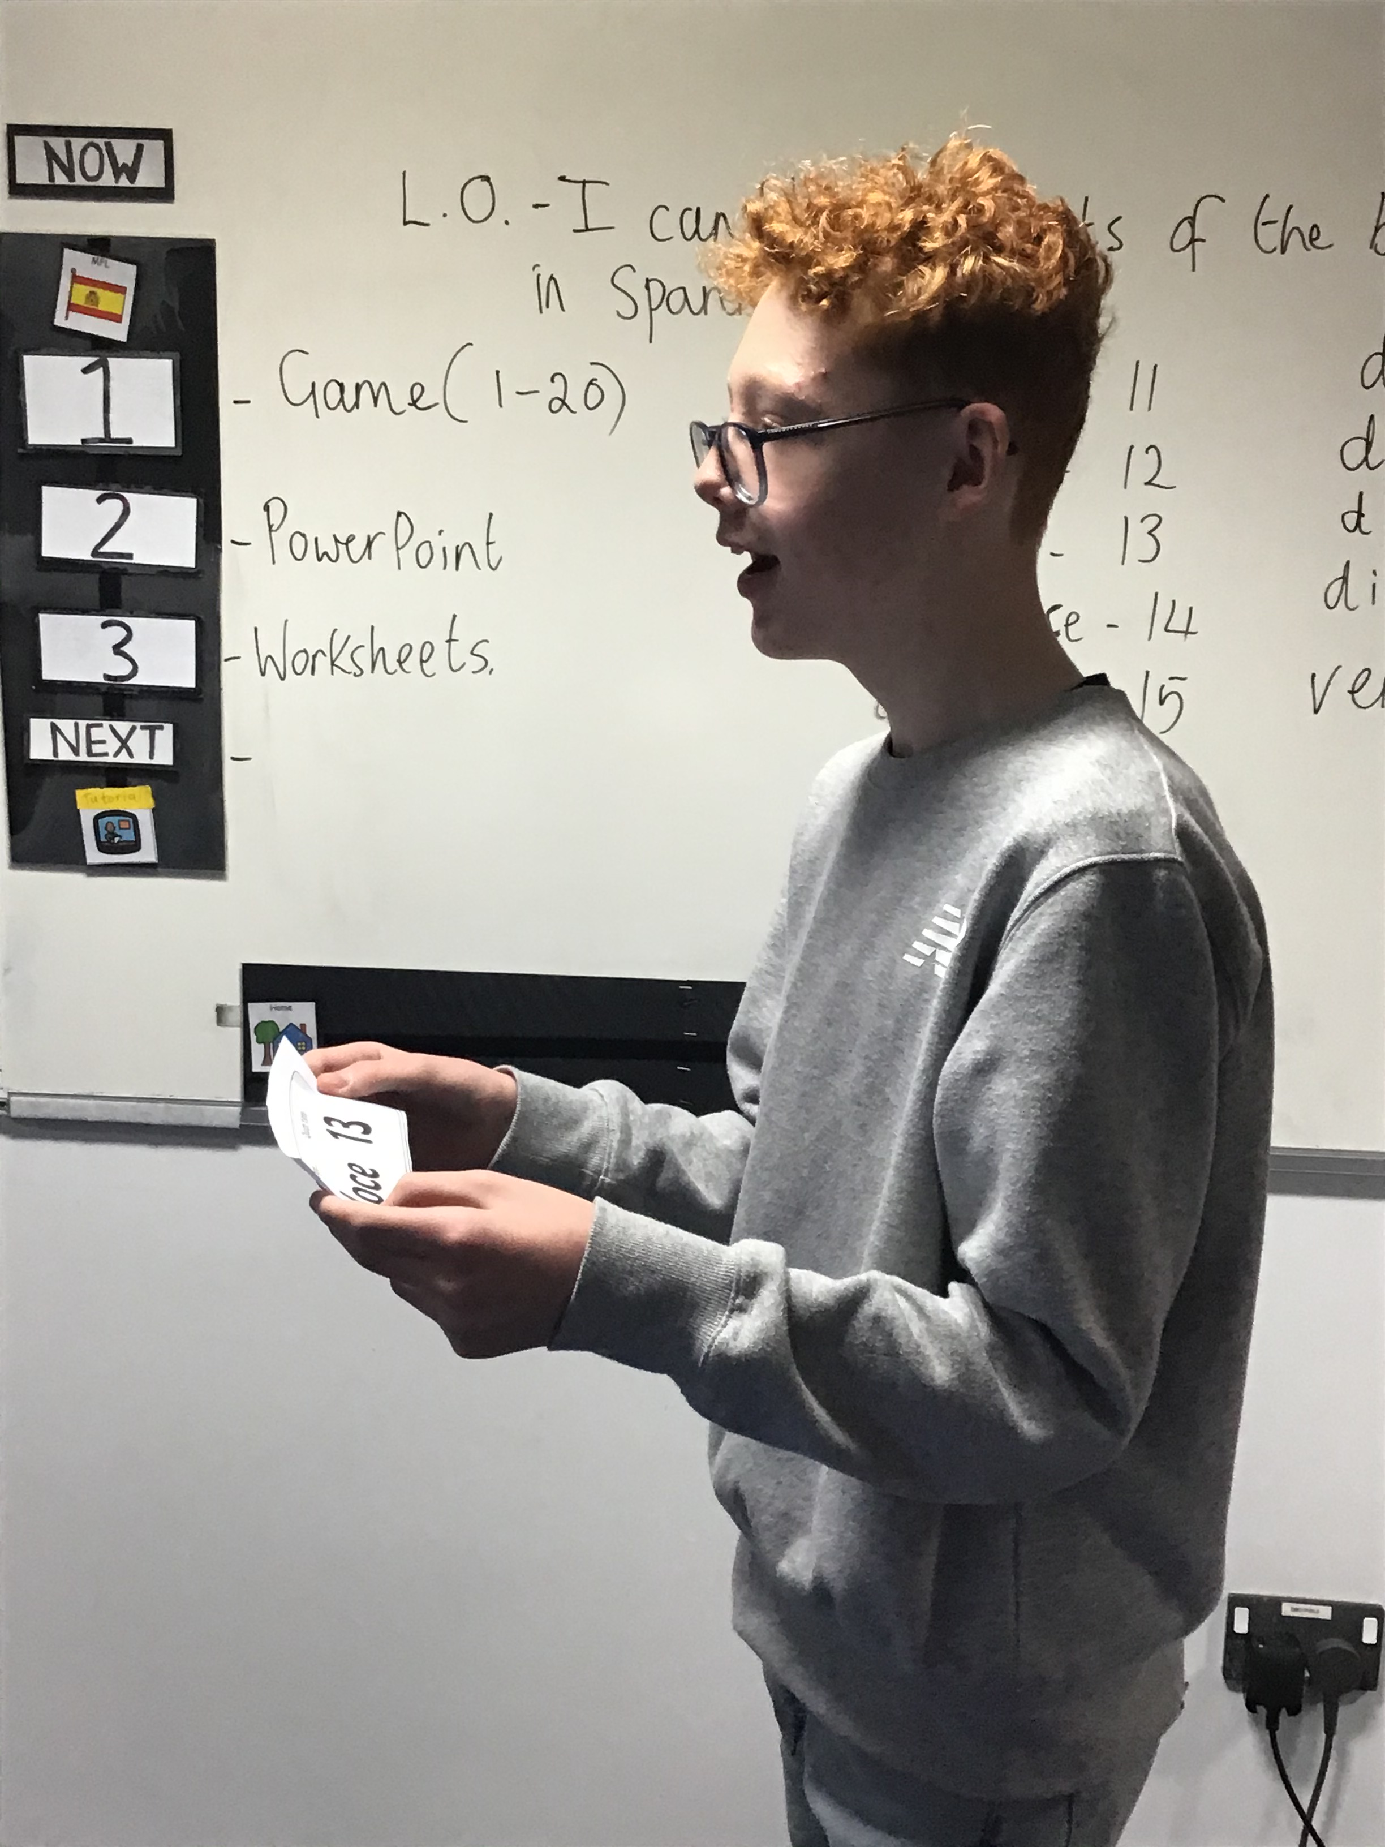
Class
News
Counting to 20 in Spanish was very exciting when we played a loop game and had to ask, "Who has?"....and say, " I have.".....for the numbers up to 20 in Spanish.

Slide 14
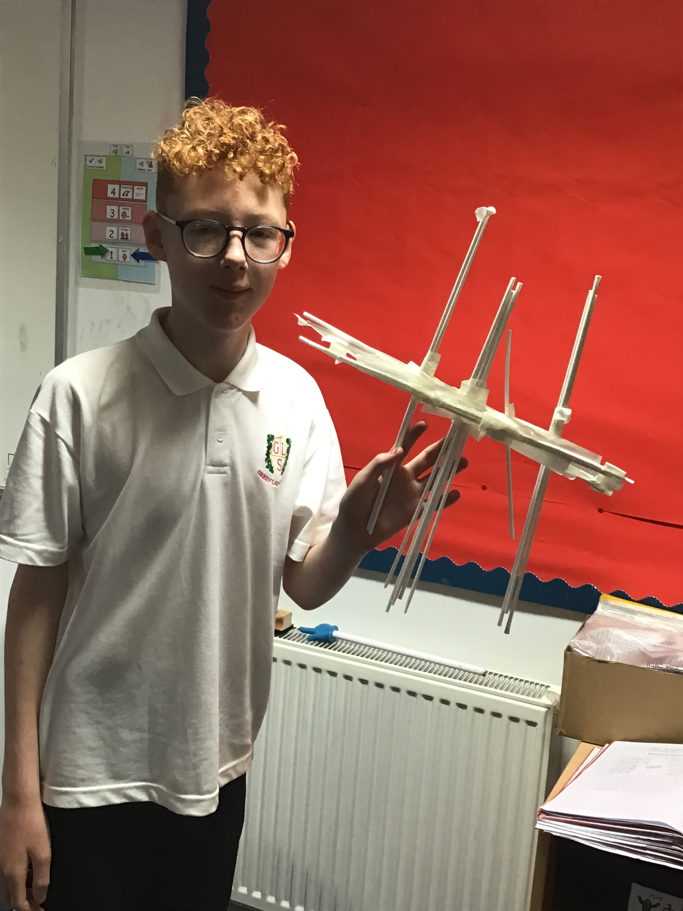
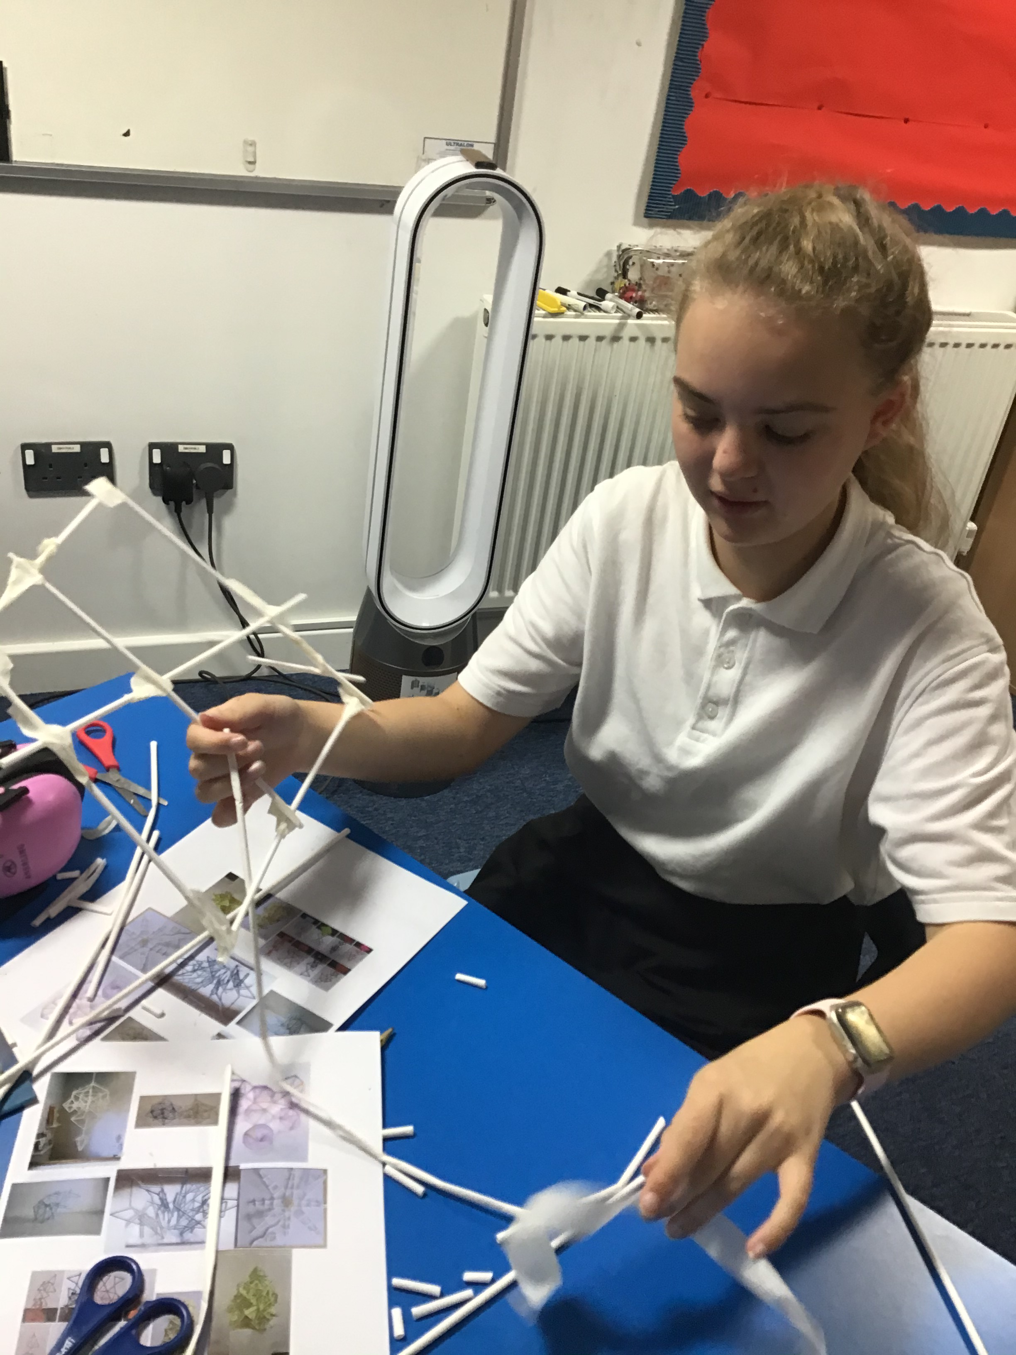
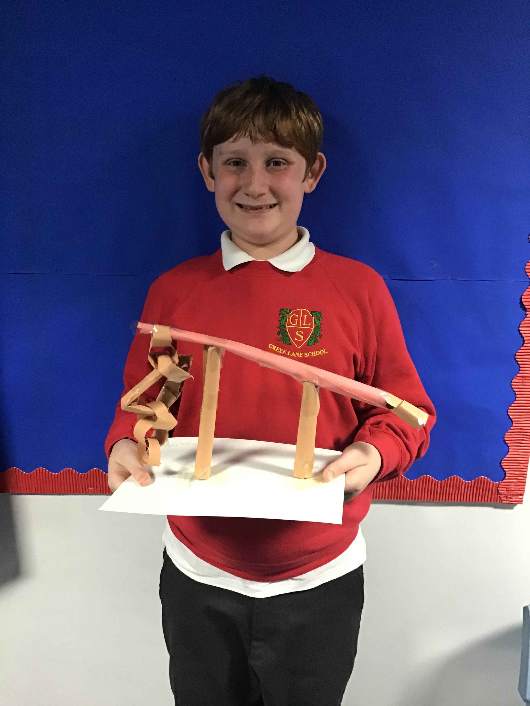
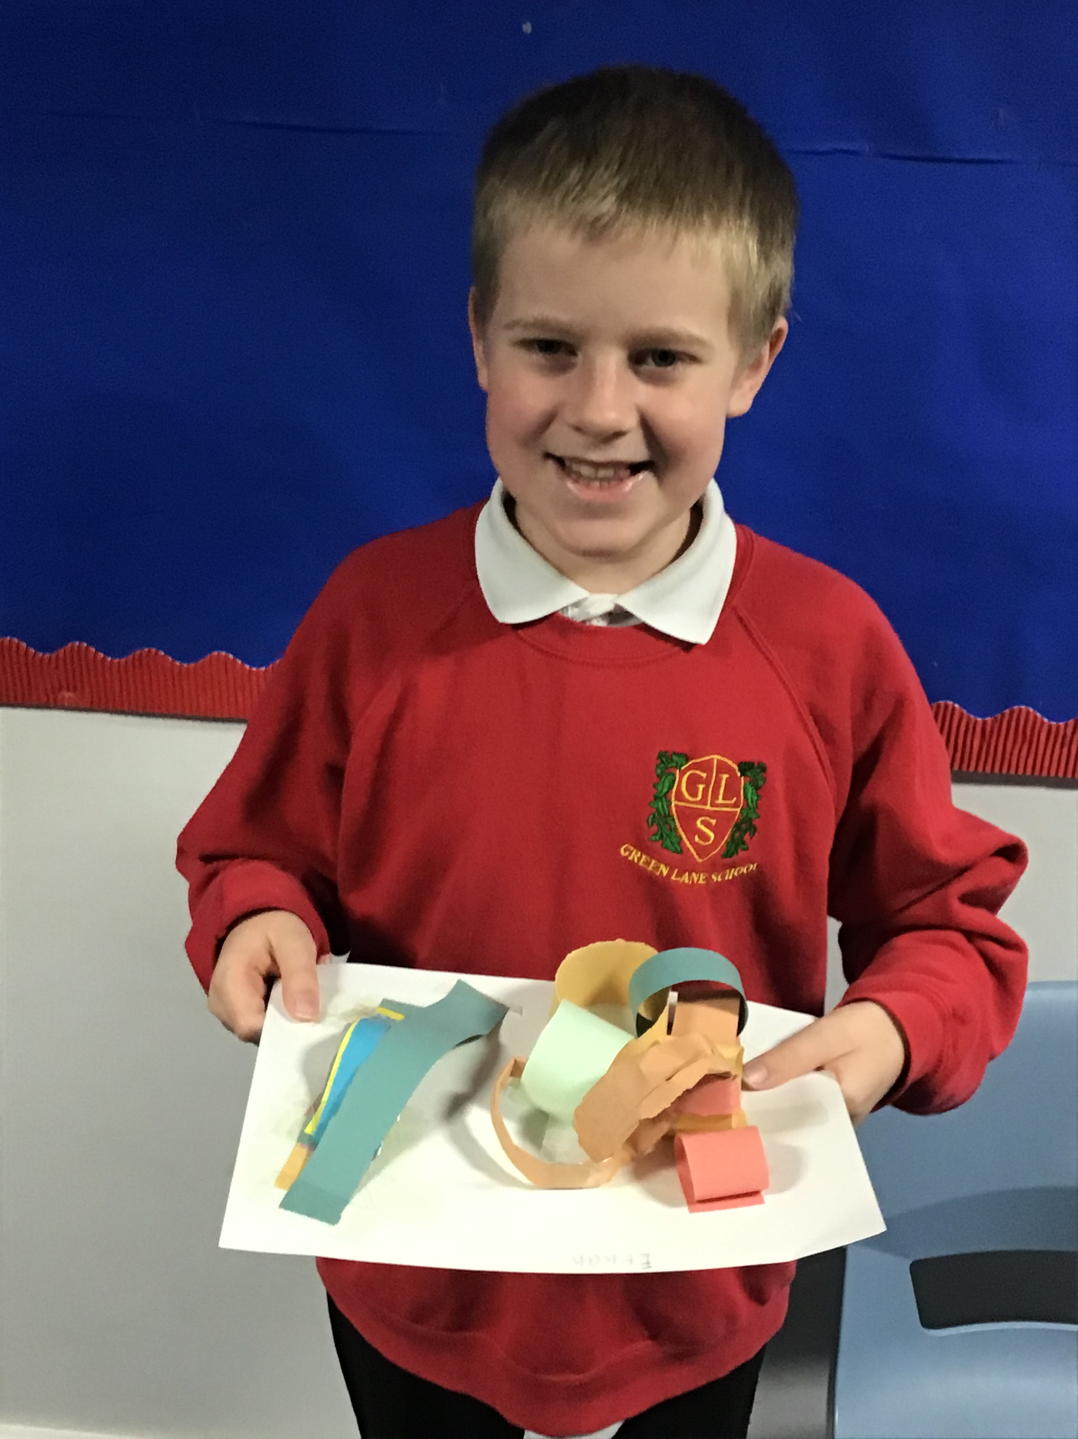
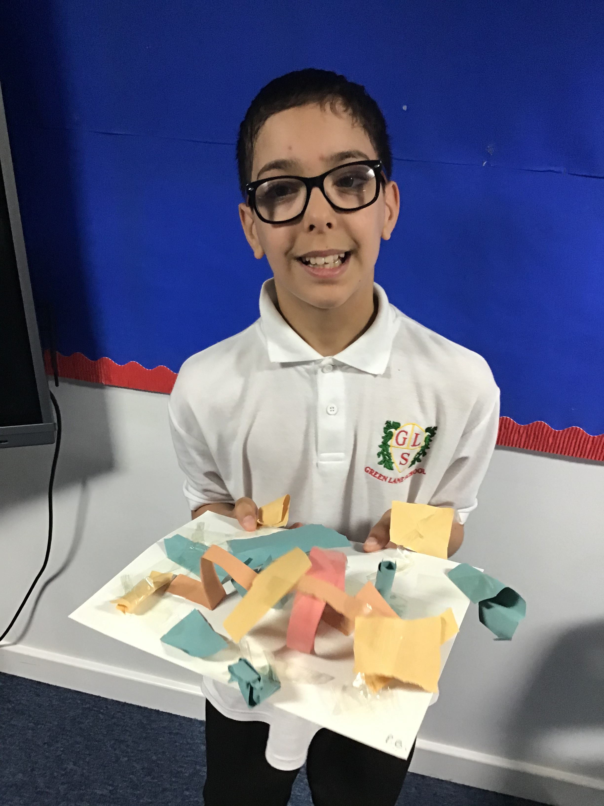
Class
News
Badger Class have been enjoying our new Art topic which is linked to 3d sculpture. We created some excellent art straw and paper sculptures.

Slide 15
Any questions? Please contact Ms White.

Slide 16
Thank you for taking the time to join us and welcome to the Badger family!

