Slide 2
Diving into Mastery Guidance for Educators
Each activity sheet is split into three sections, diving, deeper and deepest, which are represented by the following icons:
These carefully designed activities take your children through a learning journey, initially ensuring they are fluent with the key concept being taught; then applying this to a range of reasoning and problem-solving activities.
These sheets might not necessarily be used in a linear way. Some children might begin at the ‘Deeper’ section and in fact, others may ‘dive straight in’ to the ‘Deepest’ section if they have already mastered the skill and are applying this to show their depth of understanding.
Diving
Deeper
Deepest

Slide 3
Aim
Interpret and present data using bar charts, pictograms and tables.

Slide 4
Pictograms
Diving
Amir counted the colours of the cars outside school. He represented the data in a pictogram.
Black | Silver | Blue | White | Red
Which colour of car did he see the most?
Silver
How many more silver cars were there than black cars?
8
Amir counted 2 blue cars and 3 red cars. How could you add this to the pictogram?
= 2 cars

Slide 5
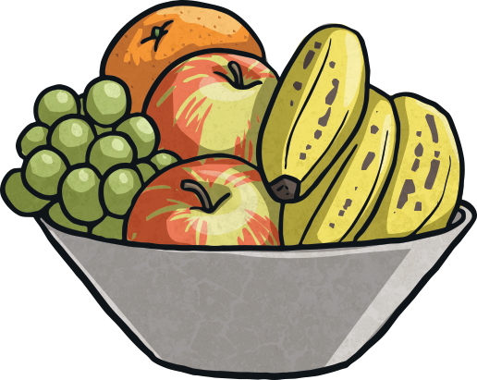
Pictograms
Deeper
The children at Twinkl Academy voted for their favourite fruit. Complete the table to show how many children chose each fruit.
Fruit | Tally | Number of Children
Apples
Bananas
Oranges
Pears
20
5
15
25
If you drew a pictogram
of this data, what scale would you use (how many children would each picture represent)? Why?
The numbers are all multiples of 5, so a scale where 1 symbol is equal to 5 children would work best.

Slide 6
Pictograms
Deeper
Fruit | Tally | Number of Children
Apples
Bananas
Oranges
Pears
20
5
15
25
The number of children who chose apples is the same as the number of children who chose bananas and oranges put together.
Do you agree? Explain your answer.
She is correct. 20 children chose apples. 5 chose bananas and 15 chose oranges. 15 + 5 = 20

Slide 7
Pictograms
Deepest
Each child in Oak Class voted for their favourite pizza topping.
8 children chose ham. What is the scale of the pictogram?
Pepperoni | Four Cheese | Ham | Mushroom
=44 children
=44 children
How many children chose mushroom?
2
If 4 more children voted for ham, what would the most popular topping be?
Pepperoni and ham would be equal with 12 votes each.

Slide 8
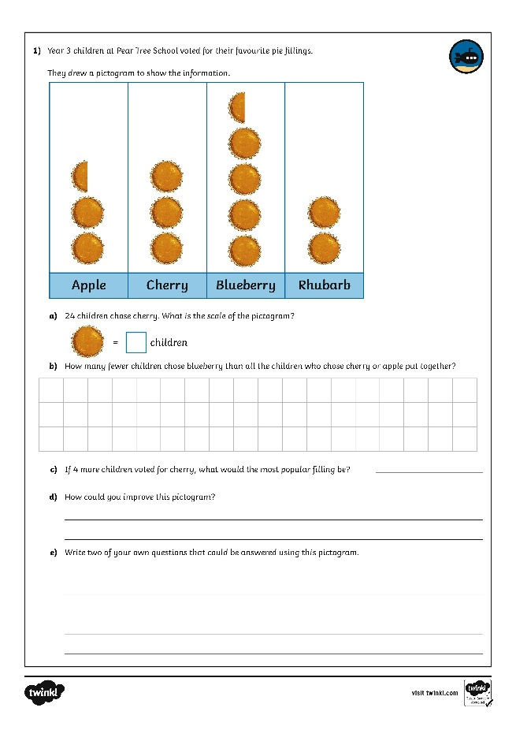
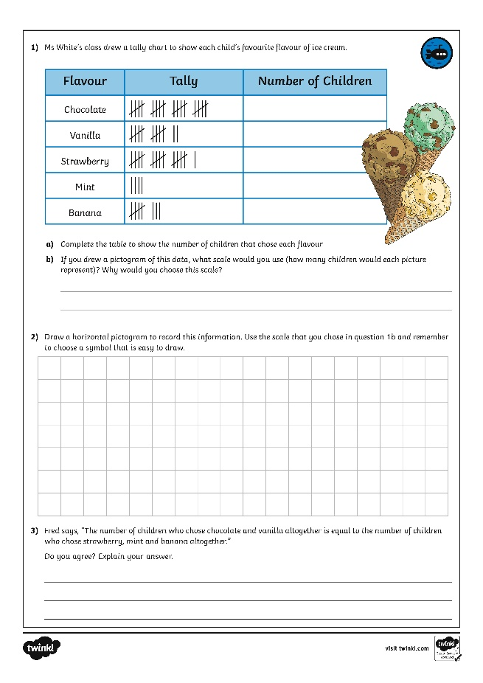
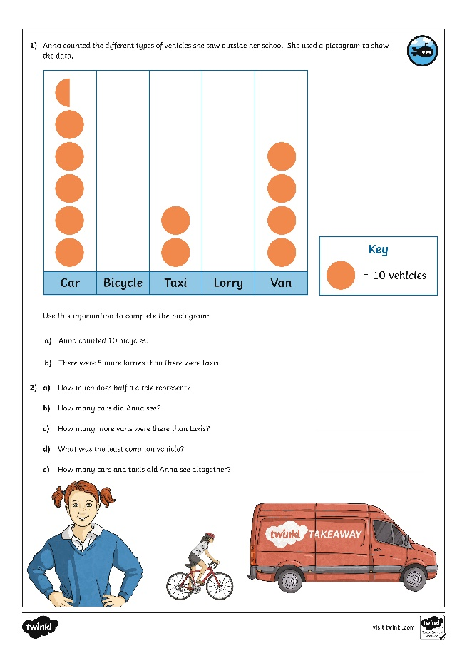
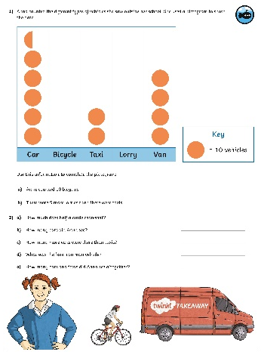
Pictograms
Dive in by completing your own activity!
Right preview - Right click and replace existing images with horizontal and vertical version jpgs of the activity sheet to keep shadow settings. Left preview - hide the image of the child, drag in your jpgs, crop to just around the black strokes. Width should be 4cm for the horizontal, 2cm for vertical. Drag and rotate into place. Doesn’t have to be too neat as meant to look like the child stuck it in ☺

Slide 9
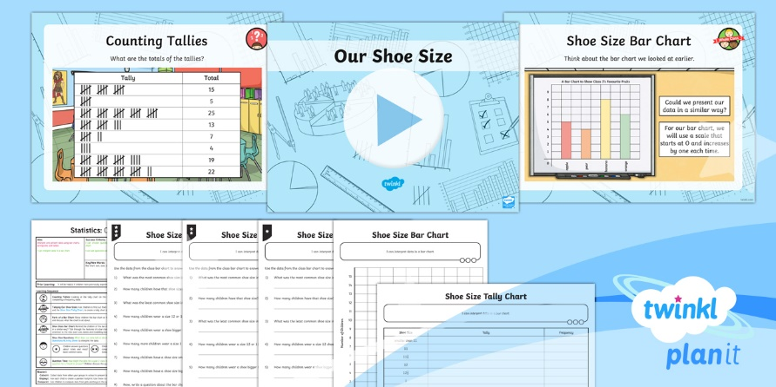
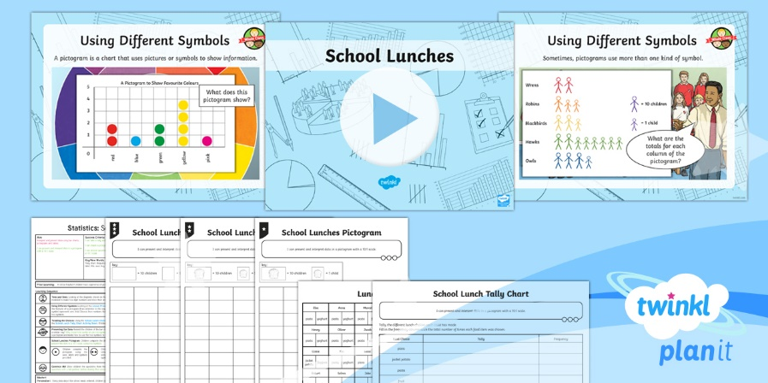
Need Planning to Complement this Resource?
National Curriculum Aim
Interpret and present data using bar charts, pictograms and tables.
For more planning resources to support this aim, click here.
Twinkl PlanIt is our award-winning scheme of work with over 4000 resources.

