Slide 1
Maths
Measurement
Year One
Maths | Year 4 | Measurement | Converting Units of Measurement | Lesson 3 of 5: Converting Units of Mass

Slide 3
Aim
I can convert between units of mass.
Success Criteria
I can convert from kilograms to grams by multiplying by 1000.
I can convert from grams to kilograms by dividing by 1000.
I can convert and order mixed units of mass.

Slide 4
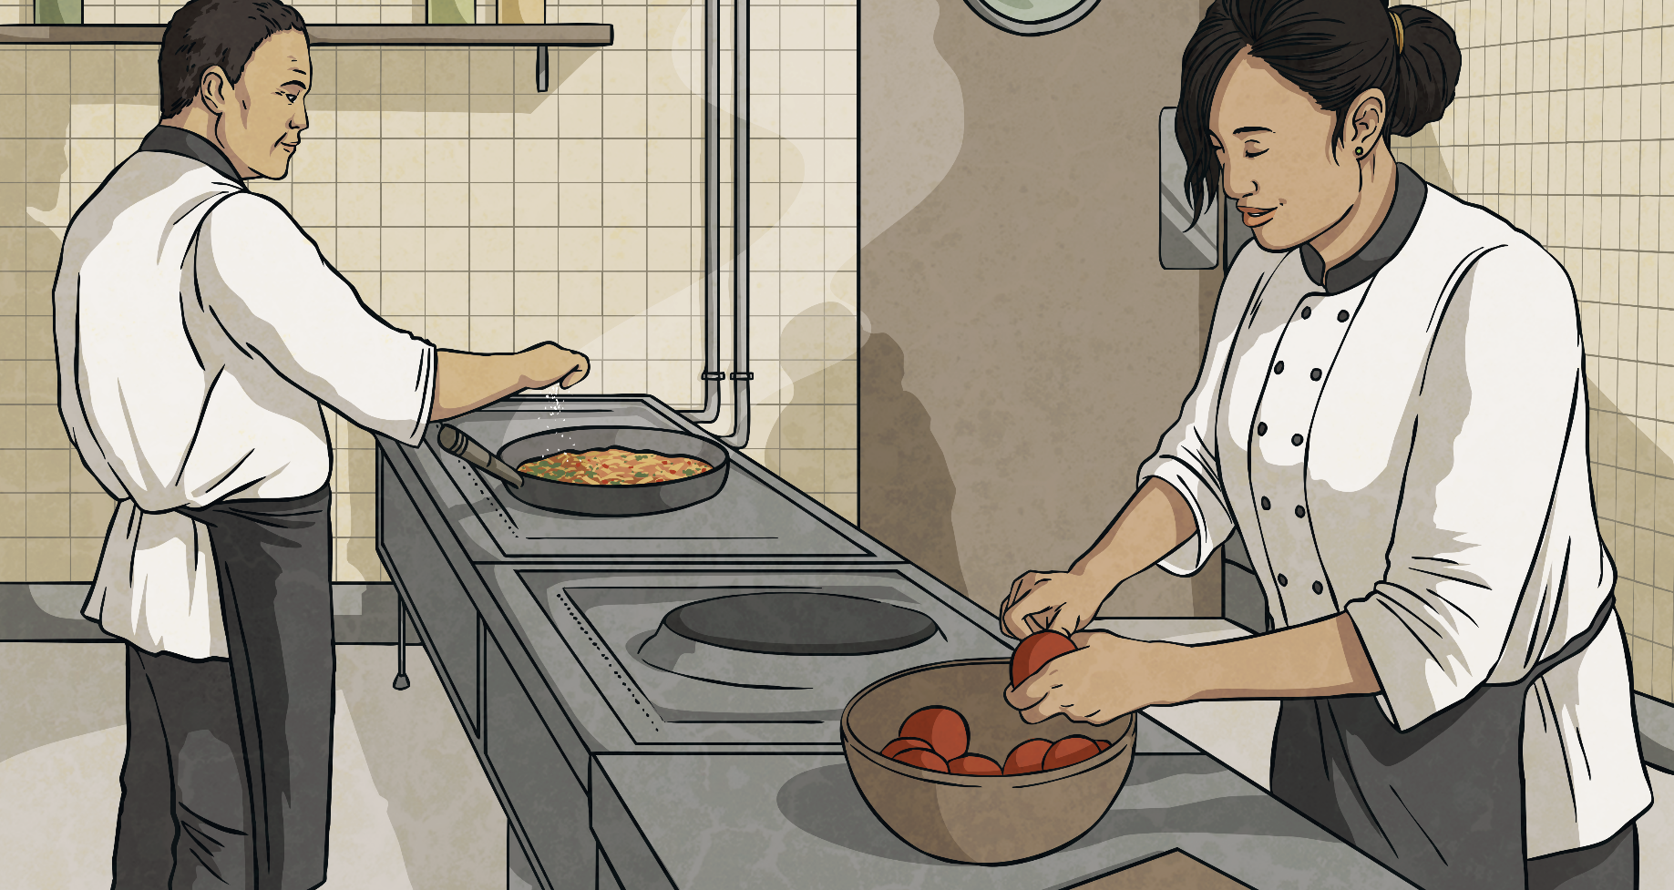
Closest to a Kilogram
The aim of the game is to get closest to a kilogram.
1kg = 1000g
Takes turns to roll a dice four times each. Choose where in a four-digit number to place each number you roll.
When you have created a four-digit number, the person who is closest to 1kg wins a point.
Click here for an example.

Slide 5
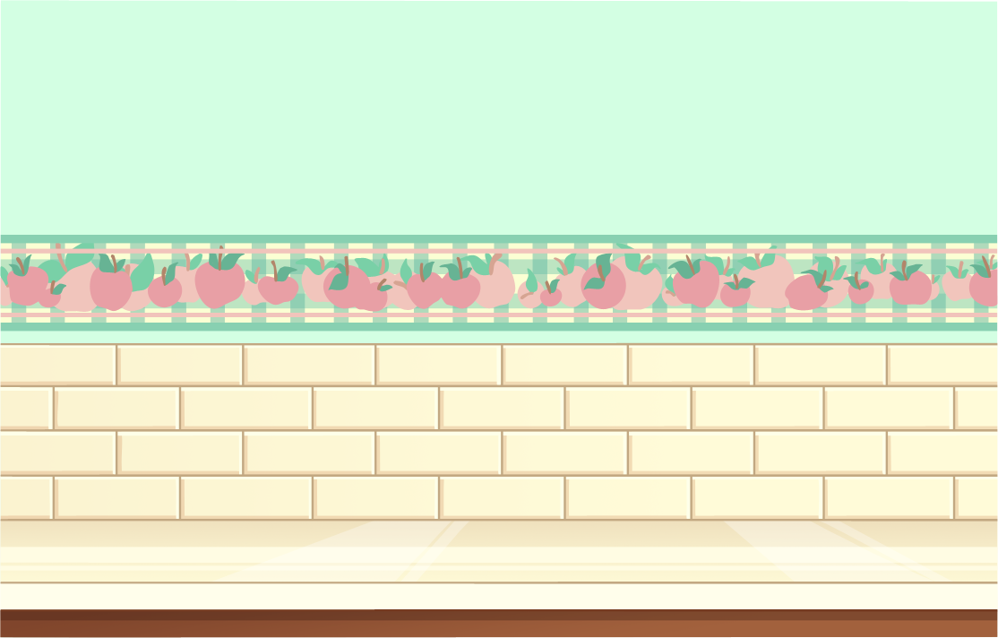
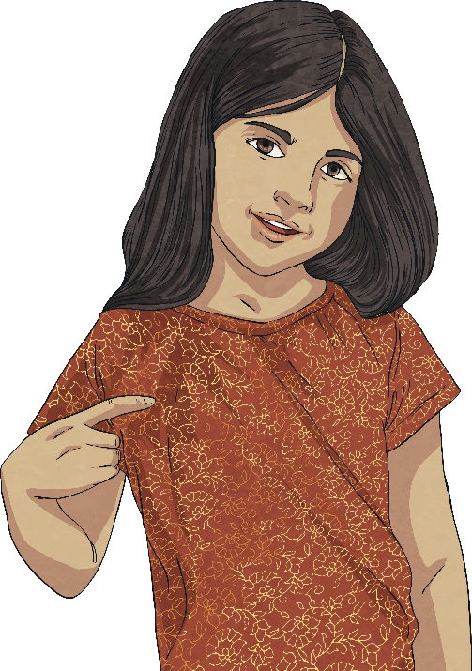
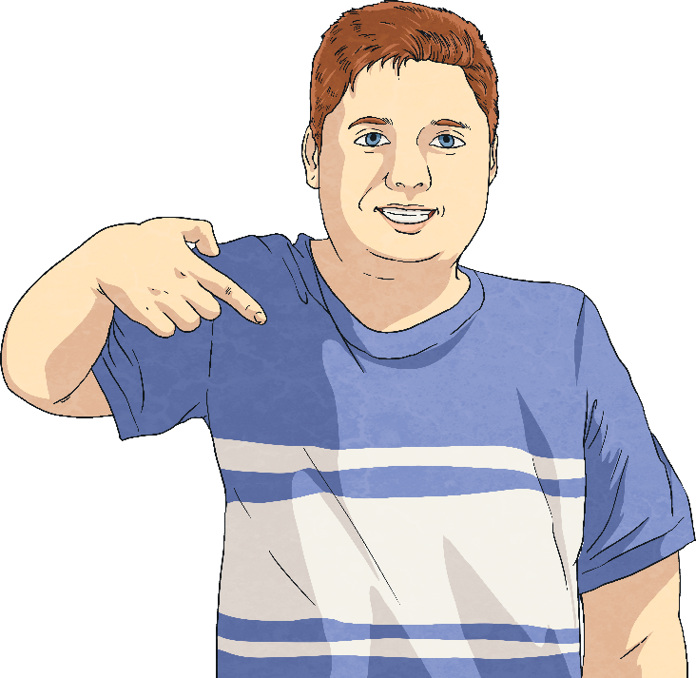
Closest to a Kilogram
I roll a 6, so I will place that in the ones column.
I roll a 2, so I will place that in the hundreds column.
 |  |  |  | g
 |  |  |  | g
6
2
Continue until you have made a four-digit number. The person closest to 1000g (1kg) scores a point.

Slide 6
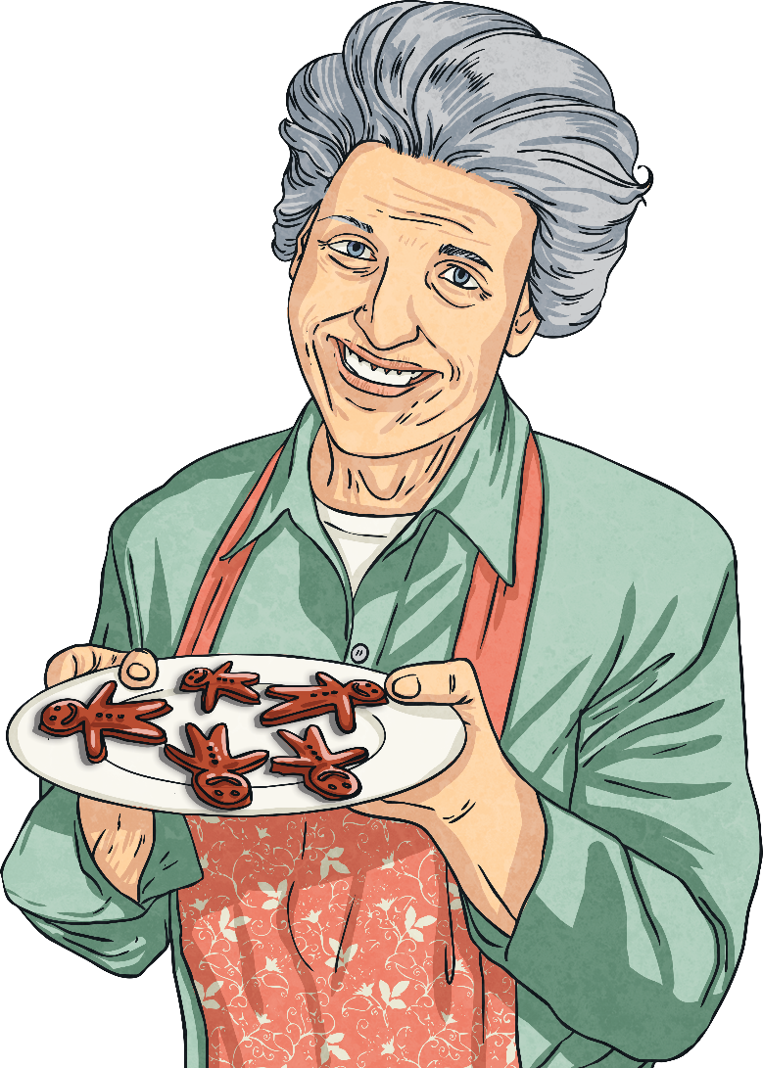
Kilograms to Grams
There are 1000 grams in 1 kilogram.
How many grams are there in
2kg? | 3kg? | 4kg? | 5kg?
2000g
3000g
4000g
5000g
What do you notice about the answers?
What calculation do we need to do to convert from kilograms to grams?
Grams are smaller than kilograms, so there are more of them in the same mass. There are a thousand times as many grams in the same mass as kilograms.
We need to multiply the number of kilograms by 1000.

Slide 7
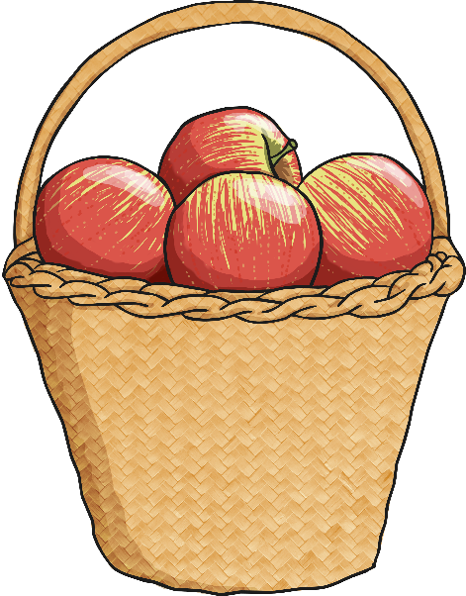
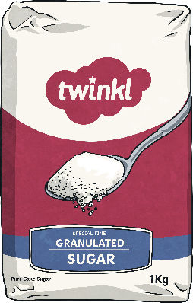
What’s the Mass?
?
What is the combined mass of all three items in kilograms?
6kg
?
How would you write this in grams?
6000g
sugar
1kg
flour
2kg
apples
3kg

Slide 8
What’s the Mass?
?
What is the combined mass of two bags of flour?
4kg
?
How would you write this in grams?
4000g
sugar
1kg
flour
2kg
apples
3kg

Slide 9
What’s the Mass?
?
What is the combined mass of three baskets of apples?
9kg
?
How would you write this in grams?
9000g
sugar
1kg
flour
2kg
apples
3kg

Slide 10
What’s the Mass?
?
What is the combined mass of 2 baskets of apples and 2 bags of flour?
10kg
?
How would you write this in grams?
10 000g
sugar
1kg
flour
2kg
apples
3kg

Slide 11
What’s the Mass?
?
What is the combined mass of 1 basket of apples, 2 bags of sugar and 3 bags of flour?
11kg
?
How would you write this in grams?
11 000g
sugar
1kg
flour
2kg
apples
3kg

Slide 12
What’s the Mass?
Mixed Units
Sometimes, mass is given in mixed units: kg and g.
1kg 300g
2kg 600g
4kg 350g
How could we convert these measurements into grams?
We need to multiply the kilogram measurement by 1000, then add on the gram measurement.
1kg 300g = 1000g + 300g = 1300g

Slide 13
What’s the Mass?
Mixed Units
Write the following in grams:
2kg 450g
3kg 700g
5kg 250g
6kg 800g
7kg 210g
2450g
3700g
5250g
6800g
7210g

Slide 14
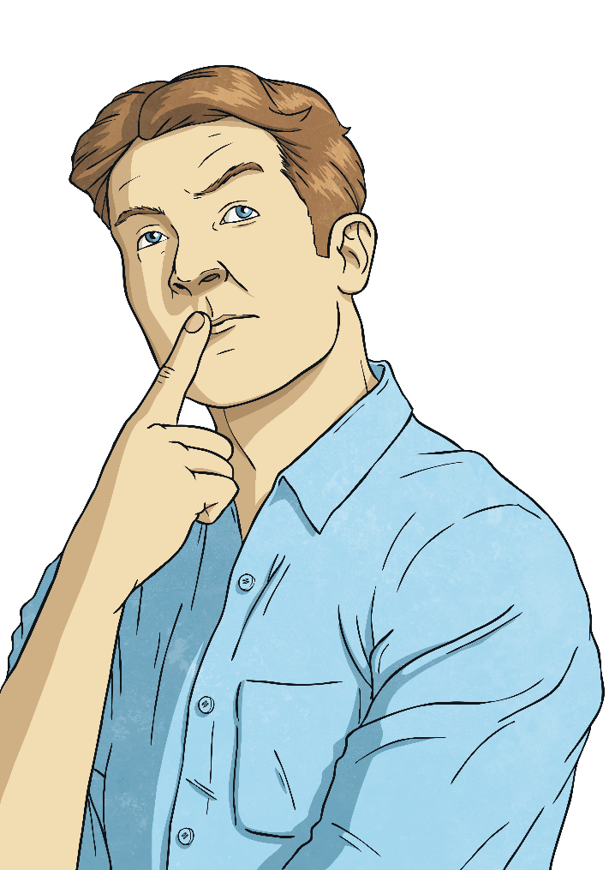
Converting Grams
to Kilograms
To convert from grams to kilograms, we divide the number of grams by 1000: 5000g ÷ 1000 = 5kg
If this creates a decimal number, the thousandths become grams:
2500g ÷ 1000 = 2.500 = 2kg 500g

Slide 15
Converting Grams
to Kilograms
Convert these grams measurements into kilograms:
8000g
4800g
6400g
4000g
7250g
9840g
8kg
4kg 800g
6kg 400g
4kg
7kg 250g
9kg 840g

Slide 16
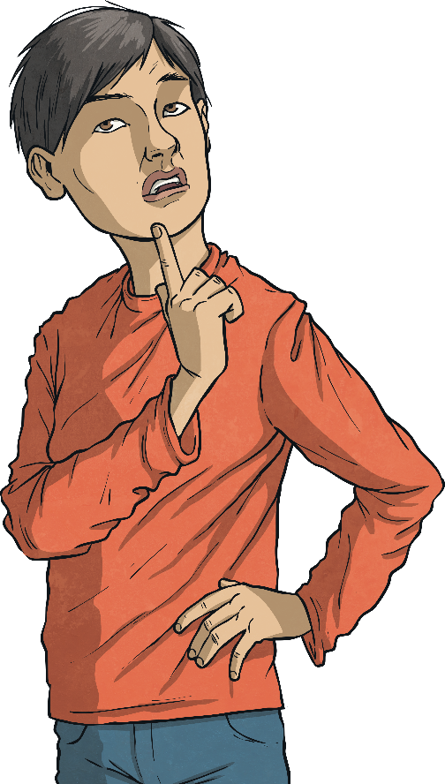
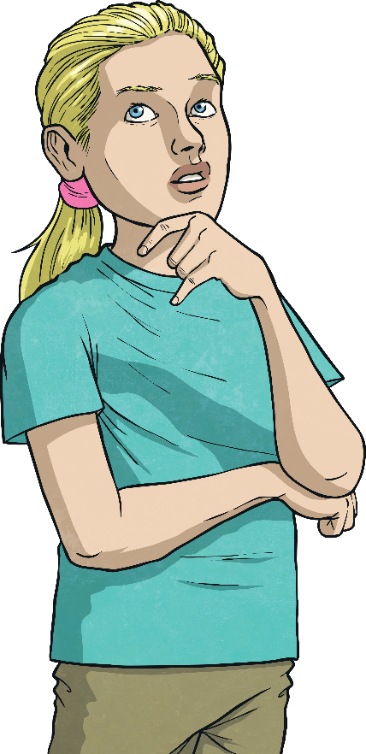
Ordering Mixed Units
Order these mass measurements from the lightest to heaviest:
2400g
4kg 100g
7kg
3kg 450g
5kg
850g
7kg
2400g
850g
3kg 450g
5kg
4kg 100g

Slide 17
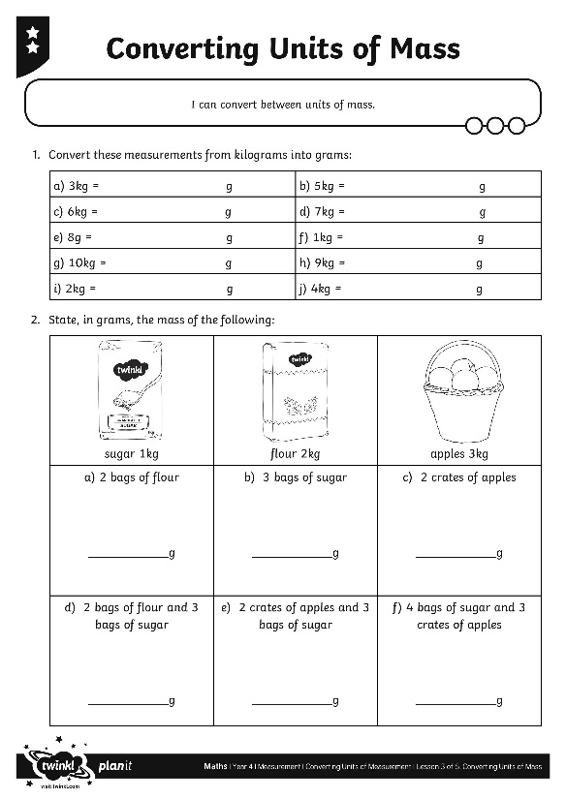
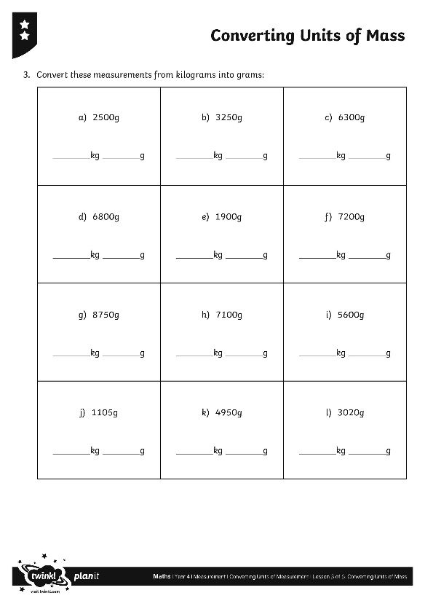
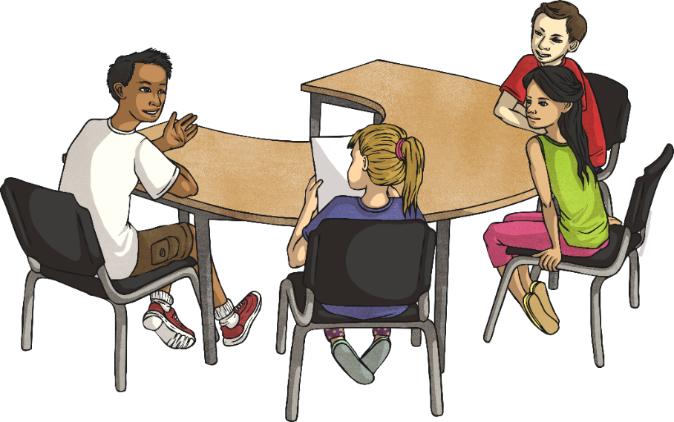
Converting Units of Mass
Use your cracking conversion skills to complete this activity sheet.

Slide 18
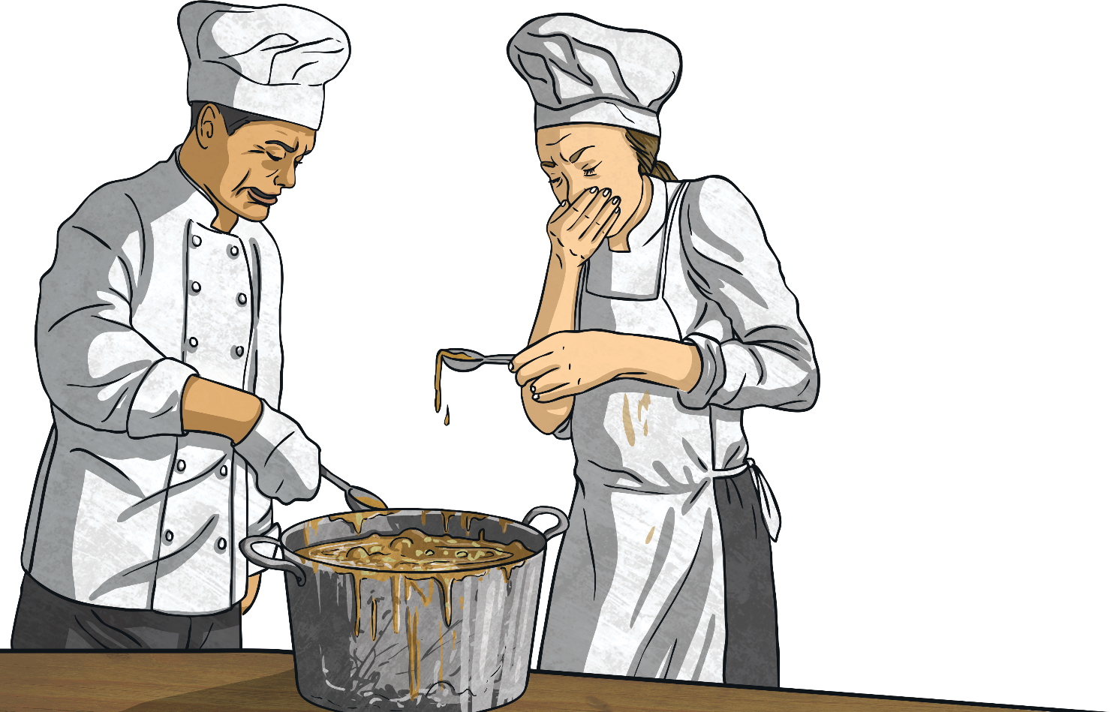
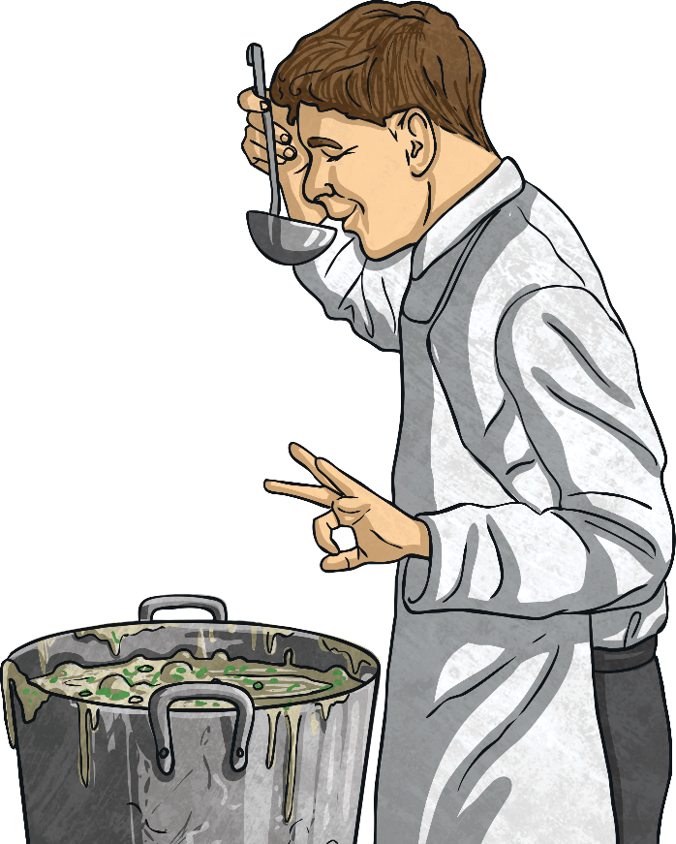
The Answer Is…
If the answer is 2500g, write two questions for which this could be the answer.

Slide 19
Aim
I can convert between units of mass.
Success Criteria
I can convert from kilograms to grams by multiplying by 1000.
I can convert from grams to kilograms by dividing by 1000.
I can convert and order mixed units of mass.

