Slide 1
Computing
Online Safety
Year One
Computing | Year 3 | Online Safety | To Buy or Not to Buy? | Lesson 2

Slide 3
Aim
To understand how websites use advertisements to promote products.
Success Criteria
I can identify adverts online.
I can identify a targeted advert.
I can explore how companies use websites to promote products.

Slide 4
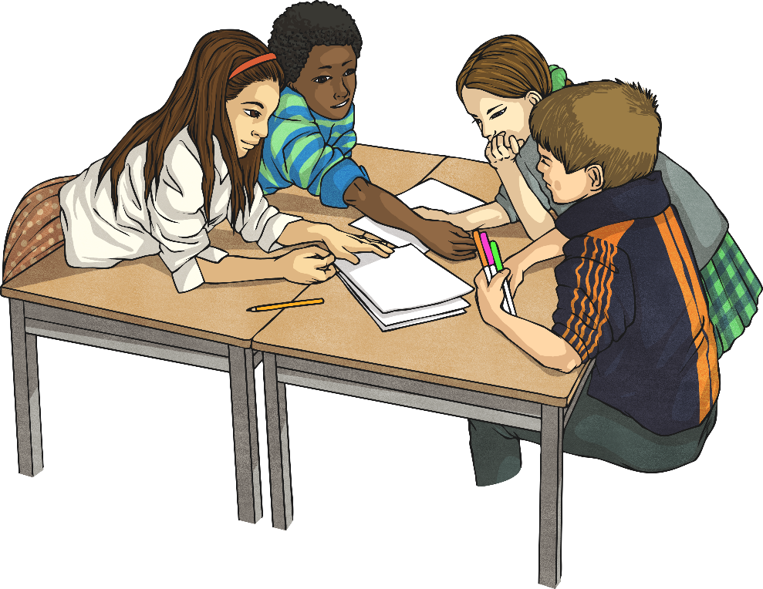
Where Did You Hear about…?
Think about a toy you really want or have asked for recently. Where did you hear about it first?
?
?
?
If a friend told you about it, where did they hear about it?
In a group, write down the ways you hear about new toys and games.

Slide 5
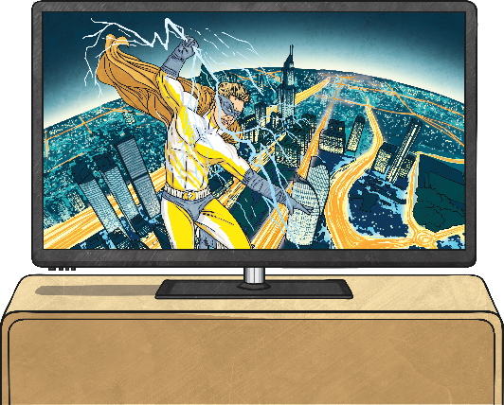
Adverts
You have probably written down ‘adverts’ for toys.
?
?
?
Where do you find adverts? What are adverts for?
Today, we are going to be looking at adverts online.

Slide 6
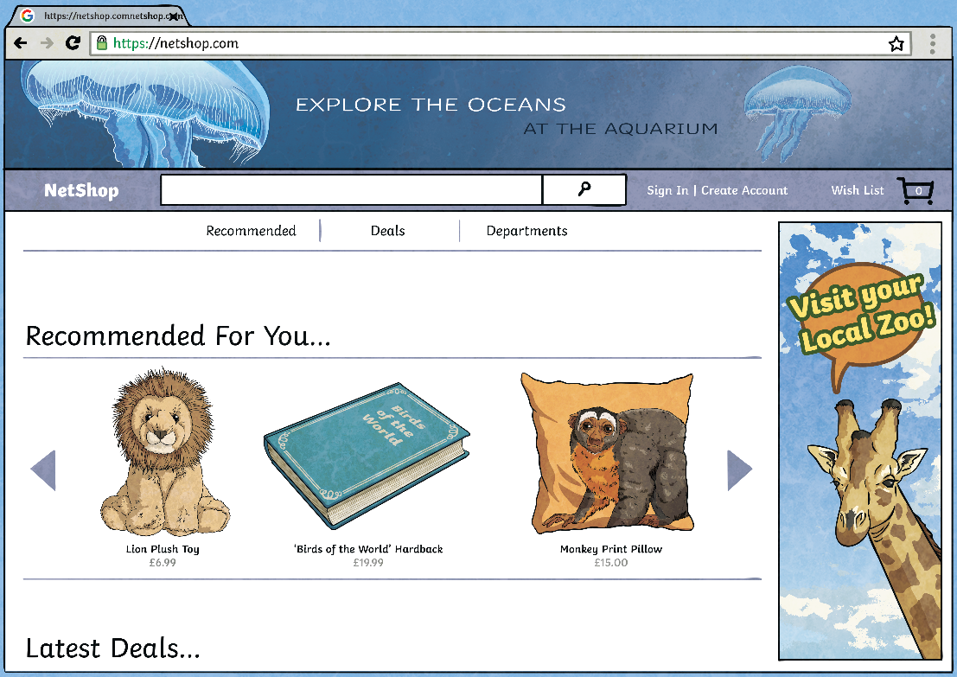
Adverts
?
When you’re online, do you notice anything about the adverts that pop up?
?
?
?
Are they usually for things you have looked at before? Or toys that are similar to the ones you’ve bought in the past?
?
?
This is called targeted advertising. This is when companies use your digital footprint to see what kind of toys you might be interested in and then make sure that you see those adverts more often.

Slide 7
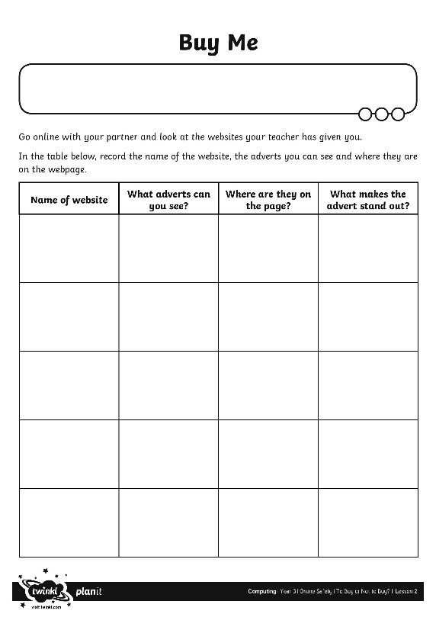
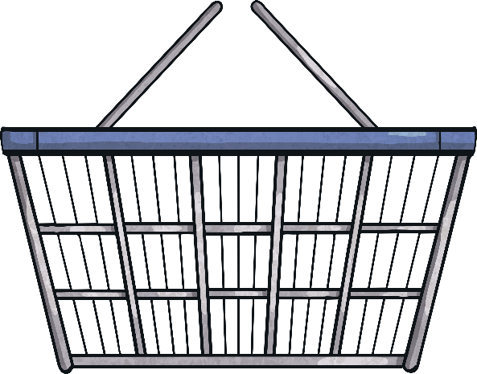
Ad Hunters
In pairs, look at the websites your teacher has chosen. Can you spot adverts online? Record them on your Buy Me Activity Sheet.

Slide 8
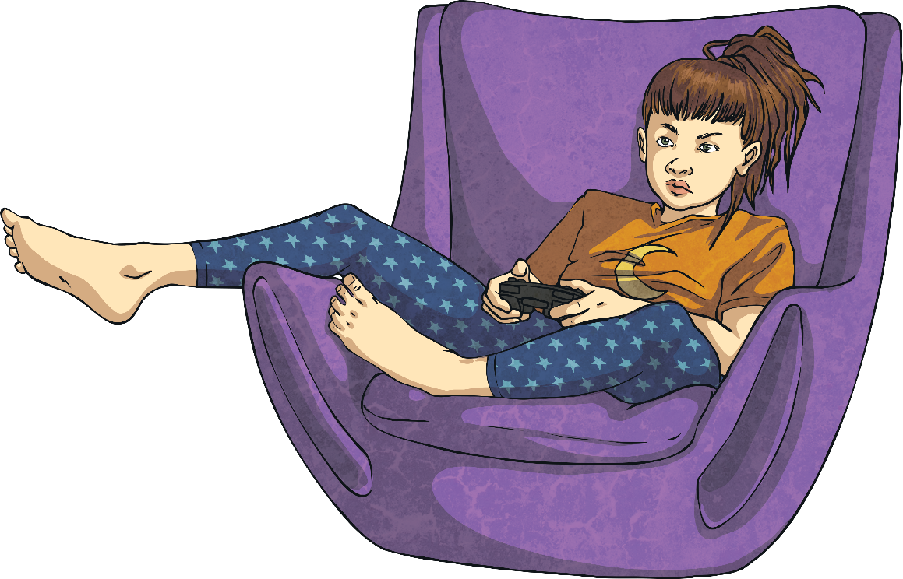
Is It an Advert?
Sometimes, an advert might not be obvious. Look at websites for toy brands and see what they include on their site.
Lots of them have games or activities on the site which are designed to draw your attention to a particular product.
With a partner, see if you can find examples of this type of advertisement.

Slide 9
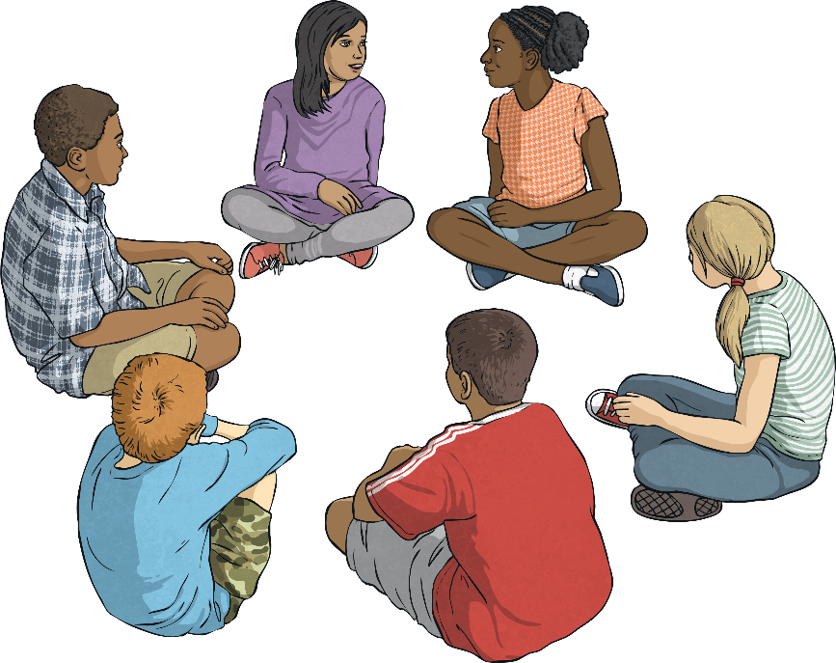
Is It Fair?
Is it fair to aim an advert specifically at children?
Sit in a circle and discuss these questions:
Who will have to pay for the product?
If they can’t get the toy they see, what could happen?
Do you think it’s good for children to get lots of new toys all the time?

Slide 10
Aim
To understand how websites use advertisements to promote products.
Success Criteria
I can identify adverts online.
I can identify a targeted advert.
I can explore how companies use websites to promote products.

