Slide 1
Welcome to Q3 2021-2022

Slide 2
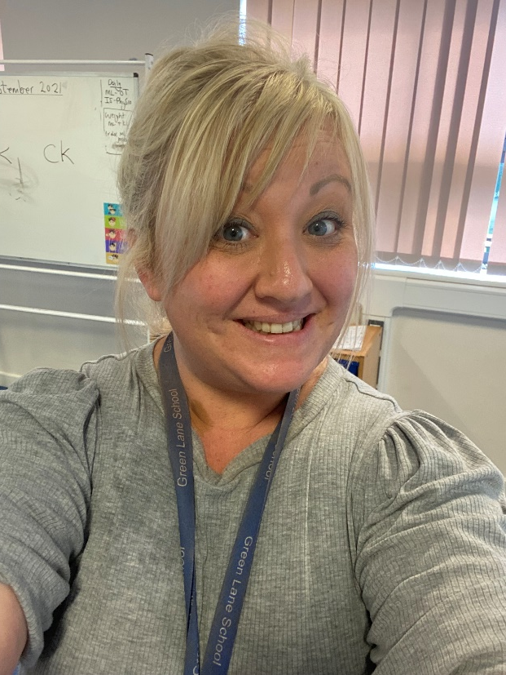
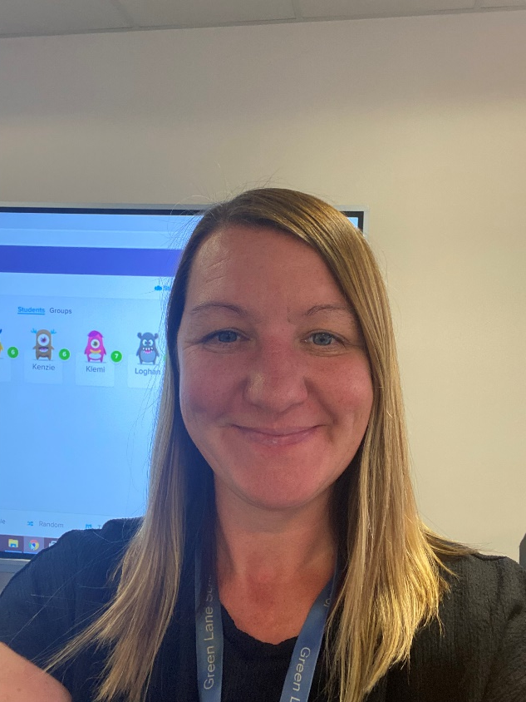
Introductions…
Miss Delaney
Miss Barker

Slide 3
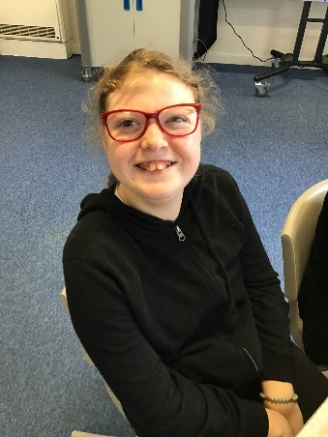
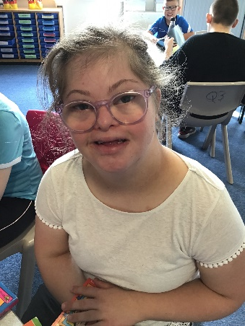
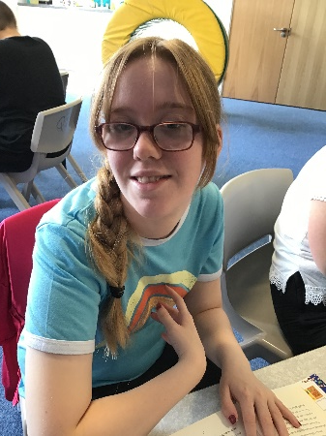
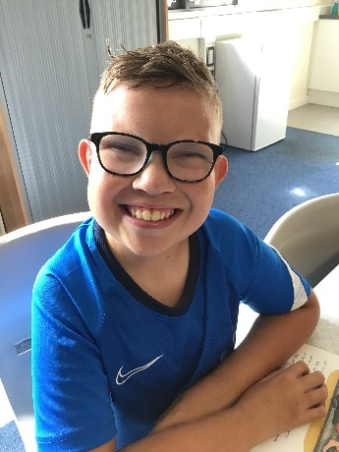
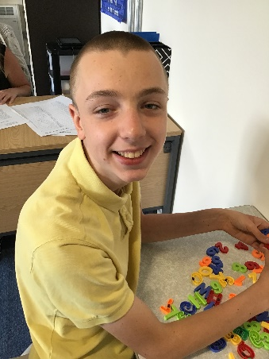
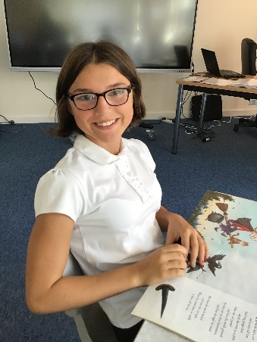
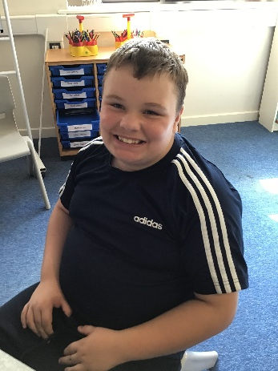
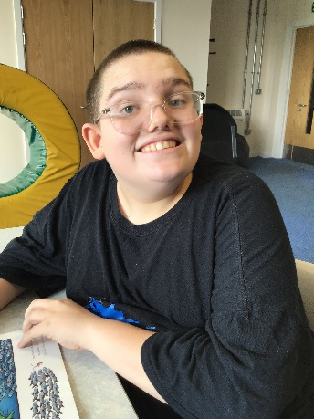
Q3 is a Key Stage 4 class made up of pupils from both years 10 and 11.

Slide 4
On arrival…
Hot/cold drinks and toast are available on arrival. Hot drinks include tea, hot chocolate or Horlicks. Cold drinks include water or sugar free squash.
Pupils can bring a mug to leave in school however we do have spares.
A contribution of £1 per week towards this cost is received with thanks as school do not fund this.

Slide 5
Equipment
All equipment is provided by school. Pupils each have their own pencil case which contains everything that they could possibly need in class.
Due to Covid-19 we would prefer that pupils do not bring in personal stationary items from home.

Slide 6
What should pupils bring to school daily?
Pupils have all been given a planner. Every Monday they will add any important information for the week ahead.
These are also used for school/home communication. Please feel free to write any notes to class staff in here. Staff will also use planners to pass on any messages home, please check these daily.
Reading books and records are given in line with pupils phonics assessments. We aim to read with your child on a 1:1 basis 3x each week. Please record in the reading record when you have read with your child at home.
Books will be changed as required.
Water bottles.

Slide 7
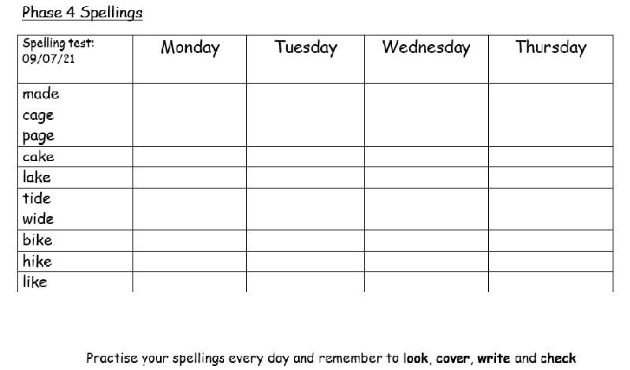
Spellings and homework
Weekly spellings will be sent home on a Monday. There is a weekly spelling test each Friday.
Pupils will have the opportunity to practise these in class each morning but should also practise at home using look, cover, write and check.
Pupils are asked to put each word into a sentence on the second page. This ensures that they understand what they mean and can use them in context.
English and Maths (alternate) homework is sent home every Friday. Pupils should return this on a Monday morning.

Slide 8
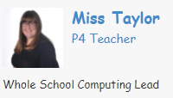
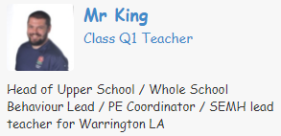
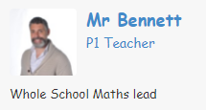
PE, ICT and Art
Computing - Wednesday
PE - Tuesday
Pupils should come to school in their PE every Tuesday.
Art - Thursday

Slide 9
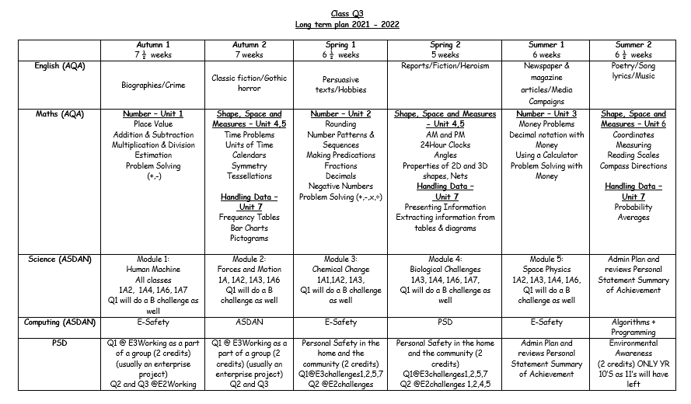
Q3 Curriculum
The Q3 curriculum includes all statutory subjects at Key Stage 4. This includes English, Maths, Science, Computing, Physical Education and Citizenship (Personal and Social Development - PSD/Sex and Relationships Education - SRE.) In each subject pupils are working towards Level 1 or Bronze Awards.
In addition to this pupils are taught ASDAN.
ASDAN includes short courses which aim to develop personal, independent living and employability skills for young people with additional needs.

Slide 10
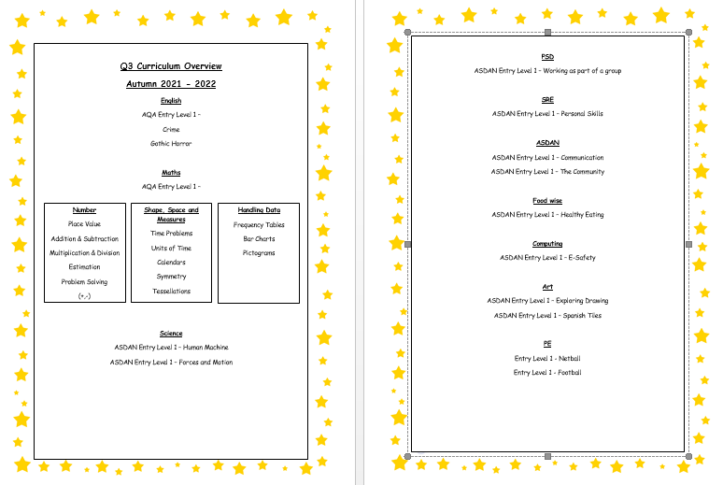
Termly overviews
At the beginning of each term you will be sent an overview showing what topics are being taught in each subject for that term..
At the end of our English and Maths units pupils will complete an end of unit test. These contribute towards pupils final accreditation.

Slide 11
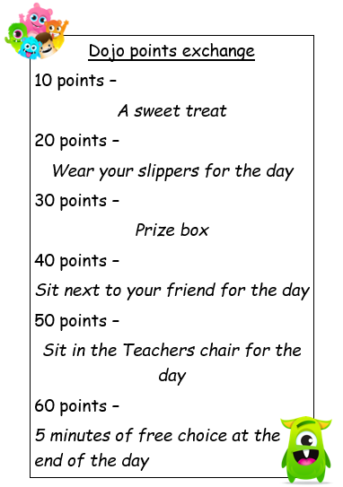
Dojo awards
Pupils are rewarded with Dojo points in class. They can receive Dojo points for many things including returning their homework on time, trying their best, good listening, Merit awards and more!
On a Friday afternoon we open the ‘Dojo bank’. This is a running total of points that pupils have received. Weekly points are added to individual pupils totals and they have the opportunity to ‘cash’ their points in for a reward.

Slide 12
Any questions?

Slide 13
Q3 classroom
Key Stage 4 have been extremely fortunate in moving to the old Integrated Services block as of September 2021.
The size of our classrooms is amazing and allows us to have the space to work comfortably, carry out OT (Occupational Therapy) if required and complete Physiotherapy plans if required all within one room.
Lets have a look!

Slide 14
Thank you for taking the time to join us this afternoon! As always your support is much appreciated.

