Slide 2
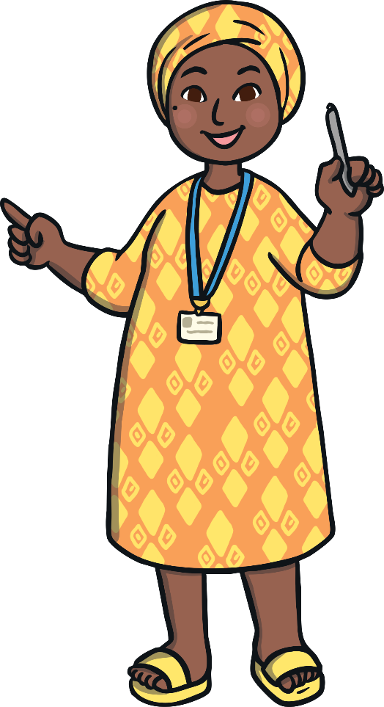
Relationships
Good…
Why are they important?
or bad?

Slide 3
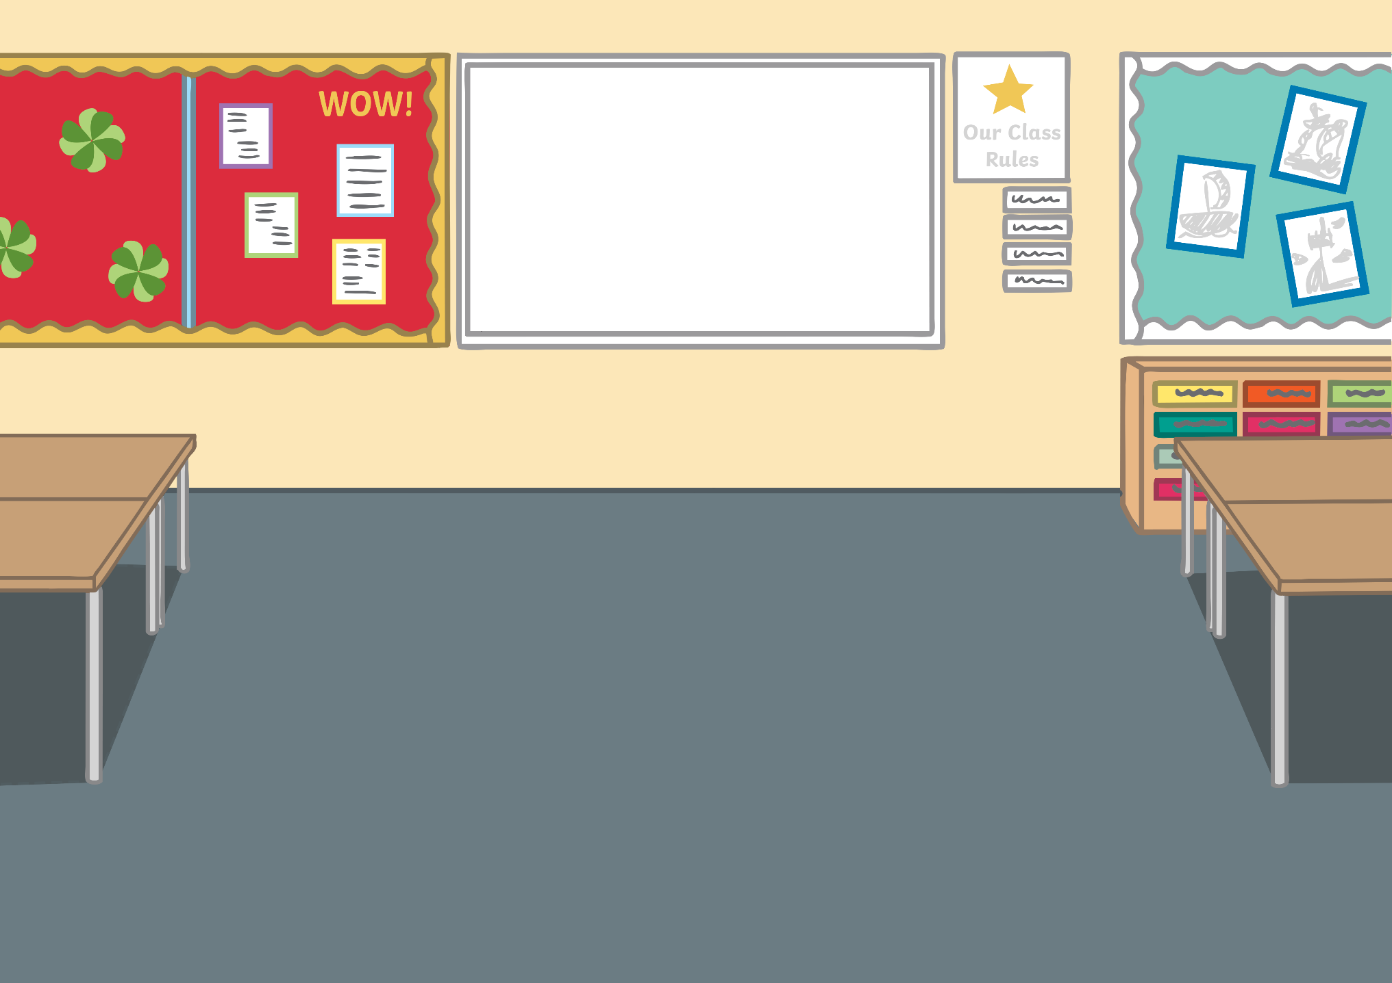
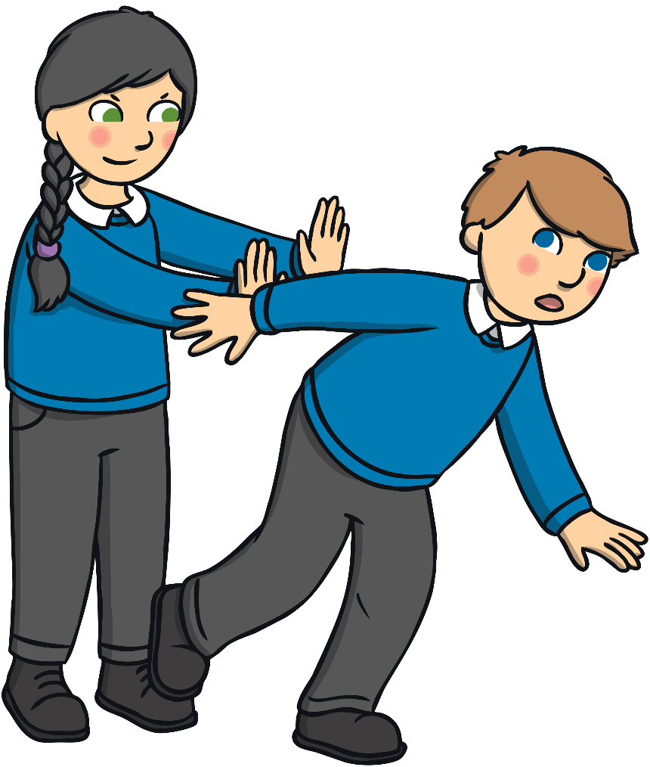
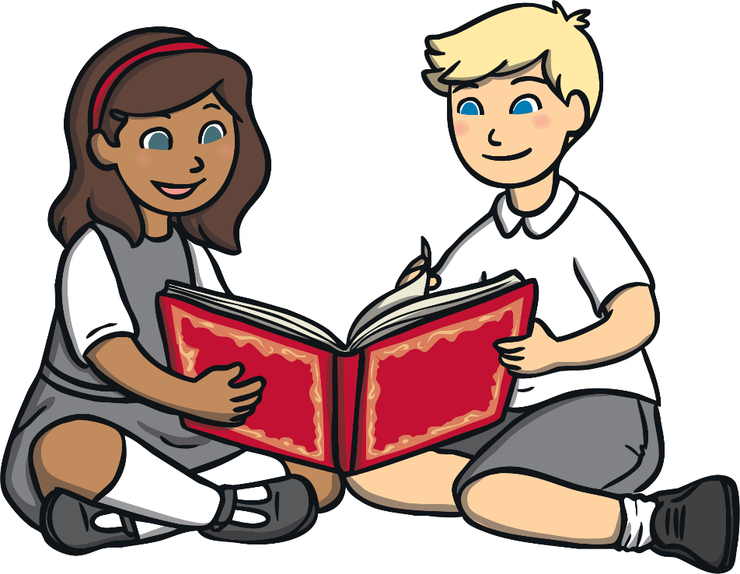
Which of the situations below is good?
Is it good to care for each other or hurt each other?

Slide 4
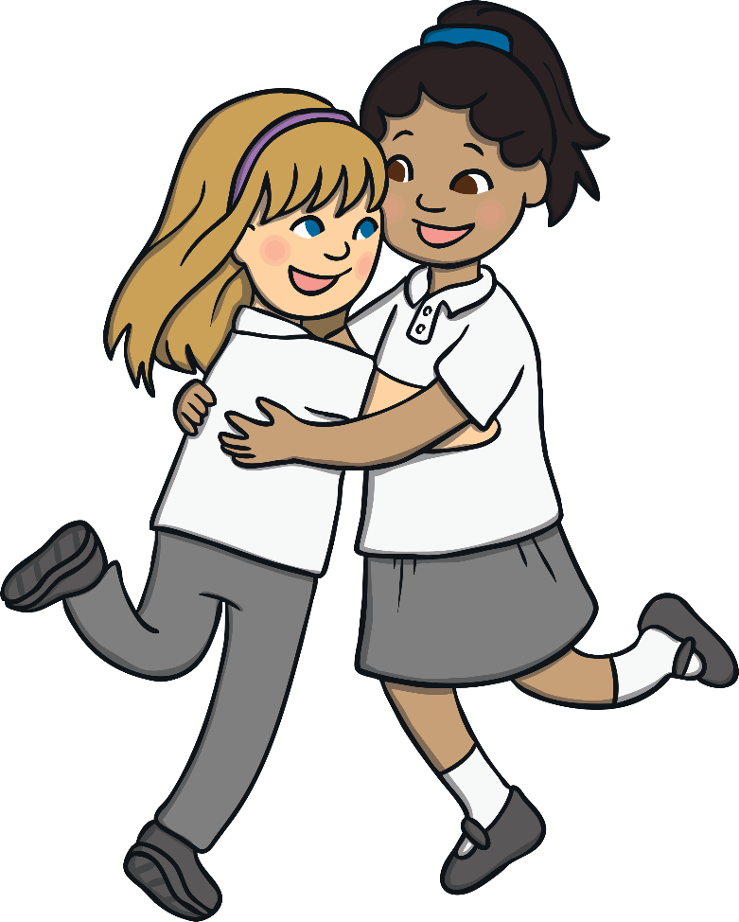
What is friendship?
Why is it important
Who is your best friend?

Slide 5
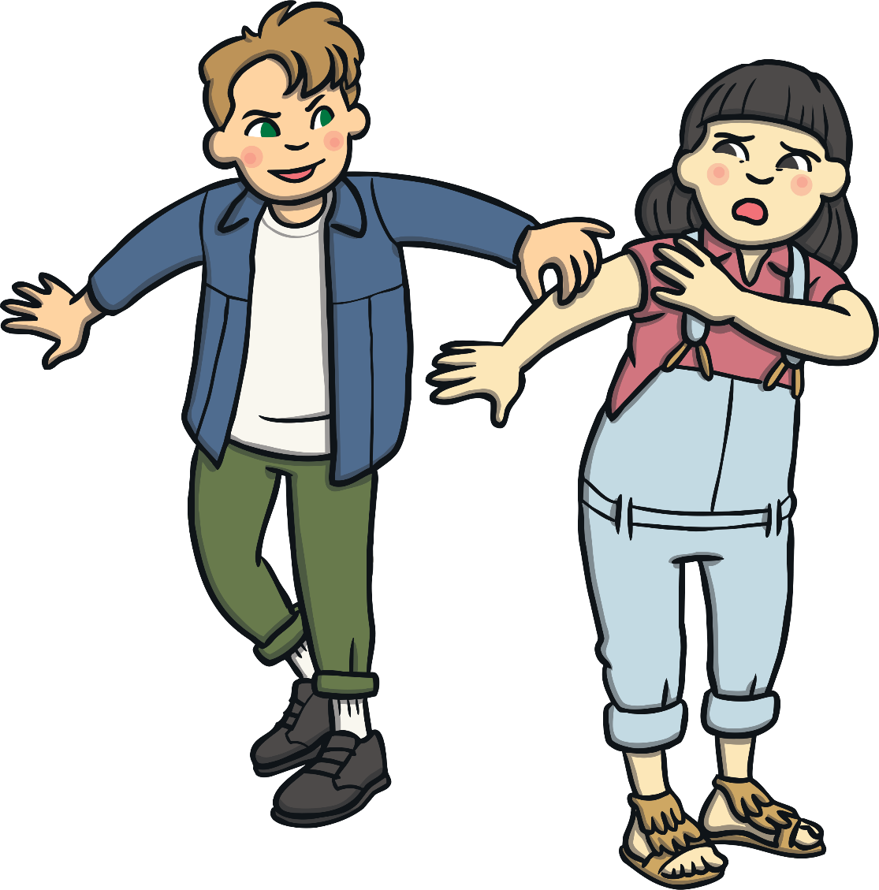
What should you do if you see that someone is hurt or being bullied?

Slide 6
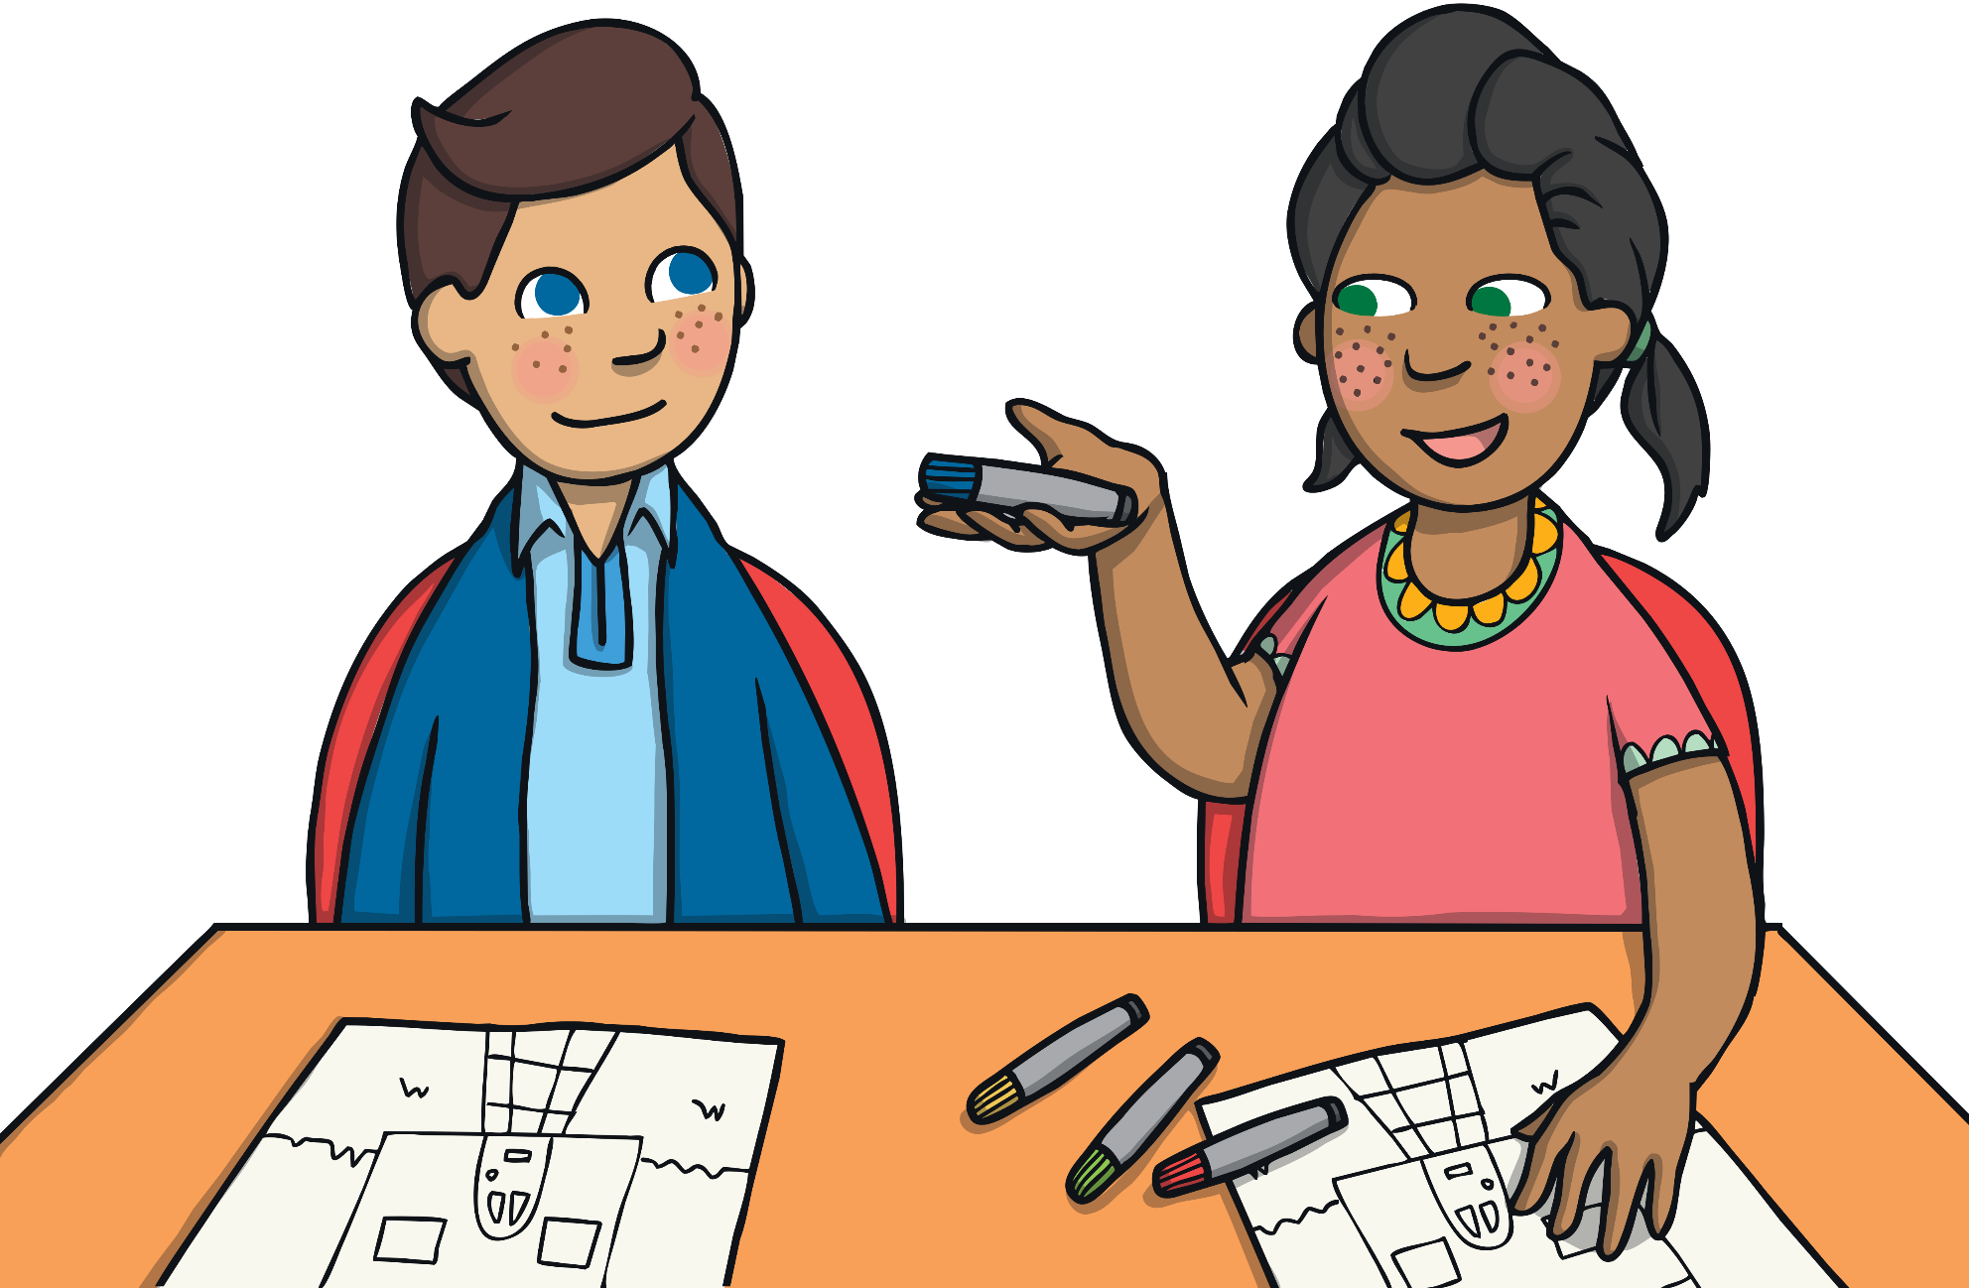
How else can we care for each other?

Slide 7
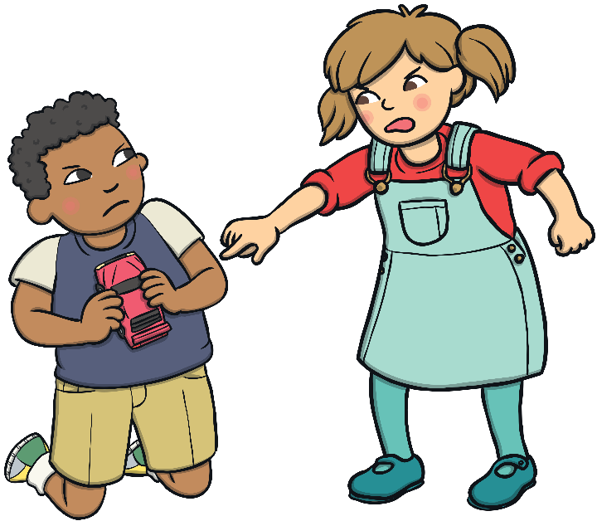
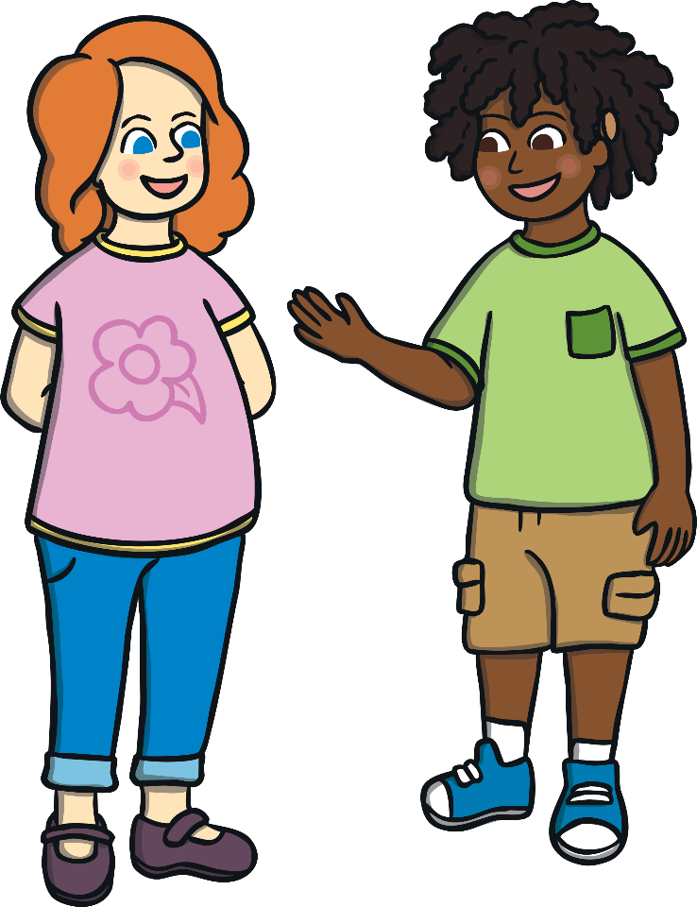
Why is it important to be nice to others?
Do you think that people who are nasty are happy afterwards?

Slide 8
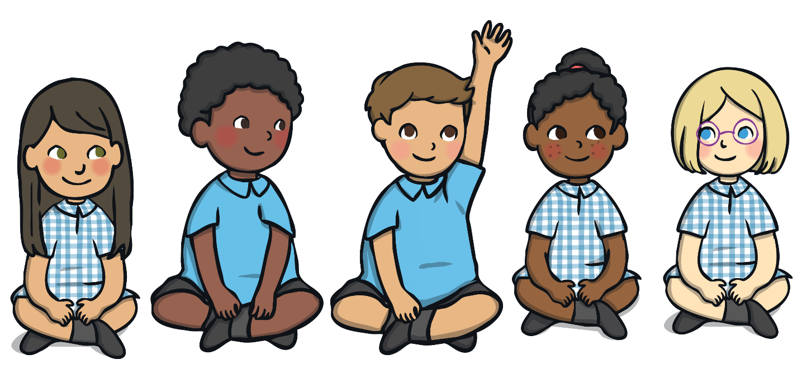
Why should you put your hand up in class?

Slide 9
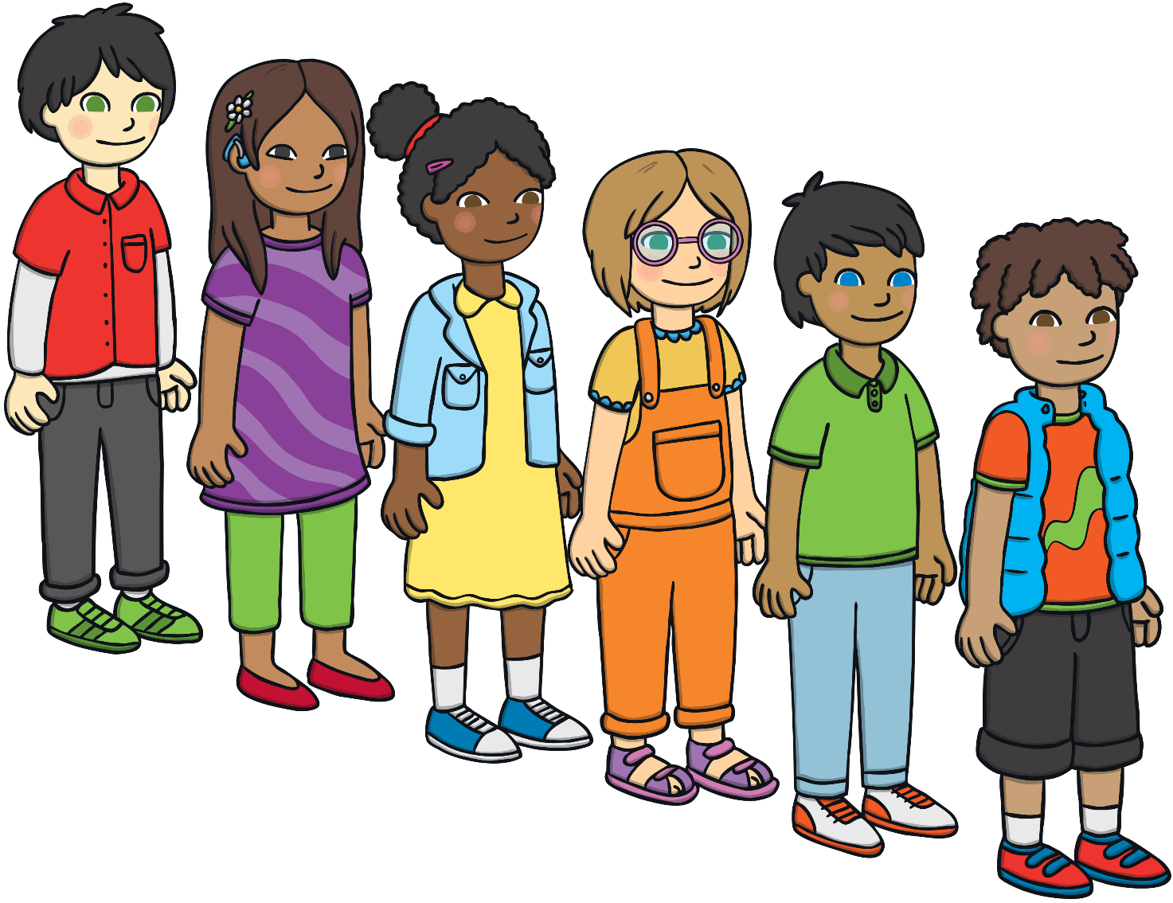
Why should we all line up quietly and sensibly?

Slide 10
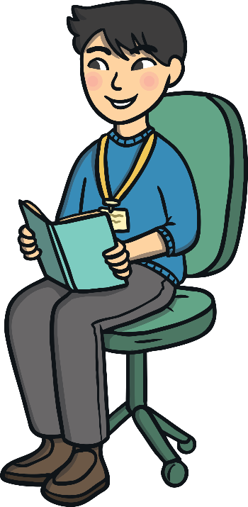
How do you think you would feel if someone stole something of yours?
Is it good or
bad to steal?

Slide 11
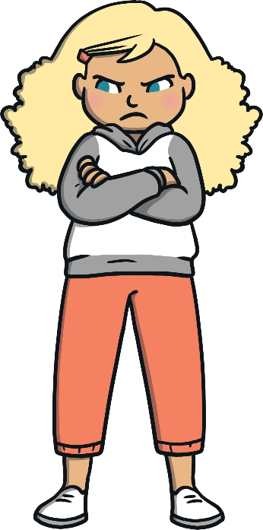
Have you ever fallen out with a friend?
How should you try and make up with someone you have fallen out with?

Slide 12
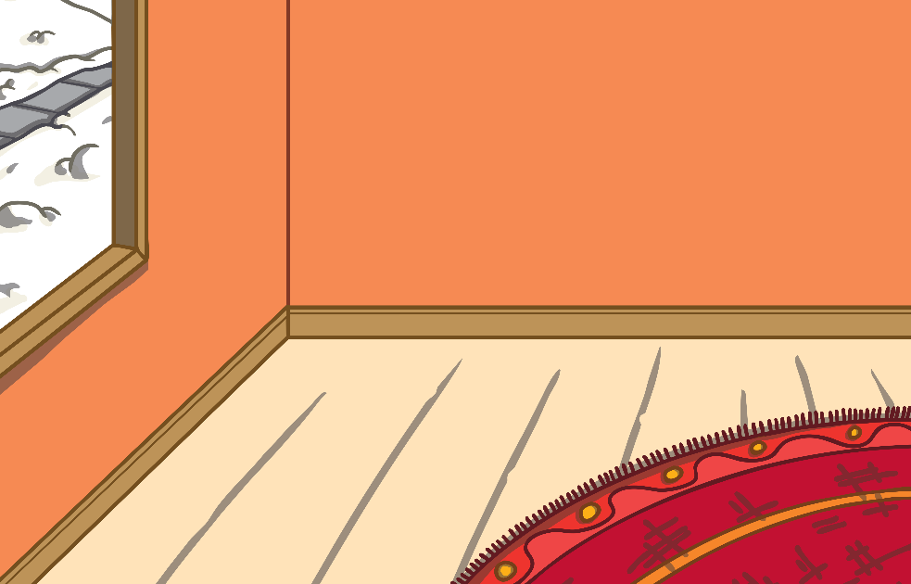
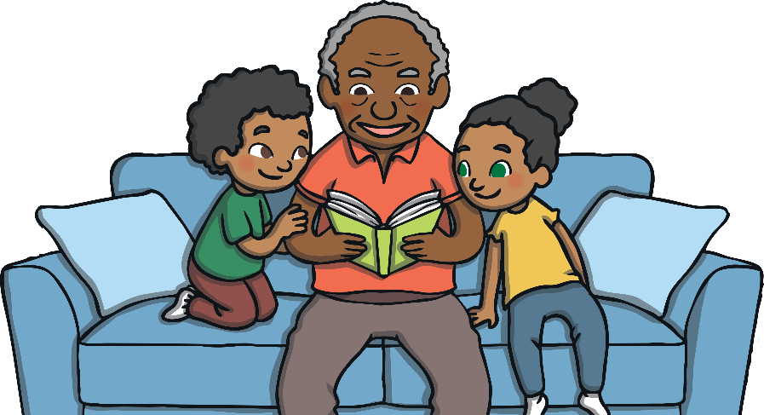
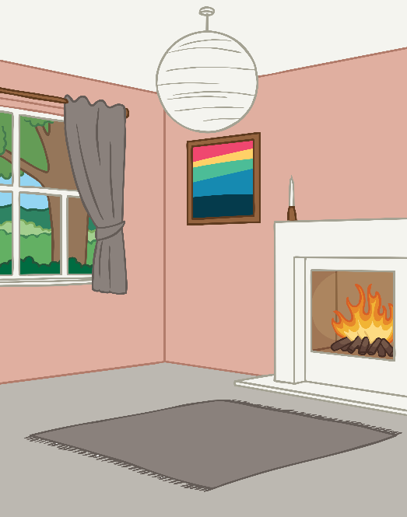
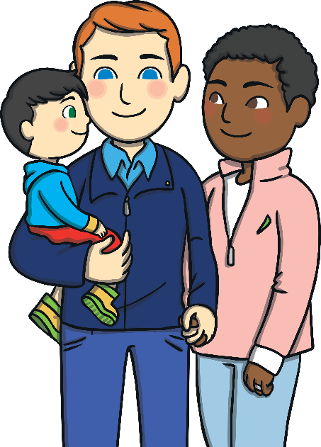
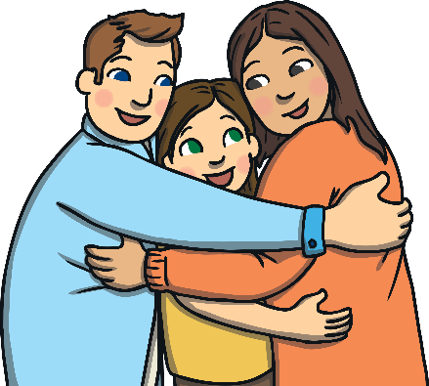
Think of all the people and things that
make you happy.
Apart from your friends, who do you have a good relationship with?

Slide 13
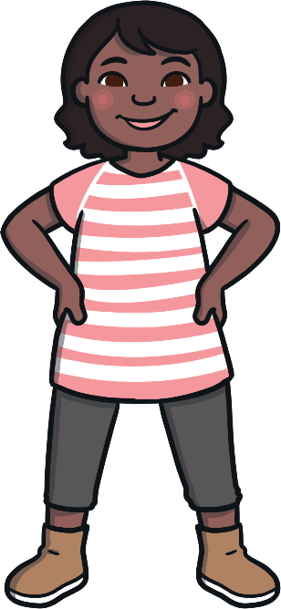
Which of these words would you use to describe a good relationship?
whispering
sharing
joyful
yelling
loving
honest
fun
kicking
robbing

