Slide 1
Maths
Measurement
Year One
Maths | Year 4 | Measurement | Converting Units of Measurement | Lesson 2 of 5: Converting Units of Length (2)

Slide 3
Aim
I can convert between metres and kilometres.
Success Criteria
I can convert from metres to kilometres by dividing by 1000.
I can convert from kilometres to metres by multiplying by 1000.

Slide 4
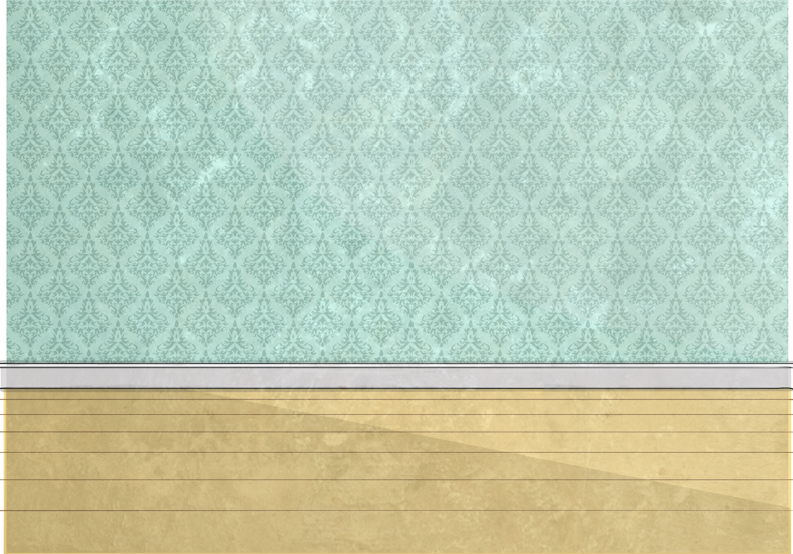
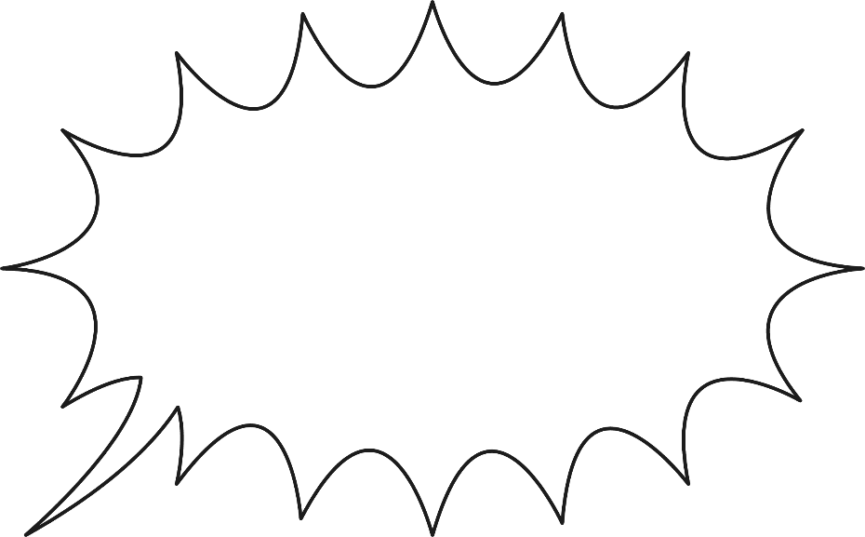
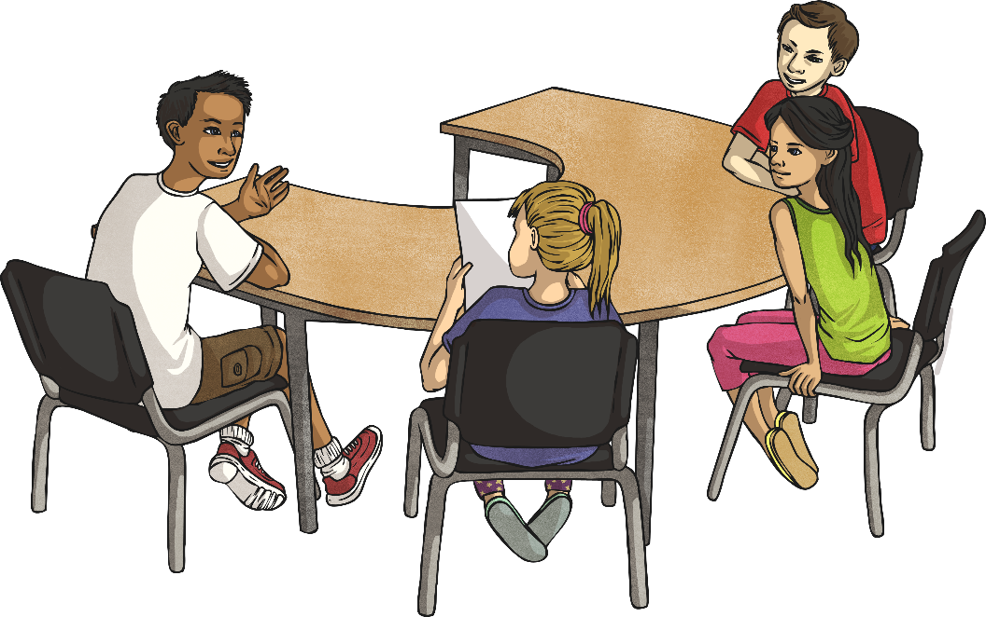
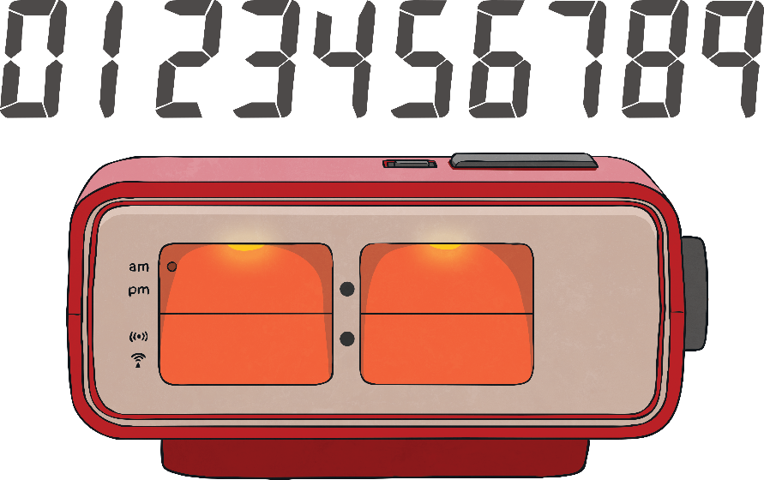
Conversions Checkup
Complete as many questions as you can on the Converting Length Units Speed Sheet.
You have two minutes! Click the timer to start.
?
Can you remember how to convert between millimetres, centimetres and metres?
How many millimetres are in a centimetre?
10mm = 1cm
How many centimetres are in a metre?
100cm = 1m
Time’s Up!

Slide 5
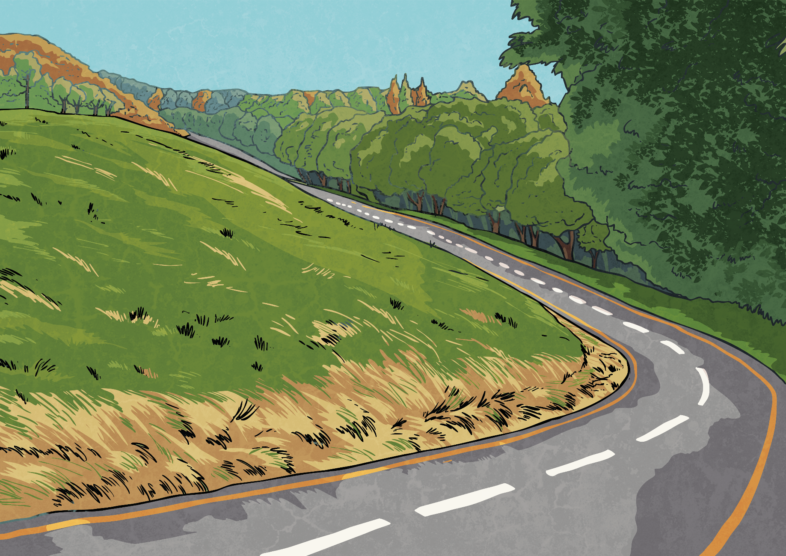
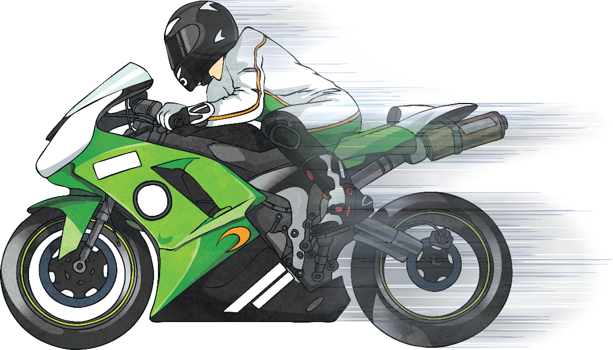
Kilometres to Metres
A kilometre is made up of 1000 metres.
How many metres are there in
2km? | 3km? | 4km? | 5km? | 6km? | 7km? | 8km? | 9km? | 10km?
2000m
3000m
4000m
5000m
6000m
7000m
8000m
9000m
10 000m
What calculation do we need to do to convert from kilometres to metres?
What do you notice about the answers?
Metres are smaller than kilometres, so there are more of them in the same length. There are a thousand times more metres in the same length than kilometres.
We need to multiply the number of kilometres by 1000.

Slide 6
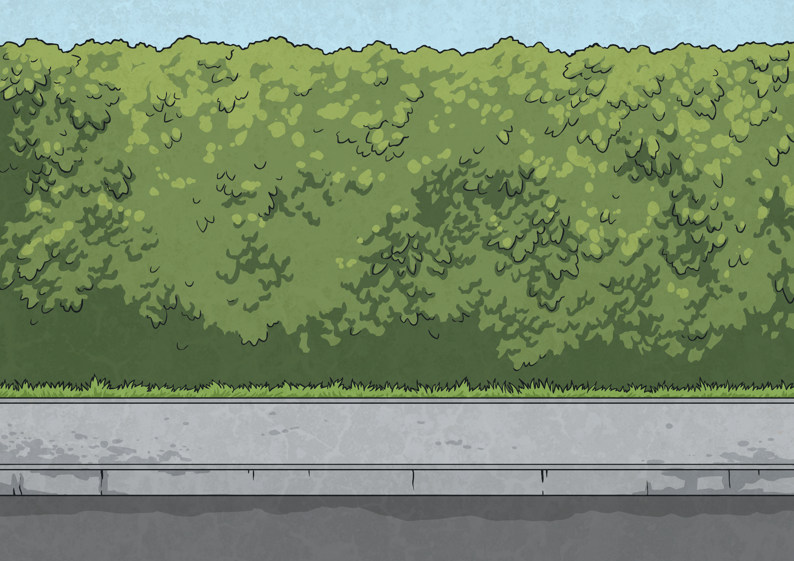
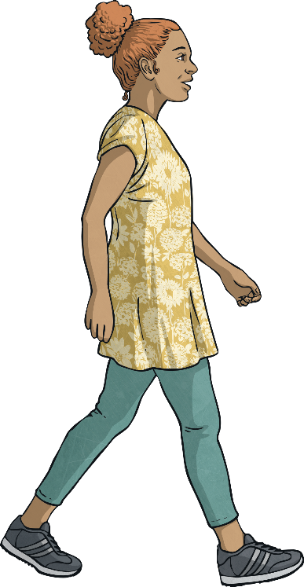
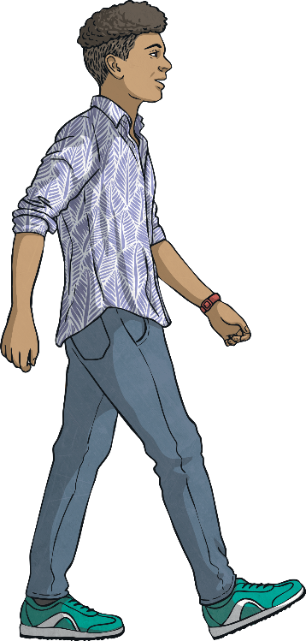
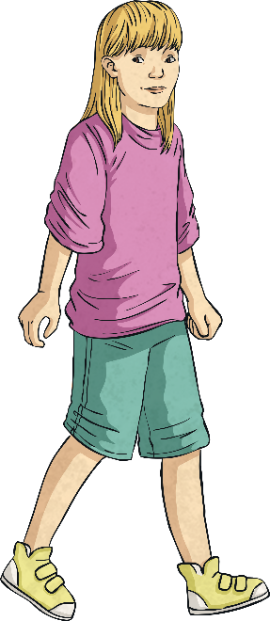
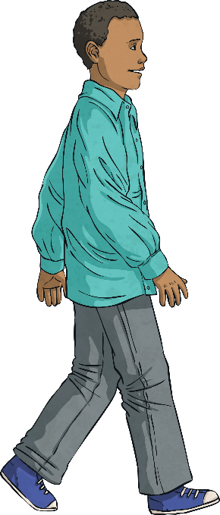
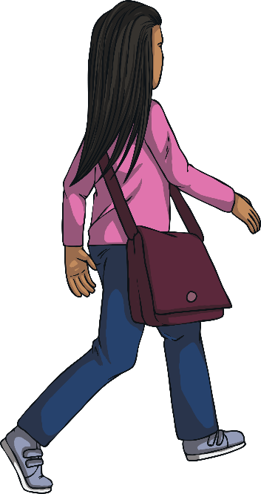
Kilometres to Metres
A group of children in Class 4W measured the distance of their journey from home to school. Some children said the distance in metres and some in kilometres.
My journey is 4km.
My journey is 5km.
My journey is 3000m.
My journey is 2000m.
My journey is 7km.
Marius
Rhiannon
Junaid
Carly
Tanya

Slide 7
Kilometres to Metres
Order the children’s journeys from nearest to school to furthest from school.
My journey is 4km.
My journey is 5km.
My journey is 3000m.
My journey is 2000m.
My journey is 7km.
Marius
Rhiannon
Junaid
Carly
Tanya
nearest |  |  |  | furthest
Junaid | Marius | Carly | Rhiannon | Tanya

Slide 8
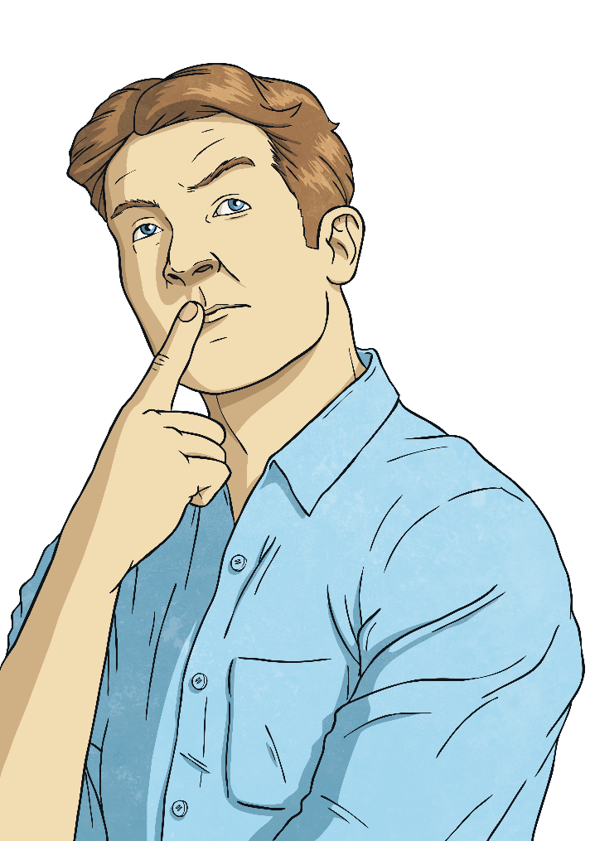
Metres to Kilometres
To convert from metres to kilometres, we divide the number of metres by 1000: 5000m ÷ 1000 = 5km
If this creates a decimal number, the thousandths become metres:
3500m ÷ 1000 = 3.500
3500m = 3km 500m

Slide 9
Metres to Kilometres
Convert these metre measurements to kilometres and metres.
Metres | Kilometres and Metres
6000m
4500m
6250m
8000m
2750m
3000m
9500m
6km
4km 500m
6km 250m
8km
2km 750m
3km
9km 500m

Slide 10
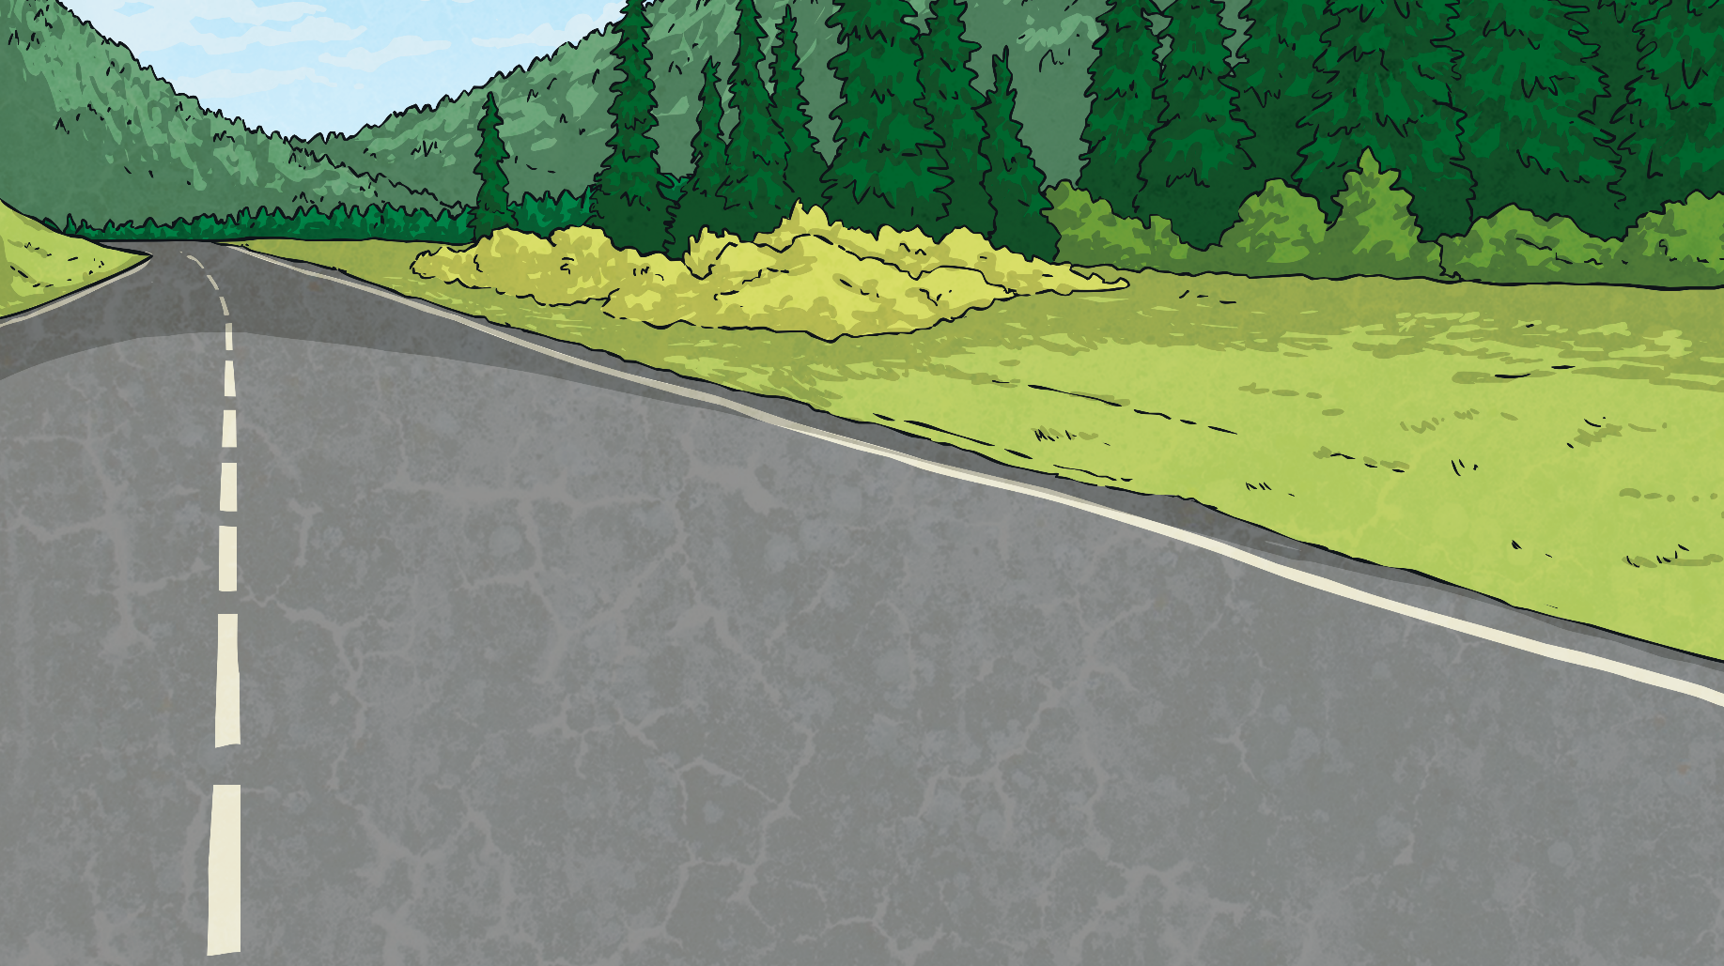
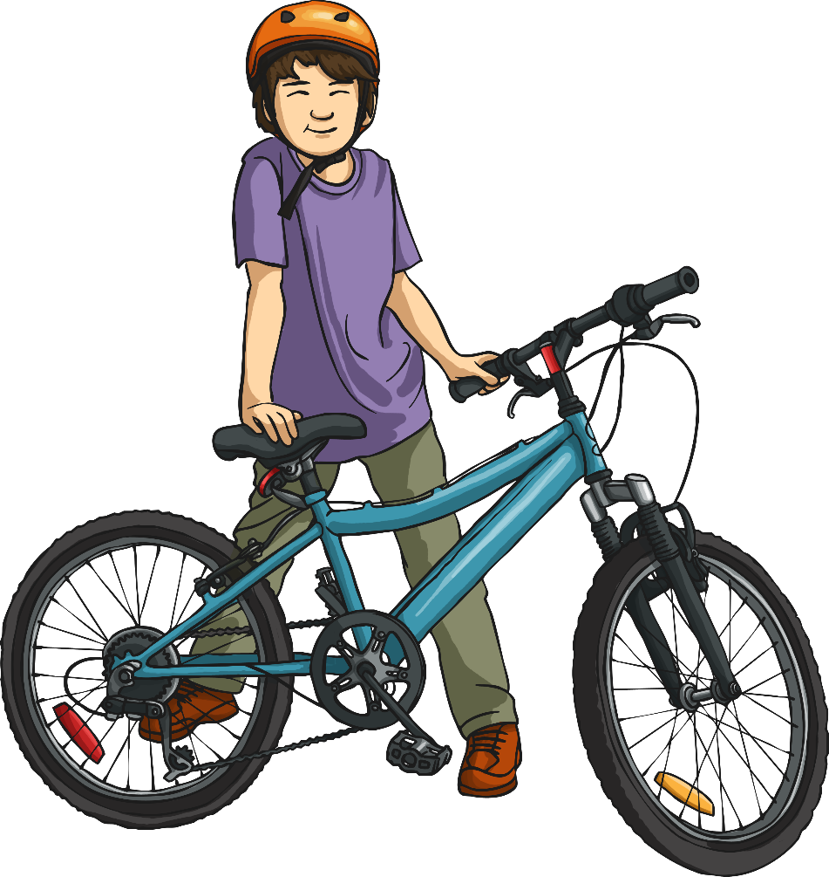
Comparing and Ordering
Use <, > or = to compare the measurements.
>
5000m |  | 3km 750m

Slide 11
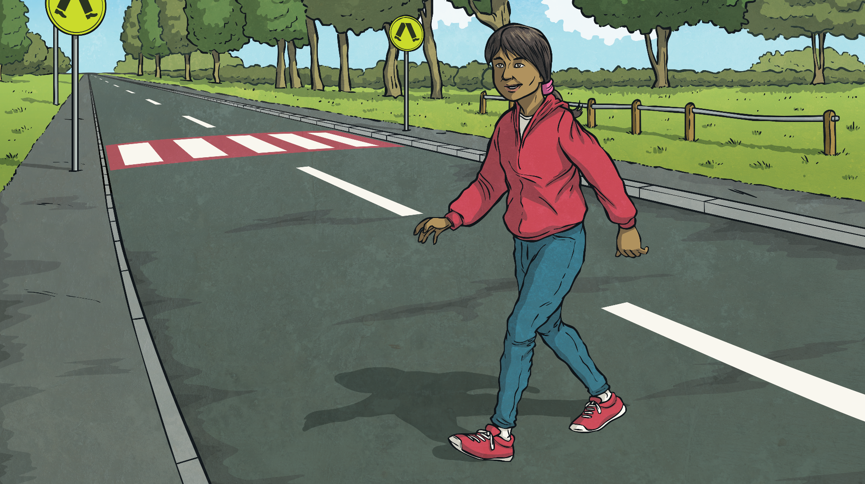
Comparing and Ordering
Use <, > or = to compare the measurements.
<
2300m |  | 4km

Slide 12
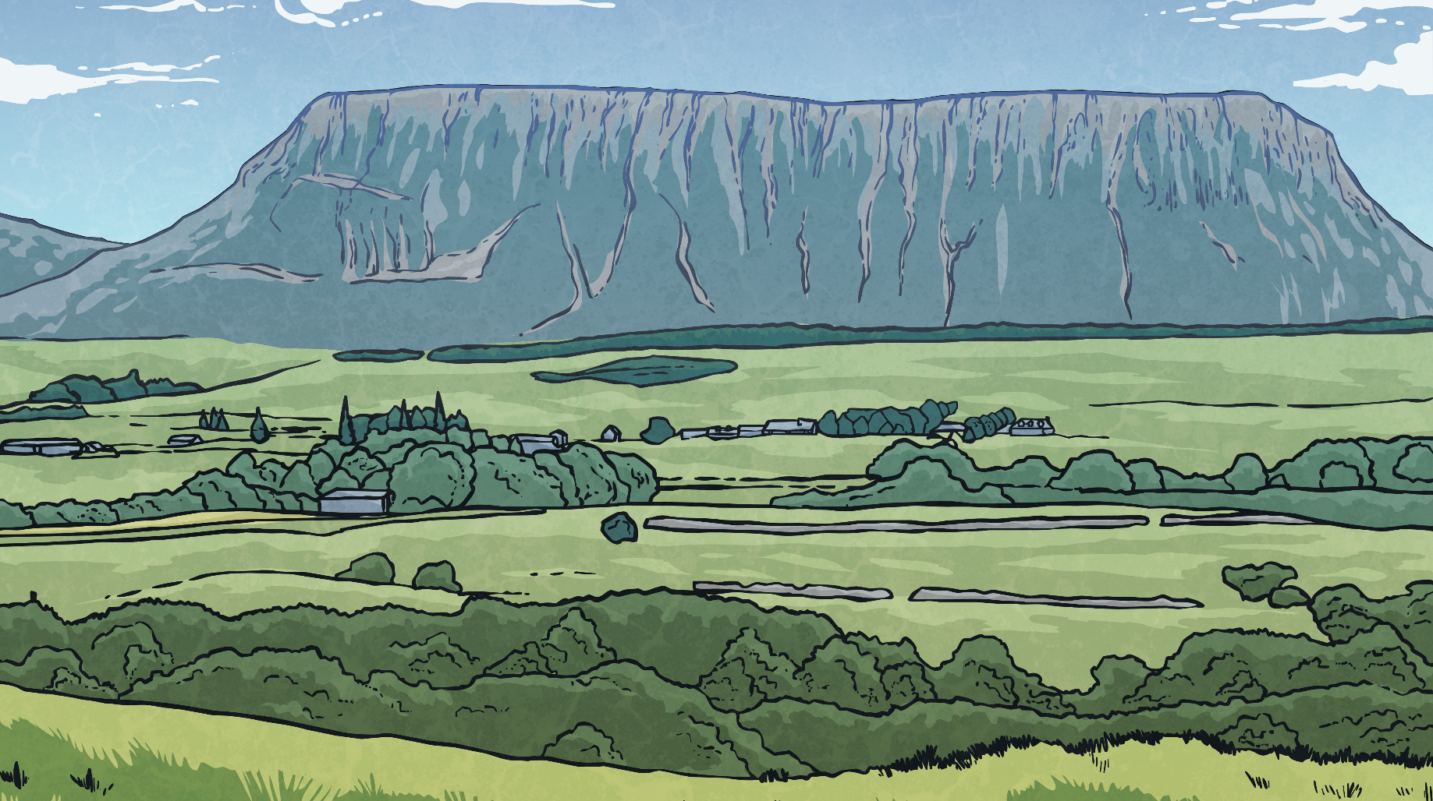
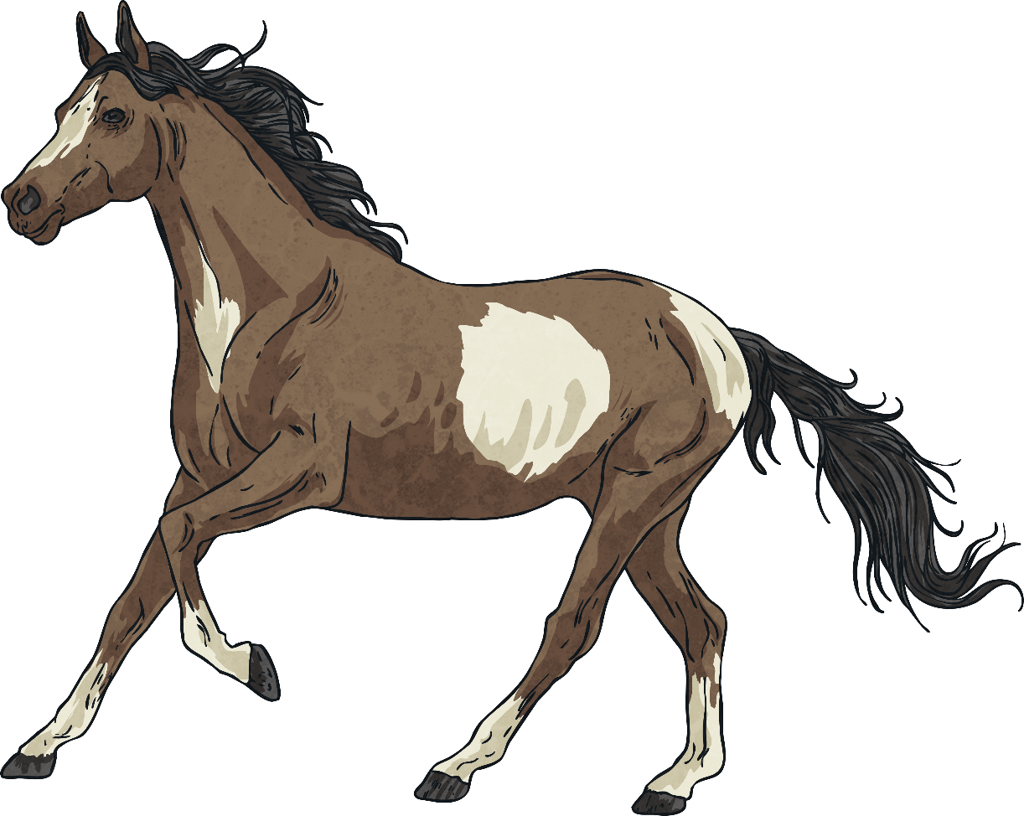
Comparing and Ordering
Use <, > or = to compare the measurements.
<
4km |  | 4250m

Slide 13
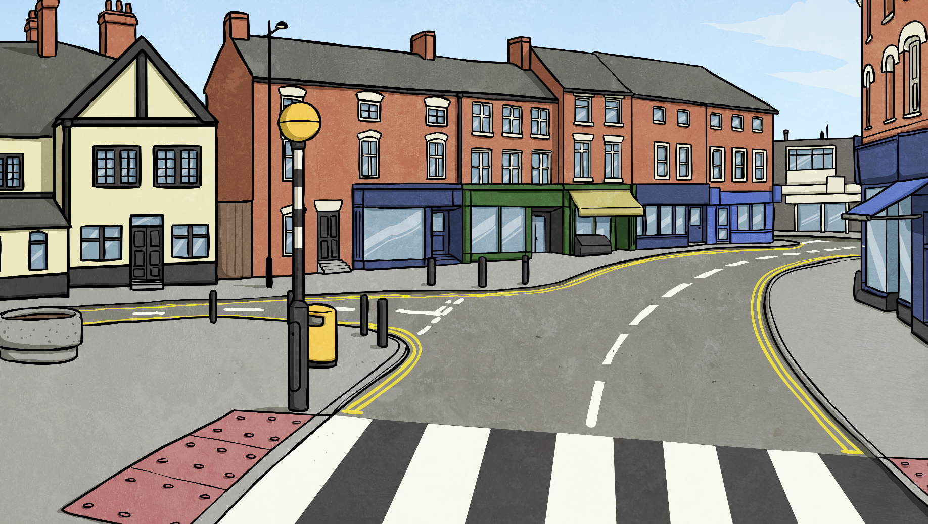
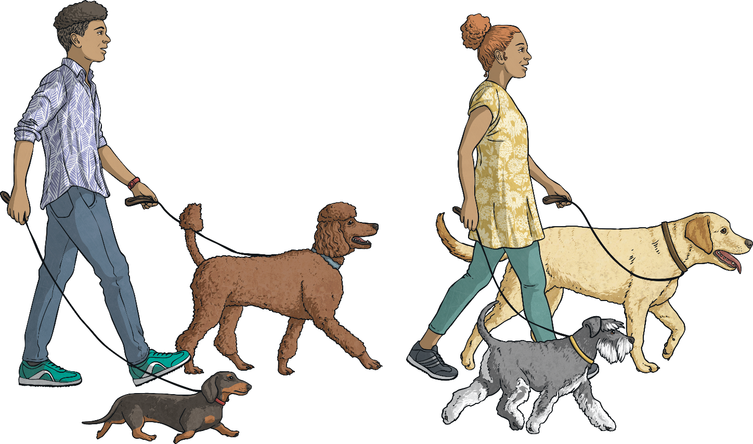
Comparing and Ordering
Use <, > or = to compare the measurements.
=
6250m |  | 6km 250m

Slide 14
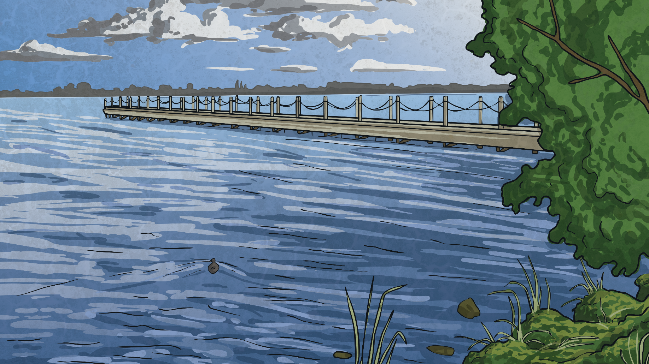
Comparing and Ordering
Use <, > or = to compare the measurements.
<
8km 475m |  | 9750m

Slide 15
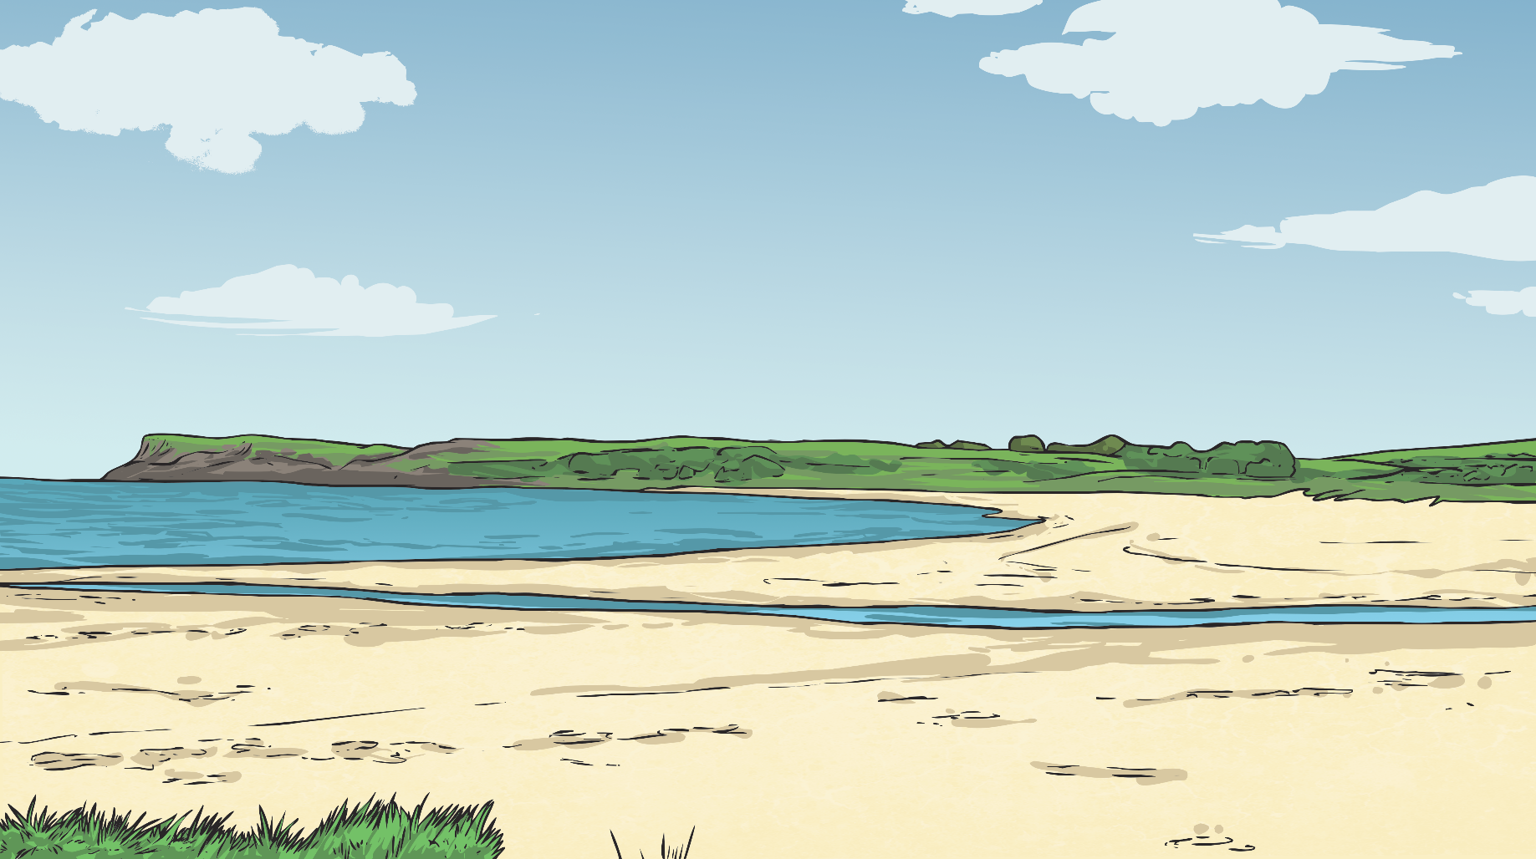
Comparing and Ordering
Use <, > or = to compare the measurements.
>
2km 300m |  | 2250m

Slide 16
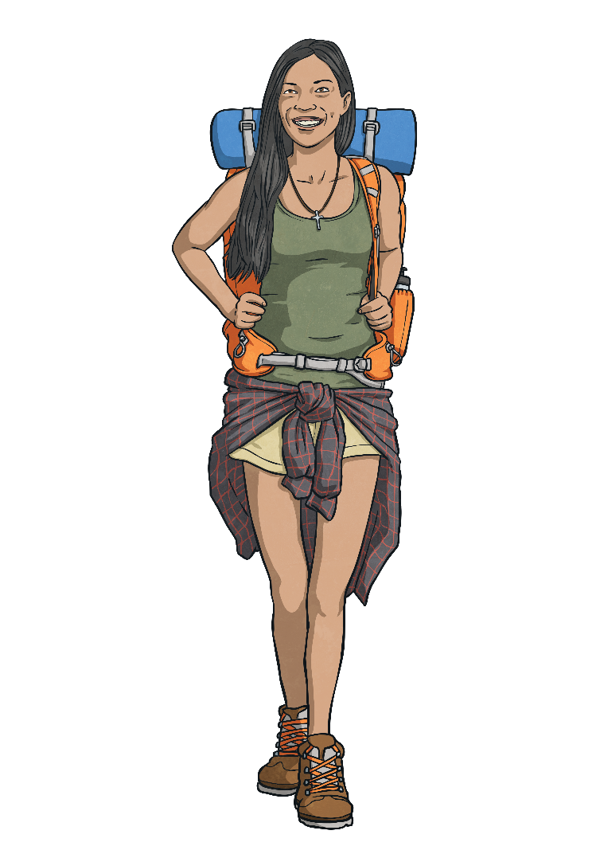
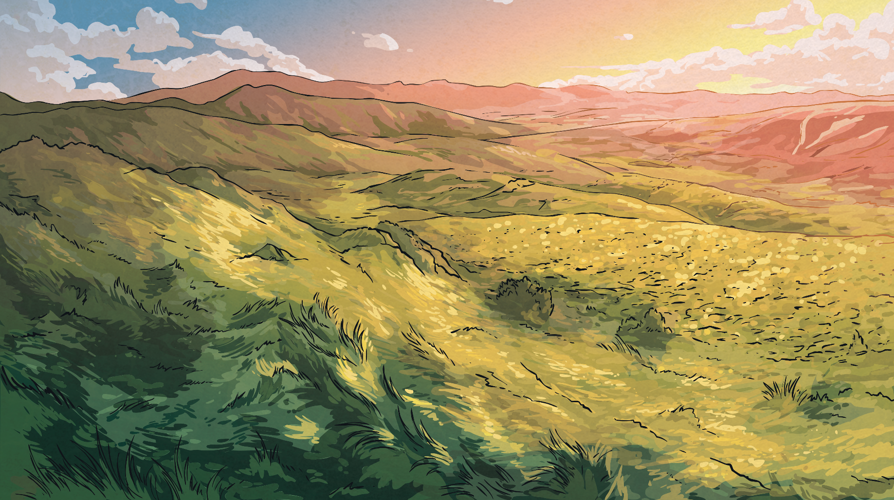
Comparing and Ordering
Use <, > or = to compare the measurements.
<
8km 475m |  | 9750m

Slide 17
Comparing and Ordering
Order these measurements from shortest to longest.
6000m
2km 195m
3km 250m
2750m
2750m
3050m
2km 195m
3km 250m
3050m
4km 295m
4km 295m
6000m
answer

Slide 18
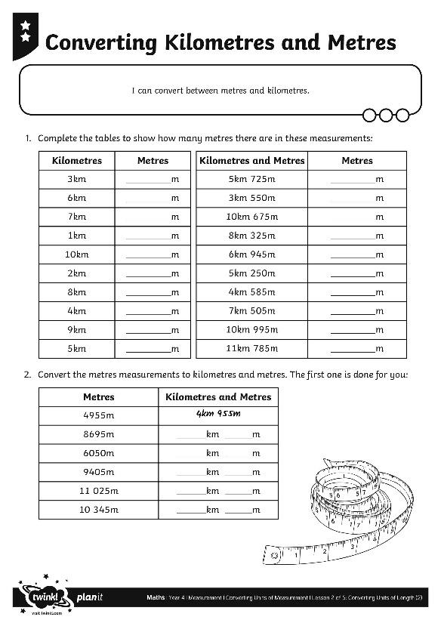
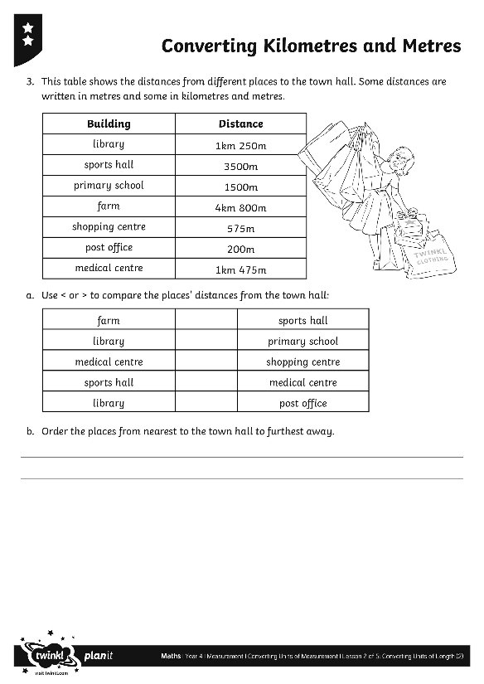
Converting Kilometres
and Metres
Use your captivating converting skills to complete this activity sheet.

Slide 19
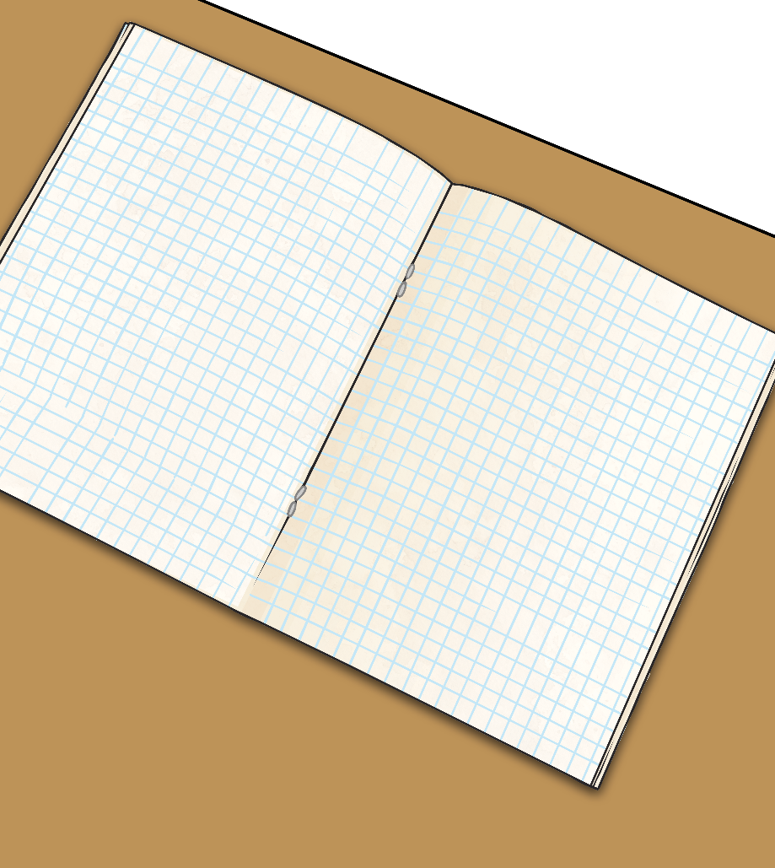
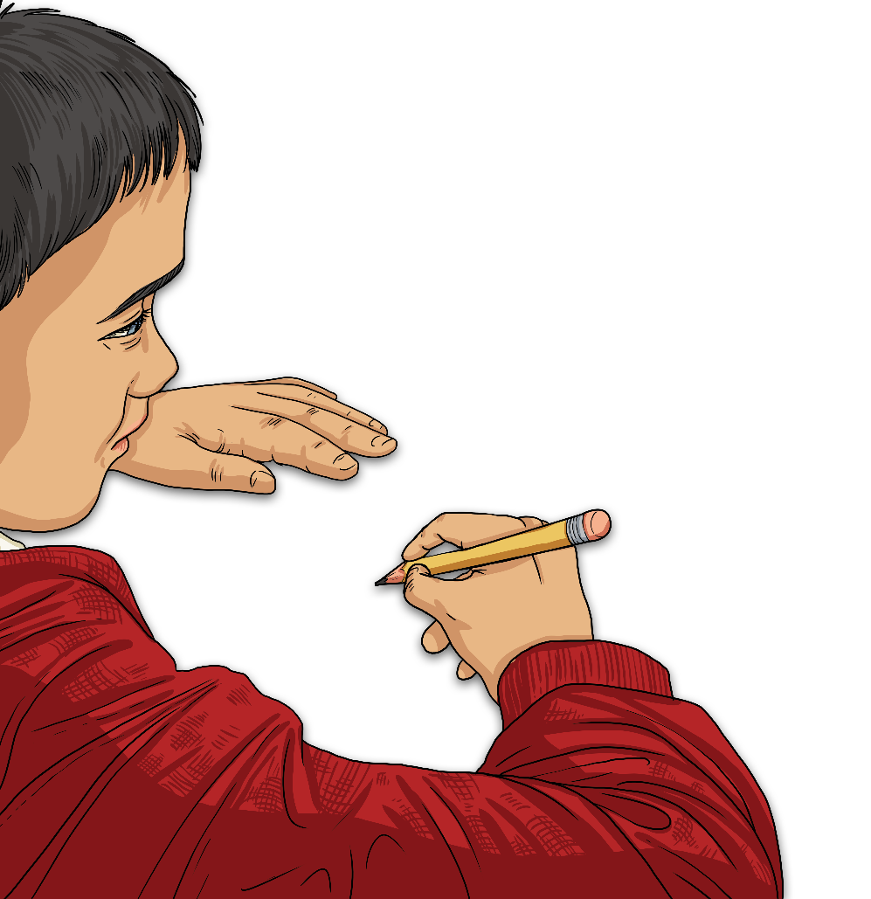
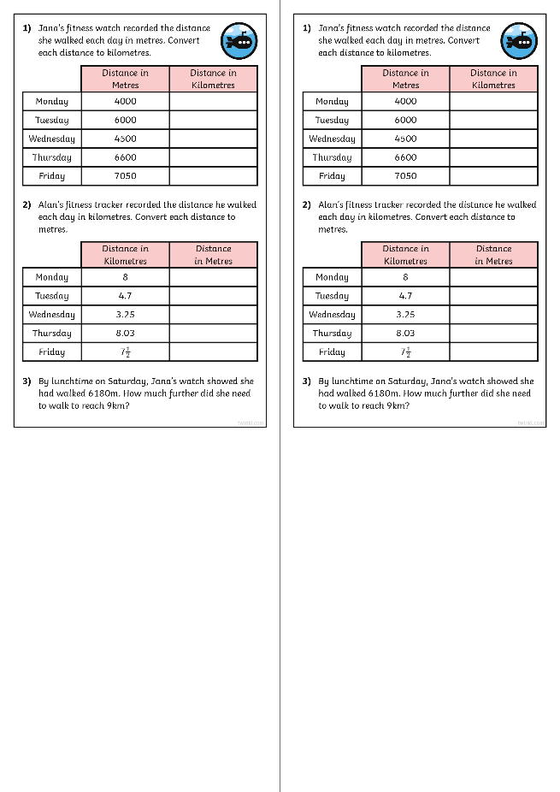
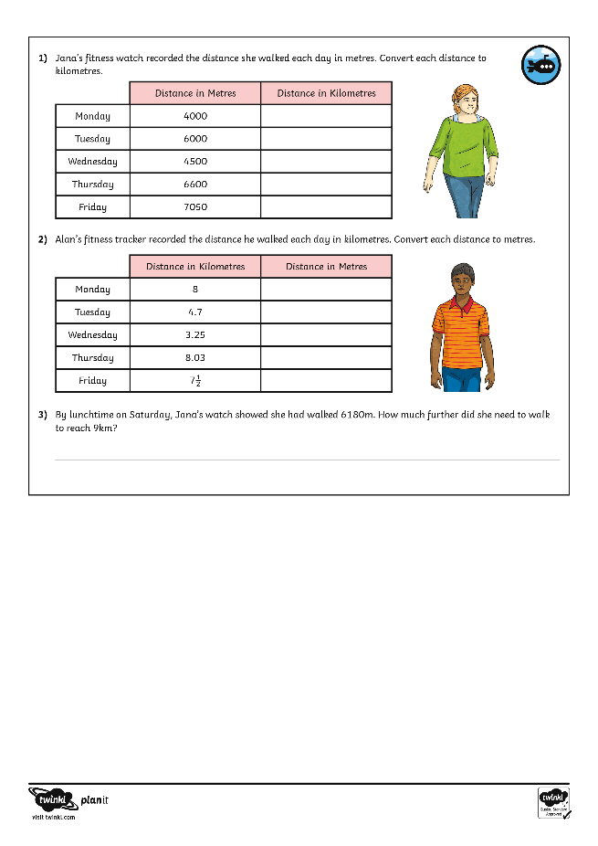
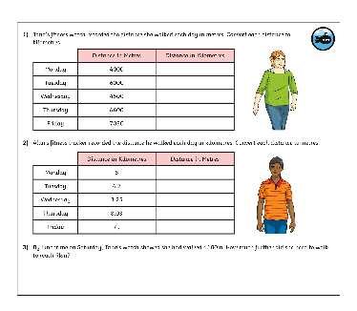
Diving into Mastery
Dive in by completing your own activity!

Slide 20
Wayne’s Walking Week
Wayne records how many metres he walks after school over a week.
Here are the distances he covered:
Day | Distance Covered
Monday | 700m
Tuesday | 800m
Wednesday | 600m
Thursday | 200m
Friday | 900m
Calculate how far Wayne walked across the week. Write your answer in km and m.
Answer:
3km 200m

Slide 21
Aim
I can convert between metres and kilometres.
Success Criteria
I can convert from metres to kilometres by dividing by 1000.
I can convert from kilometres to metres by multiplying by 1000.

