Slide 1
PSHE and Citizenship
Living in the Wider World | Money Matters
PSHE and Citizenship | LKS2 | Living in the Wider World | Money Matters | Advertising | Lesson 5

Slide 3
Aim
I can explain how adverts try to influence our spending and why they do this.
Success Criteria
I can talk about how adverts try to influence our spending.
I can give some reasons as to why they do this.
This resource is fully in line with the Learning Outcomes and Core Themes outlined in the PSHE Association Programme of Study.

Slide 4
The Big Questions

Slide 5
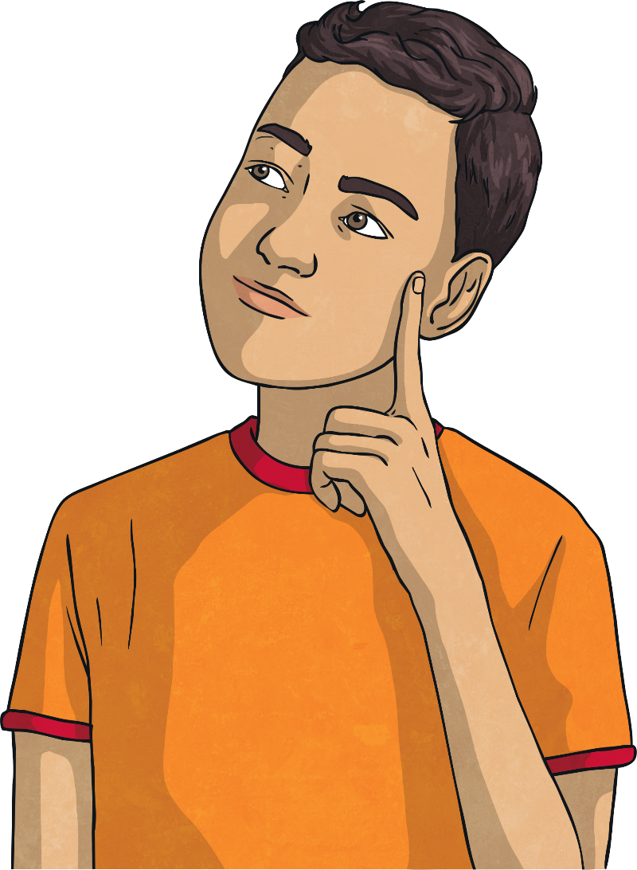
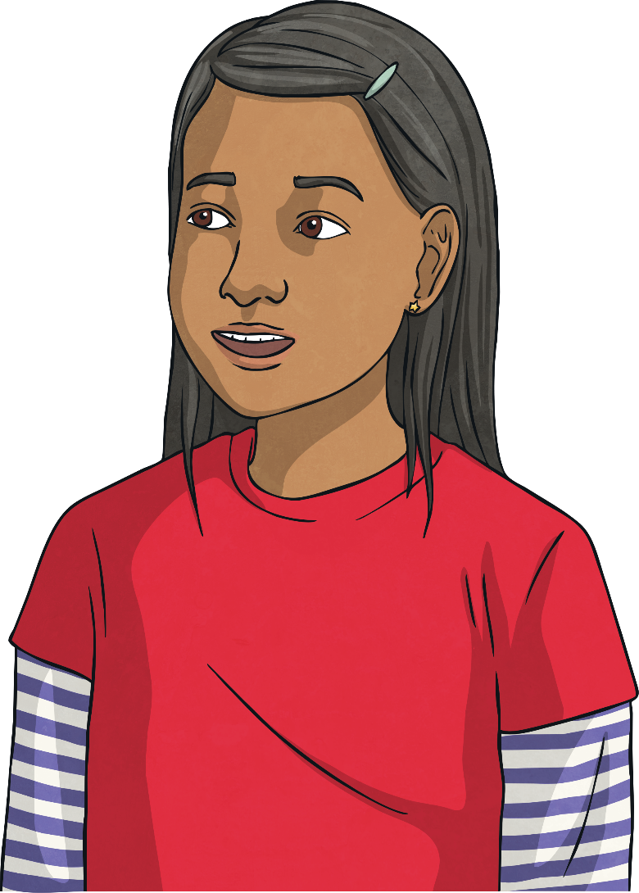
Why do adverts try to influence the way we spend money?
How do they do it?

Slide 6
Reconnecting

Slide 7
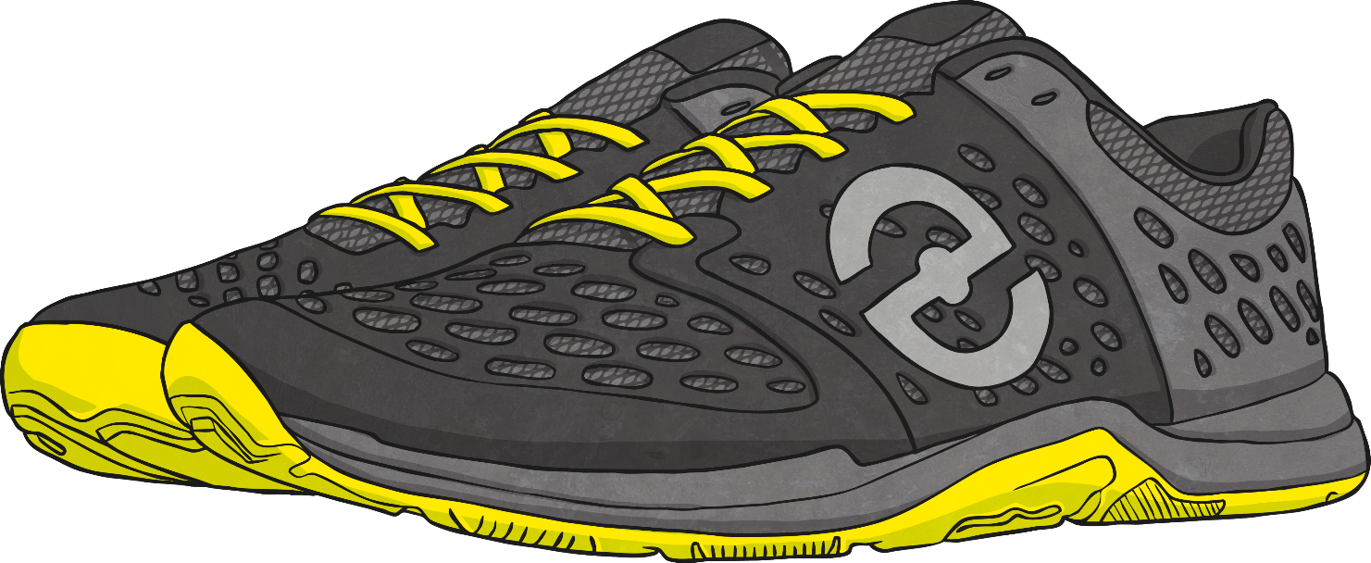
Why Advertise?
We have been thinking about where money comes from and what we can spend it on. Now let’s consider how companies try to influence our spending.
Speedz Trainers
Super cushioned soles for great comfort.
Elastic laces for convenience.
Bouncy rubber toes for super speed.
Run faster than competitors.
A brilliant choice for comfort!
Only £59.99
What is this advert trying to do?
How does it try to influence you?
Why is it doing this?
What is good about this advert?

Slide 8
Exploring

Slide 9
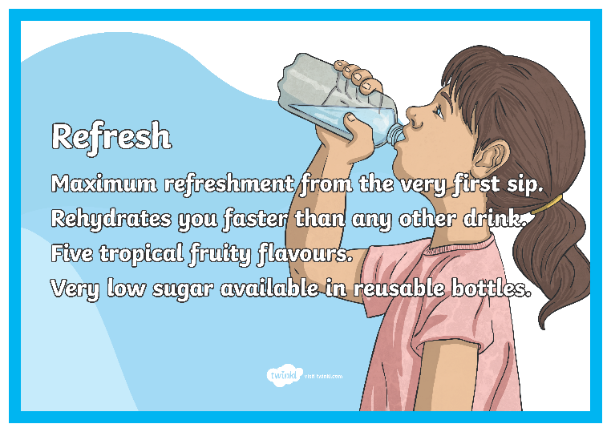
We Want Your Money
Look at the advertisements displayed around the room. Walk around the room to have a closer look at each of them. Talk to your partner about which one interests you.
Why did you choose that advertisement?
Is the product something you would like to spend your money on?
What makes it an appealing advertisement?
What makes a good advert?

Slide 10
Make Your Own Advert!
Most advertisements are from companies that want you to spend your money with them. If you buy their product, they make profits and therefore financial gain. Some advertisements offer services to help people but most companies still stand to make money from their consumers.
Working in small groups, you are now going to make your own advertisements for television. You will be given a card with information about the product you will advertise. In your advertisement, try to make it clear why you are advertising and what you can offer.
After you have worked on your advert, each group will have the chance to perform them to the rest of the class.

Slide 11
Make Your Own Advert!
Now we will watch the advert performances.
While you are watching, try to think about these questions:
What is this advert trying to make you spend money on?
How is it trying to influence your spending?
Why is it trying to do this?
Consolidating
Reflecting

Slide 12
Consolidating

Slide 13
Make Your Own Poster
You have made some fantastic adverts! Now we can make some posters to go with them. Remember to keep these questions in mind:
What is this advert trying to make you spend money on?
How is it trying to influence your spending?
Why is it trying to do this?
Word Bank
money
influence
spending
advertising
ethical
advertisement
profit
financial gain
consumer

Slide 14
Reflecting

Slide 15
Choosing Your Product
Speedz Trainers
Tread Trainers
Super cushioned soles for great comfort.
Elastic laces for convenience.
Bouncy rubber toes for super speed.
Run faster than competitors.
A brilliant choice for comfort!
Only £59.99
Comfy soles.
Laces to keep shoes safely in place.
Cushioned toes for speed.
How does the advertisement influence your spending?
Which would you choose to spend your money on? Why?
These two advertisements are for a similar product.
The adverts we have looked at have used lots of different strategies to influence our spending.
price
environmental considerations
ethical ingredients
appealing to health benefits

Slide 16
Choosing Your Product
Talking to your partner, think about what you will look for in adverts in the future when you consider products you want to buy.

Slide 17
The Big Questions

Slide 18
Why do adverts try to influence the way we spend money?
How do they do it?

Slide 19
I can explain how adverts try to influence our spending and why they do this.
Success Criteria
I can talk about how adverts try to influence our spending.
I can give some reasons as to why they do this.

