Slide 1
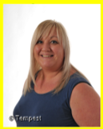
Our 1st meeting – 22nd September 2023
The School Council are the pupil voice – It is a very important job. They wear a badge so that you know who they are.
We congratulated our new School Council on being nominated by their friends.

Slide 2
News and questions
Are we having playground leaders this year?
Can we have some more bins near the yards?
Can we have bubbles on the yard?
How can we reduce noise in school?
Can we have a football club?
Can we have some more benches and canopies when the weather is hot?
Are we having Head Students?

