Slide 1
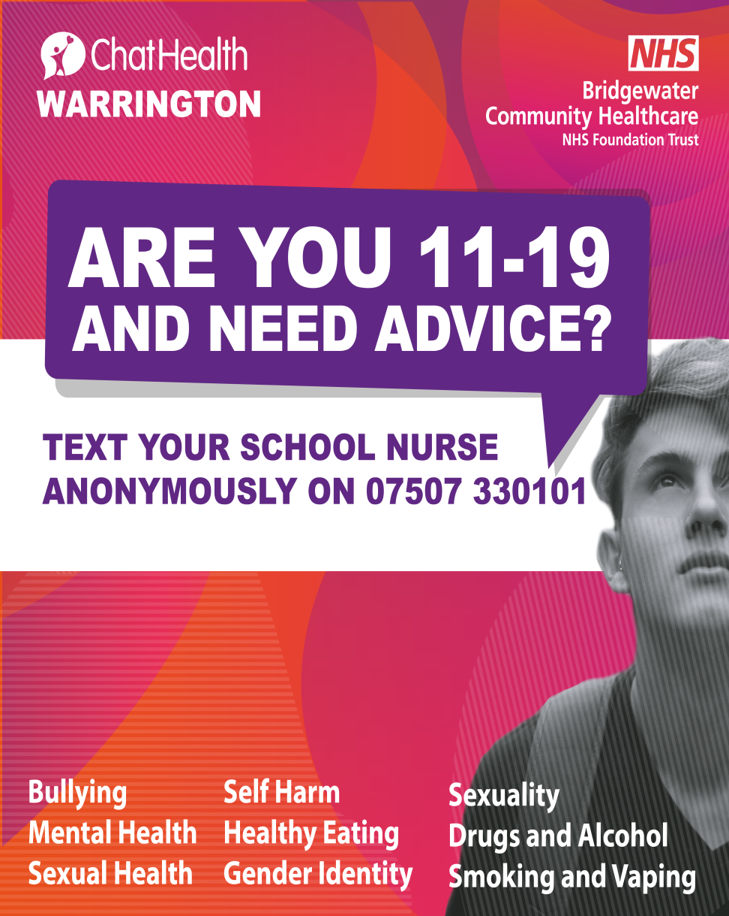
Notes:
Bridgewater Community Healthcare NHS Foundation Trust has teamed up with ChatHealth to provide a safe text messaging service for young people.
In response to the current climate where face to face contact with school health has reduced the ChatHealth texting service is an extra way for young people to access to support quickly.
As our lives have changed over the last few months due to the coronavirus pandemic, it’s more important than ever for young people have easy access to support, particularly in the absence of face to face interaction.
http://bridgewater.nhs.uk/latest-news/text-support-service-launches-for-boroughs-parents-carers-and-teens/

Slide 2
ChatHealth is confidential text messaging service for young people, it provides a safe way for you to anonymously contact a school nurse.
ChatHealth works by messages being sent to a dedicated phone number. These messages are then sent to a secure website and are read by a School Nurse who can then start a text conversation with you.

Slide 3
When to use ChatHealth?
If you have a question for a school nurse about health and wellbeing issues including anxiety, bullying, child development and sexual health.
Remember ChatHealth is not an emergency service
Notes:
ChatHealth is not an emergency service, and accordingly users will receive an automatic message explaining where to get help if their question or concern is urgent, and when they can expect a response.

Slide 4
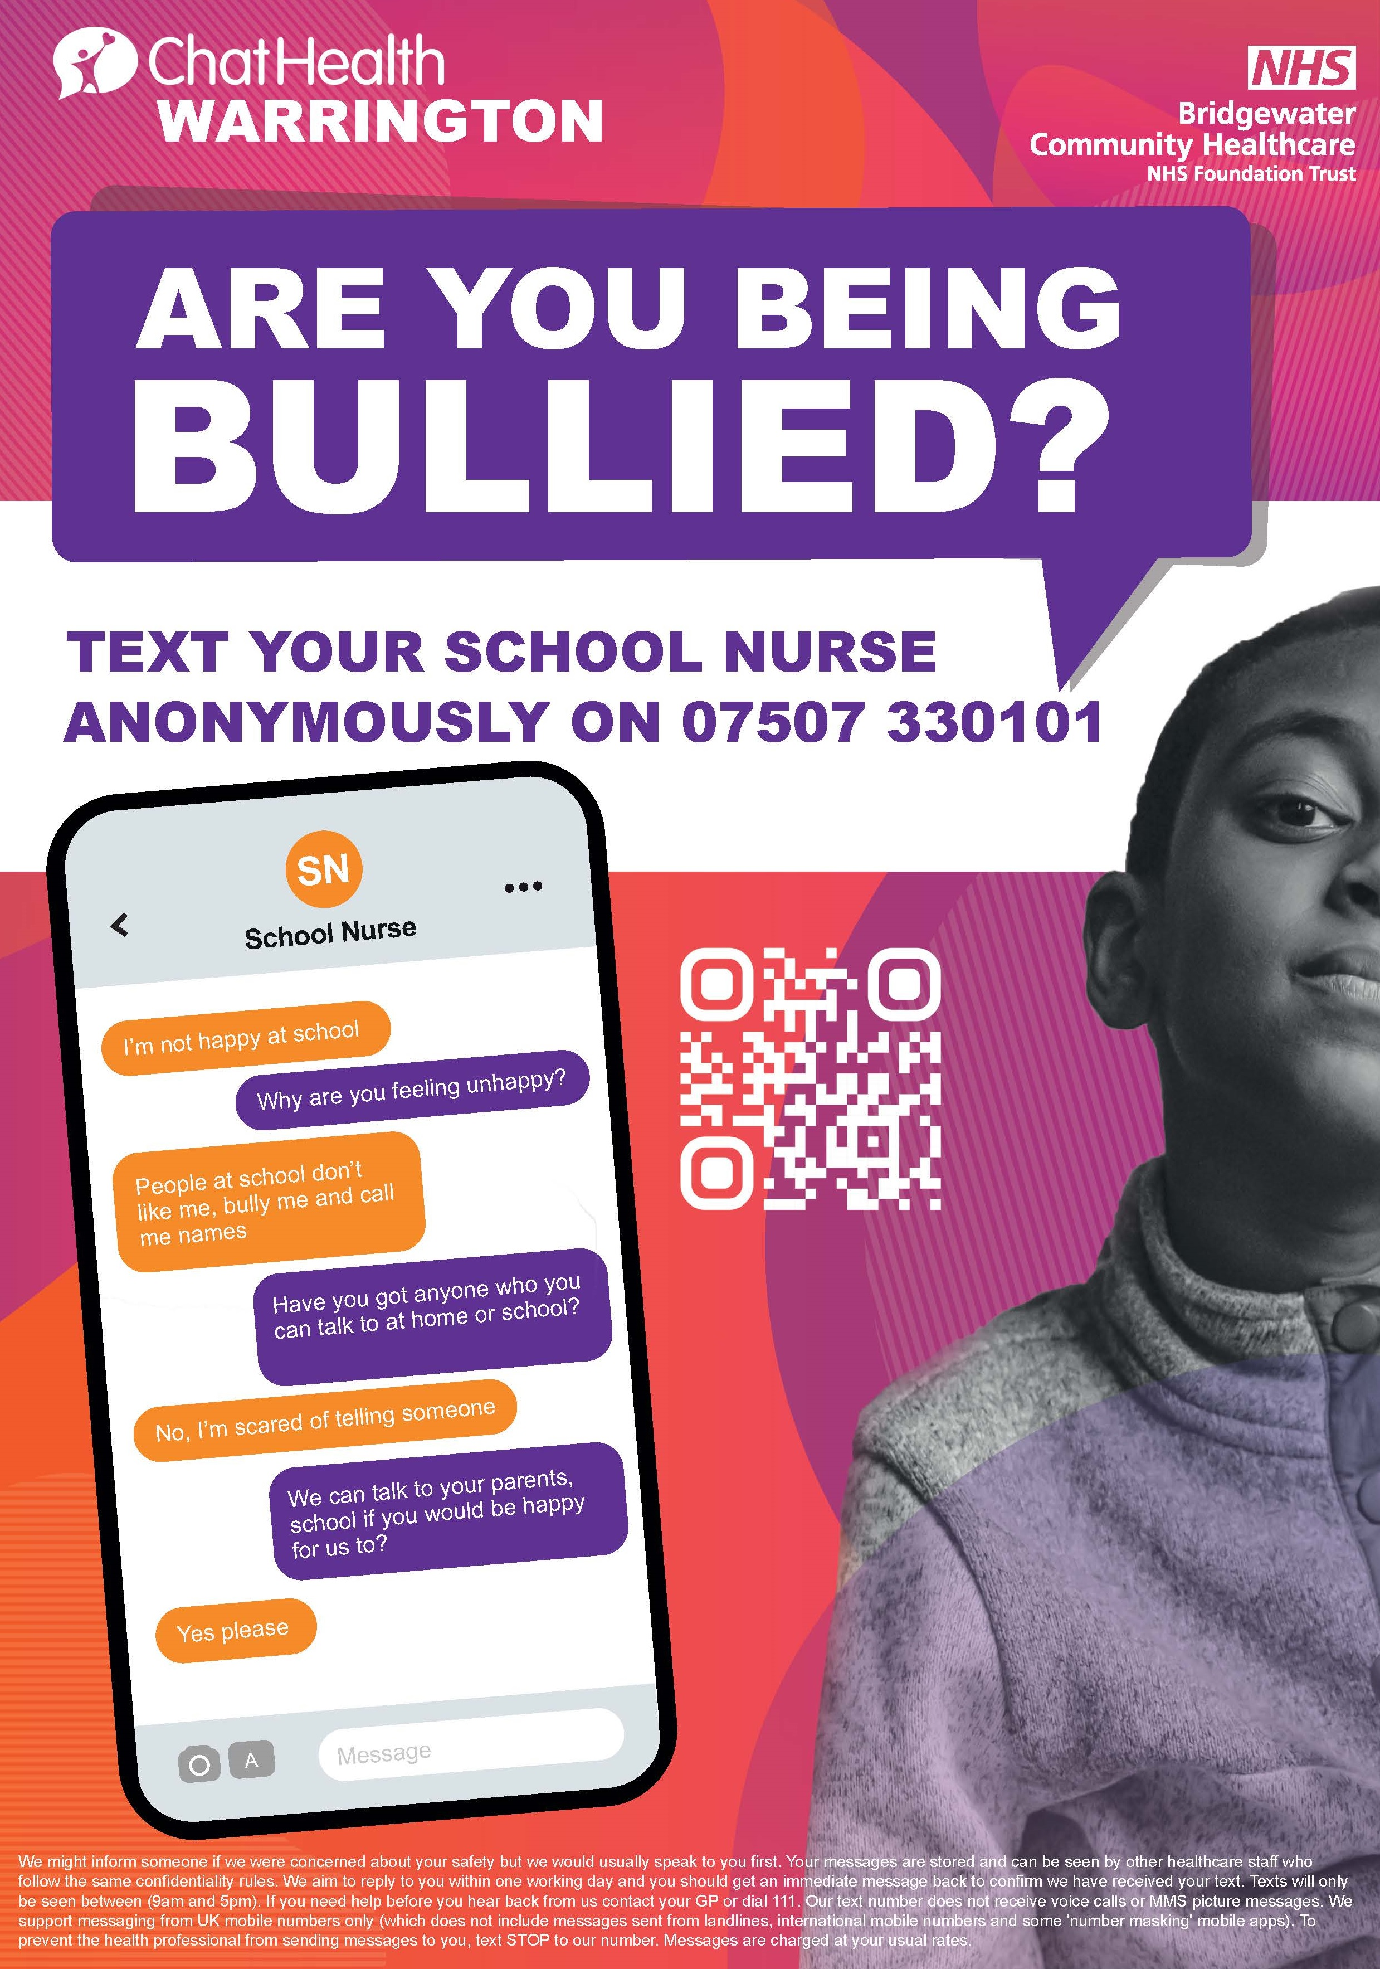
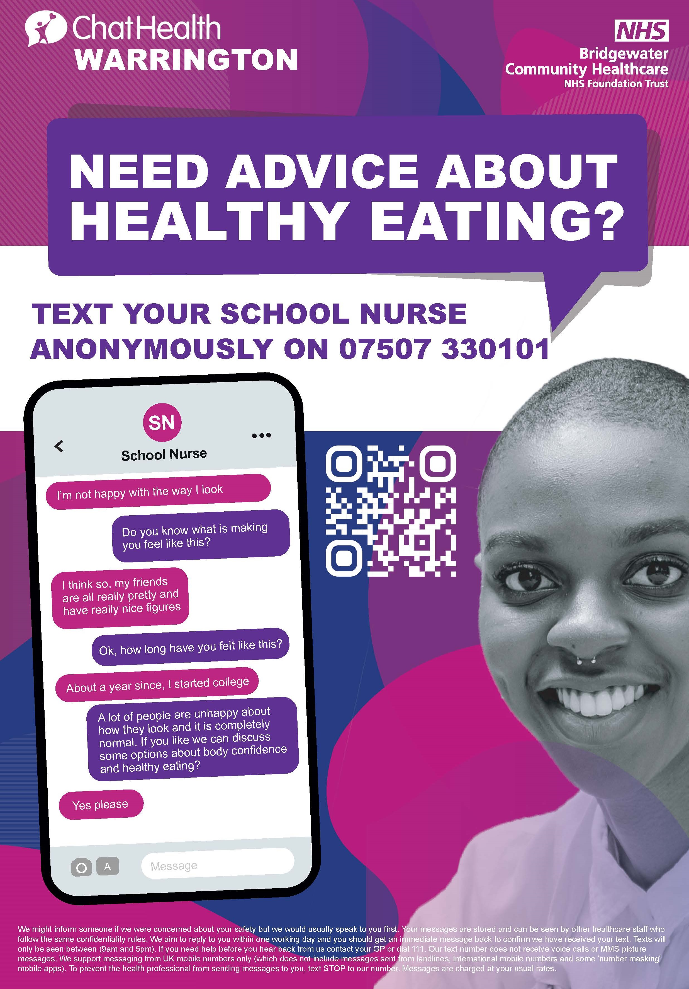

Slide 5
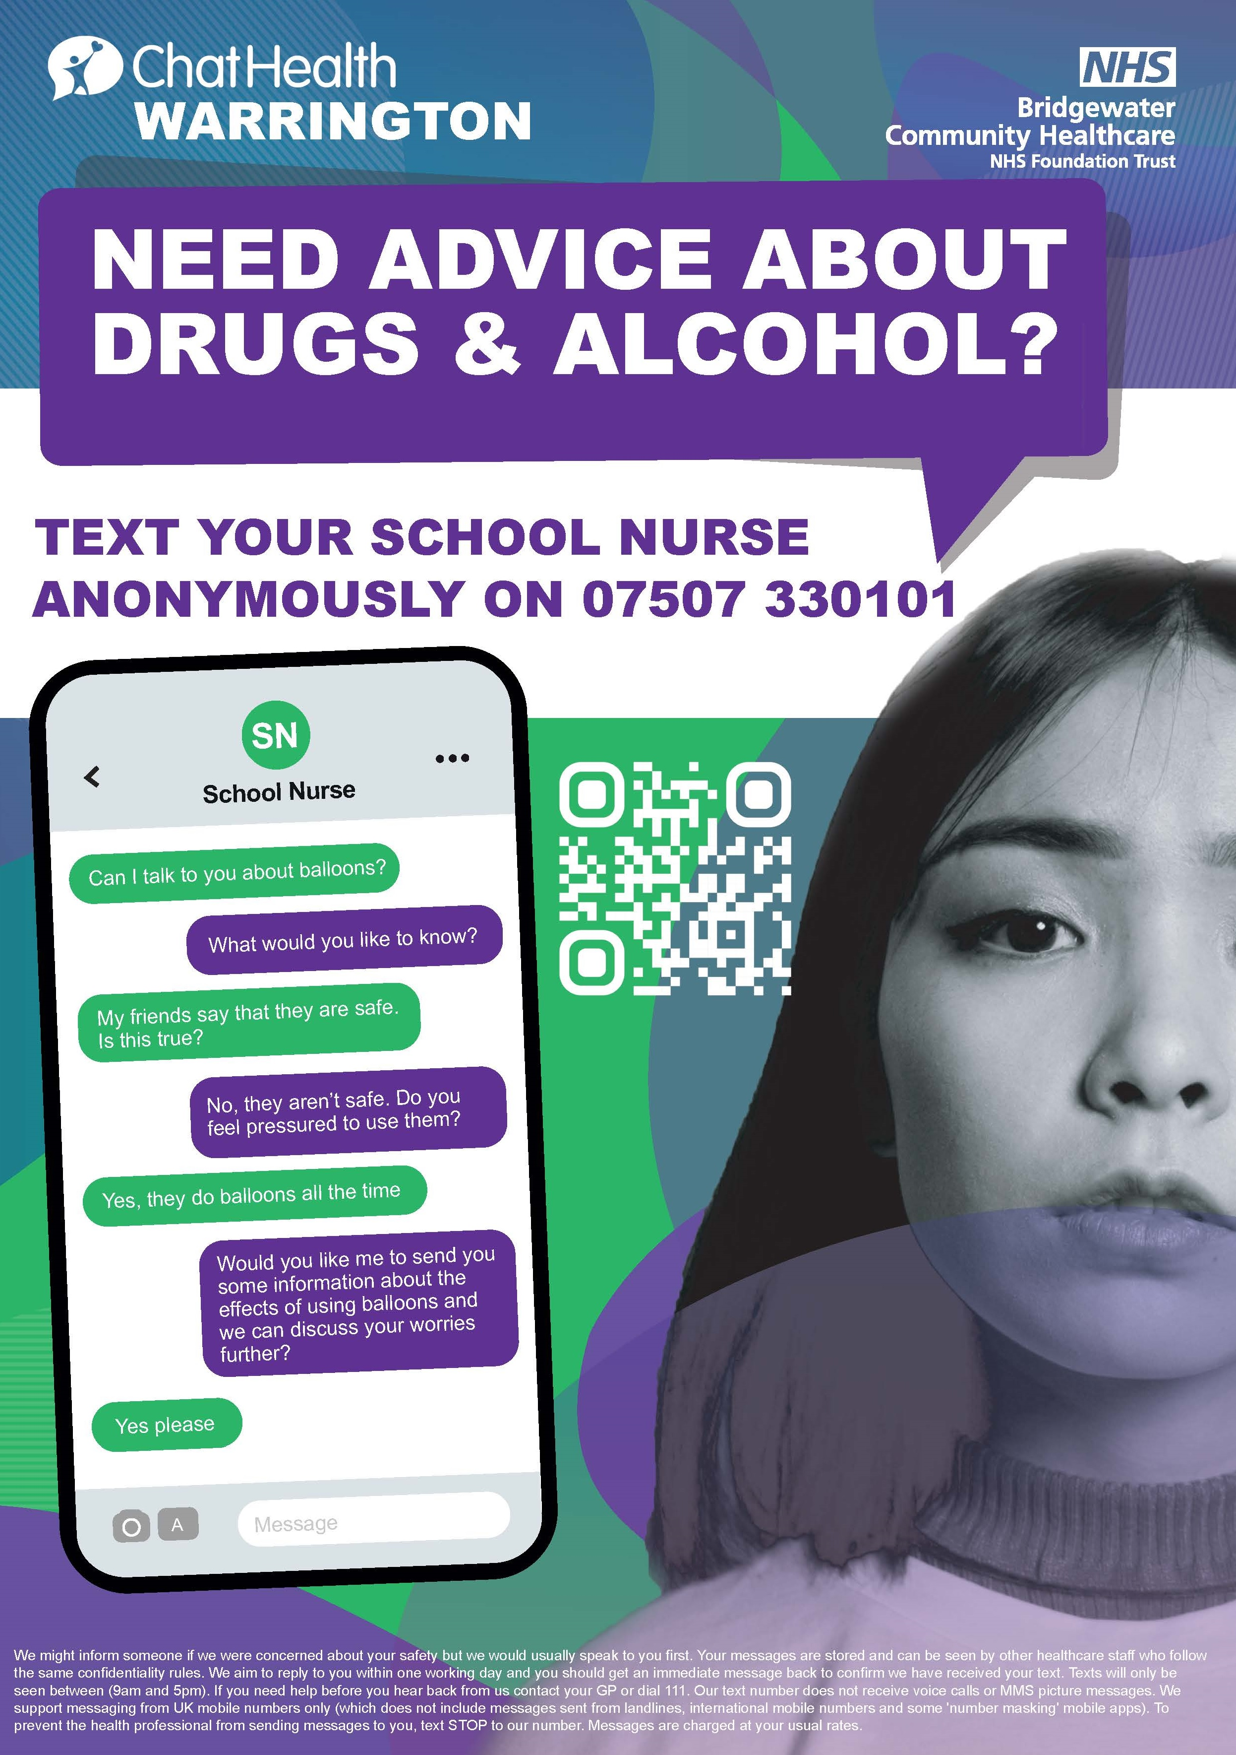
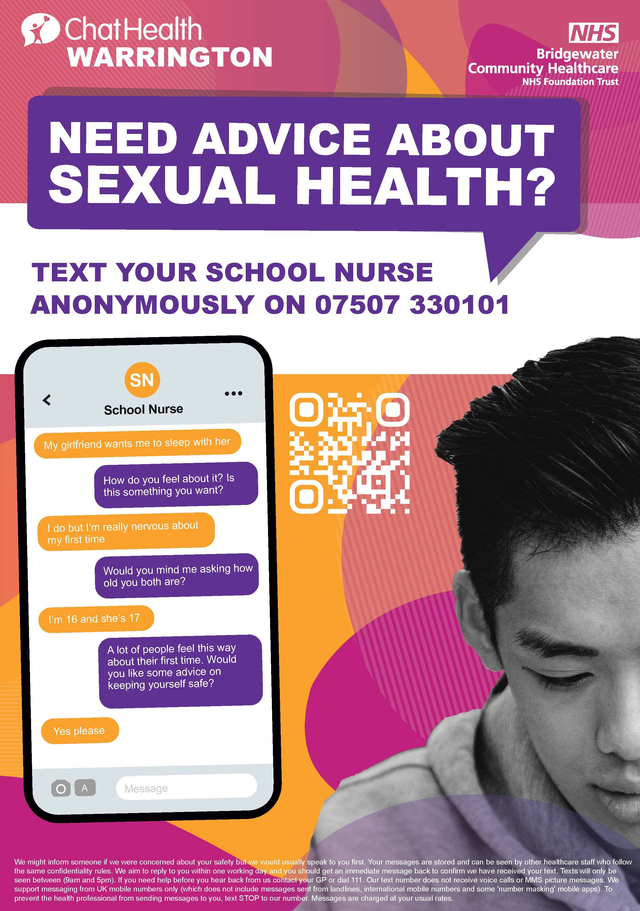

Slide 6
The ChatHealth service is available
9am – 5pm, Monday to Friday.
Outside of these hours, you will receive a text message saying you will receive a response when the line next re-opens.
The text number for Warrington is:
11 – 19 Young People’s Service – 07507 330101

