Slide 1
Welcome to Owl Class 2024-2025

Slide 2
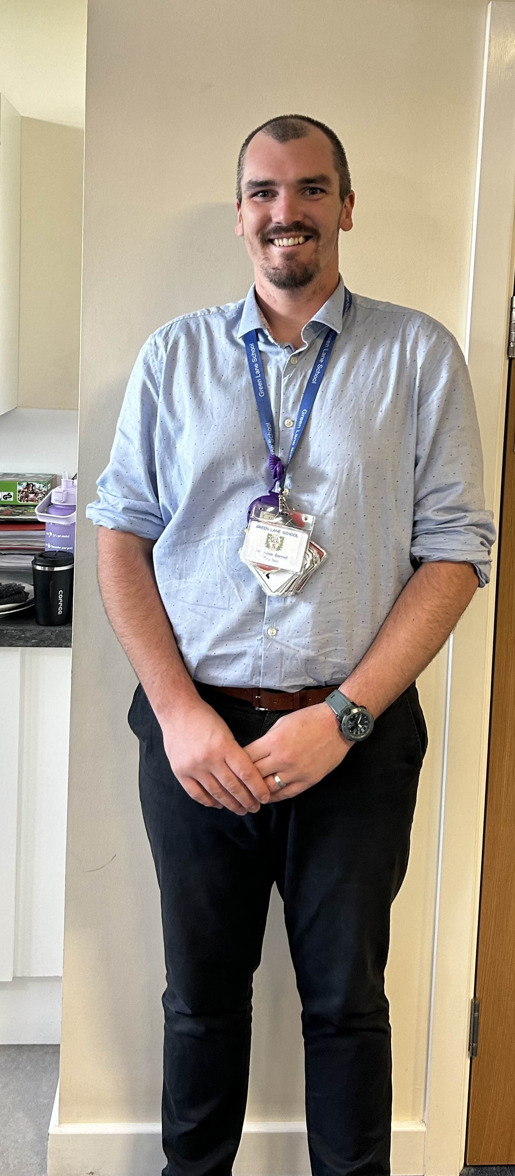
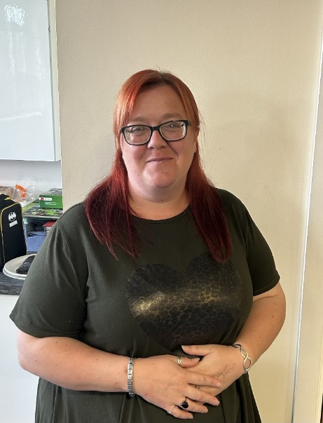
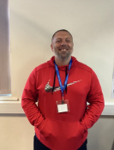
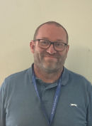
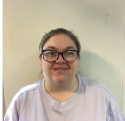
Introductions…
Mr Cartwright
1:1 TA
Jamie
1:1 TA
Miss Mclarney TA
Mr Garrod Teacher
Kirsty
1:1 TA

Slide 3
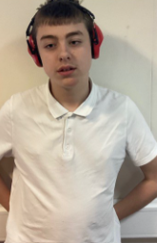
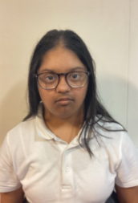
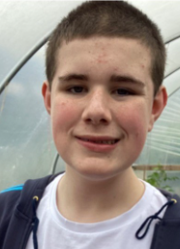
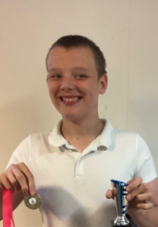
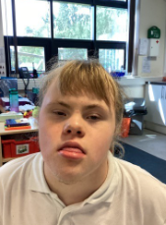
Owl Class is a Key Stage 4 class made up of pupils from both years 10 and 11.

Slide 4
On arrival…
Toast and cold drinks are available on arrival. Cold drinks include water or sugar free squash. We also have a healthy afternoon snack.
Pupils can bring a cup/water bottle to leave in school however we do have spares.
A contribution of £1 per week towards this cost (included in snack money) is received with thanks as school do not fund this.

Slide 5
Equipment
All equipment is provided by school. Pupils each have their own pencil pot which contains everything that they could possibly need in class.
Due to Covid-19 we would prefer that pupils do not bring in personal stationary items from home.

Slide 6
What should pupils bring to school daily?
The children have a school/home communication book. Please feel free to write any notes to class staff in here. Staff will also use planners to pass on any messages home, please check these daily.
Reading books and records are given in line with pupils phonics assessments. We aim to read with your child on a 1:1 basis 2x each week. Please record in the reading record when you have read with your child at home.
Books will be changed as required.
Water bottles.

Slide 7
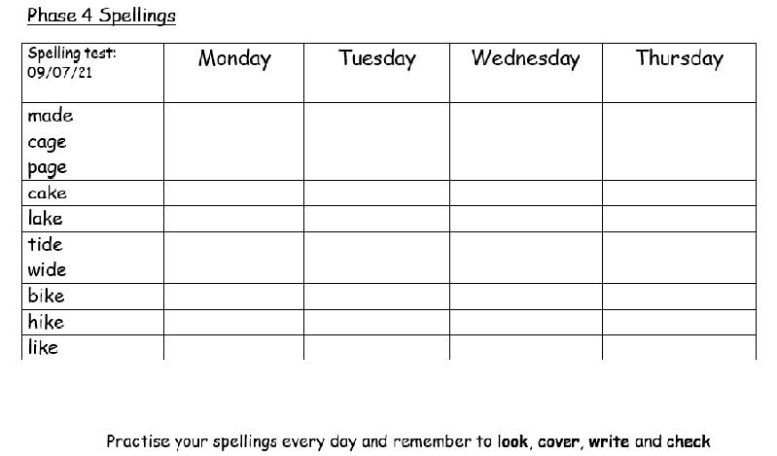
Spellings and homework
Weekly spellings will be sent home on a Monday.
Pupils will have the opportunity to practise these in class each morning but should also practise at home using look, cover, write and check. Staff can also provide other ways of practising these to be used at home.
We love to find out what you have been doing at home over the weekend. A worksheet will be sent home on a Friday for this to be returned on Monday for the pupil’s Weekend News session.

Slide 8
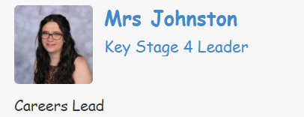
Other teaching staff in Owl class
Art – Thursday
Mrs Fernyhough
Social – Friday
Miss Johnston
Pupils should come to school in their PE every Thursday. Reminder that PE kit is dark tracksuit bottoms and a white t-shirt.

Slide 9
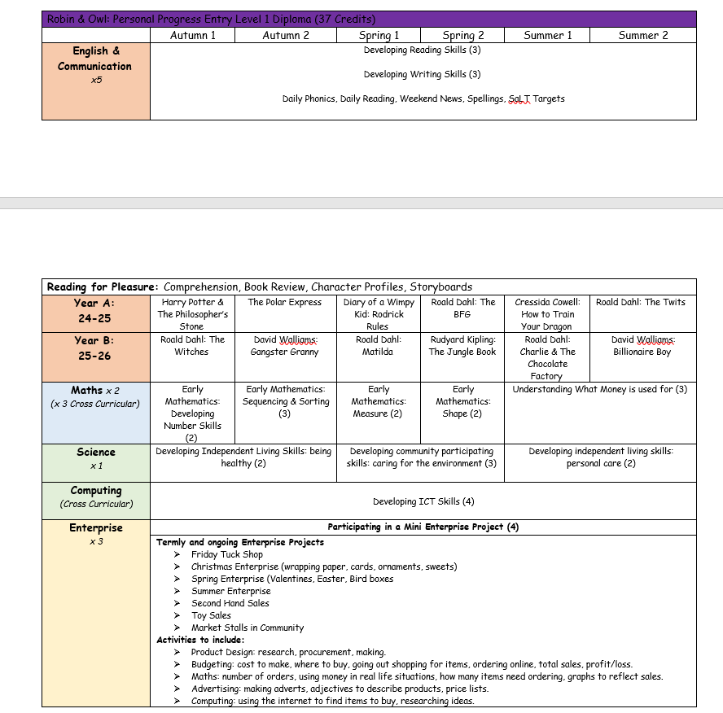
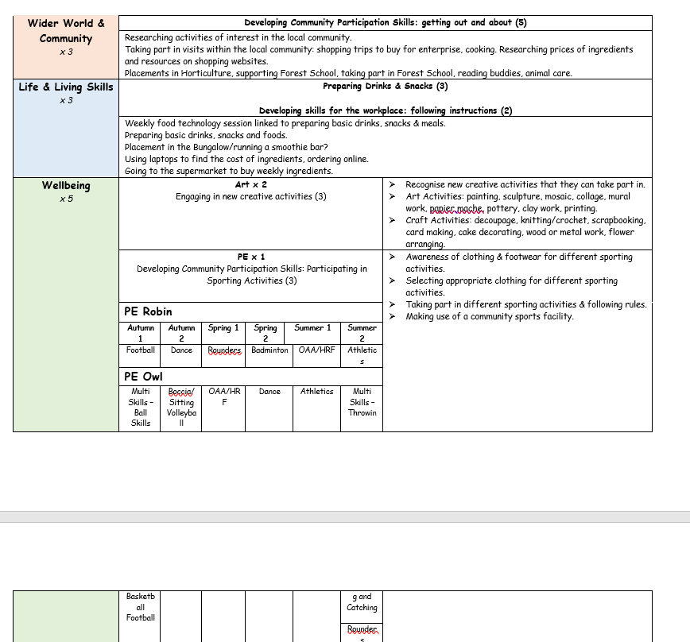
Owl Curriculum
The Owl curriculum includes all statutory subjects at Key Stage 4. This includes English, Maths, Science, Computing, Physical Education and PSHE.
In addition to this pupils are taught ASDAN.
ASDAN includes short courses which aim to develop personal, independent living and employability skills for young people with additional needs.

Slide 10
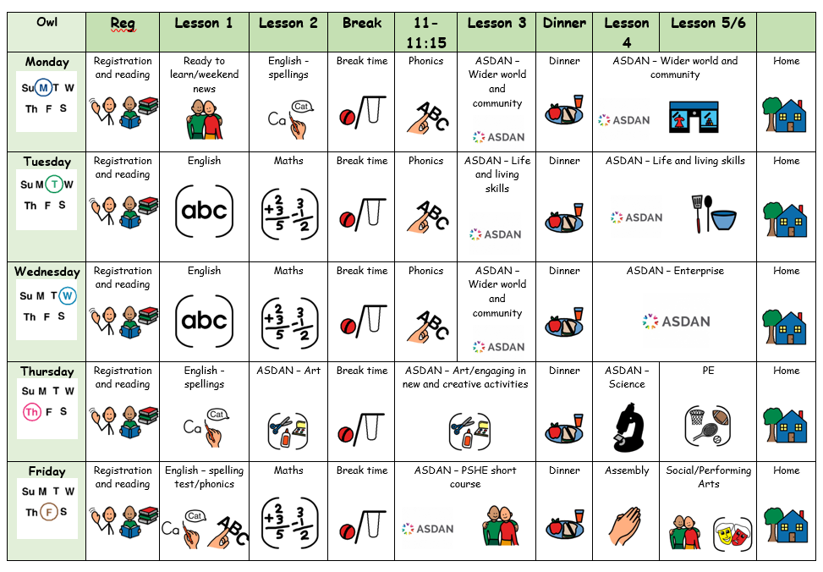
Owl Class weekly timetable

Slide 11
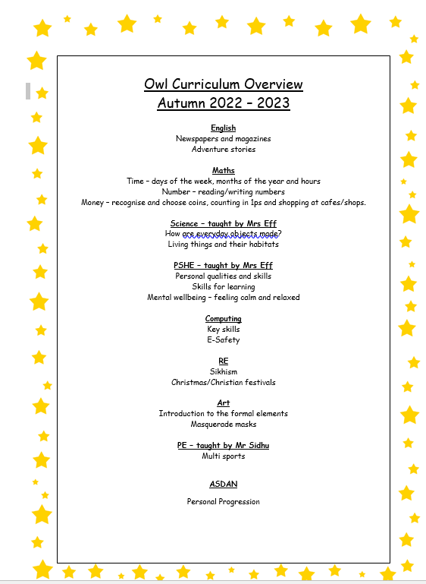
Termly overviews
At the beginning of each term you will be sent an overview showing what topics are being taught in each subject for that term.

Slide 12
Any questions?

Slide 13
Thank you for taking the time to join us this afternoon! As always your support is much appreciated.

