Slide 1
Welcome to
Bumblebee Class

Slide 2
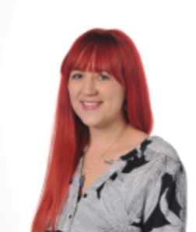
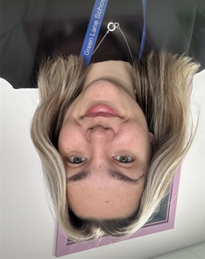
Meet the Team
Miss Shaw
Mrs Phillips
Miss Muir

Slide 3
Curriculum
Bumblebee is a KS1 classroom which includes Y1 and Y2 pupils following a creative curriculum - topic based learning.
It includes subjects such as English, Maths, Science, History, Geography, Computing, RE, PSHE, Art, Food Tech, DT, and Music.

Slide 4
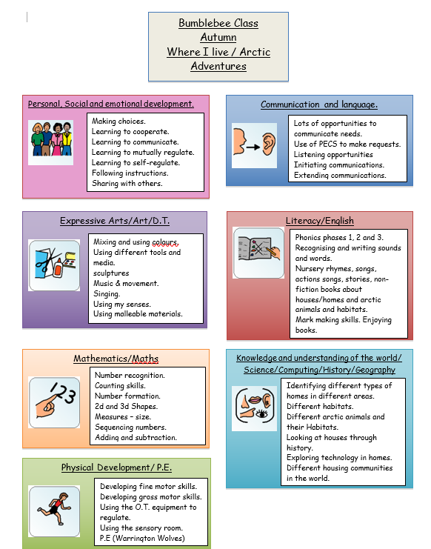
Overviews…
Each term you should receive an overview of the subjects/topics we will be covering.

Slide 5
We offer juice and toast in the morning, we ask for a £1.50 contribution per week if you want this option for your child.
Fruit and vegetables are offered at afternoon snack time.
Key info…

Slide 6
We have PE with Warrington Wolves - PE kit not necessary but PE pumps/trainers if you prefer.
Forest school - Spring term
Reading books - x2 a week in school then sent home for you to read with your child, changed as required.
Water bottles - can be kept in school if you prefer.
Key info…

Slide 7
Any questions?

Slide 8
Thank you for coming this afternoon!
We appreciate your support

