Slide 1
Welcome to Dragonfly 2024-25

Slide 2
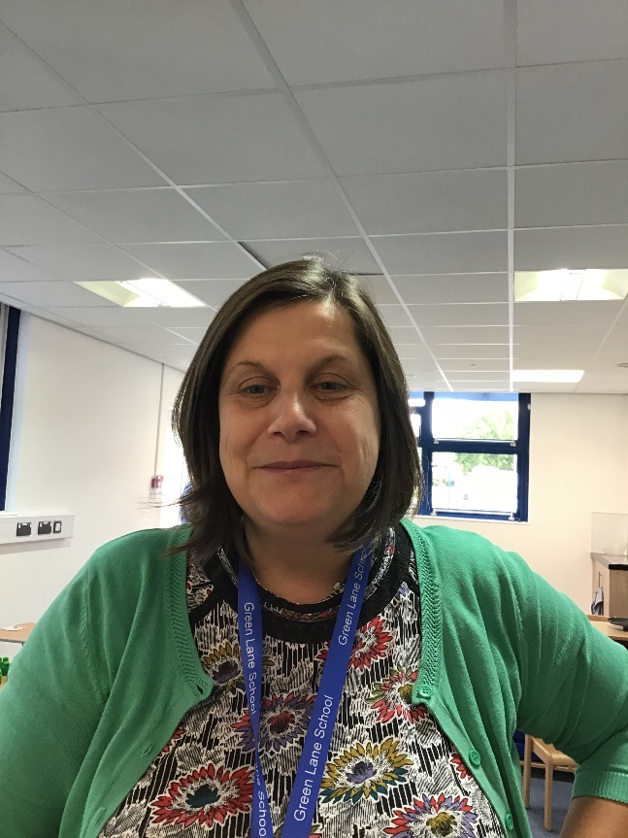
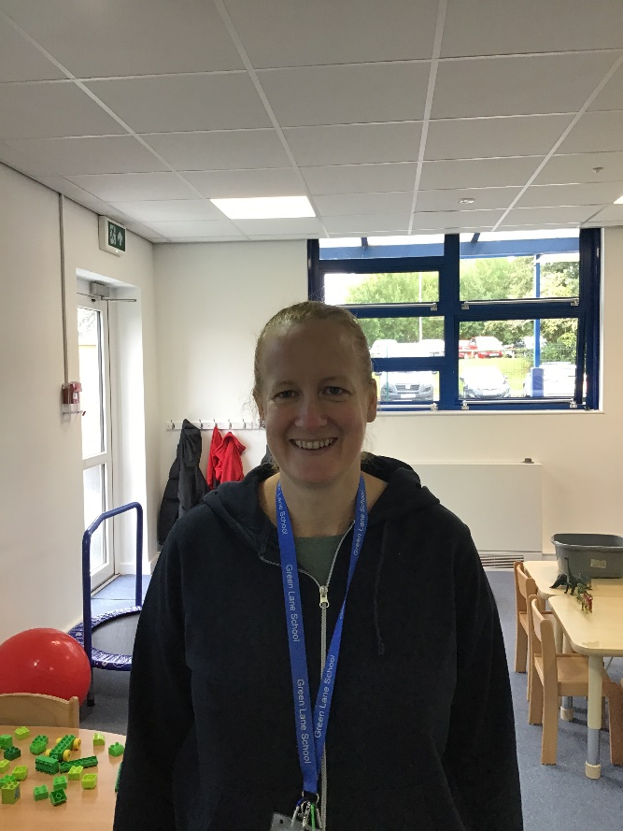
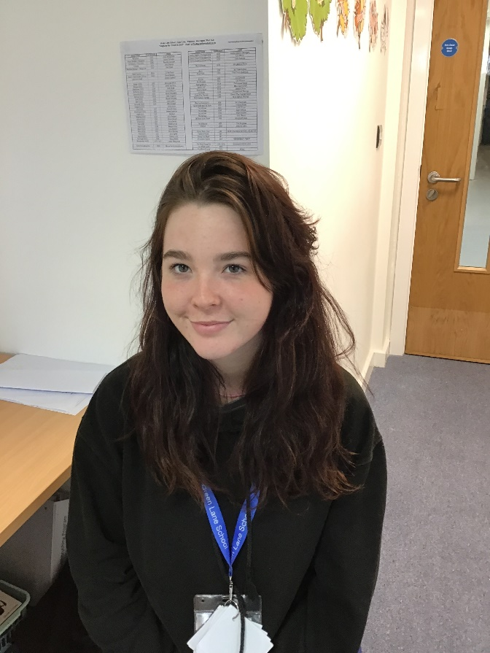
Introductions…
Mrs Smith
Mrs Beesley
Miss McHugh

Slide 3
On arrival…
Children are greeted by a member of staff at their bus or taxi if arriving by school transport and brought to class.
If a parent/carer are dropping off, then a staff member will also take them to class.
Children are going to be encouraged to hang their coats up before exploring the activities set out in the room.

Slide 4
What should pupils bring to school daily?
Pupils have been given a home/school communication book.
Please feel free to write any notes to class staff in here. Staff will use this to send messages home about how your child's day has gone.
A reading book to share together for pleasure will be sent home once a week. You can use the reading record to communicate how this has gone.
Water bottles to be brought in.

Slide 5
Snack
Children will have access to water and juice.
A contribution of £1:50 can be made for toast at the office, on a weekly basis.
All children have access to a piece of fruit daily as part of the fruit for schools system.
All children are entitled to free school meals. However, you can also provide them with a packed lunch or safe foods that they can have for lunch/snack.

Slide 6
Termly overviews
Save
fromabcstoacts.com
At the beginning of each term an overview of what we are covering will appear on the school website.
This half terms topic is All about me and colours.
.
All children have access to the sensory and the music room.
In the summer term the children will visit Woolston Sensory Centre and take part in Forrest school.

Slide 7
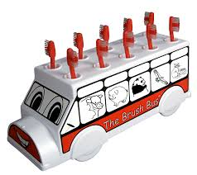
Brush bus
We are hoping to take part in the brush bus scheme, whereby children are encouraged to clean their teeth in school.
This will take place daily, after lunch break. Here is an information leaflet and the consent form if you would like them to take part.

Slide 8
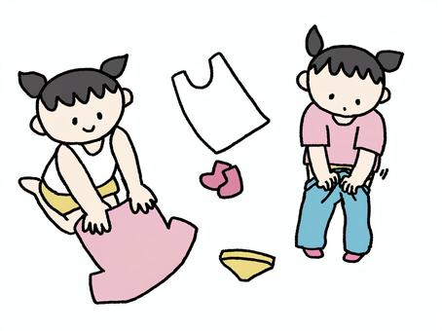
Additional Information
PE is on a Thursday ran by Warrington Wolves. No need for a kit.
The children will need several spare pairs of clothing in their school bags incase of accidents and messy play.
Nappies to be provided by yourself . As we are short on storage ideally 3 /4 per day, in their bag.

Slide 9
Support
The school have fantastic teams where by support is given with Speech and Language and Occupational Therapy (Shine). These services can be provided within the setting.
The safeguarding team are always available to support families, point you in the right direction and provide a variety of support.
No problem is too BIG. If you are concerned or worried or have any queries please reach out to the school.

Slide 10
Classroom
Our Dragonfly classroom is brand new. The outside area is a work in progress, which will hopefully be developed during October half term. Before then we will be sharing the outside area with the Ladybird class.

Slide 11
Questions

Slide 12
Thank you for taking the time to join us this afternoon! Your support is much appreciated.

