Slide 1
Welcome to Grasshopper Class

Slide 2
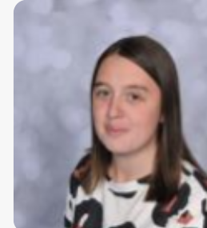
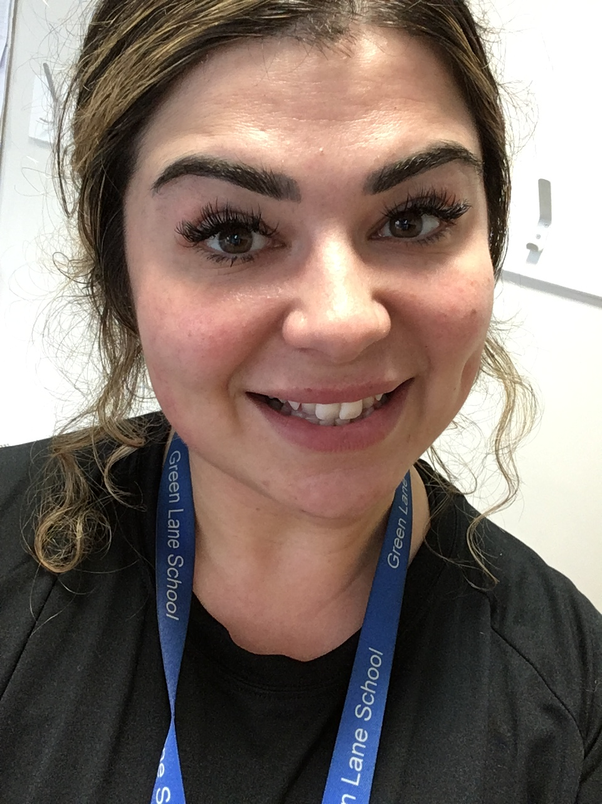
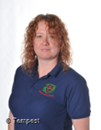
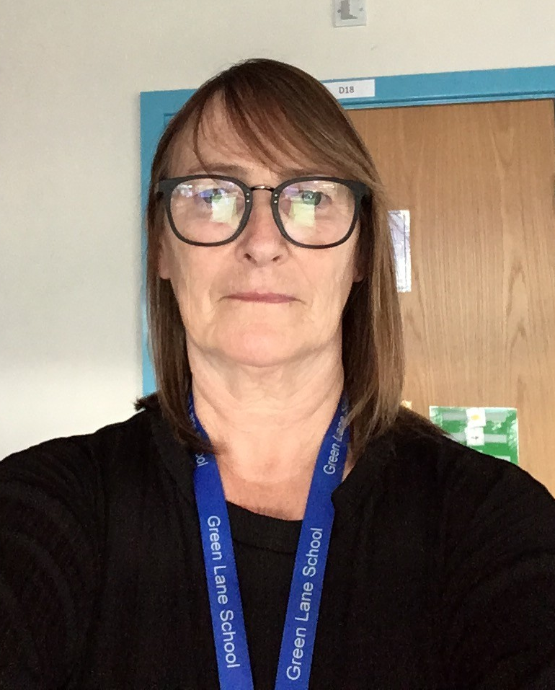
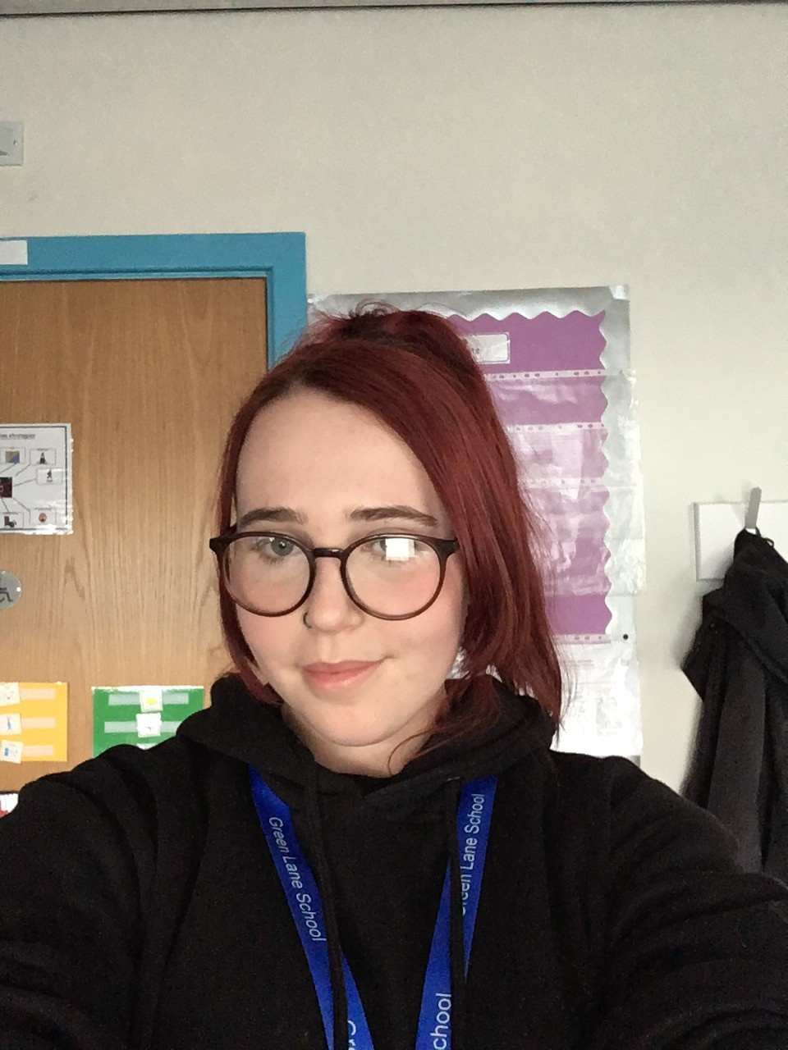
Introductions…
Miss Webster
Class Teacher
Miss Tye
Higher level Teaching Assistant
(PPA cover lead)
Mrs Golden
Teaching Assistant
Mrs Sweeney
Teaching Assistant
Miss Quirk
Teaching Assistant

Slide 3
Grasshopper class
A mix of reception and year one pupils.
All pupils have a diagnosis of autism and will follow our autism pathway across school.
In Grasshoppers we use engagement steps and use the SCERTS model which helps to track children's learning, focusing more on social communication and emotional regulation.
Structure and zones- visual timetable, zoned areas, outdoor and indoor continuous provision.
Sensory circuit of a morning and sensory room access twice weekly
Trips out into the community, sensory centre access in April time! Track walks,
Snack- PECS
ThePhoto by PhotoAuthor is licensed under CCYYSA.

Slide 4
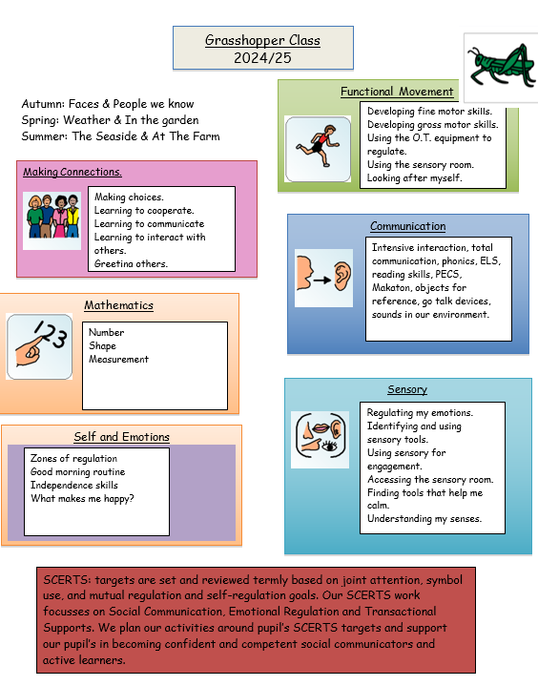
What we are doing in Grasshoppers...

Slide 5
Engagement model
exploration, realization, anticipation, persistence, and initiation
Measures pupil progress against new skills and engagement
Works towards progression steps

Slide 6
On arrival…
Pupils will take off their coats and bags and go to their timetable, settle in together time.
Low arousal, calm environment and sensory circuit.
Toast.

Slide 7
What should pupils bring to school daily?
Home school book
Coat
PE Kit- stay in school and go home each term
Reading books and records will start to go home next week
Buddy the Bear- weekly
Lunch box, snack, water bottles.
Toast money if you would like your child to have toast (£1.50 per week)

Slide 8
Additional information...
Our PE day is on a Tuesday morning
We have sensory room slots twice a week
April time we will be going to the sensory centre.
A contribution of 50p- £1 per week towards snacks/baking (the fun stuff) is received with thanks as school do not fund this. (Please note: this is voluntary!)

Slide 9
SHINE (Lisa and Sophie)
Parent talks
OT reports
Sensory supports
Restrictive eating

Slide 10
SALT

Slide 11
SCERTS
Social Communication
Emotional Regulation
Transactional Supports
Curriculum
Targets
SCERTS clinics
EFL

Slide 12
SCERTS Parents groups
Working together with your children in the school environment and out in the community.
Working with school to develop consistent approaches and strategies.
Common themes and challenges.
Talks with our OT
Emotional regulation advice
Heading to the local supermarket
Eating out in a restaurant

Slide 13
NAS Advanced School

Slide 14
EFL & Website
Please check EFL to see your child’s work and progress in school. You are more than welcome to pictures from home- we love sharing with the children the photos you upload :)
There is an autism section on the website in which we keep up to date.
Class information
Communication via home school book or class email.
Class email: grasshopperclass@greenlaneschool.co.uk

Slide 15
Any questions?

