Slide 1
Welcome to Squirrel Class

Slide 2
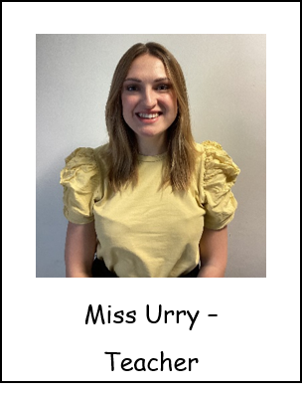
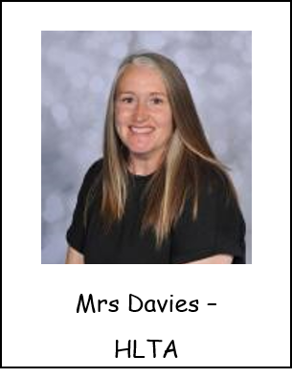
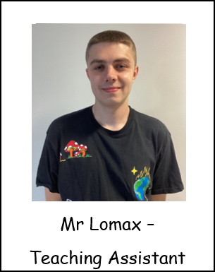
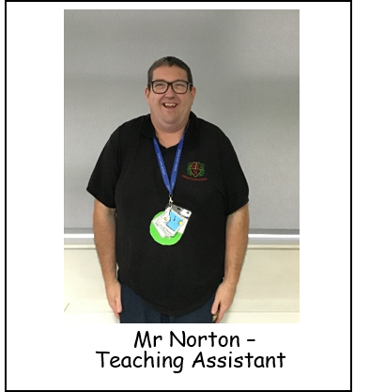
Introductions…

Slide 3
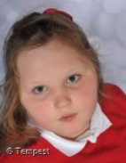
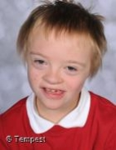
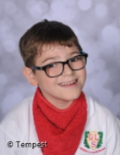
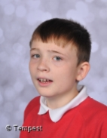
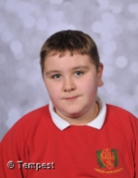
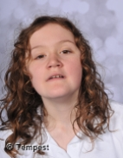
Squirrel Class is a Key Stage 3 class made up of pupils from years 7 and 8.

Slide 4
Our School Day
Pupils arrive at school
All pupils participate in individual OT circuits or fine motor activities
Good Morning Routine/Greetings/Feelings
OT Walk
Lesson 1&2 - Teacher lead input – work based activities – Teacch Baskets (intensive interactions)- Indoor and outdoor continuous provision.
Snack time
Break time
Lesson 3
Lunch time
Break time
OT Walk
Lesson 4&5 - Teacher lead input – work based activities – Teacch Baskets (intensive interactions)- Indoor and outdoor continuous provision.
Snack Time
Home Time

Slide 5
Snack and Dinner
We have a healthy choice of fruit, breadsticks and crackers in the morning then the same in the afternoon but with a choice of a biscuit as well
We will be going to the shop to buy our snack next term
We ask for a voluntary £1 a week towards this
We have a menu with three yummy choices including chips on a Friday!
Your child can have food on any day, all days or none at all!

Slide 6
What should pupils bring to school daily?
Each child has been given a home-school diary. Staff will write in these every day and please pass on any messages from home.
Reading books will be sent home with a reading record book, please record anything that you read with your child in this book. It doesn’t have to be only the reading book we send home!
Books will be changed as required.
Water bottles are provided in school but please feel free to send one in with your child if you want to.

Slide 7
Curriculum
Squirrel Class is on the Maple Pathway within school which means we use a sensory based learning environment. Please send a small selection of spare clothes with the pupils in case our learning gets messy! The curriculum focuses on achieving the 5 key skills of the engagement model: exploring, realising, anticipating, persisting and initiating.
We support pupils through a total communication approach and highly structure our day to promote independence and choice making. Our children have access to both indoor and outdoor activities, as well as trips and visits.

Slide 8
Enhancements
We have PE on a Monday afternoon taught by Warrington Wolves
Forest School – we will be having our sessions on a Tuesday afternoon during the second half of the Summer Term
This year we are going to introduce story massage into our weekly timetable
We have an Attention Autism lesson twice a week
We have slots in the Sensory Room twice a week
We aim to go shopping as often as we can to buy snack items, we ask for a voluntary donation of £1 towards this
We have music with Mr Higham on a Friday afternoon
We have Gardening on a Thursday morning during our Spring term

Slide 9
The Engagement Model
Engagement Model: 5 Areas
The children are assessed on their engagement in the task. They won’t always need to be showing all 5 areas to be engaging and making progress.
Exploration
Anticipation
Initiation
Realisation
Persistence

Slide 10
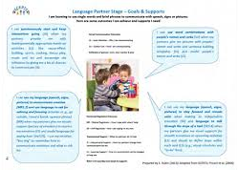
SCERTS
The first SCERTS clinic will be held during parents evening

Slide 11
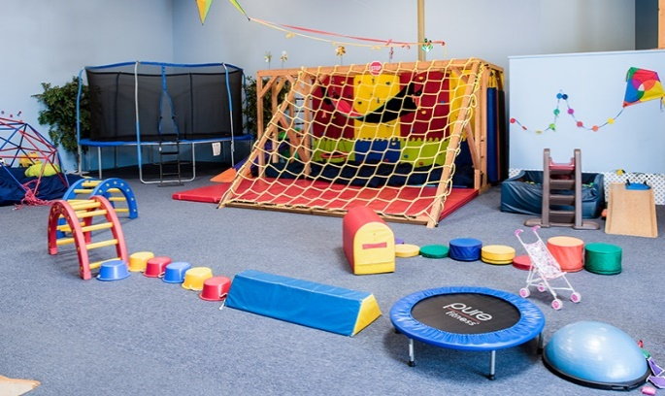
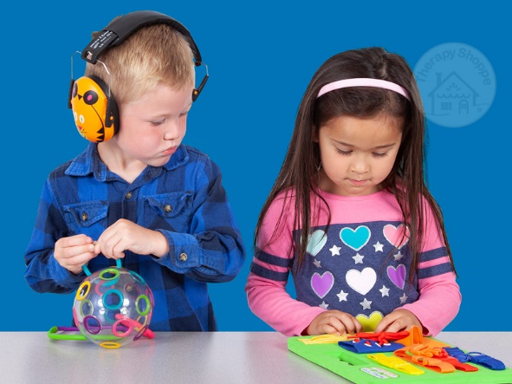
OT Therapy
Shine therapy are our new OT.
They are here twice a week to advise and write new OT plans for the children.

Slide 12
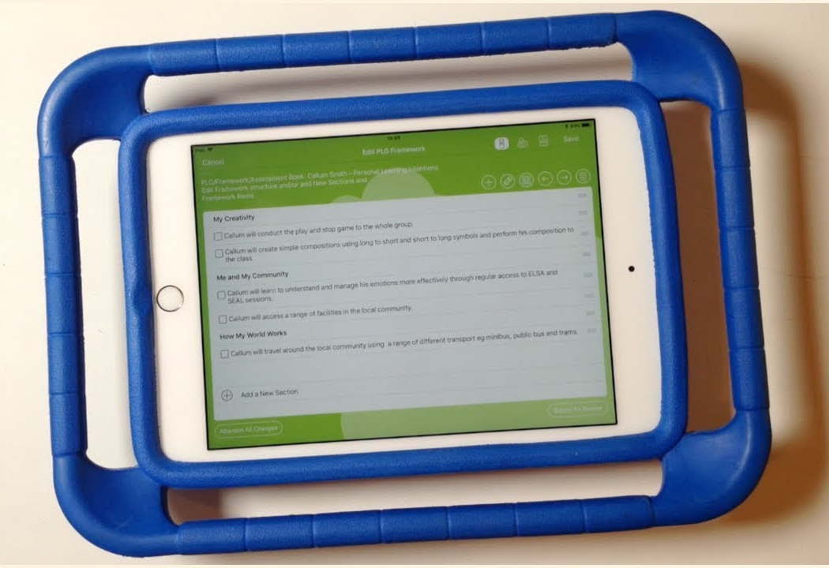
EFL
If you don’t know your log in details please
Let school know so you can access EFL.

Slide 13
Sent out half termly with SCERTS targets and ideas to help.
Loading photos to EFL will be really helpful.
Reading books will be sent out weekly to be returned by Thursday.

Slide 14
Any questions?

Slide 15
Thank you for taking the time to join us this afternoon! As always your support is much appreciated.

