Slide 1
Welcome to : Daisy class

Slide 2
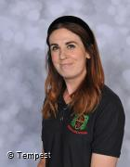
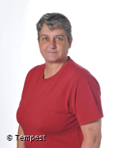
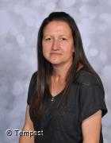
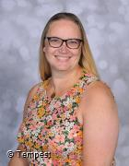
Class team

Slide 3
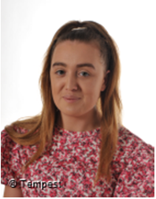
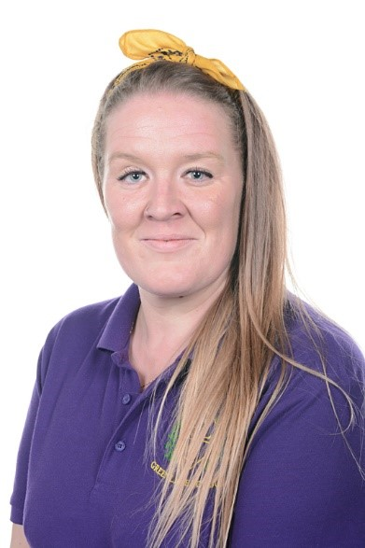
Cover supervisors

Slide 4
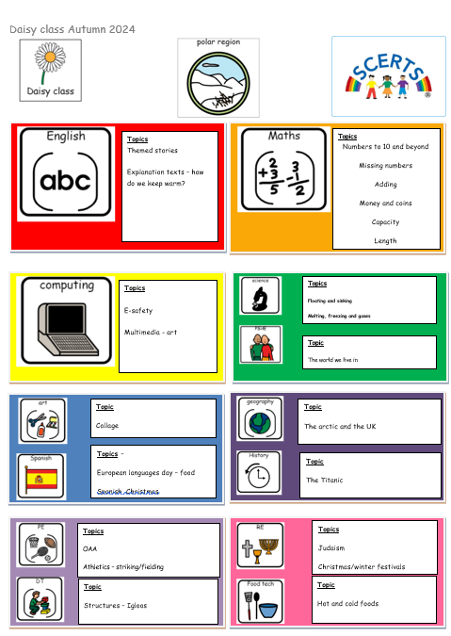
Medium term topics

Slide 5
SNACK

Slide 6
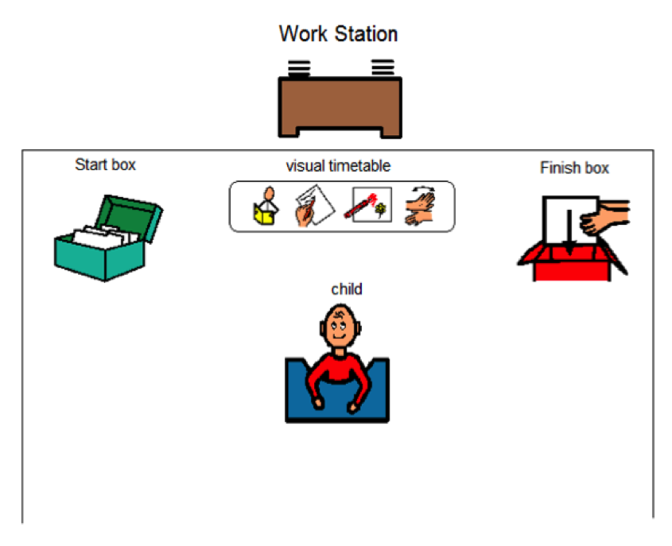
TEACCH

Slide 7
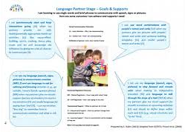
SCERTS
The first SCERTS clinic will be held during parents evening. SCERTS parent groups are held regularly and offer help, support and a place to get to know other parents.

Slide 8
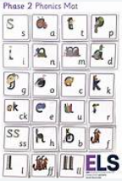
Phonics
Phonics is delivered each day in 1:1 intervention sessions.

Slide 9
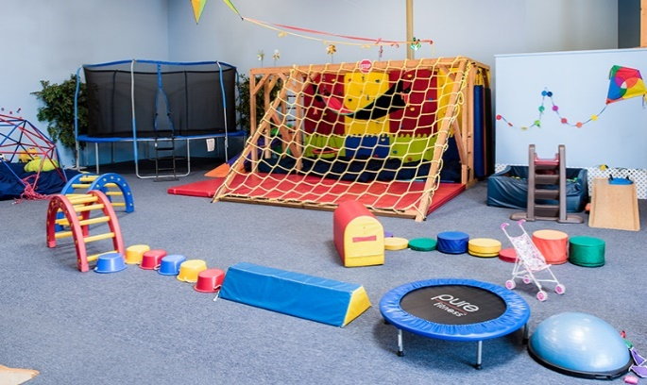
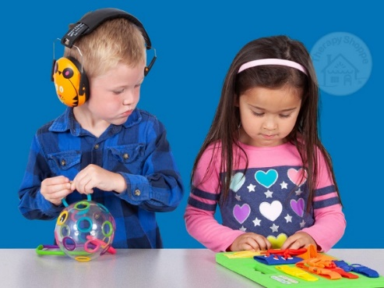
OT/sensory
Shine therapy are our OT support.
They are here once a week to advise and write new OT plans for the children.
We do OT twice a day along with two walks and OT integrated into the daily routine for any ‘snacks’ the children need. We also access the sensory room 2x a week.

Slide 10
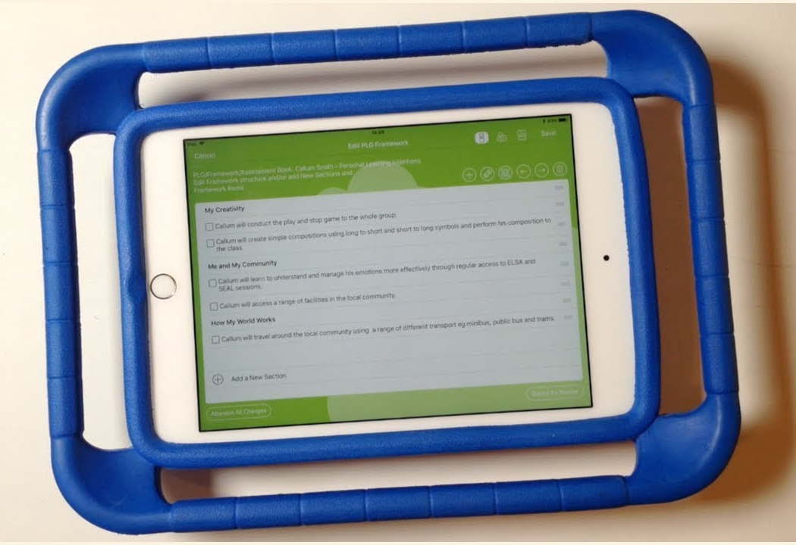
EFL
If you don’t know your log in details please
Let school know so you can access EFL.

Slide 11
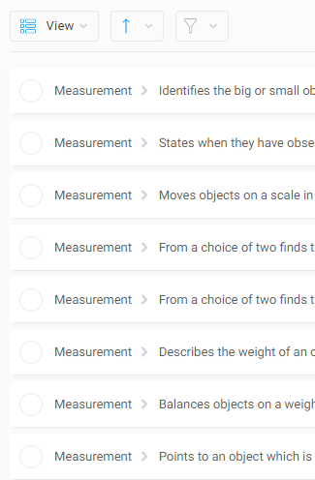
IEPs
Last year we moved from p levels on bsquared to progression steps
IEP’s will only have 1 target

Slide 12
Homework
Sent out termly with SCERTS targets and ideas to help.
Loading photos to EFL will be really helpful.
Reading/spellings will be sent out weekly to be returned by Thursday.

Slide 13
Curriculum enhancements

Slide 14
Any questions?

