Slide 1
Welcome to Poppy Class 24-25

Slide 2
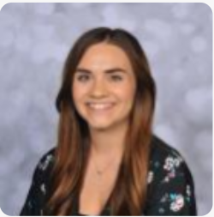
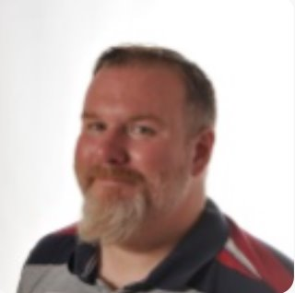
Introductions…
Miss Collins
Mr Murty
Miss Yoyo

Slide 3
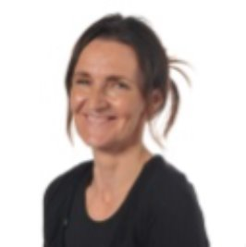
Introductions…
Mrs Grimes (1:1 support)
Miss Butler
(1:1 support)

Slide 4
Poppy Class is a KS2 class made up of year 5 and year 6 pupils

Slide 5
Willow Pathway
Pupils in this pathway require a curriculum which has topic led focuses with cross-curricular links. Phonics and maths lessons are taught discretely.
In the Willow Pathway, we take a creative approach to delivering the curriculum. Children will have access to both practical learning and workbook learning.

Slide 6
On arrival…
Toast, juice and water are available on arrival for the children to enjoy! Snack at the end of the day is also offered for children to have!
Pupils can bring a bottle to leave in school, however we do have cups.
A contribution of £1.50 per week towards toast is received with thanks to school and a 50p contribution for snack is appreciated as school do not fund this.

Slide 7
Forest School
Mrs Lothrop runs Forest School sessions. We are taking part in Forest School in Autumn 2. Forest School will be on a Thursday and we ask if the children can bring suitable clothes and wellies.

Slide 8
PE
PE is on a Thursday afternoon and delivered by Warrington Wolves.
*For the first half term, PE will be on a Tuesday morning due to our trip to the sensory centre on a Thursday.

Slide 9
Equipment
All equipment is provided by school. Pupils each have access to equipment within the classroom.

Slide 10
What should pupils bring to school daily?
Pupils have all been given a home-school diary.
These are used for school/home communication. Please feel free to write any notes to class staff in here. Staff will also use the diary to pass on any messages home, please check these daily.
Reading books and records are given in line with pupils phonics assessments. We aim to read with your child on a 1:1 basis 3x each week. Please record in the reading record when you have read with your child at home.
Books will be changed as required.
Please bring a water bottle to school everyday.

Slide 11
Any questions?

Slide 12
Thank you for taking the time to join us this afternoon! As always your support is much appreciated.

