Slide 1

Welcome to Daffodil
2024-2025

Slide 2
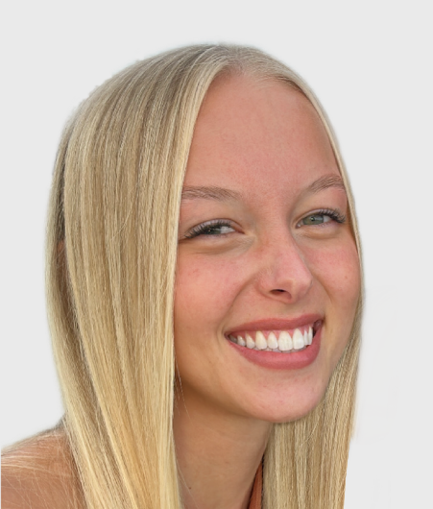
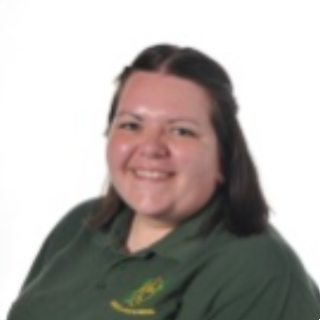
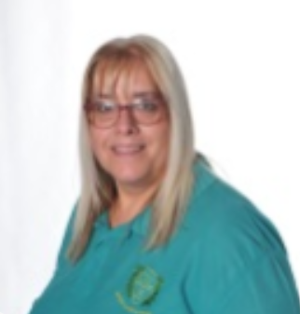

Introductions…
Miss Stappard
Miss Sudworth
Mrs McKenna
Mr Higham

Slide 3
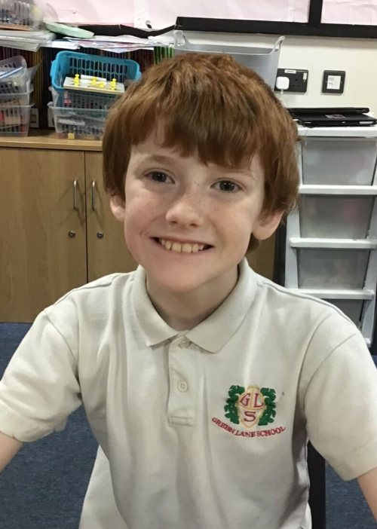
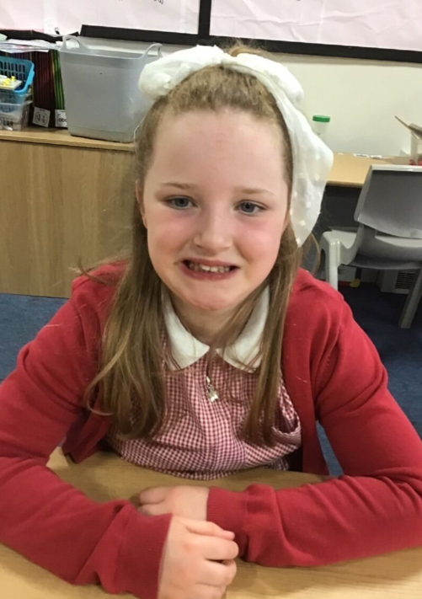
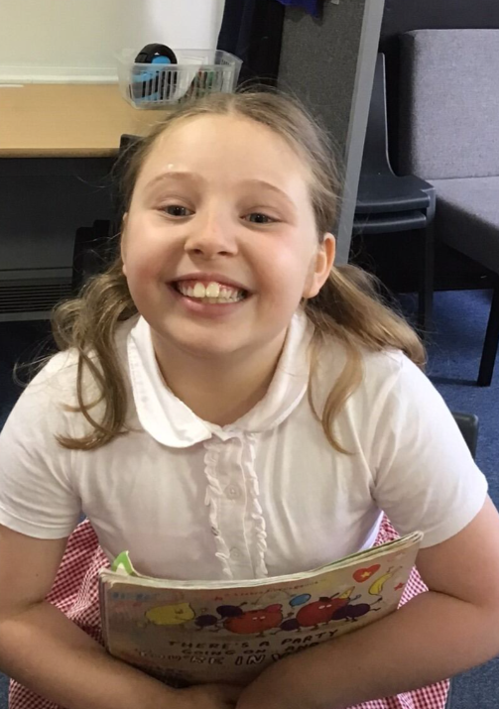
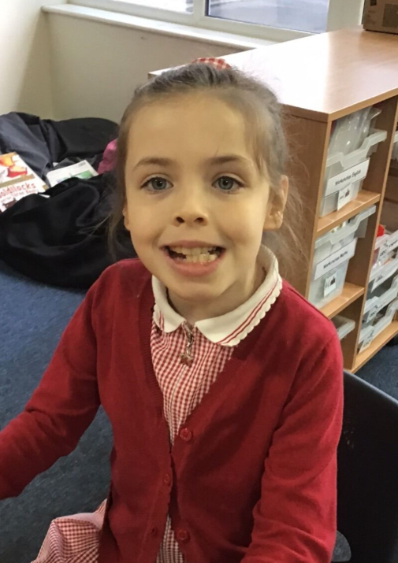
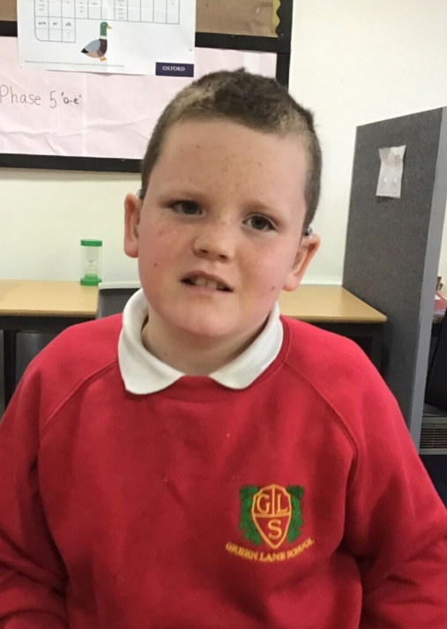
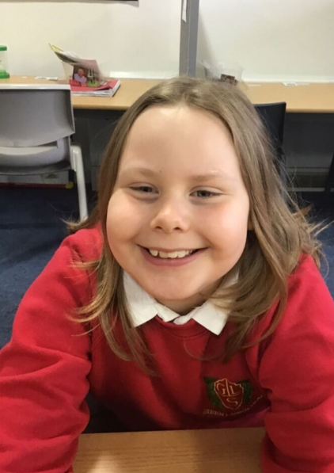
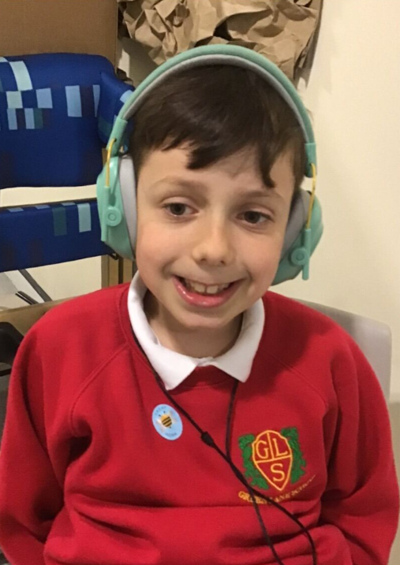
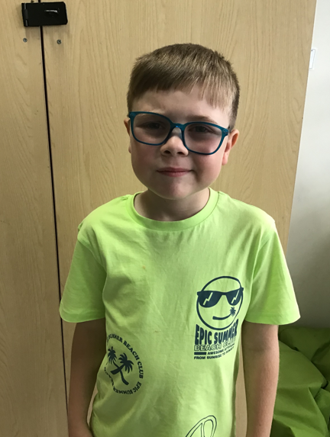
Daffodil is a KS2 class made up of Year 4, Year 5 and Year 6 pupils.

Slide 4
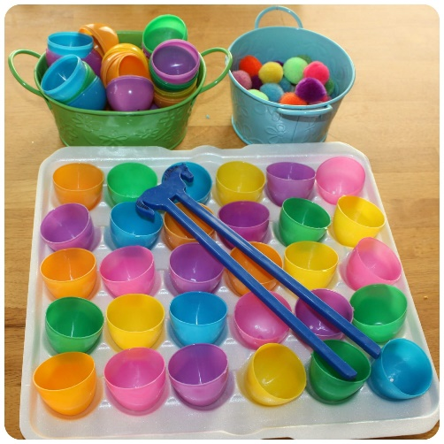
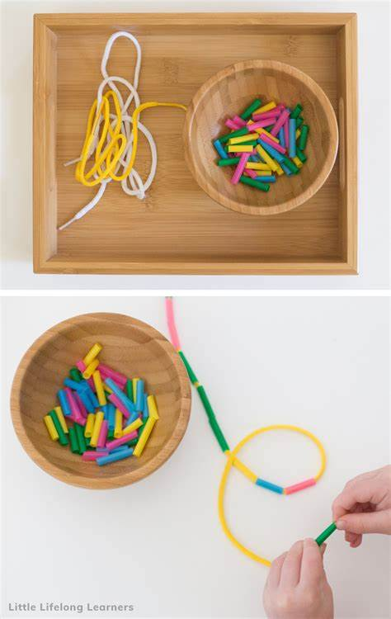

On arrival…
When the children arrive, they take part in fine motor activities. These are changed each day.
We have a snack during this time. Your child can have some toast or they can bring in their own snack if preferred.

Slide 5

Equipment
All equipment is provided by school. We have everything that the children could possibly need in class!

Slide 6



What should pupils bring to school daily?
Pupils have all been given a home-school book for communication. Please feel free to write any notes to class staff in here. Staff will also use planners to pass on any messages home, please check these daily.
Reading books and records are given in line with pupils phonics assessments. Please record in the reading record when you have read with your child at home. These will be sent home on a Monday.
Books will be changed weekly.
Water bottles should be brought into school.

Slide 7
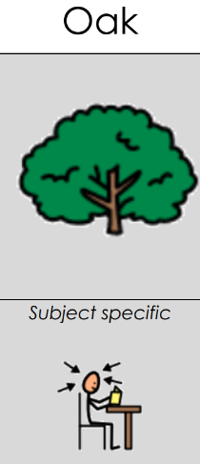
Curriculum
The Oak Pathway curriculum includes a a subject specific curriculum where subjects are taught discretely.

Slide 8



Spellings and homework
Weekly spellings will be sent home on a Friday. There is a weekly spelling test each Monday.
English and Maths (alternate) homework is sent home every Friday. Pupils should return this on a Monday morning.

Slide 9

Any questions?

Slide 10

Thank you for taking the time to join us this afternoon! We really appreciate your support.

