Slide 1


Welcome to : Grasshopper Class

Slide 2



Class team
Mr Sykes
Mrs Beesley
Miss Leigh

Slide 3
School Day
Pupils arrive at school
All pupils participate in individual OT circuits
Good Morning Routine/Greetings
Breakfast
Lesson 1&2 - Teacher lead input – work based activities – Teacch Baskets (intensive interactions)- Indoor and outdoor continuous provision. Linked to Topic
Break time
Lesson 3 Attention Autism/Phonics/Sensory Room
Lunch time – We eat in class
Break time
OT Walk around green mile – weather permitting
Lesson 4&5 - Teacher lead input – work based activities – Teacch Baskets (intensive interactions)- Indoor and outdoor continuous provision. Linked to Topic
Snack Time
Home Time

Slide 4
Enhancements
We have PE on a Friday afternoon taught by Warrington Wolves
Forest School – we will be having our sessions during the first half of the Summer Term.
Swimming – This usually takes place in the Spring 2 Term
This year we are going to introduce story massage into our weekly timetable we will try to complete this during our end of day routine.
We have an Attention Autism lesson everyday.
We have slots in the Sensory Room twice a week.
We aim to go shopping as often as we can.
We have music with Mr Higham on a Monday morning.
Music Live sessions will take place in our first half term.
We will visit the Sensory Centre at the end of the first half term and the beginning of the second.
Trips out of school will happen throughout the year.

Slide 5
The Engagement Model
Engagement Model: 5 Areas
The 5 areas are not hierarchical, so there is no expectation that pupils need to demonstrate progress in all 5 areas. Instead, each of the areas represent what is necessary for pupils to fully engage in their learning and reach their full potential. The areas also provide the scaffolding to enable pupils to become independent in learning a new skill or concept.
Exploration
This shows whether a pupil can build on their initial reaction to a new stimulus or activity, for example, whether they display more than an involuntary or startled reaction to the activity. Additionally, the pupil may be interested in and curious about the stimulus or activity, for example, they may notice it or reach out to it.
Exploration becomes more established when the pupil is still responsive to the same stimulus or activity when it is presented in different contexts or environments, for example, a different time of day, a different place or with different people.
Exploration is important in identifying which stimuli or activities interest the pupil and motivate them to pay attention and investigate them further, so that they can develop new knowledge and skills.

Slide 6
The Engagement Model
Realisation
This shows how the pupil interacts with a new stimulus or activity or discovers a new aspect of a familiar stimulus or activity. They will display behaviours that show they want more control of the stimulus or activity, for example by stopping it or trying to make changes to it. The pupil will often show what familiar adults consider to be ‘surprise’, ‘excitement’, ‘delight’, ‘amazement’ or ‘fear’.
Realisation becomes more established when the pupil uses the newly developed skills or knowledge in new ways and in different contexts or environments. This is important as it can keep the pupil excited in their learning and prevents an activity from becoming routine.
Anticipation
This shows how much the pupil predicts, expects or associates a stimulus or activity with an event. They may anticipate that a familiar activity is about to start or finish by interpreting cues or prompts such as auditory (what they hear), tactile (what they feel) and visual (what they see).
Anticipation becomes more established when the pupil shows awareness that a familiar activity is about to start or finish, even when cues and prompts are reduced.
Anticipation is important in measuring the pupil’s understanding of cause and effect, for example if they do this, then something will happen. This prepares the brain for learning and helps with the pupil’s memory and sequencing.

Slide 7
The Engagement Model
Persistence
This shows whether the pupil can sustain their attention in a stimulus or activity for long enough that they can actively try to find out more and interact with it.
Persistence becomes more established when the pupil shows a determined effort to interact with the stimulus or activity. They will do this by showing intentional changes such as changes in their gaze, posture and hand movement.
Persistence is important so that the pupil maintains an activity long enough to develop and reinforce learning. It also helps the pupil apply their skills or knowledge so they can achieve their desired outcome.
Initiation
This shows how much, and the different ways, a pupil investigates a stimulus or activity in order to bring about a desired outcome. The pupil will act spontaneously and independently during a familiar activity without waiting for direction.
Initiation becomes more established when the pupil shows they understand how to create an impact on their environment in order to achieve a desired outcome.
Initiation is important to establish how well the pupil is developing independence, which is required for more advanced learning.

Slide 8
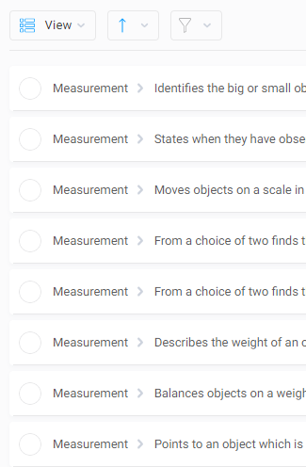

IEPs
We now link our IEP Targets with individual EHCP plans.

Slide 9

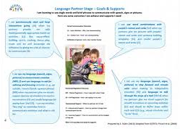
SCERTS
The first SCERTS clinic will be held during parents evening in a few weeks and will take place every time a new IEP has been written. Parents will be invited to 3 Class based sessions throughout the Year.

Slide 10

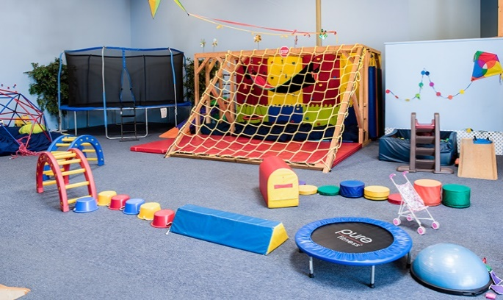
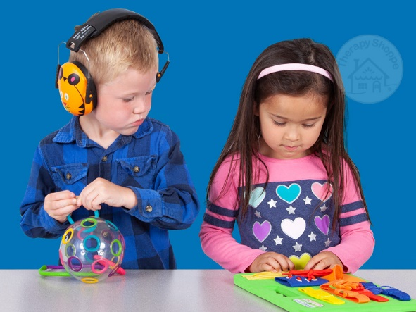
OT
Shine therapy are our OT providers.
OT takes place everyday in class and pupils have access to sensory input and sensory snacks when needed throughout the day.
They are here twice a week to advise and write new OT plans for the children.

Slide 11

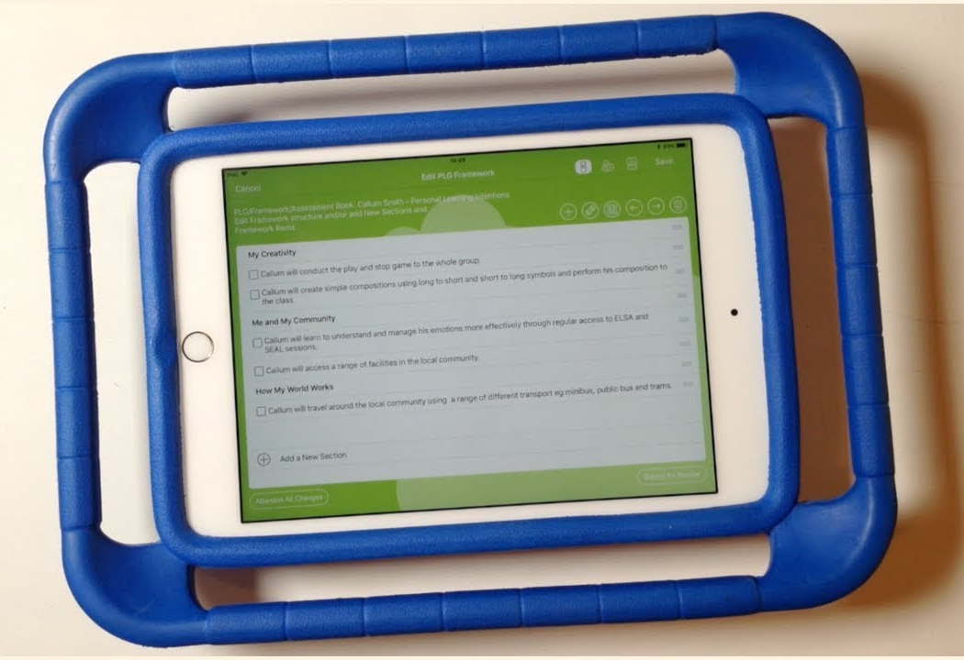
EFL
If you don’t know your log in details please
Let school know so you can access EFL.

Slide 12

Homework
Sent out termly with SCERTS targets and ideas to help.
Loading photos to EFL will be really helpful.

Slide 13
