Slide 1

Welcome to Rose Class

Slide 2
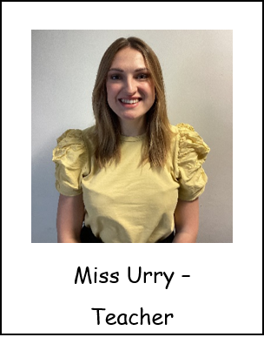

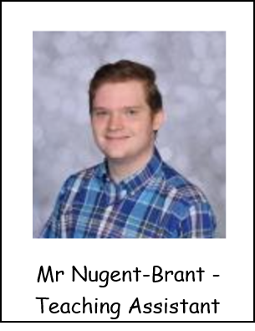

Introductions…
Ms Williams -
Teaching Assistant

Slide 3
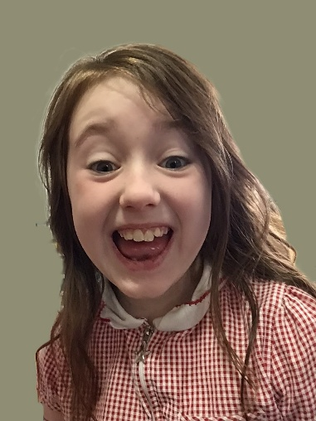
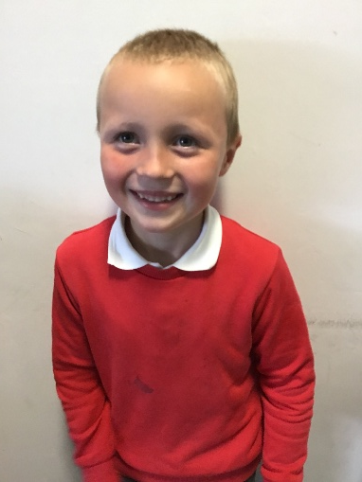
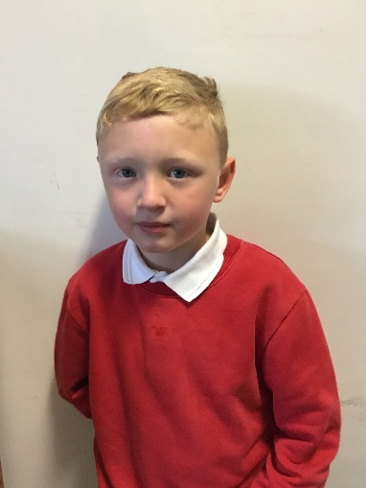
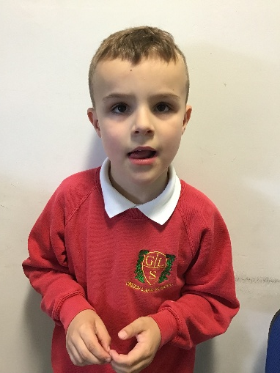
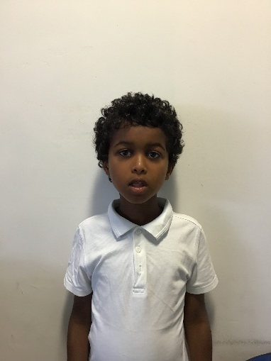
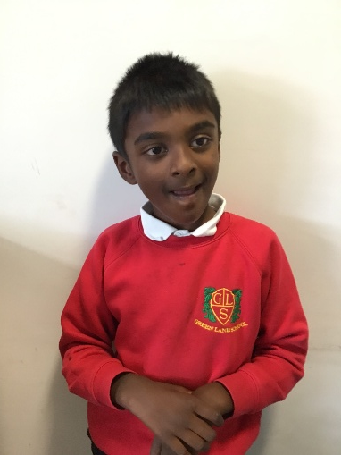
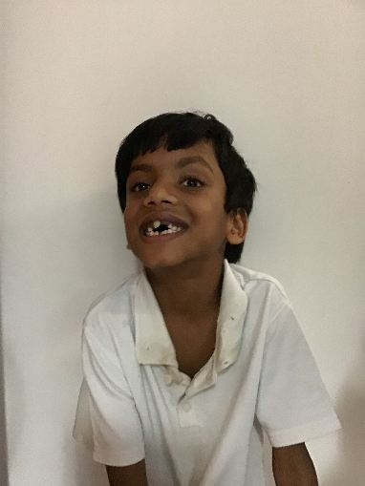
Rose Class is a Key Stage 2 class made up of pupils from years 3, 4 and 5.

Slide 4

Our School Day
Pupils arrive at school
All pupils participate in individual OT circuits and Phonics activities
Good Morning Routine/Greetings
OT Walk
Lesson 1&2 - Teacher lead input – work based activities – TEACCH Baskets (intensive interactions)- Indoor and outdoor continuous provision.
Snack time
Break time
Lesson 3 - Teacher lead input – work based activities (Sensory Room Tues and Thurs)
Lunch time
Break time
OT, Tooth brushing and OT Walk
Lesson 4&5 - Teacher lead input – work based activities – TEACCH Baskets Baskets (intensive interactions)- Indoor and outdoor continuous provision.
Snack Time
Home Time

Slide 5
Enhancements
We have PE on a Monday afternoon taught by Warrington Wolves
Forest School – we will be having our sessions on a Wednesday morning during the first half of Autumn Term
We have Story Massage integrated into our timetable
We have an Attention Autism lesson twice a week
We have slots in the Sensory Room twice a week
We aim to go shopping as often as we can to buy snack items, we ask for a voluntary donation of £1 towards this
We have music with Mr Higham on a Monday morning
We have Karate in the first half of our Summer Term
We will visit the Sensory Centre during our Spring Term

Slide 6



What should pupils bring to school daily?
Each child has been given a home-school diary. Staff will write in these every day and please pass on any messages from home.
Reading books will be sent home with a reading record book, please record anything that you read with your child in this book. It doesn’t have to be only the reading book we send home!
Books will be changed as required.
Water bottles are provided in school but please feel free to send one in with your child if you wish to.

Slide 7
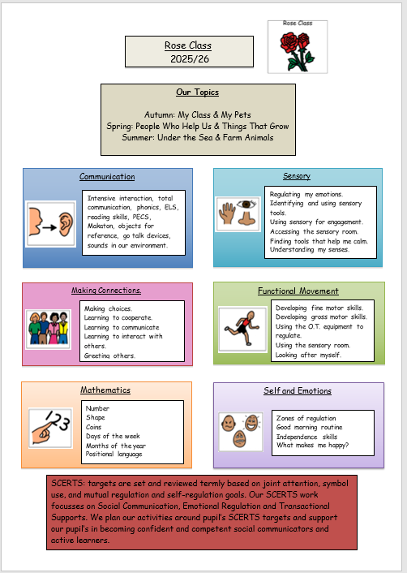
Curriculum
Rose Class is on the Maple Pathway within school which means we use a sensory based learning environment. Please send a small selection of spare clothes with the pupils in case our learning gets messy! The curriculum focuses on achieving the 5 key skills of the engagement model: exploring, realising, anticipating, persisting and initiating.
We support pupils through a total communication approach and highly structure our day to promote independence and choice making. Our children have access to both indoor and outdoor activities, as well as trips and visits.

Slide 8
The Engagement Model
Engagement Model: 5 Areas
The 5 areas are not hierarchical, so there is no expectation that pupils need to demonstrate progress in all 5 areas. Instead, each of the areas represent what is necessary for pupils to fully engage in their learning and reach their full potential. The areas also provide the scaffolding to enable pupils to become independent in learning a new skill or concept.
Exploration
This shows whether a pupil can build on their initial reaction to a new stimulus or activity, for example, whether they display more than an involuntary or startled reaction to the activity. Additionally, the pupil may be interested in and curious about the stimulus or activity, for example, they may notice it or reach out to it.
Exploration becomes more established when the pupil is still responsive to the same stimulus or activity when it is presented in different contexts or environments, for example, a different time of day, a different place or with different people.
Exploration is important in identifying which stimuli or activities interest the pupil and motivate them to pay attention and investigate them further, so that they can develop new knowledge and skills.

Slide 9
The Engagement Model
Realisation
This shows how the pupil interacts with a new stimulus or activity or discovers a new aspect of a familiar stimulus or activity. They will display behaviours that show they want more control of the stimulus or activity, for example by stopping it or trying to make changes to it. The pupil will often show what familiar adults consider to be ‘surprise’, ‘excitement’, ‘delight’, ‘amazement’ or ‘fear’.
Realisation becomes more established when the pupil uses the newly developed skills or knowledge in new ways and in different contexts or environments. This is important as it can keep the pupil excited in their learning and prevents an activity from becoming routine.
Anticipation
This shows how much the pupil predicts, expects or associates a stimulus or activity with an event. They may anticipate that a familiar activity is about to start or finish by interpreting cues or prompts such as auditory (what they hear), tactile (what they feel) and visual (what they see).
Anticipation becomes more established when the pupil shows awareness that a familiar activity is about to start or finish, even when cues and prompts are reduced.
Anticipation is important in measuring the pupil’s understanding of cause and effect, for example if they do this, then something will happen. This prepares the brain for learning and helps with the pupil’s memory and sequencing.

Slide 10
The Engagement Model
Persistence
This shows whether the pupil can sustain their attention in a stimulus or activity for long enough that they can actively try to find out more and interact with it.
Persistence becomes more established when the pupil shows a determined effort to interact with the stimulus or activity. They will do this by showing intentional changes such as changes in their gaze, posture and hand movement.
Persistence is important so that the pupil maintains an activity long enough to develop and reinforce learning. It also helps the pupil apply their skills or knowledge so they can achieve their desired outcome.
Initiation
This shows how much, and the different ways, a pupil investigates a stimulus or activity in order to bring about a desired outcome. The pupil will act spontaneously and independently during a familiar activity without waiting for direction.
Initiation becomes more established when the pupil shows they understand how to create an impact on their environment in order to achieve a desired outcome.
Initiation is important to establish how well the pupil is developing independence, which is required for more advanced learning.

Slide 11
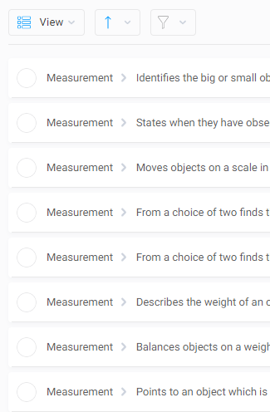

IEPs
We now link our IEP Targets with individual EHCP plans.

Slide 12

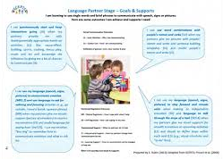
SCERTS
The first SCERTS clinic will be held during parents evening

Slide 13

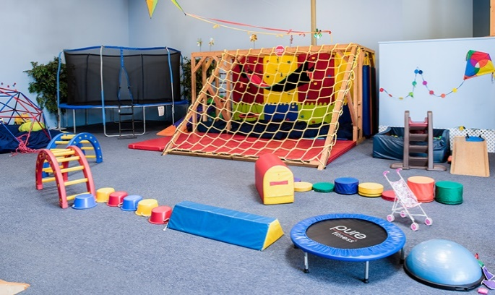
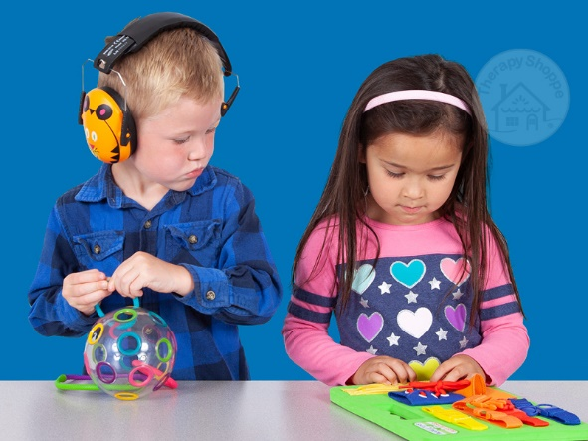
OT
Shine therapy are our new OT.
They are here twice a week to advise and write new OT plans for the children.

Slide 14

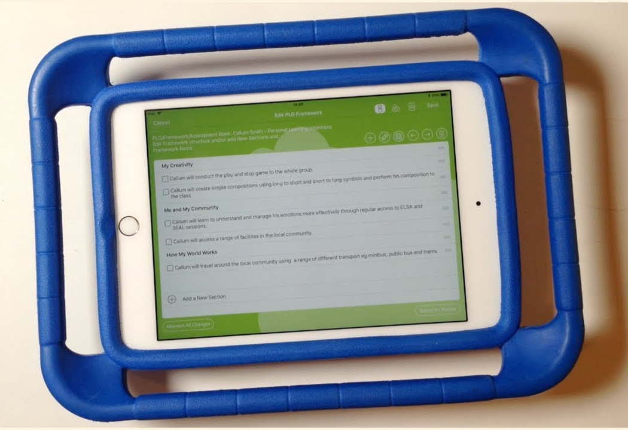
EFL
If you don’t know your log in details please
Let school know so you can access EFL.

Slide 15

Sent out half termly with SCERTS targets and ideas to help.
Loading photos to EFL will be really helpful.
Reading books will be sent out weekly to be returned by Thursday.
Weekly newsletters will be sent home on a Friday, these don’t need to be returned every week.

Slide 16

Any questions?

Slide 17

Thank you for taking the time to join us this afternoon! As always your support is much appreciated.

