Slide 1

Welcome to Owl Class 2025 - 2026

Slide 2
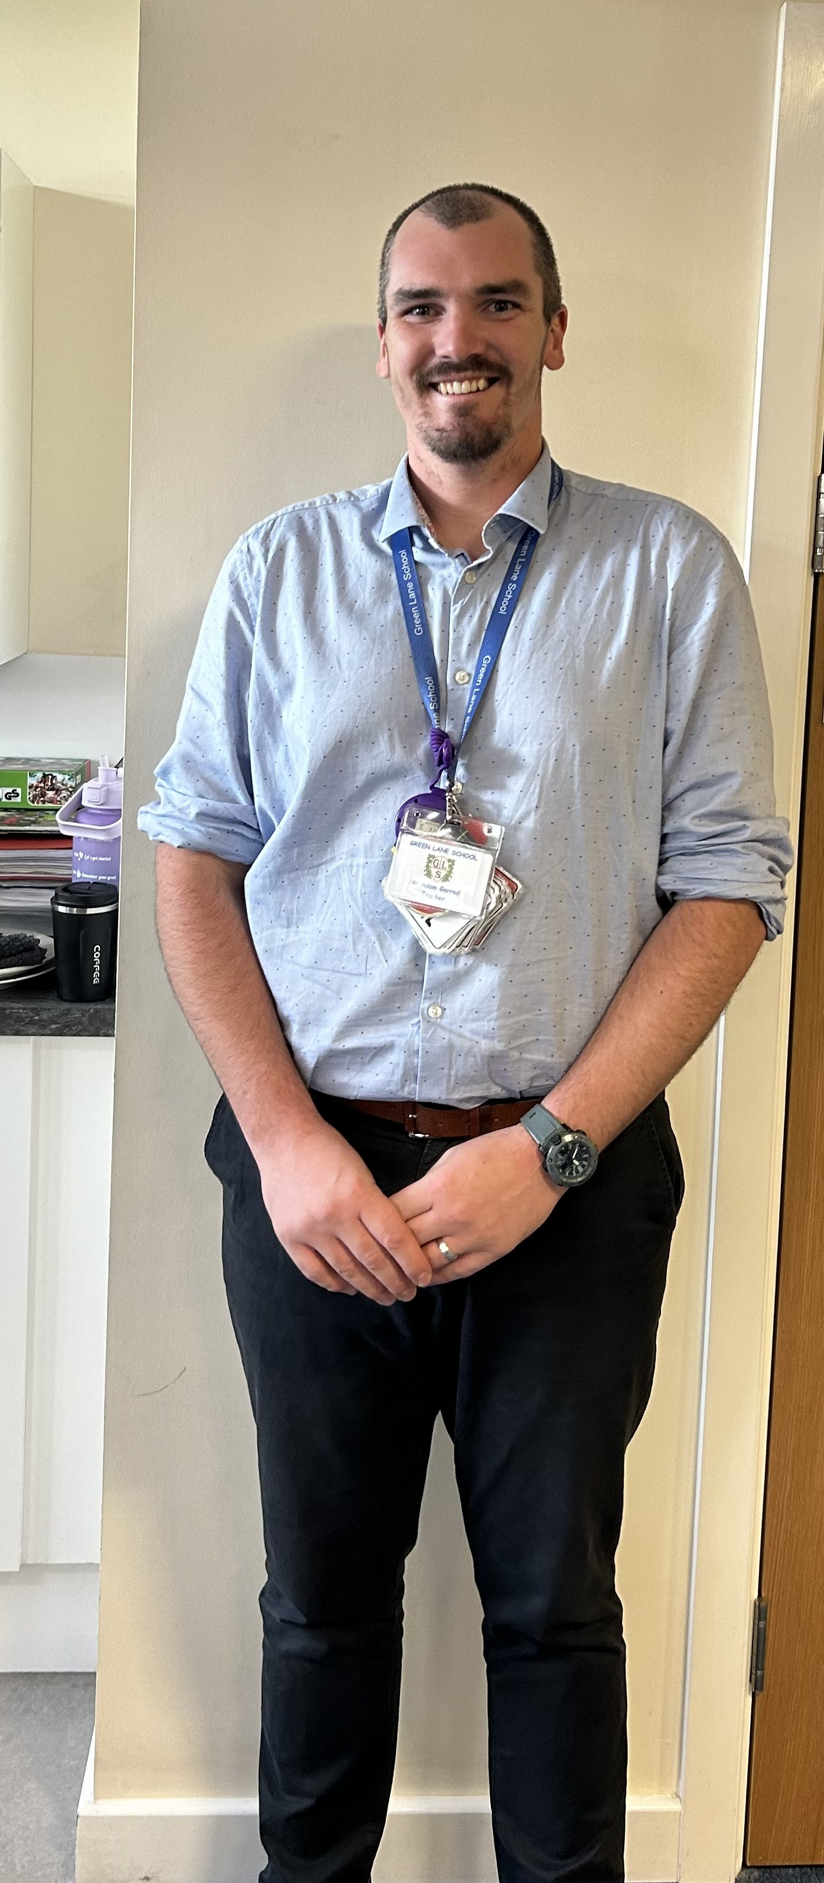
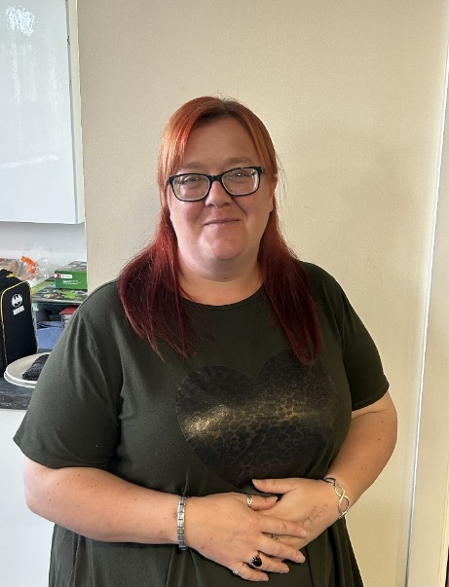
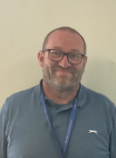
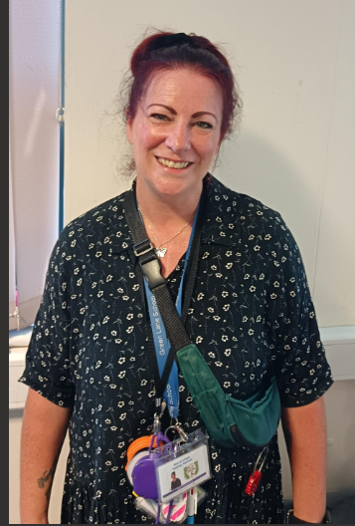
Introductions…
Miss Mclarney (Mac) TA
Mr Cartwright
1:1 TA
Miss Lythgoe
1:1 TA
Mr Garrod Teacher

Slide 3
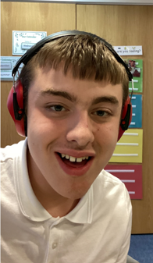
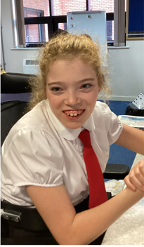
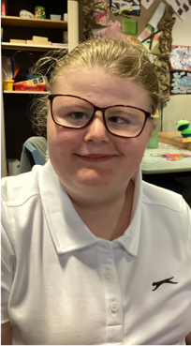
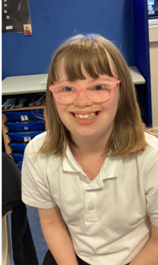
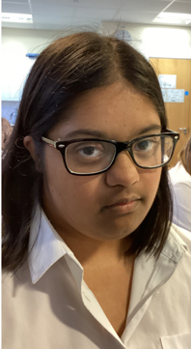
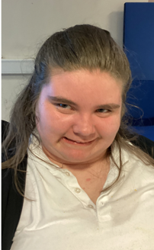

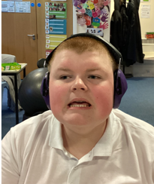

Owl Class is a Key Stage 4 class made up of pupils from both years 10 and 11.

Slide 4


On arrival…
Toast and cold drinks are available on arrival. Cold drinks include water or sugar free squash. We also have a healthy afternoon snack.
Pupils can bring a cup/water bottle to leave in school however we do have spares.
A contribution of £1 per week towards this cost (included in snack money) is received with thanks as school do not fund this.

Slide 5

Equipment
All equipment is provided by school. Pupils each have their own pencil pot which contains everything that they could possibly need in class.

Slide 6


What should pupils bring to school daily?
The children have a school/home communication book. Please feel free to write any notes to class staff in here. Staff will also use planners to pass on any messages home, please check these daily.
Reading books and records are given in line with pupils phonics assessments. We aim to read with your child on a 1:1 basis 2x each week. Please record in the reading record when you have read with your child at home.
Books will be changed as required.
.

Slide 7
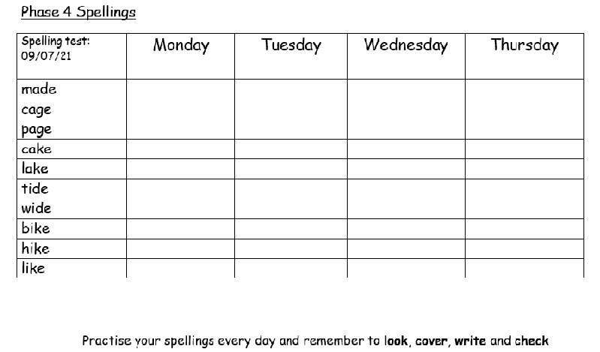
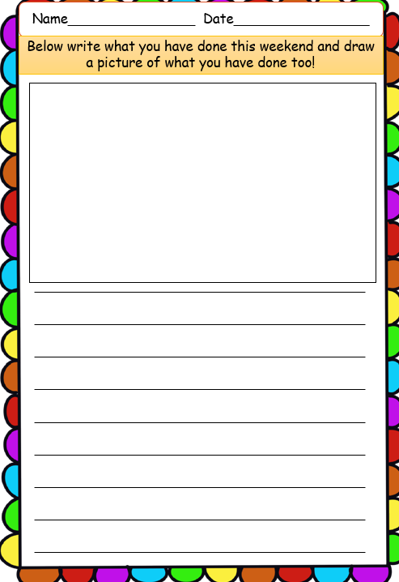
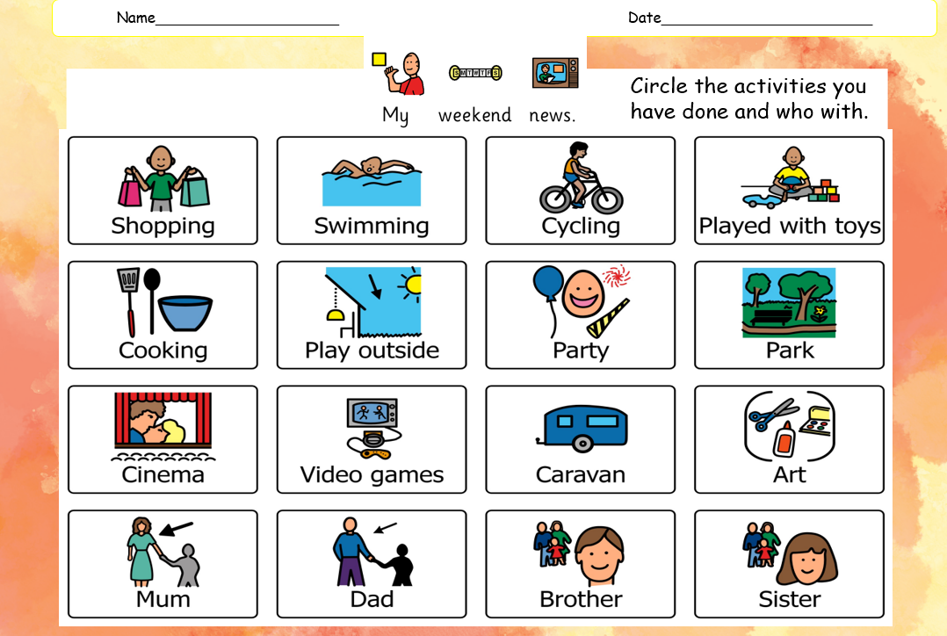
Spellings and homework
We love to find out what you have been doing at home over the weekend. A worksheet will be sent home on a Friday for this to be returned on Monday for the pupil’s Weekend News session.
Some pupils will receive spelling words to practise at home on a Monday ready for a spelling test on a Friday.

Slide 8
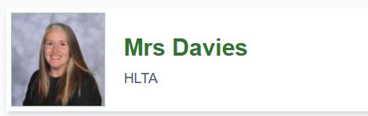

Other teaching staff in Owl class
Mrs Davies (Dave) will be teaching Art on a Monday afternoon and Handwriting on a Tuesday morning.
Pupils should come to school in their PE every Friday. Reminder that PE kit is dark tracksuit bottoms/shorts and a white t-shirt.

Slide 9
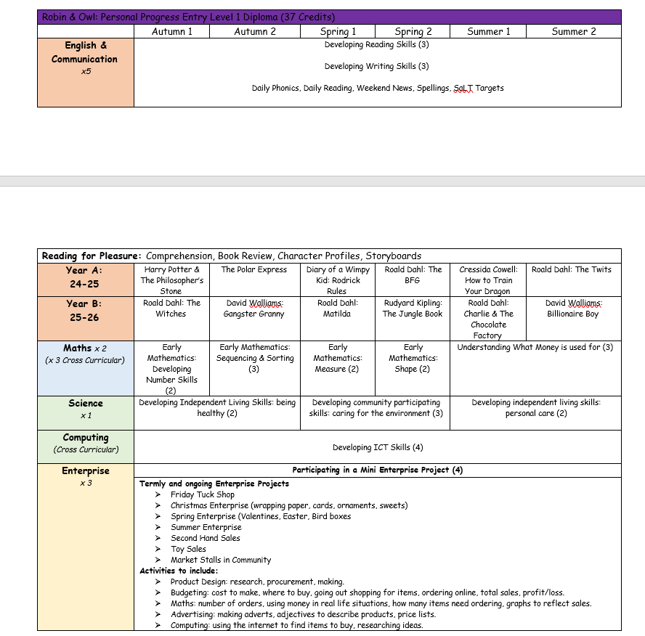
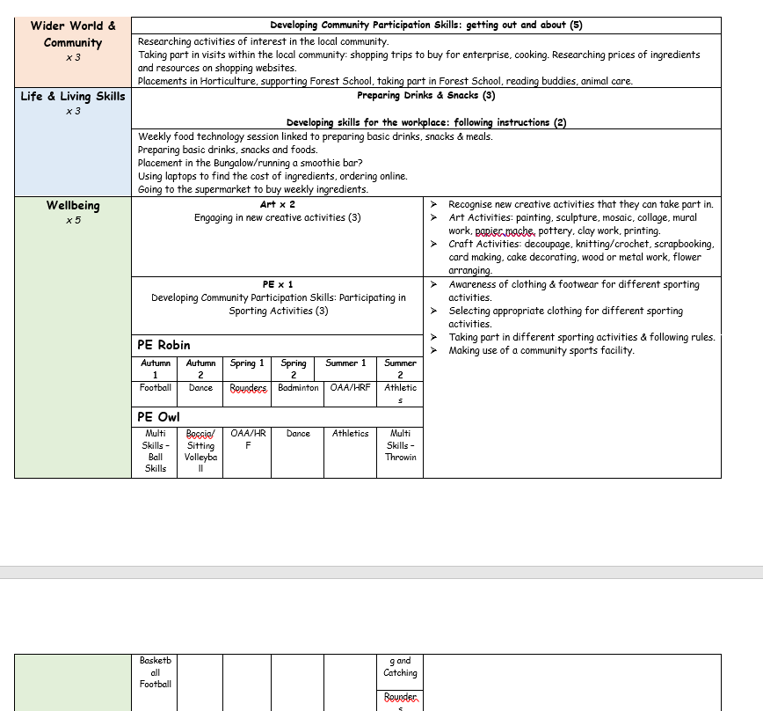
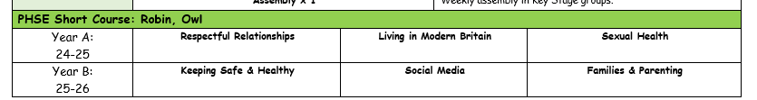
Owl Curriculum
The Owl curriculum includes all statutory subjects at Key Stage 4. This includes English, Maths, Science, Computing, Physical Education and PSHE.
In addition to this pupils are taught ASDAN.
ASDAN includes short courses which aim to develop personal, independent living and employability skills for young people with additional needs.

Slide 10

ASDAN Personal Progress
Who is it for?
The qualifications have been developed for learners working towards and at Entry 1 to have their achievements recognised within a qualification framework. They can be undertaken in schools, colleges, residential and day care services, training providers and independent provision.
Personal Progress (PP) is available for delivery in England, Wales and Northern Ireland.

Slide 11
ASDAN Personal Progress
The class team choose units from the topics of Employability, Independent living, Good health, and Community inclusion. There are 58 units available, with credit values of between 2 credits and 5 credits each.
Any combination of units can be completed for a Personal Progress qualification.
Learners achieve a qualification that reflects the credit value of the number of units they have completed:
Award – 8 credits
Certificate – 14 credits
Extended Certificate – 25 credits
Diploma – 37 credits
Learners who complete units with a total value less than 8 credits will be awarded unit certification, providing they meet the requirements of the full units

Slide 12
ASDAN Personal Progress
Name of module | Credit value
Reading | 3
Writing | 3
Number | 2
Sequencing and sorting | 3
Money | 3
Being healthy | 2
Shape | 2
Measure | 2
Personal care | 2
Mini Enterprise | 4
Getting out and about | 5
Name of module | Credit value
Preparing drinks and snacks | 3
Following instructions | 2
Engaging in new and creative activities | 3
Total | 39

Slide 13
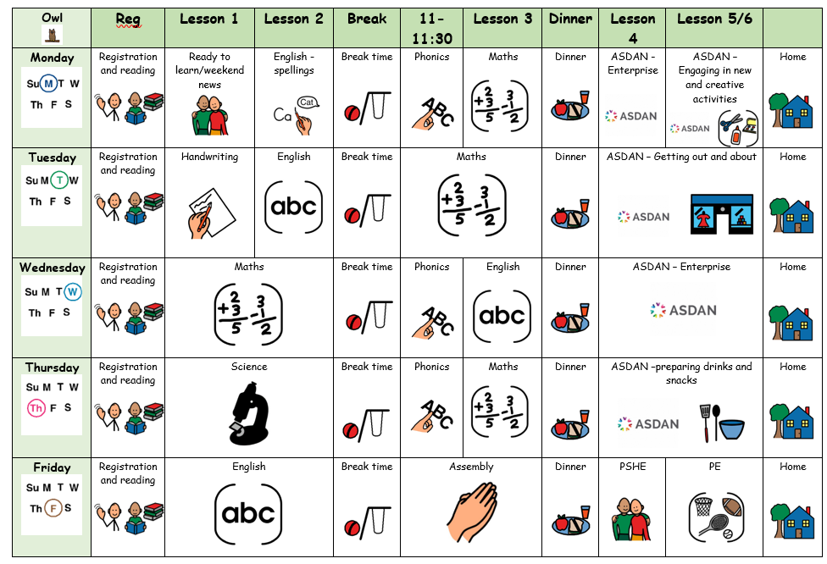
Owl Class weekly timetable

Slide 14

Any questions?

Slide 15

Thank you for taking the time to join us this afternoon! As always your support is much appreciated.

