Slide 1


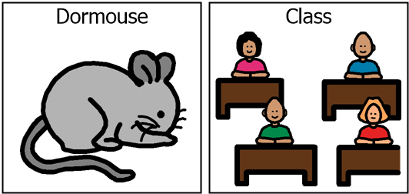
Welcome to Dormouse Class
2025-2026

Slide 2
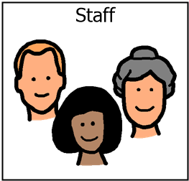
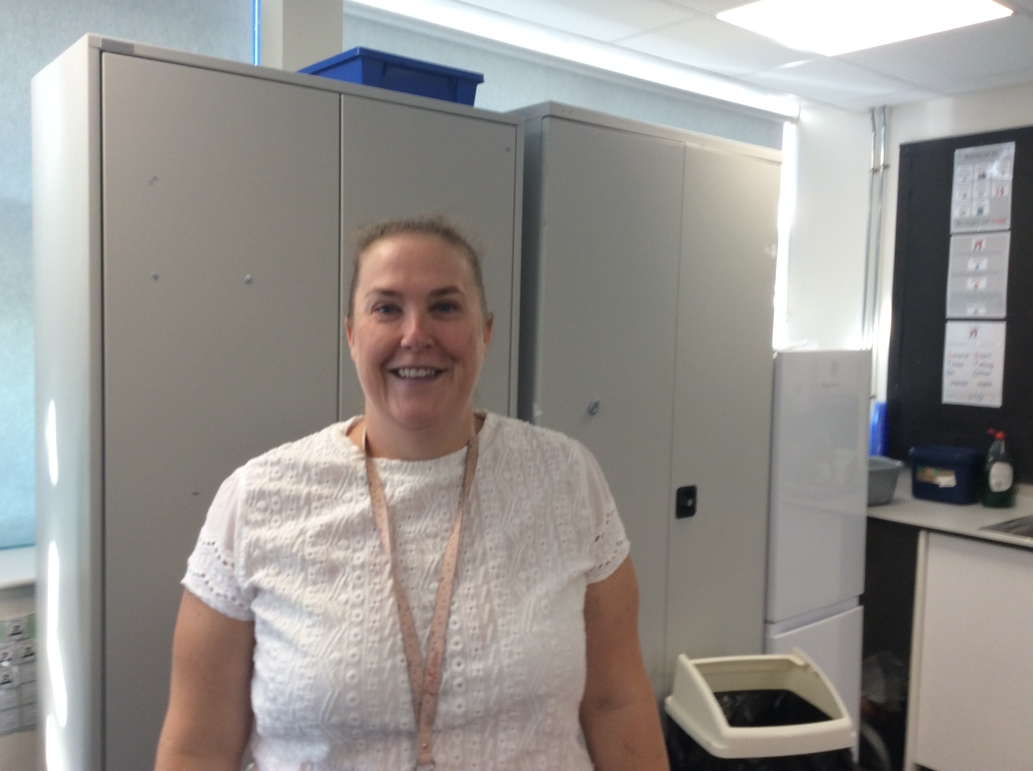
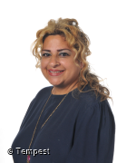
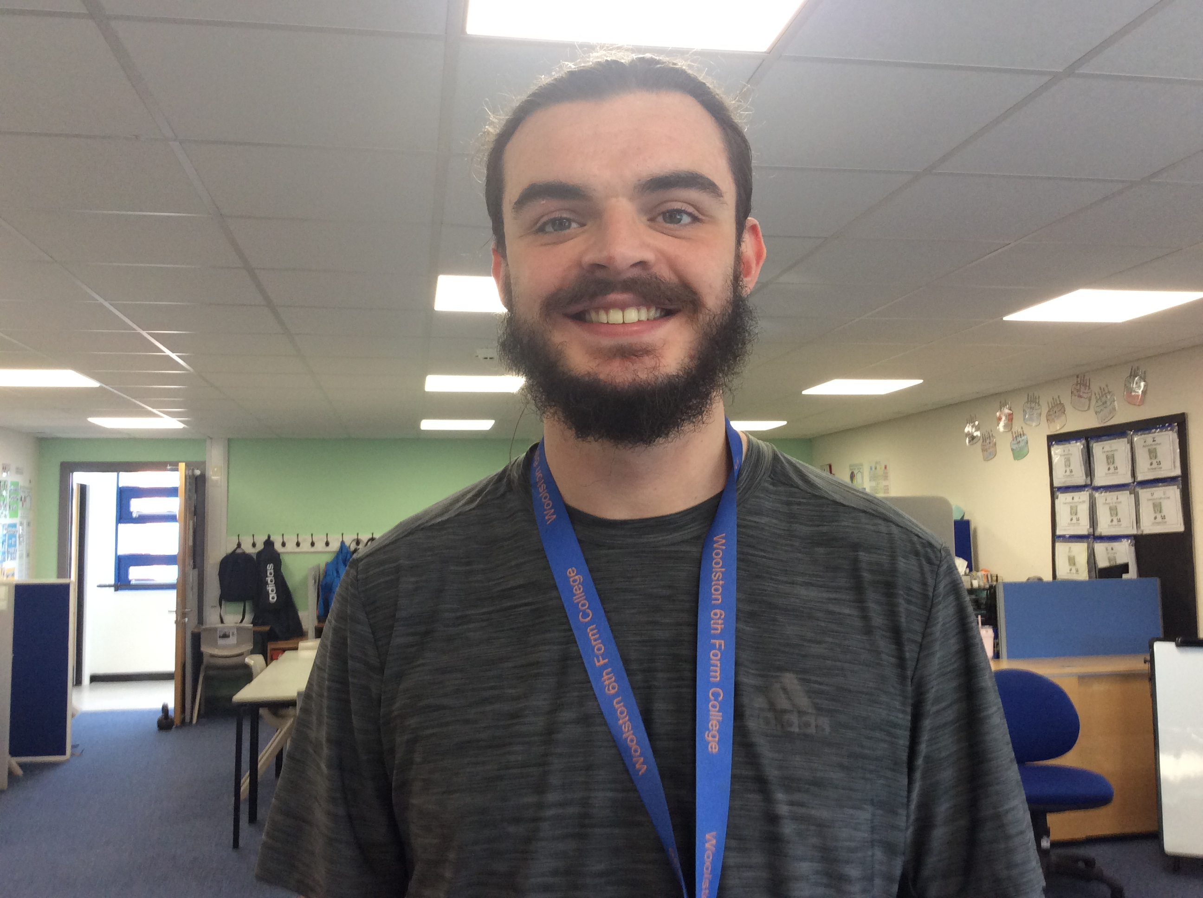
Staff team / Introductions
Mrs Hilary Taylor
Mrs Sonia Bhalla
Mr Mike Mooney
Class Teacher
Teaching Assistant
Teaching Assistant

Slide 3

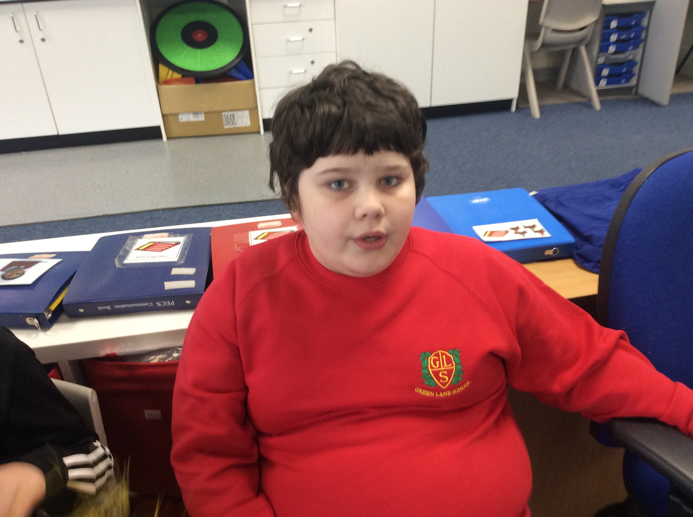
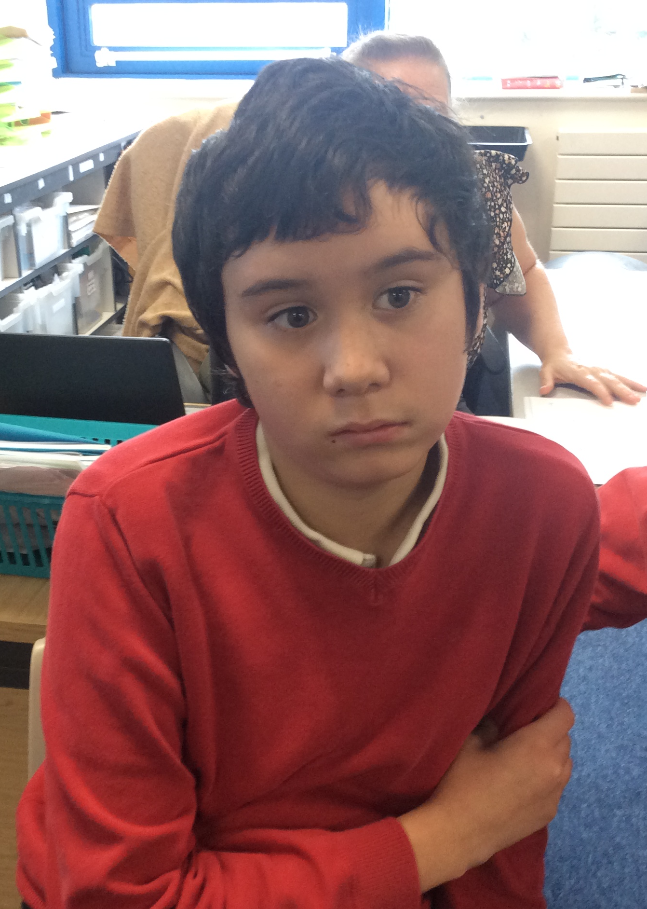
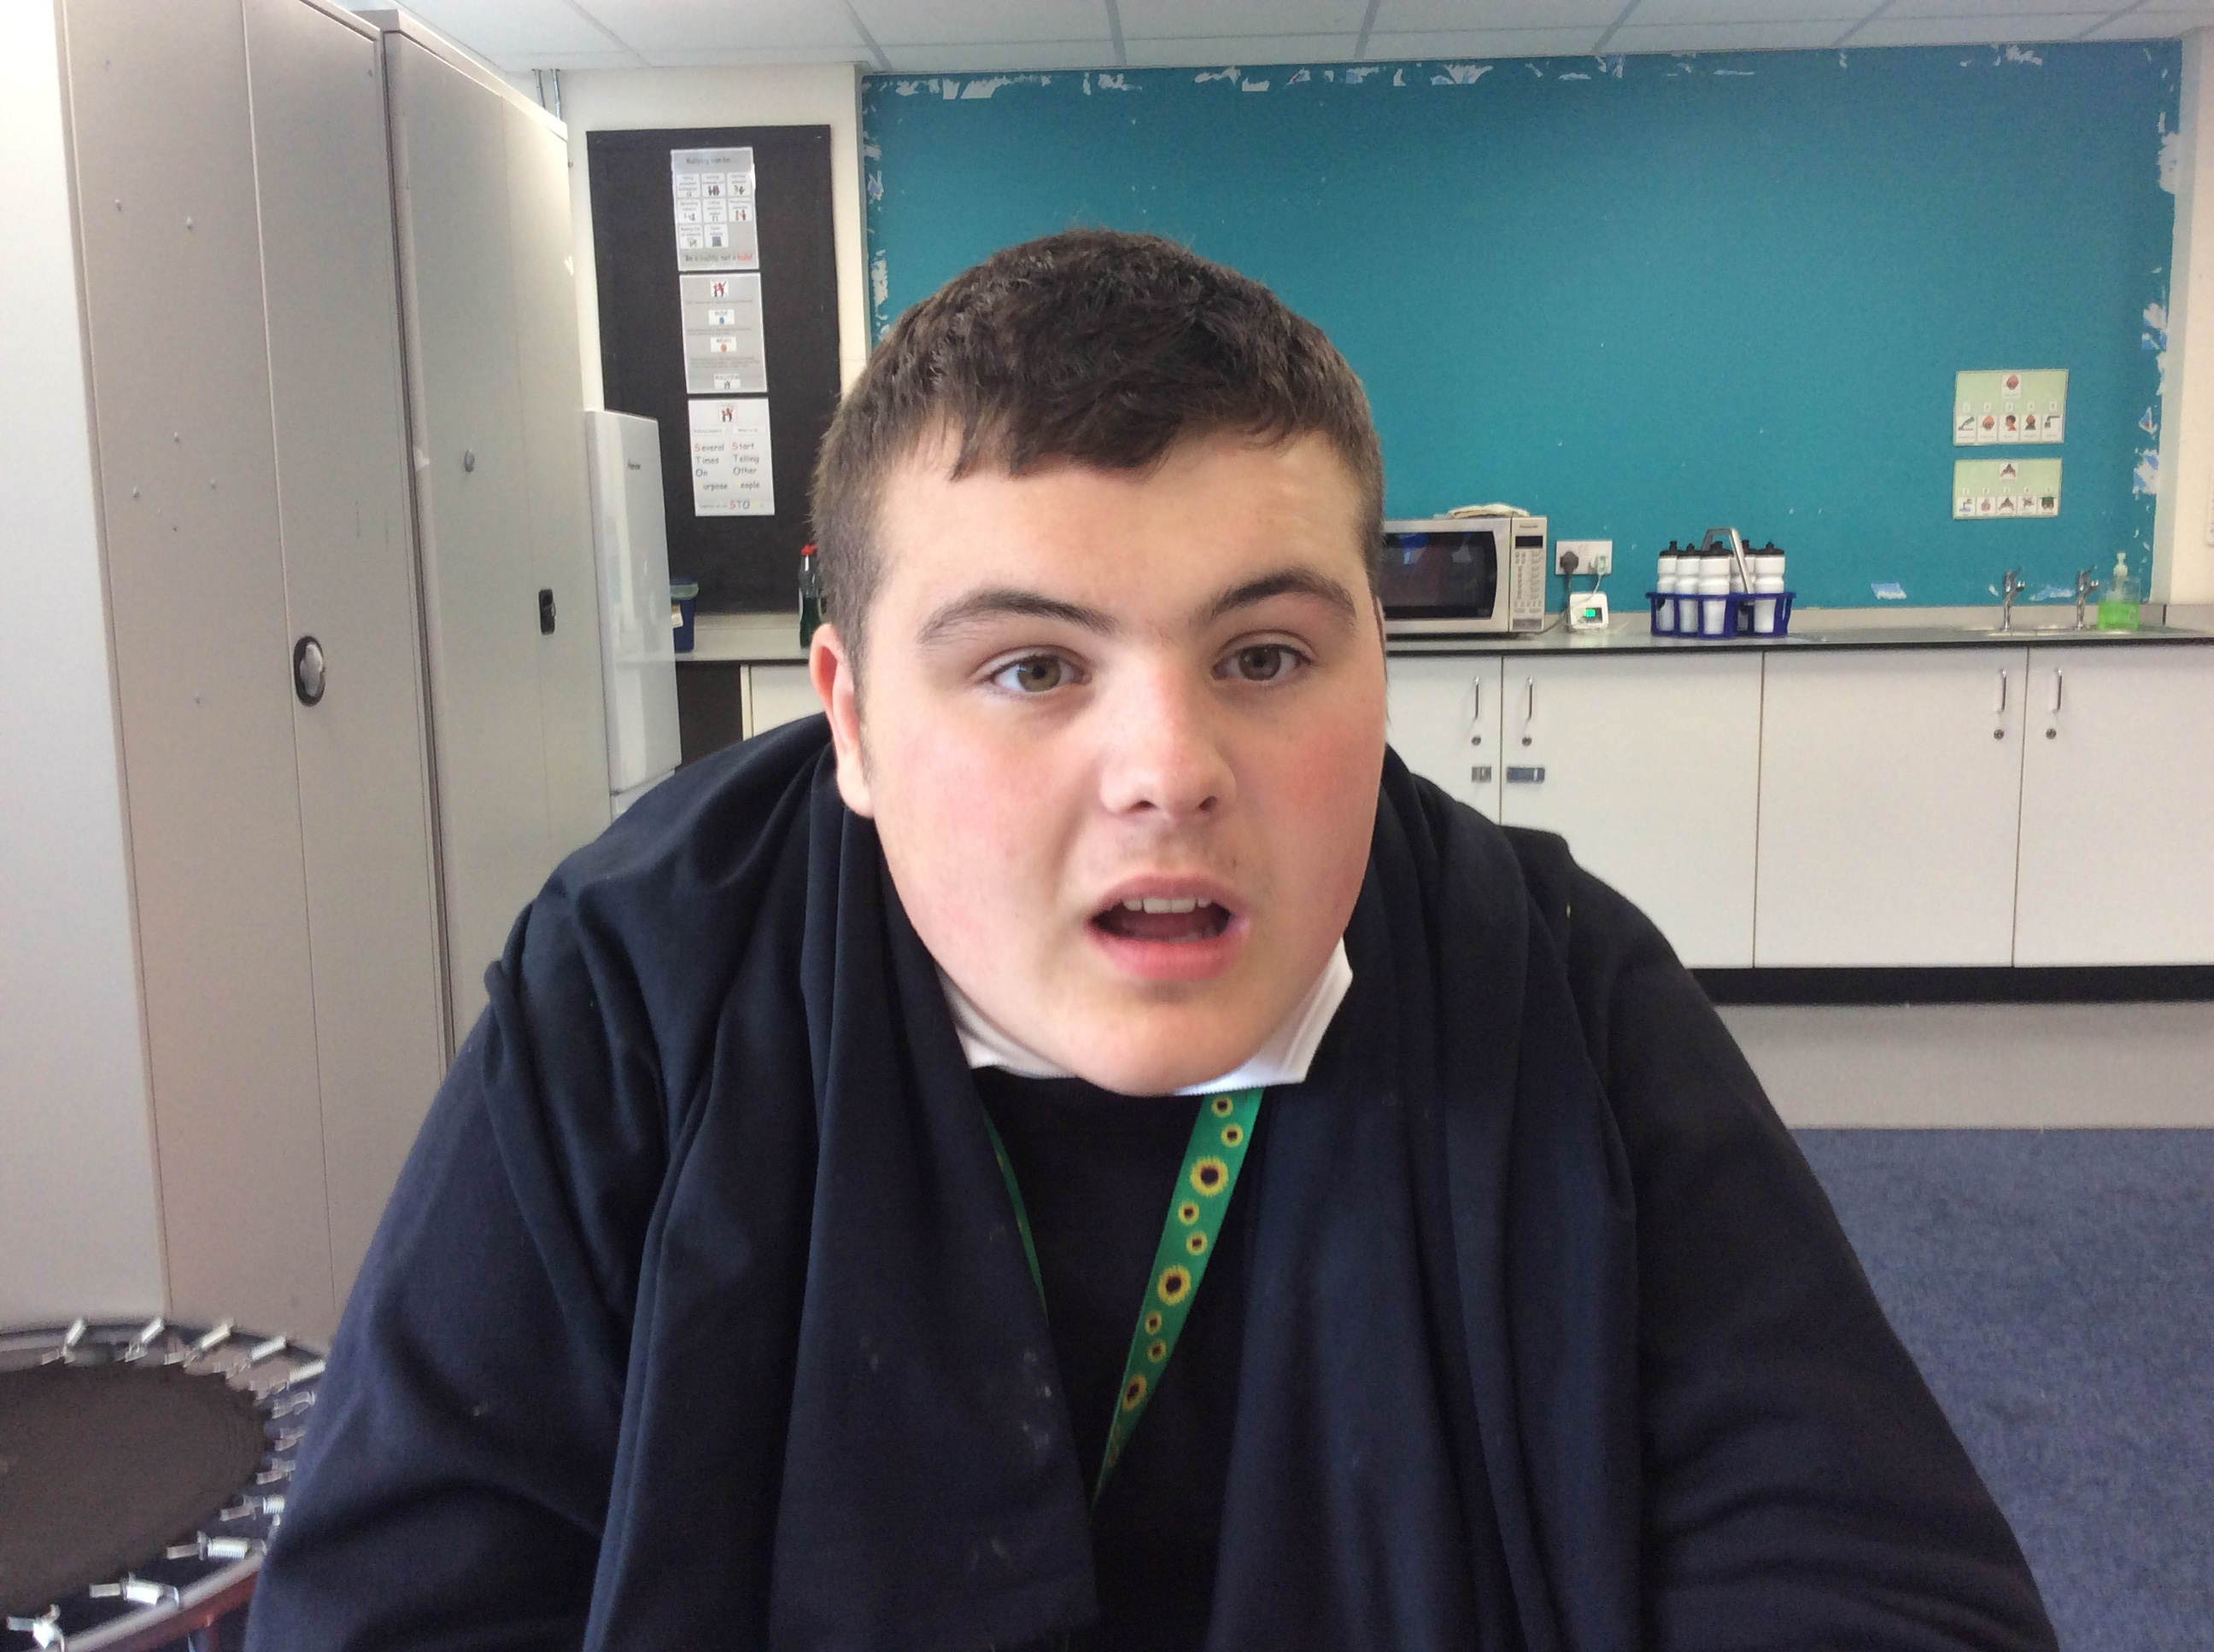
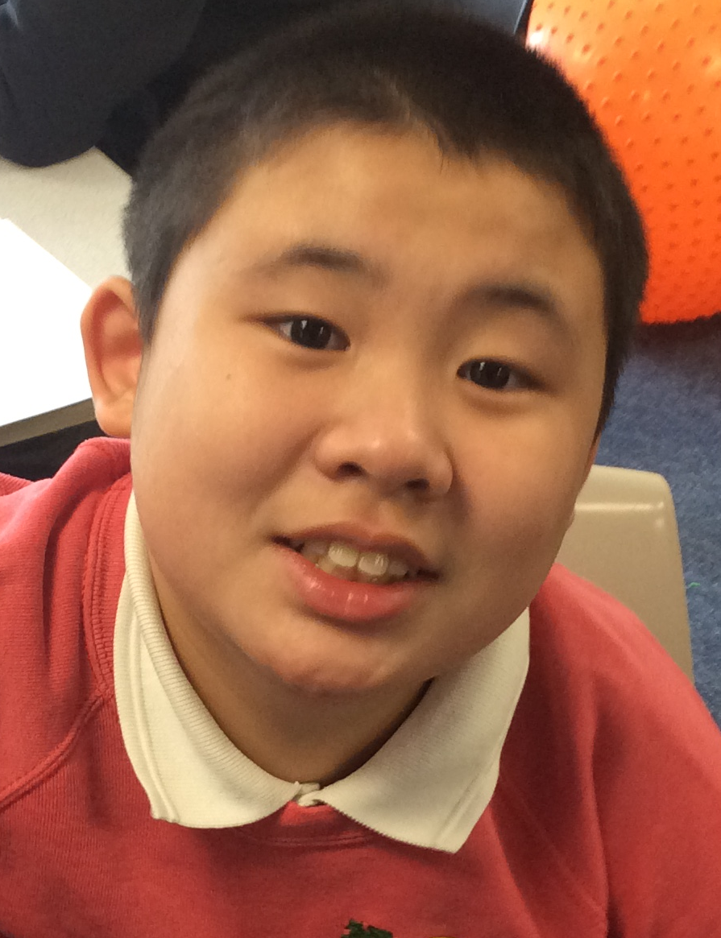
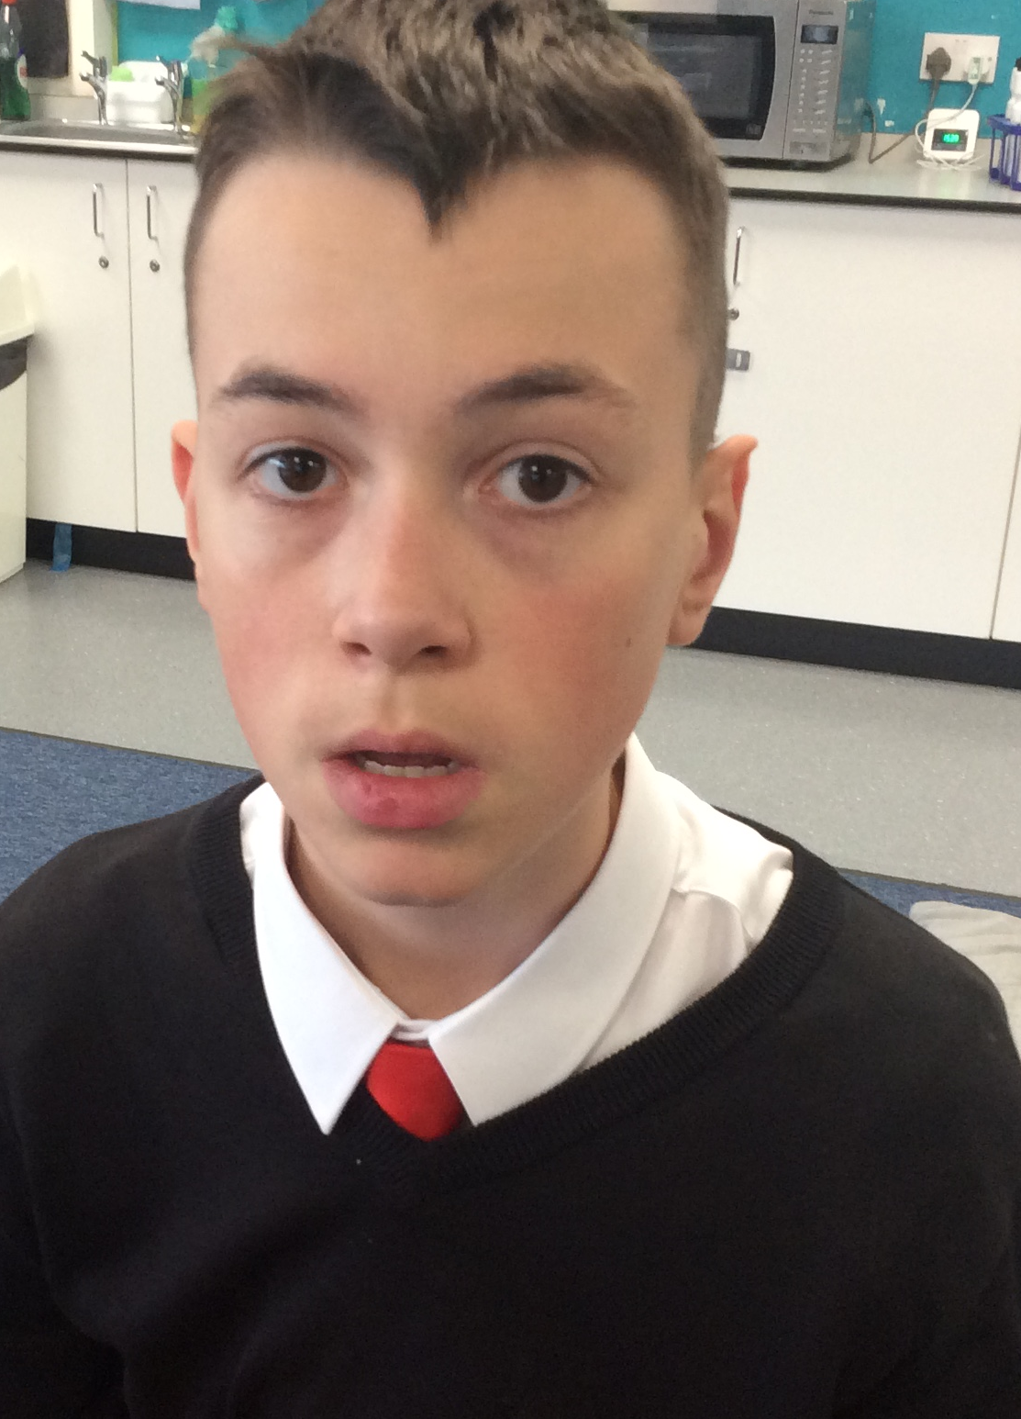
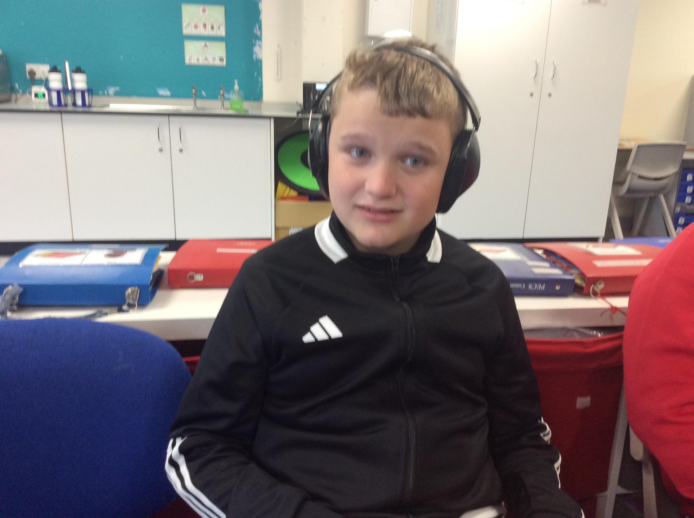
Dormouse Class is an Elm Pathway (Communication and Emotional Regulation) class. We work across Key Stage 3 and 4
We have 6 students in our class this year!

Slide 4

Key information about Dormouse Class
We work on a topic based curriculum including the SCERTS programme.
This programme works on developing social communication and emotional regulation alongside the transactional supports that are provided by staff.
SCERTS links in with all life skills, which is a huge part of Dormouse Class and this is built into all aspects of the school day.
Key stage 4 pupils will also work towards ASDAN accreditation.
All lessons in Dormouse Class involve practical and sensory aspects, including ranges of technologies to facilitate engagement and concentration.
Our activities and lessons take place both inside and outside and all pupils will develop independent work skills in their own workstations.

Slide 5
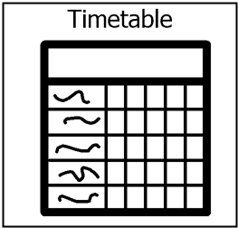
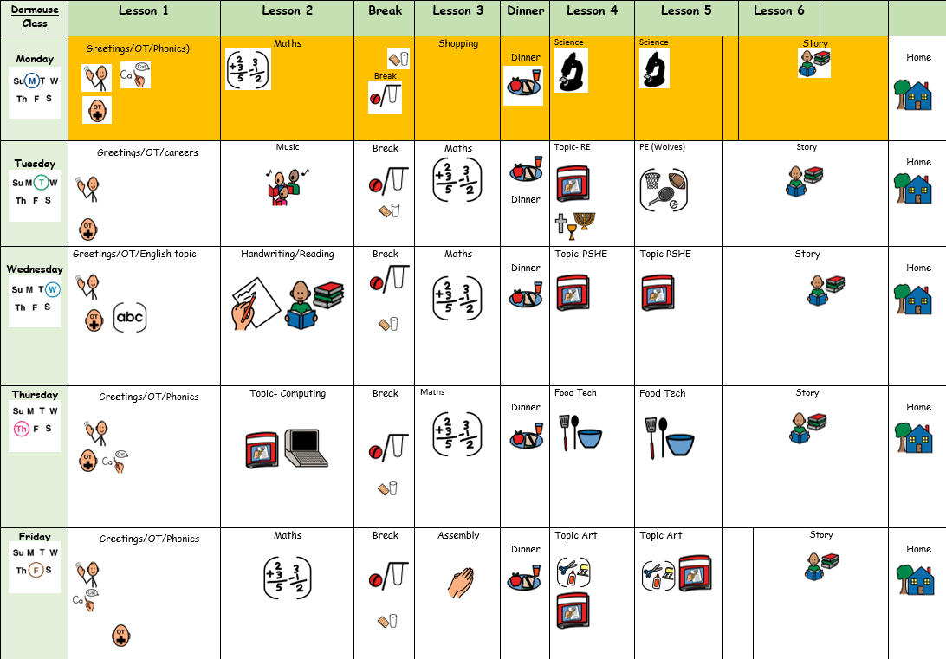
Our weekly timetable

Slide 6

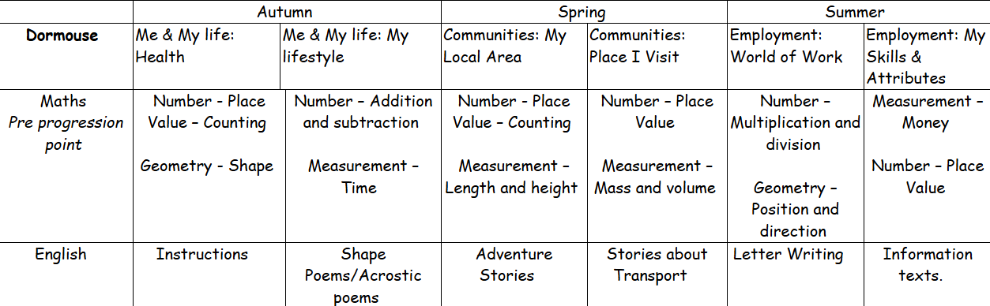
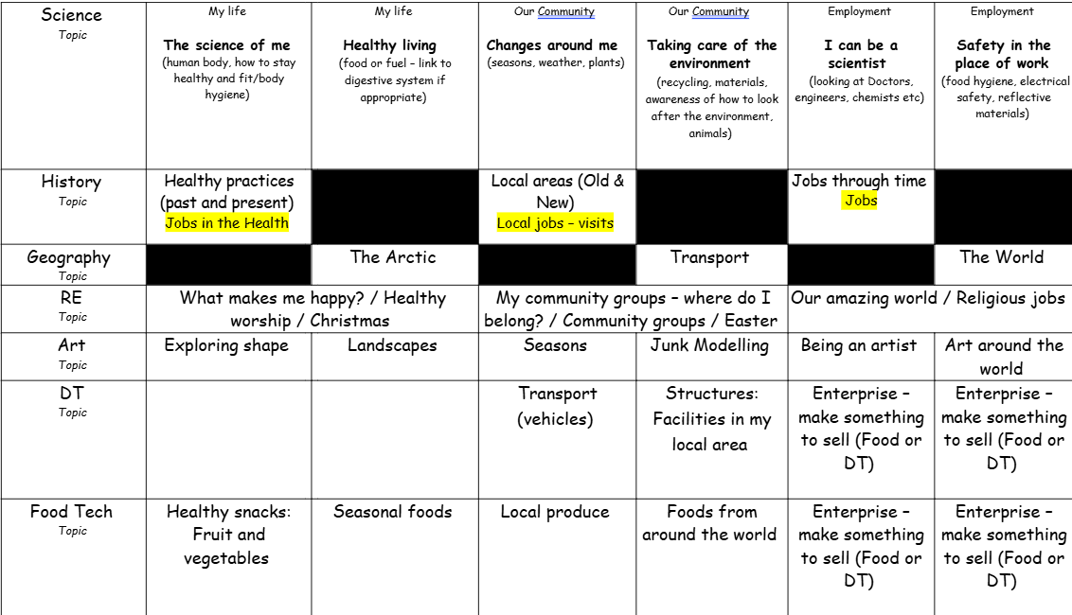
Yearly overview
The Dormouse curriculum includes all statutory subjects at Key Stage 3 and 4. This includes English, Maths, Science, Computing, PSHE & Physical Education.
In addition to this, pupils are supported in achieving ASDAN accreditation (KS4).

Slide 7
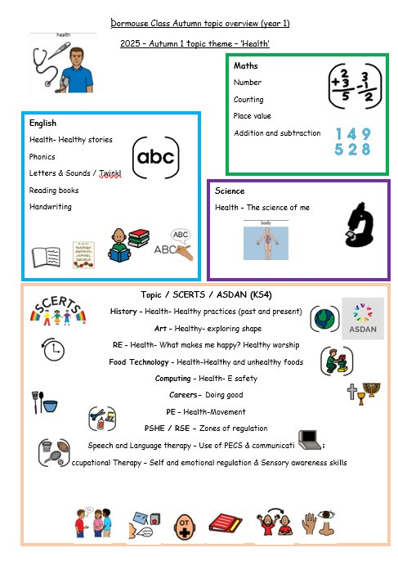
Termly overviews
Each term you will be sent an overview showing what topics are being taught in each subject for that term.

Slide 8

Approaches and supports used throughout school and in Dormouse Class
SCERTS (Social Communication, Emotional Regulation, Transactional Support).
TEACCH approach (Treatment and Education of Autistic and Related Communication Handicapped Children)
SPELL approach (Structure, Positive approaches and expectations, Empathy, Low Arousal, and Links)
PECs (Picture Exchange Communication Systems)
AAC (Augmentative and alternative communication)
Occupational therapy / Sensory

Slide 9

Main aims of SCERTS
Understanding what a child’s behaviour is achieving for them and then teaching other skills to substitute for the less desirable ones.
Sets goals for everyone working with the child.

Slide 10
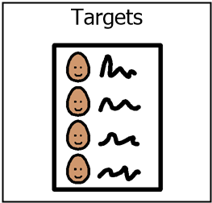
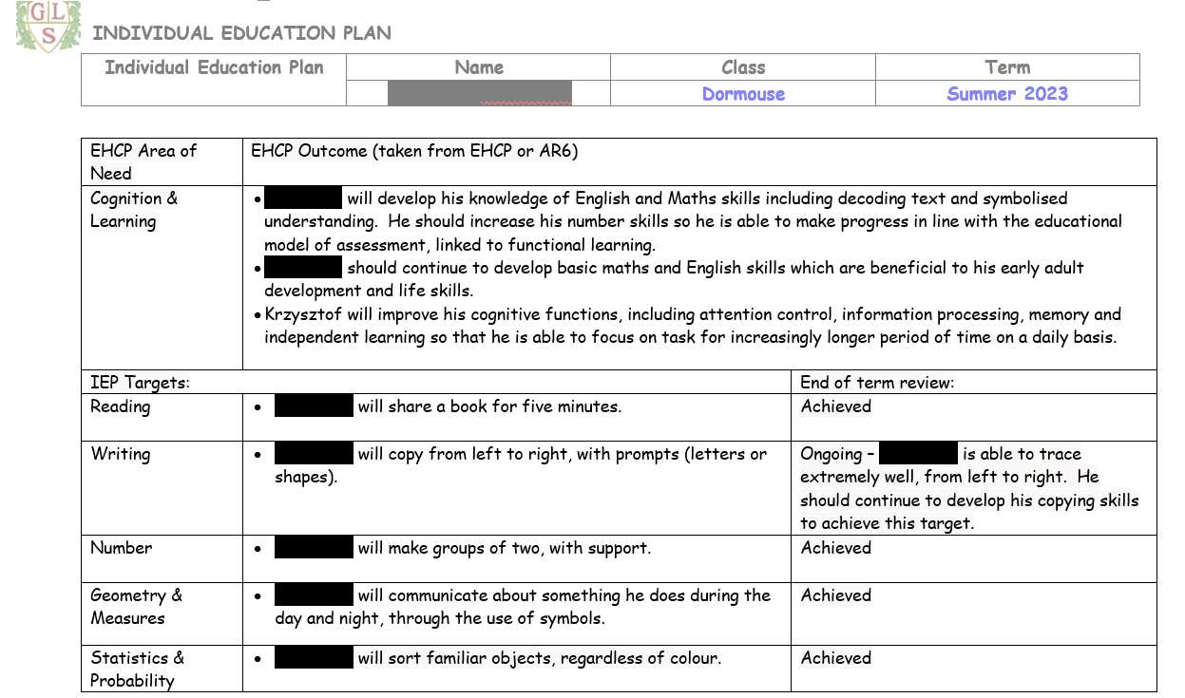
IEP / SCERTS targets

Slide 11
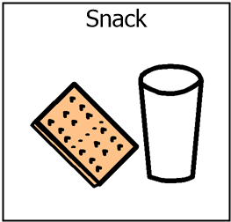
Snack
Snack times are important times during the school day in Dormouse class!
We use snack time as a lesson itself, working on SCERTS and SALT targets / communication methods as well as other curriculum areas such as maths (number, counting and uses of money).
Our main snack lesson is just before morning break and we have short drink and snack just before the end of the day.
If possible, we ask you contribute up to £1.50 a week for snack. This also covers some of our Food Technology ingredients and items during our café visit.
If pupils prefer to bring their own snack, this is also absolutely fine!

Slide 12

Out of school visits
We will be starting up our local weekly trip to the supermarket.
This term we have a number of educational trips planned to aid in our topic learning.
These are great community lessons and contribute to LOTS of learning and different experiences. It supports social understanding, life skills, communication, self-regulation and emotional regulation, all contributing to both academic learning skills and our SCERTS curriculum.

Slide 13
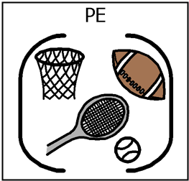
PE
PE will take place on Tuesday afternoons, which is ran my the Warrington Wolves Federation- This term we are looking at the importance of movement.
Please send a PE kit or a change or shoes / trainers.

Slide 14


Slide 15

Evidence for learning (EFL)
Keep up to date via EFL.
Evidence sent home each week.
End of Year report.
Homework.

Slide 16

Home school diaries
All pupils in Dormouse Class will have a home school diary which will have information, daily, about what has taken place during in the day, which will enable conversations and communication at home about school.
Please also use this book to let the team know what they have been up to at home during the evenings or weekends and of course if there are any messages or question, please don’t hesitate to write these in.

Slide 17

Any questions?

Slide 18

Thank you for taking the time to join us! As always your support is much appreciated.

