Slide 1




Welcome to Caterpillar Class
2025-2026

Slide 2

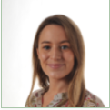
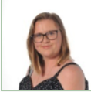
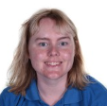
Staff team / Introductions
Mrs L Owen
Miss N Vance
Miss M Kirby
Class Teacher
Teaching Assistant
1-1 Teaching Assistant
Other staff: Mrs E Taylor/Miss Birchenough, Mr M Higham, Miss A Butler

Slide 3

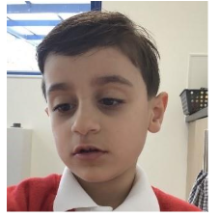
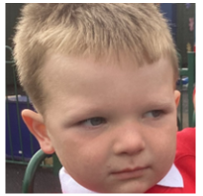
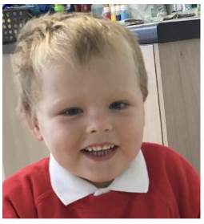
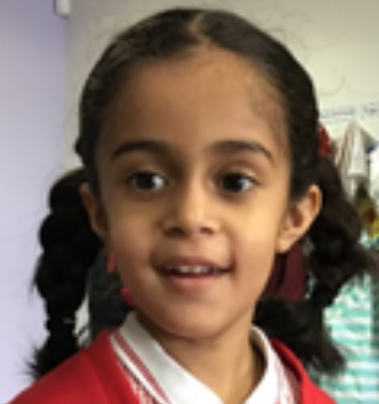
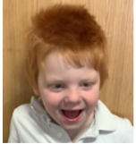
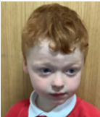
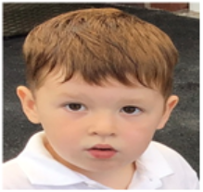
Caterpillar is a KS1 class following the Willow pathway (creative curriculum).
We have 7 students in our class this year!

Slide 4

Key information about Caterpillar Class
We work on a topic based curriculum where learning is sensory and creative.
We work closely with other professionals such as SALT and SHINE therapy.
We have an outdoor area and promote learning both inside and outside everyday.
All lessons in Caterpillar Class involve practical and sensory aspects, including ranges of technologies to facilitate engagement and concentration.
Our pupils will have opportunity to attend trips over the year to enrich our curriculum.
We are a messy class! Please send spare clothes in.

Slide 5

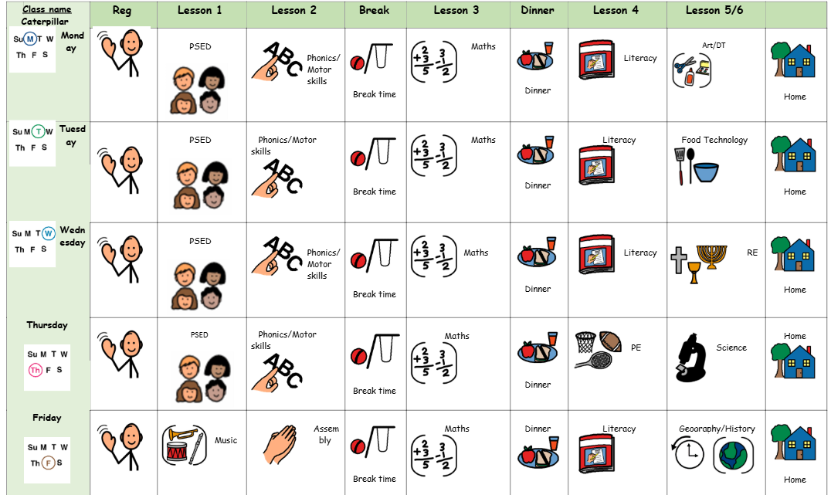
Our weekly timetable

Slide 6

Approaches and supports used throughout school and in Caterpillar Class
TEACCH approach (Treatment and Education of Autistic and Related Communication Handicapped Children)
SPELL approach (Structure, Positive approaches and expectations, Empathy, Low Arousal, and Links)
PECs (Picture Exchange Communication Systems)
AAC (Augmentative and alternative communication)
Occupational therapy / Sensory

Slide 7
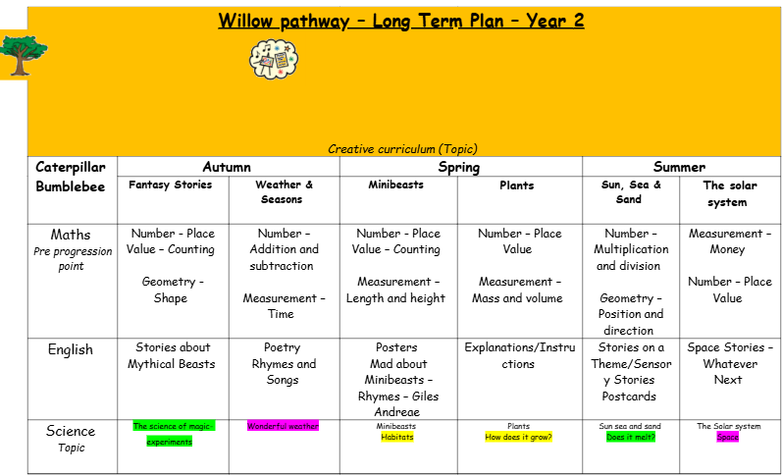

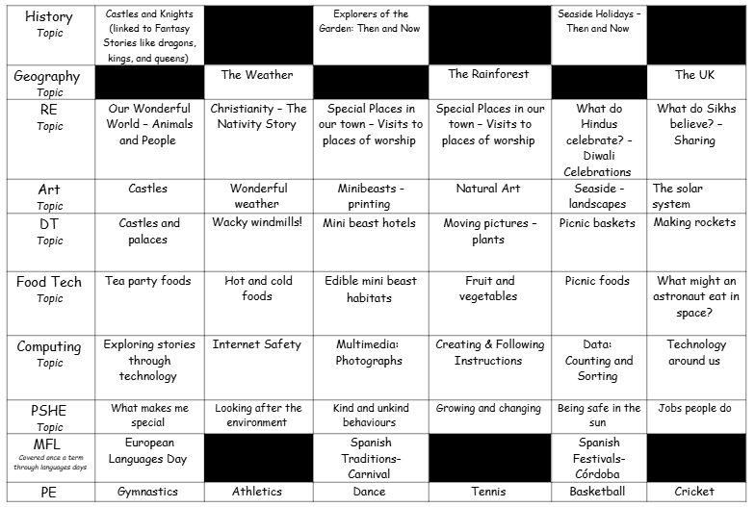

Slide 8
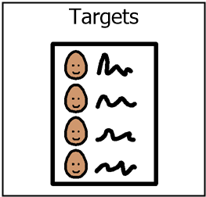
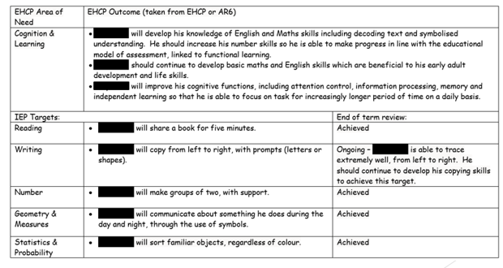
IEP targets

Slide 9

Snack/Lunchtime
Snack/lunchtimes are important times during the school day in Caterpillar class!
We use snack/lunchtime as an opportunity to work on our communication skills.
We have snack at 10am and 2.45pm each day and lunch is at 12.
If possible, we ask you contribute up to £1.50 a week for snack if your child has toast.
If pupils prefer to bring their own snack/lunch, this is also absolutely fine!

Slide 10

Out of school visits
Over the year, we will go on some trips to enrich our learning.
We like to visit places such as the Children’s Adventure Farm Trust.
We will also get opportunity to visit the Sensory Centre.

Slide 11

PE
PE will take place on a Thursday - Wolves.
You are welcome to send in a PE kit/trainers.

Slide 12


Slide 13

Evidence for learning (EFL)
Keep up to date via EFL.
Evidence sent home each week.
End of Year report.
Homework.

Slide 14

Home school diaries
All pupils in Caterpillar Class will have a home school diary which will have information, daily, about what has taken place during in the day, which will enable conversations and communication at home about school.
Please also use this book to let the team know what they have been up to at home during the evenings or weekends and of course if there are any messages or questions, please don’t hesitate to write these in.

Slide 15

Any questions?

Slide 16

Thank you for taking the time to join us! As always your support is much appreciated.

