Slide 1

Welcome to the Hawk Class

Slide 2
Introductions…
Mrs Bani (Class teacher)
Mrs Barker (Teaching Assistant)

Slide 3

Hawk is a Key Stage 4 class made up of pupils from both years 10 and 11.

Slide 4

Equipment
All equipment is provided by school. Pupils each have their own pencil case which contains everything that they could possibly need in class.

Slide 5



What should pupils bring to school daily?
Pupils have all been given a planner this is to used for school/home communication. Please feel free to write any notes to class staff in here. Staff will also use planners to pass on any messages home, please check these daily.
Reading books and records are given in line with pupils phonics assessments. We aim to read with your child on a 1:1 basis at least once a week. Please record in the reading record when your child has read at home.
Books will be changed as required.
Water bottles will be provided in class but pupils can bring one from home if they prefer.

Slide 6
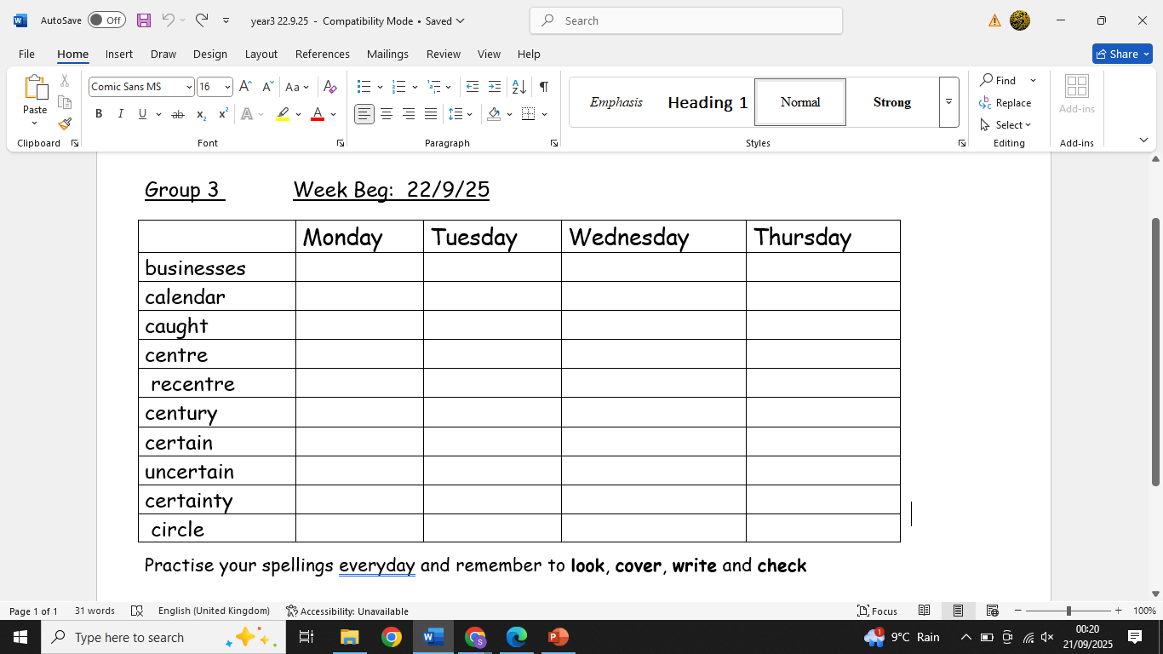
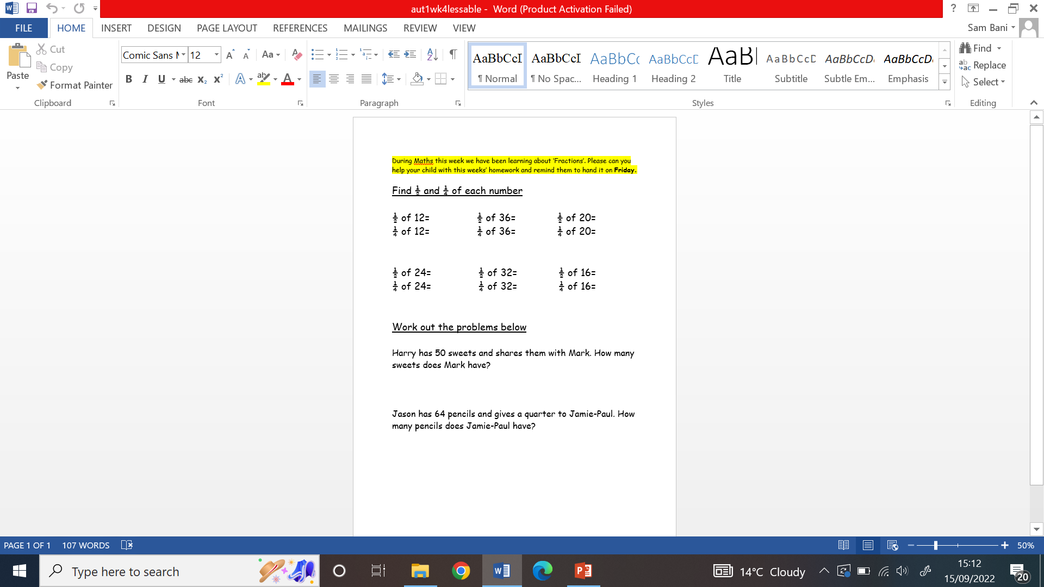
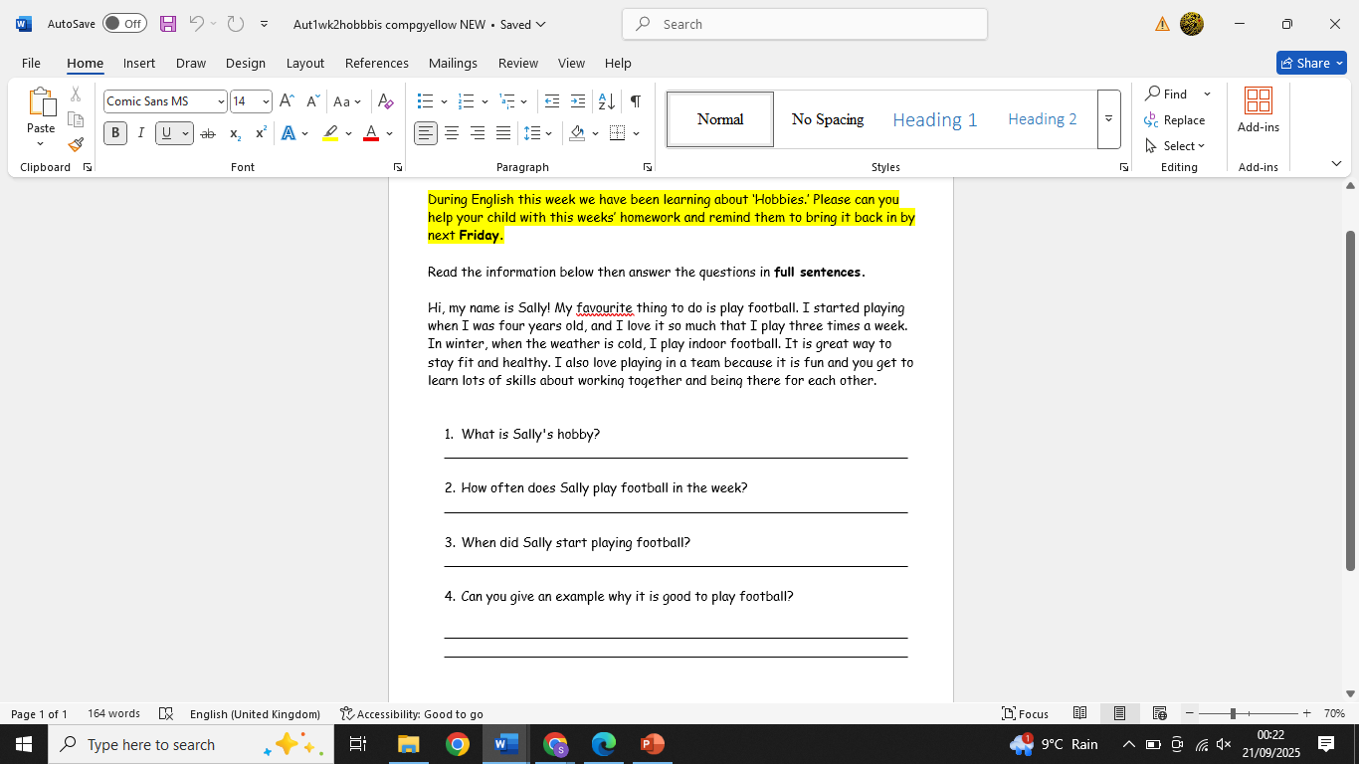
Spellings and homework
Weekly spellings will be sent home on a Monday. There is a weekly spelling test each Friday.
Pupils will have the opportunity to practise these in class each morning during the phonic lesson but should also practise at home using look, cover, write and check.
English and Maths homework is sent home every Friday. Pupils should return this the following Friday.

Slide 7

PE
P.E is on a Tuesday and pupils are expected to wear the correct P.E uniform:
Dark joggers/leggings/shorts-black or grey
White T-shirt
Trainers

Slide 8
Hawk Curriculum
The Hawk curriculum includes all statutory subjects at Key Stage 4. This includes English, Maths, Science, Computing, Employability, Physical Education and Personal and Social Development. In each subject pupils are working towards Entry Level 1 or 2, Silver Award in Asdan or a pass in short courses.
In addition to this pupils are taught ASDAN.
ASDAN includes short courses which aim to develop personal, independent living and employability skills for young people with additional needs.

Slide 9
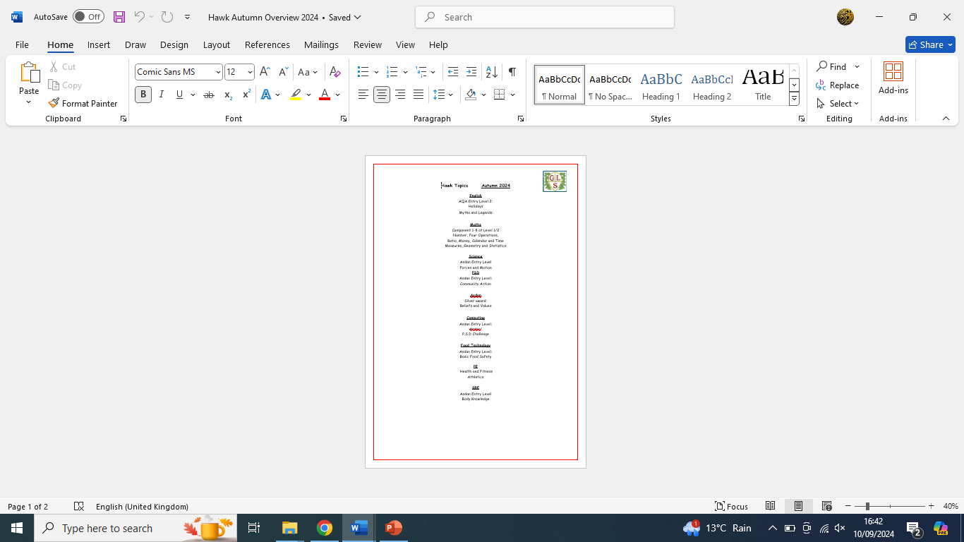
Termly overviews
This is a termly overview showing what topics are being taught in each subject for that term.
At the end of our English and Maths topics pupils will complete an end of topic test. These contribute towards pupils final accreditation.

Slide 10
Entry level
Each entry level qualification is available at three sub-levels - 1, 2 and 3.
Entry level 3 is the most difficult.

Slide 11
Entry level
Entry level qualifications are:
entry level award
entry level certificate (ELC)
entry level functional skills

Slide 12
Level 1
Level 1 qualifications are:
GCSE - grades 3, 2, 1 or grades D, E, F, G
level 1 functional skills
level 1 national vocational qualification (NVQ)

Slide 13
Level 2
Level 2 qualifications are:
GCSE - grades 9, 8, 7, 6, 5, 4 or grades A*, A, B, C
intermediate apprenticeship
level 2 functional skills

Slide 14
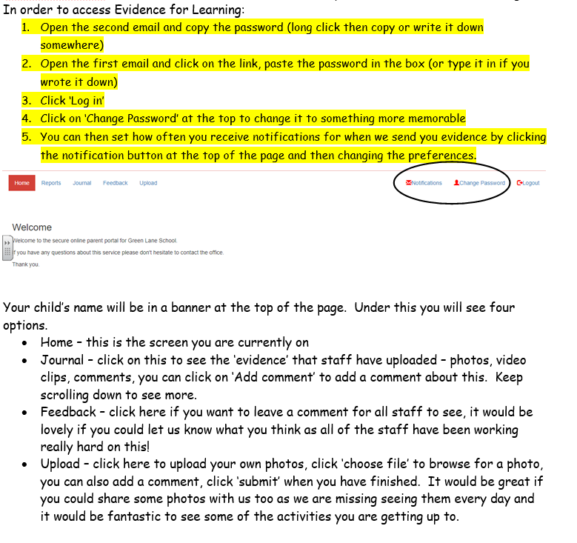
EFL-Evidence for learning
At Green Lane School we use an application called ‘Evidence for Learning (EfL)’ to record your child’s learning. We take snapshots of your child’s learning throughout their time at Green Lane School and then upload them to create a learning journey.
When you are signed up to EfL, you will receive two automated emails from ‘TheTeacherCloud’ one containing a link to your child’s Parent View Portal and the other with your password. You can change the password to one of your own choice when you first login.

Slide 15

Any questions?

Slide 16

Thank you for taking the time to join us this afternoon! As always your support is much appreciated.

