Slide 1

Welcome to
Primrose Class!

Slide 2

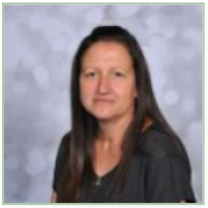


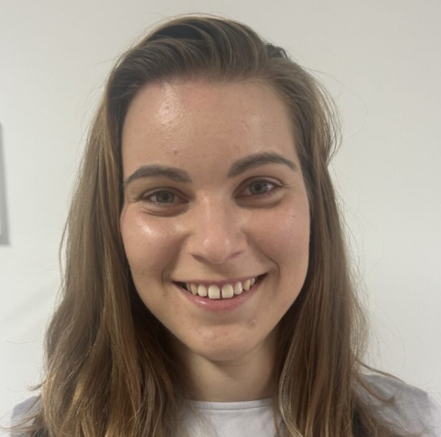
Meet the Team
Miss Shaw
Class Teacher
Miss Gill
Teaching
Assistant
Mrs Lothrop
Teaching
Assistant
Miss Grant
Teaching
Assistant
Miss Dobisova
Teaching
Assistant

Slide 3
Curriculum
Primrose is a KS1/KS2 classroom which includes Y2 and Y3 pupils on the Willow Pathway, which means we follow a creative curriculum - topic based learning.
It includes subjects such as English, Maths, Science, History, Geography, Computing, RE, PSHE, Art, Food Tech, DT, and Music.

Slide 4
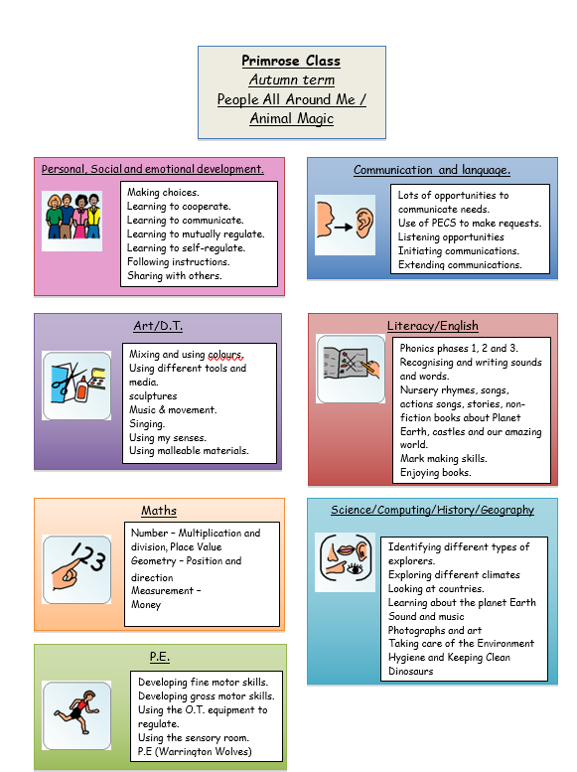
Overviews…
Each term we have an overview of the subjects/topics we will be covering. (Available on the school website)

Slide 5
We offer juice and toast in the morning, we ask for a £1.50 contribution per week if you want this option for your child.
Fruit and vegetables are offered at afternoon snack time.
Key info…

Slide 6
We use the EFL app to upload your child's learning journey.
EFL will show 4 pieces of evidence per week from school. Updated every 2 weeks.
We would love to see what your child gets up to at home!
Evidence For Learning

Slide 7
We have PE with Warrington Wolves - PE kit not necessary but PE pumps/trainers if you prefer.
Sensory centre – Summer 1
Forest school – Summer 2
Reading books - Three times a week in school then sent home for you to read with your child, changed as required.
Water bottles - can be kept in school if you prefer.
Key info…

Slide 8

Any questions?

Slide 9

Thank you for coming this afternoon!
We appreciate your support

