Slide 1
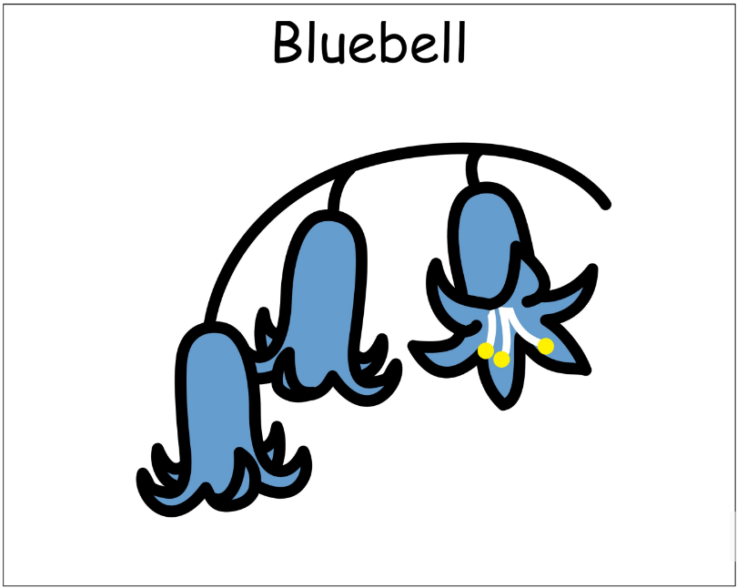
Welcome to Bluebell
2025-2026

Slide 2
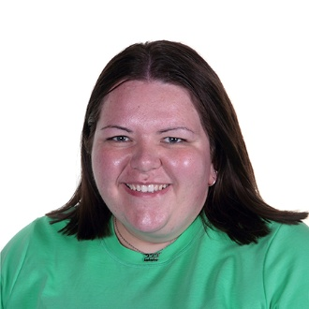
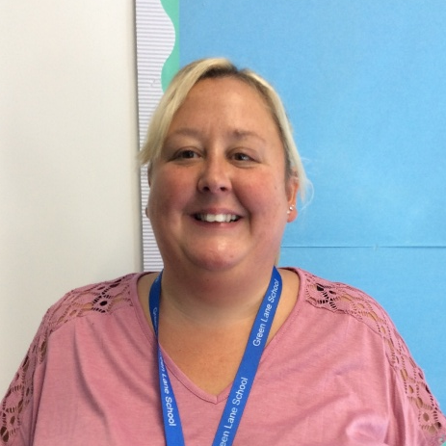
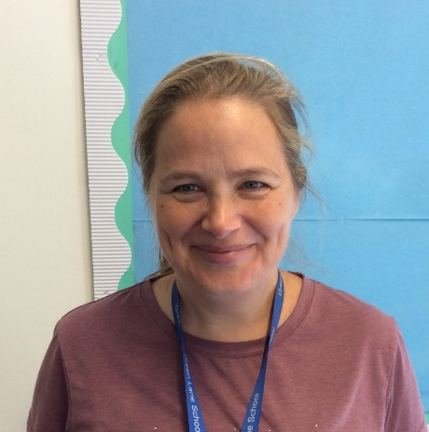
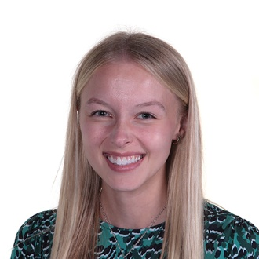
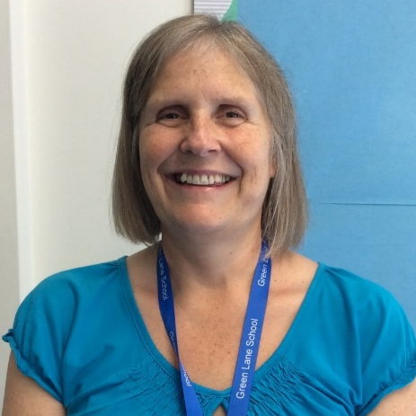
Introductions
Miss Stappard
Miss Sudworth
Mrs King
Mrs Pucill
Ms Cockram
We are also joined by Mr Higham (Music) and Miss Butler.

Slide 3
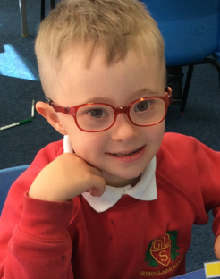
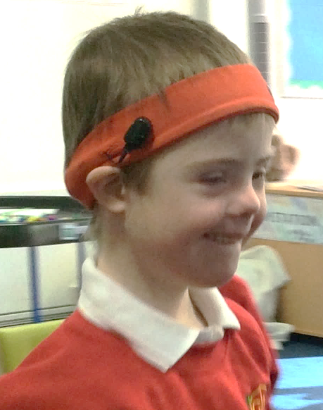
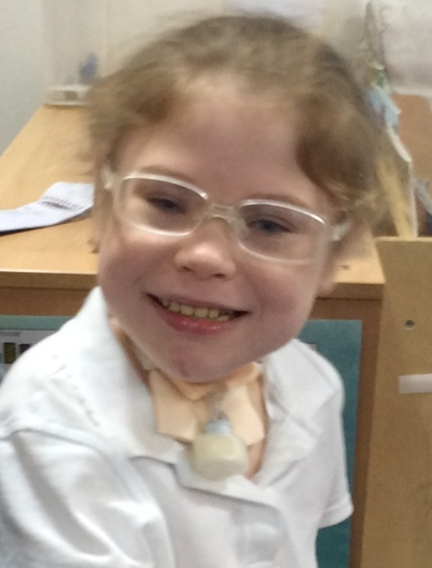
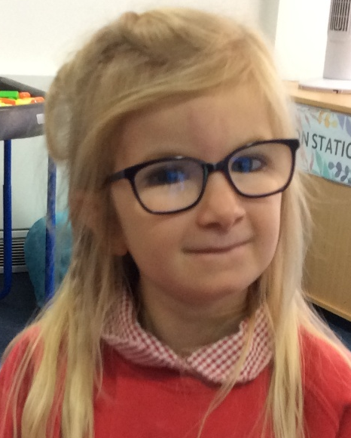
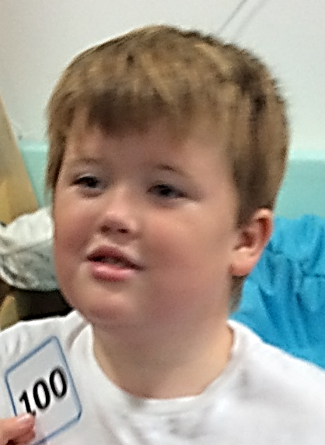
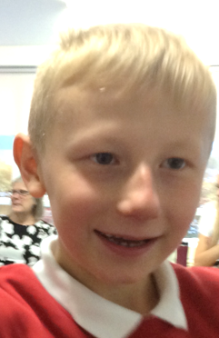
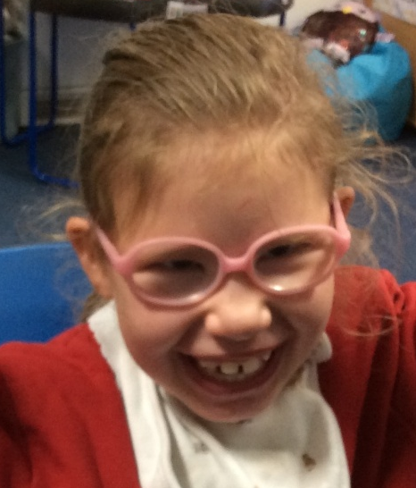
Bluebell is a KS2 class made up of Year 3 and Year 4 pupils.

Slide 4
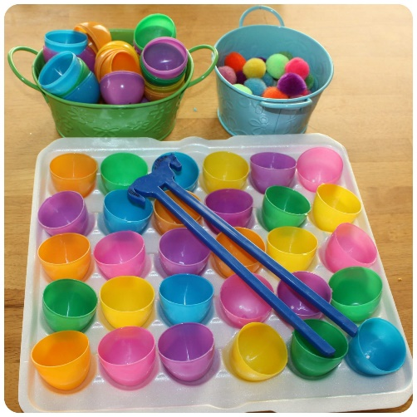
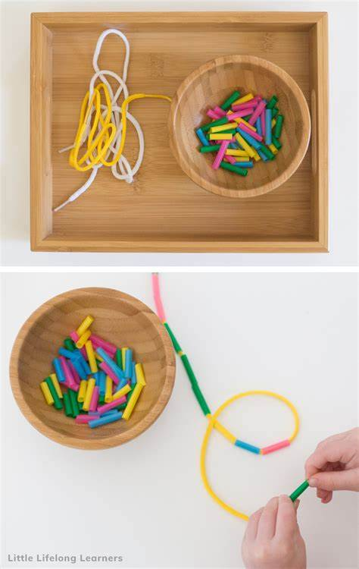
Arrival
When the children arrive, they take part in fine motor and provision activities. These are changed each day.
We then carry out Occupational Therapy (OT), physio and a ‘Good Morning’ routine, including the timetable for the day.

Slide 5
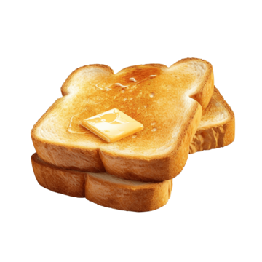
Snack
We have a snack during the morning and afternoon. Your child can have some toast or they can bring in their own snack if preferred.
We ask for £1.50 per week for toast and other class snacks. This is very much appreciated.

Slide 6

Equipment
All equipment is provided by school. We have everything that the children could possibly need in class!

Slide 7



What should pupils bring to school daily?
Pupils have all been given a home-school book for communication. Please write any notes to class staff in here. Staff will also use them to pass on any messages home, please check these daily.
Reading books and records are given to take home. Please write in the reading record when you have read with your child at home. Books will be changed every Friday.
Water bottles should be brought into school.

Slide 8

Curriculum
We follow the Willow pathway, a creative curriculum, taking part in topic and sensory-based activities.
We have lots of fun and can get a bit messy, so we would ask that your child brings in spare clothes.

Slide 9

Evidence for Learning
Please access EfL, as this is where we will share examples of the fun activities pupils have been enjoying in class!

Slide 10

PE
Our PE lesson will be provided by Warrington Wolves on a Thursday.
Please ensure your child is dressed for PE before coming to school.

Slide 11

Thank you for taking the time to join us this afternoon! We really appreciate your support.
We look forward to an amazing year ahead!

Slide 12

Any questions?

