Slide 1

Bendrigg Residential
Parent/Carer Information – Pre Visit
25th – 27th February 2026

Slide 2

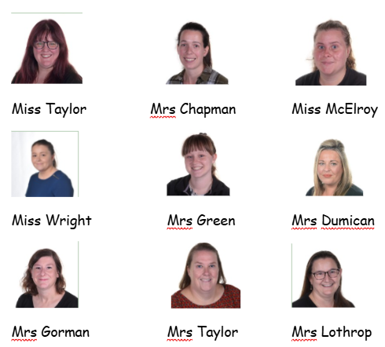
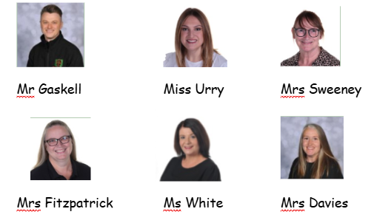
Meet the staff
Staff have all been allocated to groups, in addition named staff will be on waking nights and additional staff on night call

Slide 3
Pupil information collection
The key information form was sent home in December. Please ensure that reply slips have been returned to school FAO Mrs Irwin asap (due 16th January)
Mrs Irwin will take a printed copy of all information in addition to it being accessible online (emergency contact information, medication, accessible aids, collection arrangements) All information is kept confidential
Within this document parents and carers have been asked to state any equipment that their child will require. Mrs Irwin will share this with Bendrigg in advance who will ensure that we have everything that we need
Bendrigg require all parents and carers to complete some key information - https://bendrigg.jotform.com/team/bookings-team/green-lane-community-special-school If you have not yet completed this, please let me know
Medication forms – Spare copies are available. A form is required for each medication and needs to be returned to school FAO Mrs Chadwick by 6th February.
If pupils start on a new medication or have any changes to their medication following this date, please send them in asap

Slide 4
Prior to the trip…
If you would prefer, luggage can be dropped off at the school reception on Tuesday 24th February – Please drop off between 1-3
If luggage will come via transport on the day, please check in advance with transport that they can accommodate this
Please ensure that all luggage and clothing, etc. is clearly labelled with your child’s name or initials
On the information collection sheet parents/carers have been asked whether they will be collecting their child at this time (on the day of return,) or whether they will remain in school and go home on transport as usual – If there are any changes to this please inform the school office asap
Ensure that you can access EfL as staff will be uploading photographs and videos throughout the trip – If you have any problems please speak to your child’s class teacher asap

Slide 5
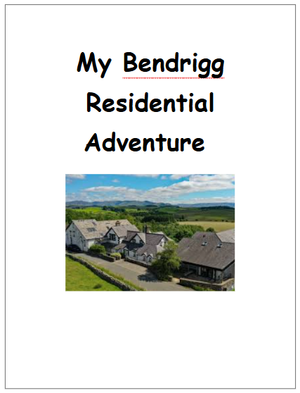
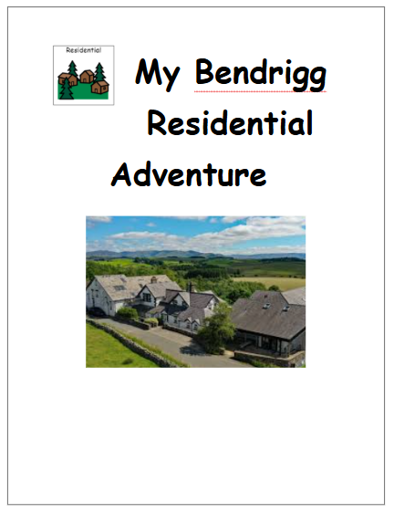

Social Stories
Your child's class teacher will have sent home the most appropriate version for your child on Friday/today. If you would prefer an electronic copy, these can be downloaded from the school website, under the Bendrigg section - https://www.greenlaneschool.co.uk/

Slide 6
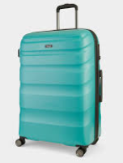
What to pack…
4-8 sets of comfortable loose fitting clothing for activities
Trainers or comfortable appropriate shoes
Warm coat
Hat and gloves
Water bottle (for drinking)
Towel
Toiletries
Medication
Sleepwear
Slippers or indoor shoes
Soft toy or comforter
Money for a souvenir from the gift shop (no more than £10)
Any specific equipment that your child will need
iPad/tablets in a protective case with a screen protector
**Whilst school will do our very best to ensure that iPad are handled with care, parents who choose to send one accept that school are not liable for any damage to them.**

Slide 7
Medication
All medication will need to be prescribed by your child’s GP and have a clear label showing the date issued, expiry date and dosage. Medication that has not been prescribed by the GP cannot be accepted
A medication form is required for each medication. All medication forms need to be sent to school FAO Mrs Chadwick by Friday 6th February. Medication can then follow on the day. This will allow Mrs Chadwick time to review all of the medication and storage requirements in advance
If your child takes medication in a specific way, e.g. if it has been advised that Melatonin is crushed and added to food/drink please write this information on the medication form
If your child is prescribed any new medications after this date that they will need to take on residential, please complete a new medication form and send into school as soon as possible
Mrs Chadwick will be available from 8:30 – 9:45 on Wednesday 25th February to receive any medication
If sending medication via transport, please ensure in advance that transport have agreed to this, as on the day you will need to pass it directly to the bus escort, who will then need to hand this directly to staff. Please do not send in cases or bags.
Mrs Chadwick will then be available upon our return to sign out any medication and hand this back to you. If your child will be remaining in school, then transport will be made aware so that they can ensure it reaches you safely.

Slide 8
On the day…
If luggage has not been dropped off in advance/coming on transport, please drop luggage at the office between 9:15 – 9:45 once the car park has cleared. Pupils who come in with parents are welcome to arrive later (between 9:15 – 9:45) on the day to avoid parents/carers having to wait around
We will leave school at 10:30am prompt and return to school on Friday 27th February 2026 by 12:00
Pupils are not permitted to bring mobile phones under any circumstances, due to Safeguarding reasons. Mrs Irwin will inform school when we arrive at Bendrigg and a parent mail will be sent to let you all know that we have arrived safely.
**Mrs Irwin and Mrs VanRooy will have mobile phones and emergency contact details for all pupils. Please be assured that in the event of an emergency we would contact you directly however, due to the number of pupils attending are unable to make individual calls beyond this. **

Slide 9
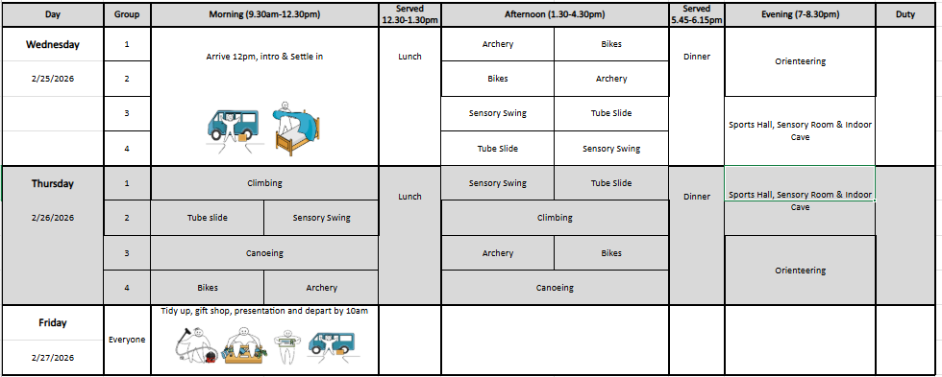
Activities
Pupils and staff have been split into 4 groups. Each group will have a Green Lane group leader and a Bendrigg group leader plus additional Bendrigg staff (number depends on the activity)
Social stories are available for all activities that we will be participating in. Copies are available to collect today. In addition, copies will be taken with us to read, where appropriate in advance of activities. The lounge and the grounds are available for ‘down-time’.

Slide 10
Food and drink
Breakfast, lunch and tea, along with snacks throughout the day and evening are all provided.
Breakfast – 7:30am – 9am
Lunch – 12:30pm – 1:30pm
Tea – 5:45pm – 6:45pm
Any dietary requirements should have been shared through the information collect sheet (returned to SI) and on the online form which has gone directly to Bendrigg who then plan for any dietary needs prior to us arriving.
Please do not send food (unless agreed with Mrs Irwin in advance) as there are pupils with allergies.

Slide 11
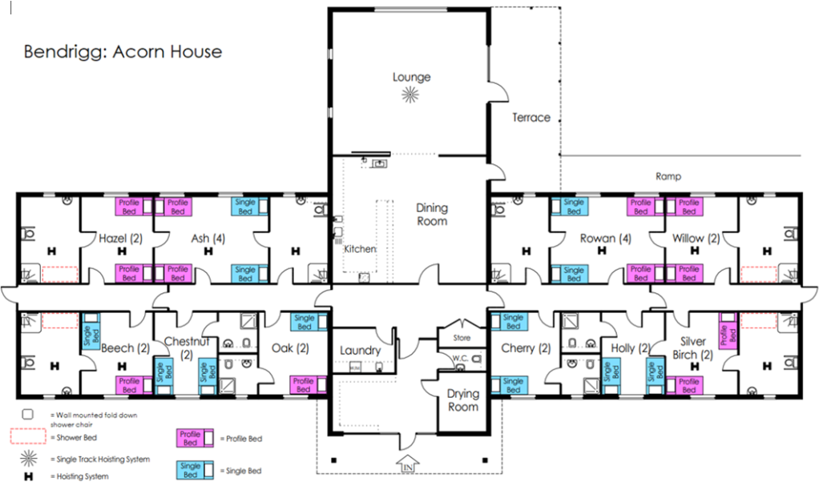
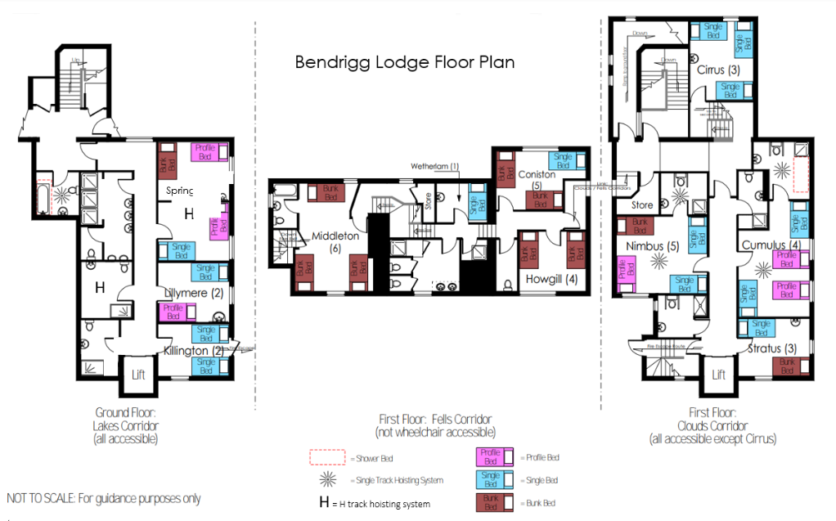
Sleeping arrangements
Pupils and staff will reside across both Acorn House and Bendrigg Lodge. Bedrooms will be allocated this week following reviewing the information sheets. Single rooms are available along with rooms that sleep 2 – 6 pupils. Staff will not share bedrooms with pupils but will be carefully allocated rooms to ensure adequate supervision throughout the stay.
If your child is set on sharing with a specific friend (or you know that they would rather sleep alone,) please let me know today or by mid week using the email address - ks3residential@greenlaneschool.co.uk​ by Wednesday 28th January. We will do our best to accommodate requests. Bedroom allocation and pupil groupings will be shared with parents/carers prior to half term.

Slide 12
On the day we return…
Mrs Irwin will then inform school on the day of departure when we are leaving Bendrigg, and a parent mail will be sent to let you know that we are on our way.
If pupils are remaining in school, they will either re-join their classes for low challenge activities or group together for a film afternoon (based on what is best for each individual)
Mrs Chadwick will be available to sign any medication over. If medication is going home via transport, please ensure in advance that transport are aware and in agreement. The same process will apply to transport bringing medication.

Slide 13
Things to do…
Ensure all payments are made by the end of January on parent pay
Ensure that the key information letter is completed and returned FAO Mrs Irwin asap (return date 16th January)
Begin sharing the social story with your child to help prepare them for the trip
Book in a 1:1 meeting before leaving this afternoon, alternatively please email the ks3residential@greenlaneschool.co.uk to arrange this asap, if required
If your child is on transport, please inform transport of the dates that your child will not require collecting/dropping off

