Slide 1

Ladybird Class

Slide 2
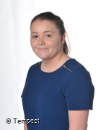
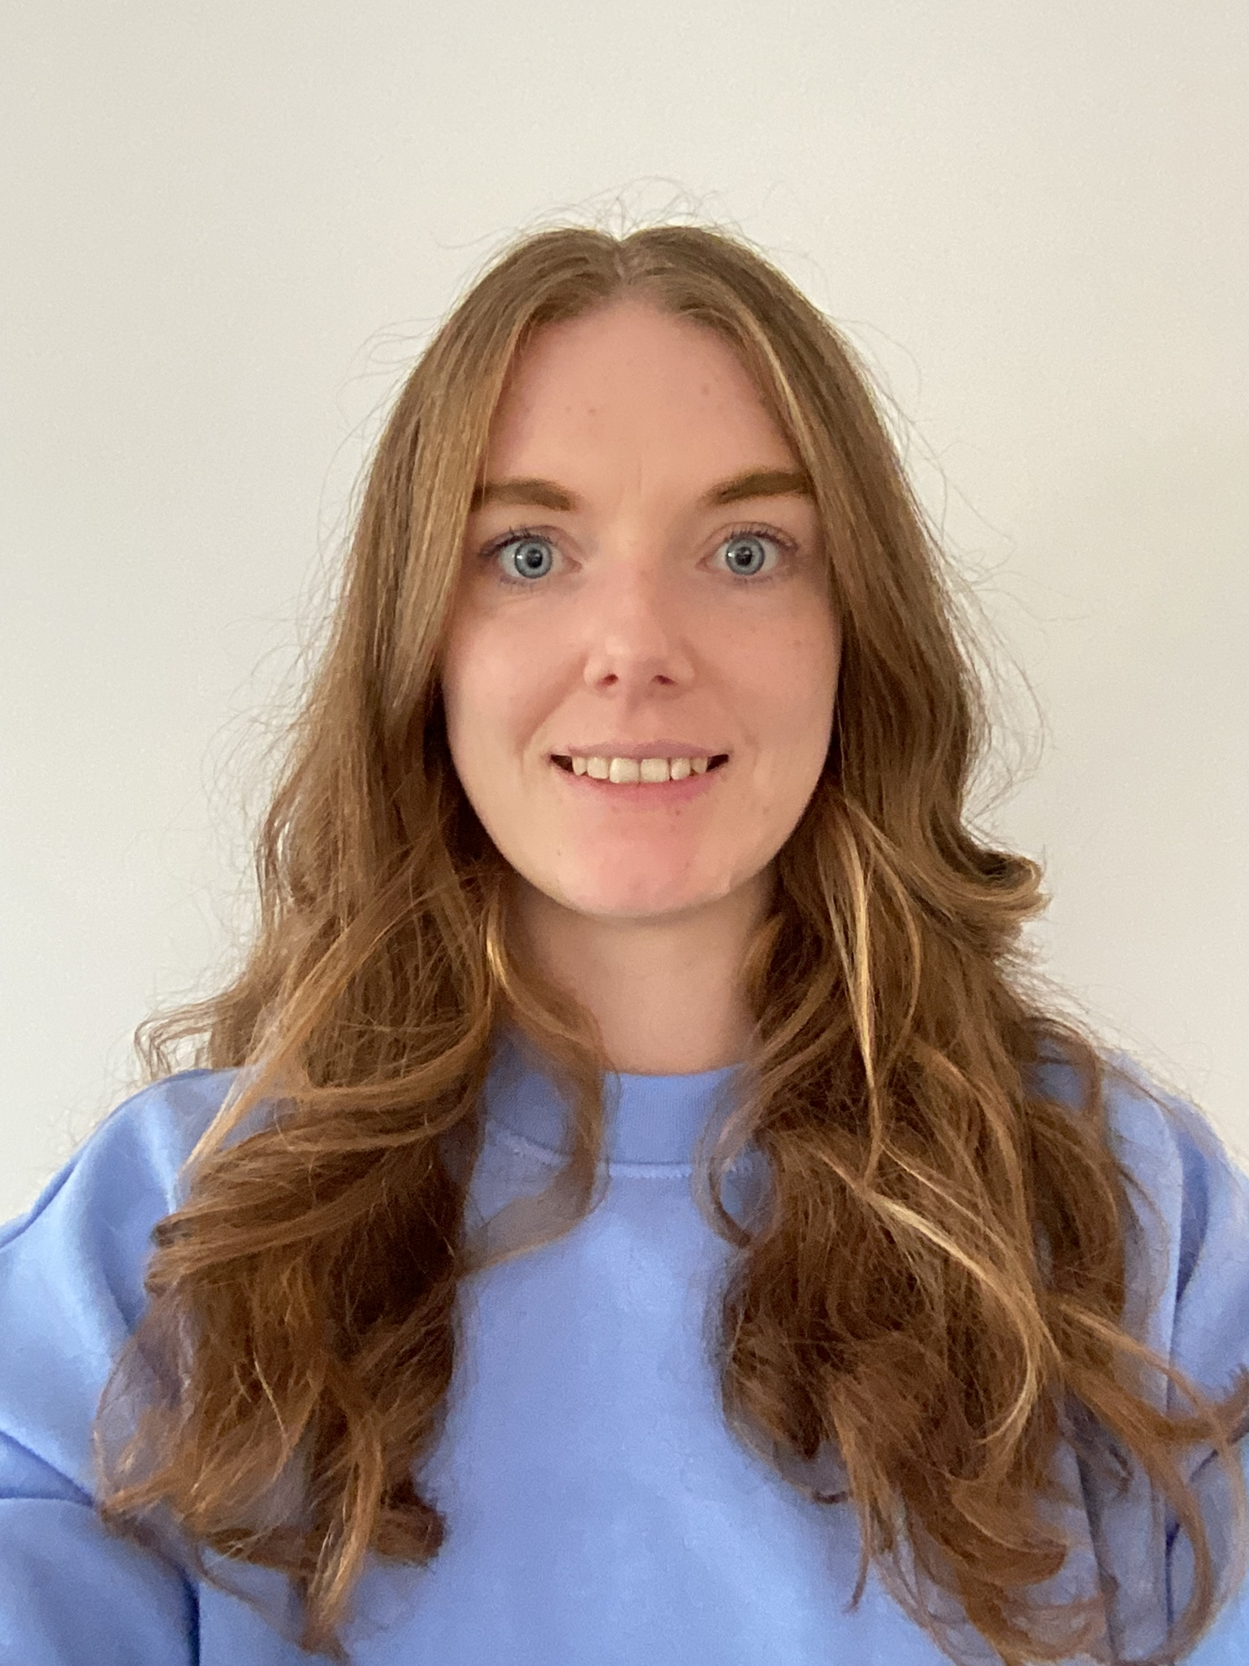
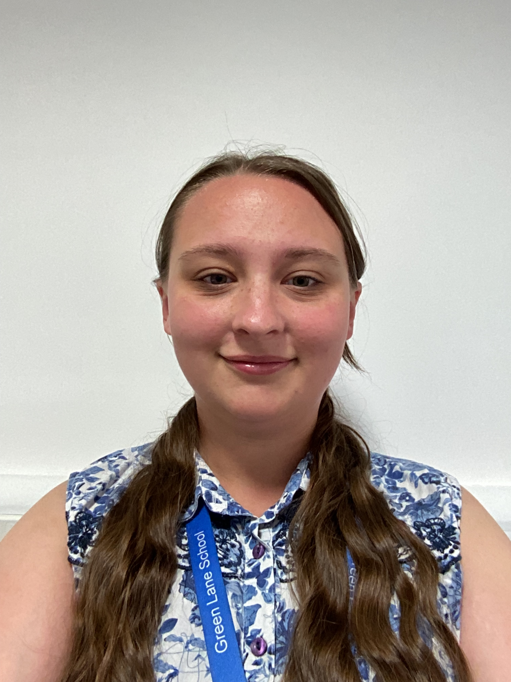
Class team:
Miss Alison Wright – Class Teacher
Class Teaching assistants are:
Miss Karen Brown
Mrs Logan Heywood

Slide 3
Weekly activities:
Thursday- PE lesson with Warrington Wolves
Tuesday PM and Thursday PM- Sensory room for 1 hour.
Friday- Assembly
We will also be taking part in Forest school sessions later in the year.

Slide 4
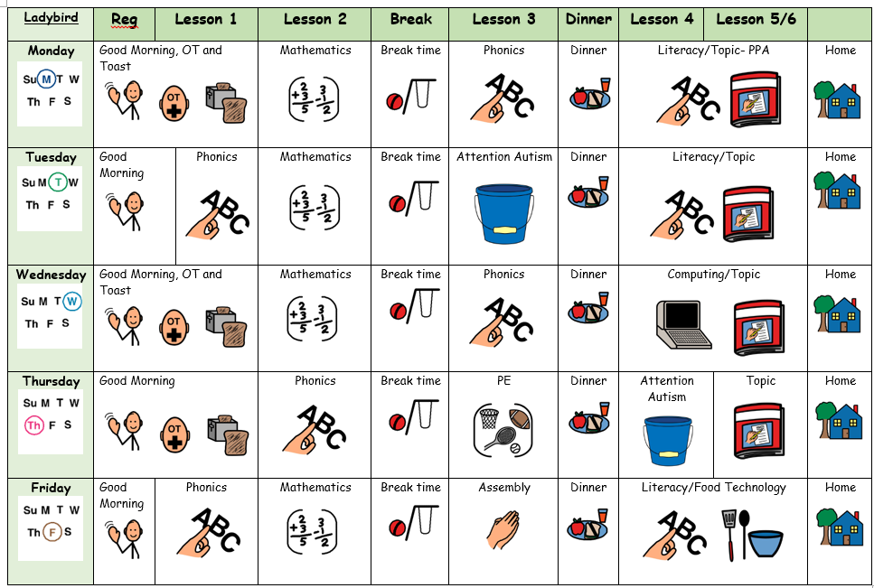

Slide 5
We follow the EYFS curriculum- Development matters.
We have daily phonic sessions.
Work is displayed in books and on EFL (electronic way of capturing learning)

Slide 6
As we arrive to school we have Choose/OT sessions then morning circle time followed by 1:1 work and continuous provision activities.
We have toast mid morning. This is a cost of £1.50 per week which can be paid at the office.

Slide 7
We have a home school diary which is used to communicate what we have lessons and activities we have taken part in during the day.
Any questions please ask.
Thank you
Alison Wright
(class teacher)

