Slide 1



Welcome to Hedgehog Class
2025 - 2026

Slide 2
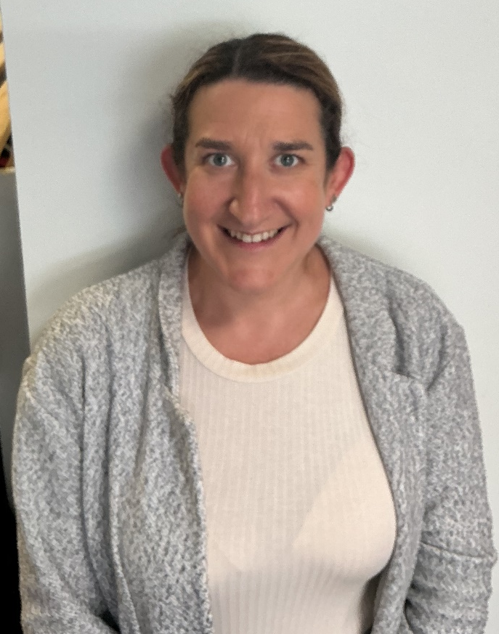
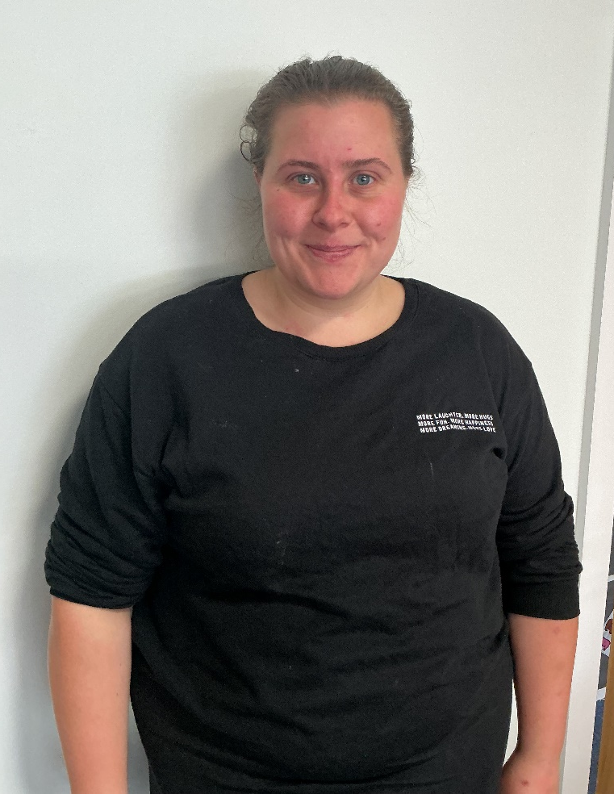
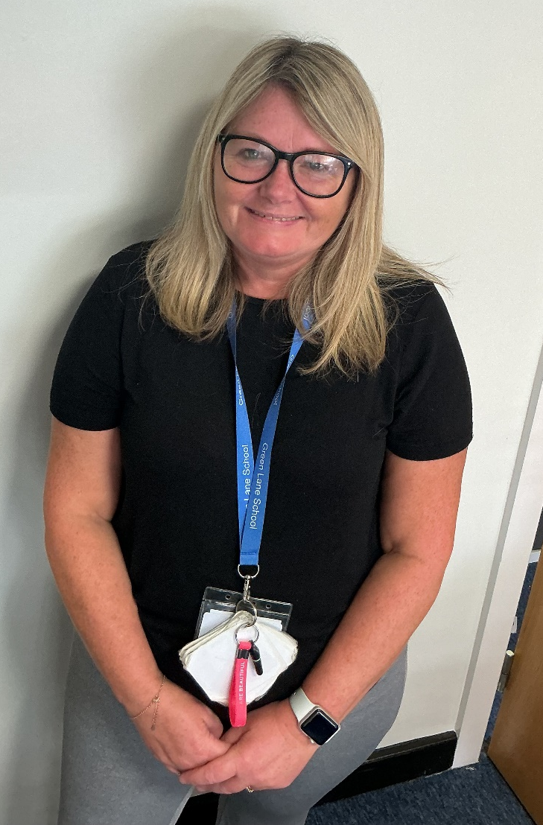
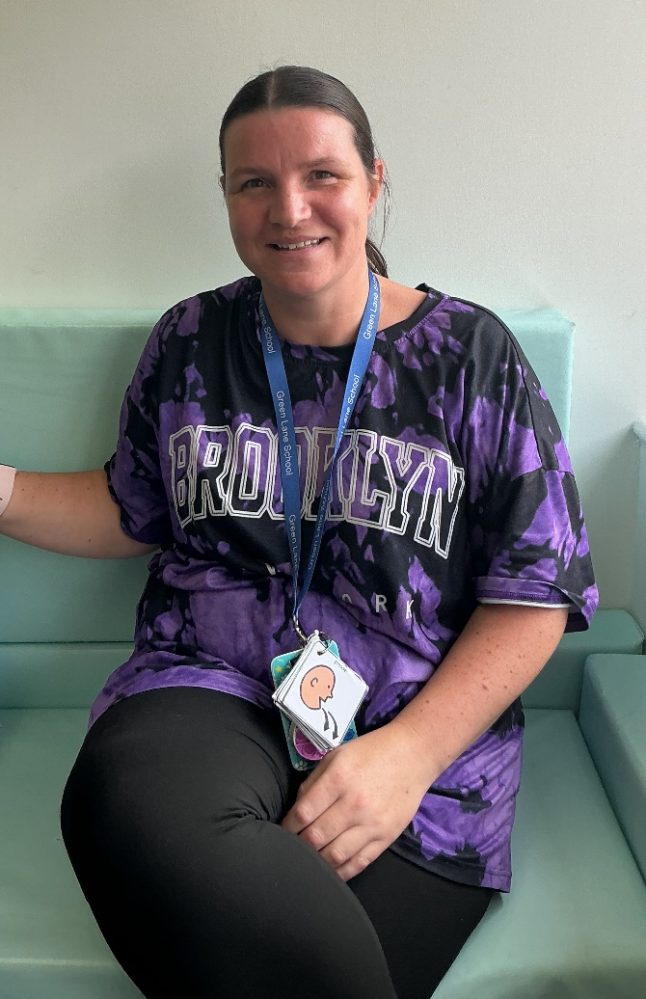
Staff Team
Miss Laura Bell
Class Teacher
Miss Lauren McElory
Teaching Assistant
Mrs Lisa Donnelly
Teaching Assistant
Miss Christine Baddeley
Teaching Assistant

Slide 3
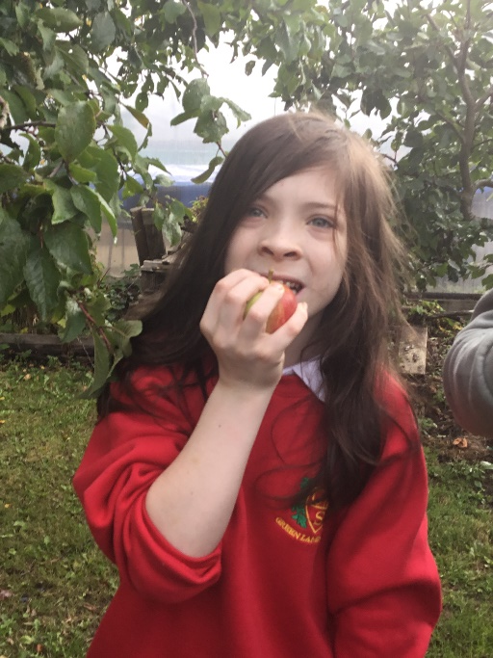
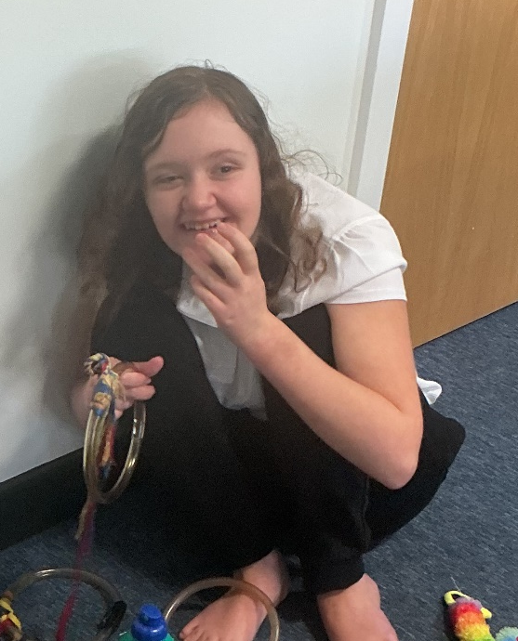
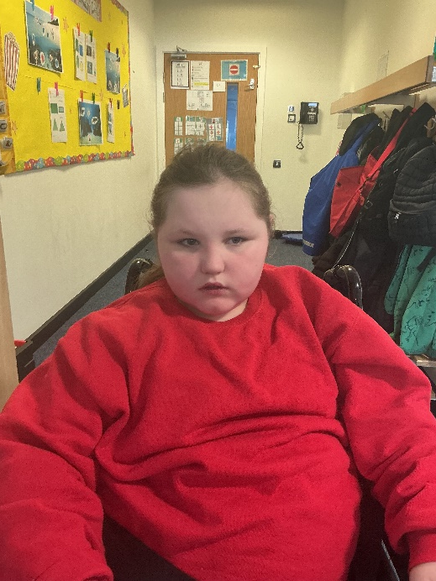
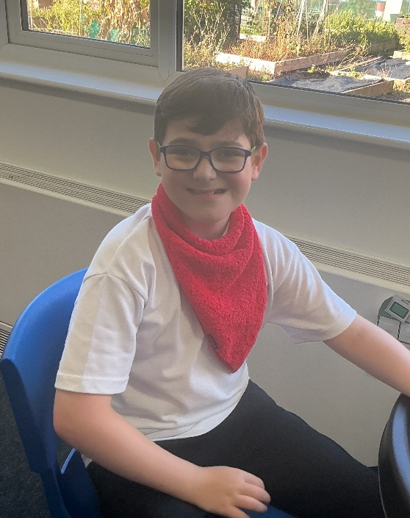
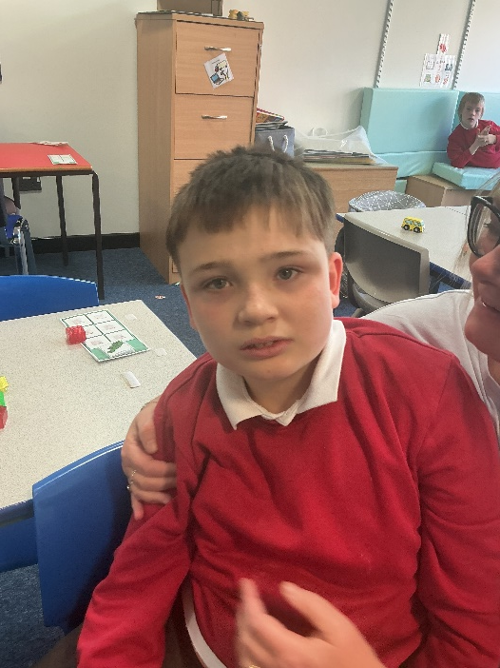
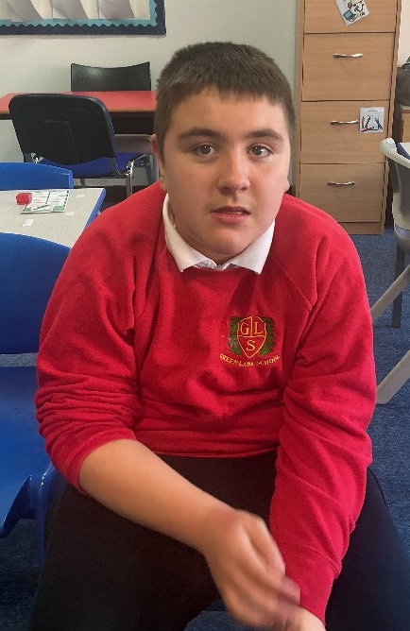
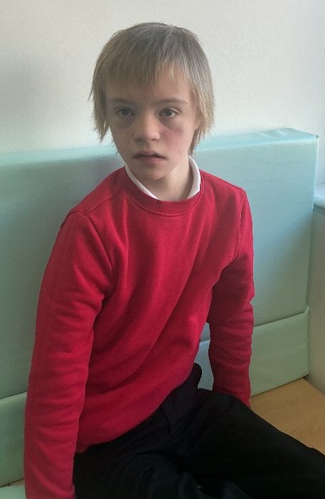
Hedgehog class works across both the Maple and Willow Pathways. The pupils are in Key Stage 3 (years 7 - 9)

Slide 4
Key Information
  We work on a topic based curriculum with some of the pupils working on the SCERTS programme. alongside this
  This programme works on developing social communication and emotional regulation alongside the transactional supports that are provided by staff.
  SCERTS links in with all life skills, which is a huge part of Hedgehog Class and this is built into all aspects of the school day.
  All lessons in Hedgehog Class involve practical and sensory aspects, including ranges of technologies to facilitate engagement and concentration.
  Our activities and lessons take place both inside and outside the classroom.

Slide 5
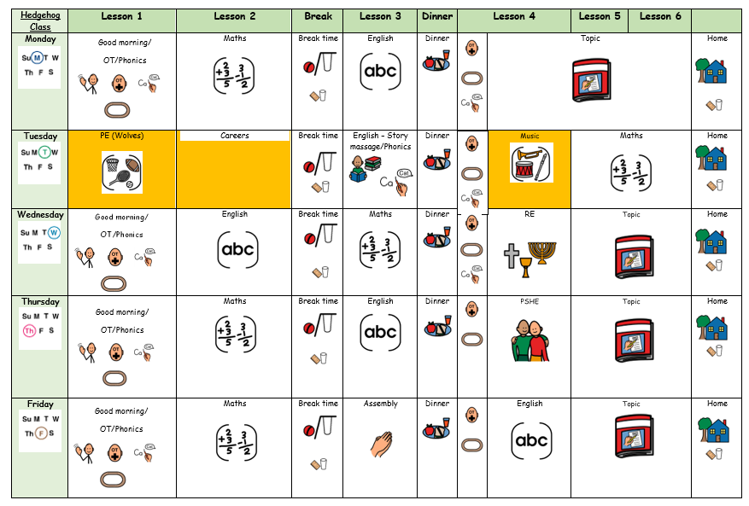
Our Weekly Timetable,

Slide 6
Yearly Overview
The Hedgehog curriculum includes all statutory subjects at Key Stage 3. This includes English, Maths, Science, Computing, PSHE & Physical Education.
 | Autumn 1 | Autumn 2 | Spring 1 | Spring 2 | Summer 1 | Summer 2
 | Under the Sea | Seasons | Adventure | Rainforest | Greek Mythology | Into the Future
Maths | Number – Place Value Number – Addition and Subtraction Geometry - Shape |  | Number – Place Value Measurements – Length and Height Measurement – Mass and Volume |  | Number – x and ÷ Fractions Geometry – Position and direction Measurement – Time and money
English | Topical stories/ Real Life issues. | Seasonal poems - Acrostic | Adventure Stories | Non-Chronological reports | Myths and Legends | Balanced arguments/ Writing letters
Science | Habitats | Sounds of the season | Rocks and Volcanoes | Plants that grow in the rainforest | Exploring materials | Electricity
History | Famous Explorers and underwater discoveries |  | Famous explorers and Adventures |  | Greek Mythology
Geography |  | Seasons and extreme weather |  | The Amazon |  | Map Skills
RE | Special places visiting places or worship. | Christmas/ Christmas around the world | Christianity Easter traditions | What do Muslims celebrate | Judaism The touch and helping others | Sikhism and equality
Art | Collage | Seasons | Travel inspired art | Rainforest | Ancient Greek pottery | Into the future
DT/Food Tech | Aquariums | Decorations/ Seasonal food | Watercraft boats Food for adventure | Food grown on trees. Poison frog beanbags | Greek buildings. Greek food. | British inventors.
Computing | Typing skills, exploring apps | Internet safety | Programmable toys/coding | Presenting information | Films Animation | Using the internet
PSHE | Exploring how choices affect the environments | Mental Health and wellbeing | Keeping safe in an emergency | Caring for animals | Saying no and staying safe | Goals and Aspirations.
Careers. | Doing good |  | Community Cafe |  | Free to be me

Slide 7
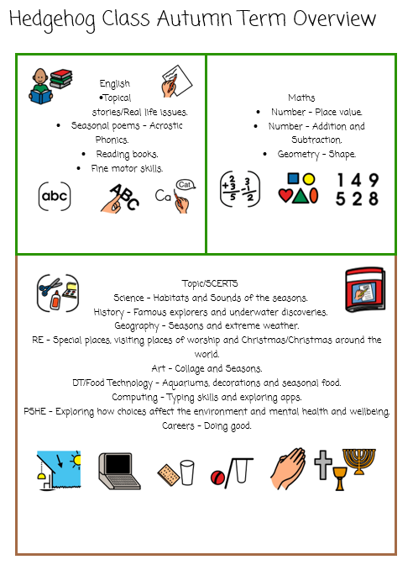
Termly Overviews
Each term you will be sent an overview showing what topics are being taught in each subject for that term.

Slide 8
Approaches and supports used throughout school and in Hedgehog Class.
  SCERTS (Social Communication, Emotional Regulation, Transactional Support).
  TEACCH approach (Treatment and Education of Autistic and Related Communication Handicapped Children)
  SPELL approach (Structure, Positive approaches and expectations, Empathy, Low Arousal, and Links)
  PECs (Picture Exchange Communication Systems)
  AAC (Augmentative and alternative communication)
  Occupational therapy / Sensory

Slide 9

Main aims of SCERTS
1. Understanding what a child’s behaviour is achieving for them and then teaching other skills to substitute for the less desirable ones.
2. Sets goals for everyone working with the child.

Slide 10
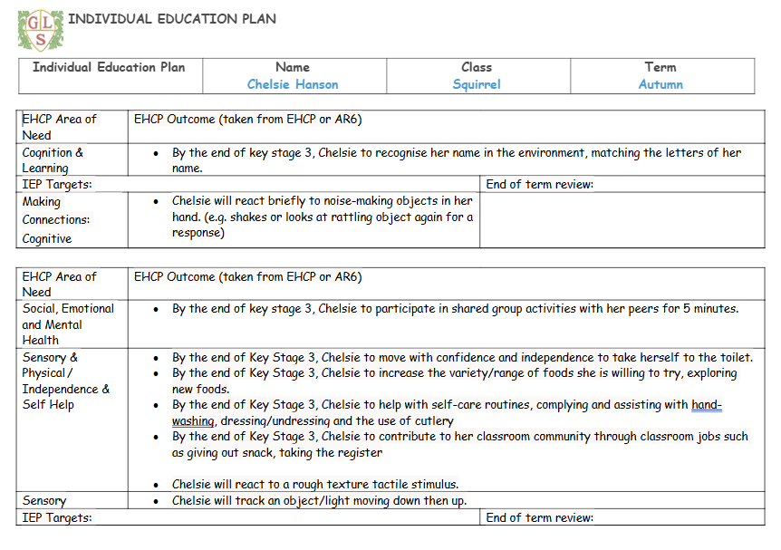
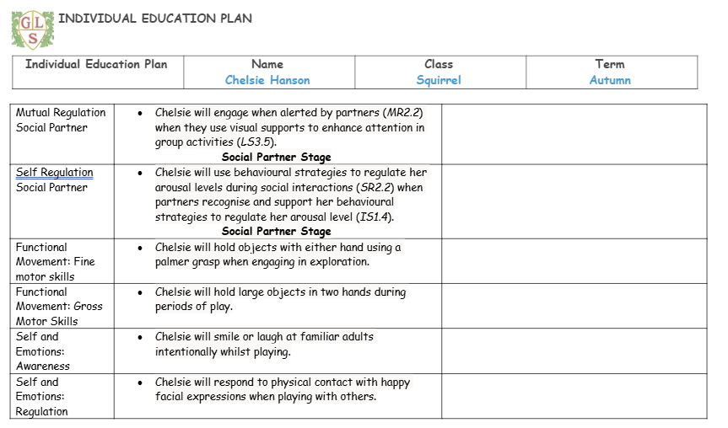
IEP/SCERTS Targets.

Slide 11
Snack
  Snack times are important times during the school day in Hedgehog class!
  We use snack time as a lesson itself, working on SCERTS and SALT targets / communication methods as well as other curriculum areas such as maths (number, counting and sharing).
  Our main snack lesson is just before morning break and we have short drink and snack just before the end of the day.
  If possible, we ask you contribute up to £1 a week for snack.
  If pupils prefer to bring their own snack, this is also absolutely fine!

Slide 12
PE
  PE will take on Tuesday morning and is run by the wolves.
  Please feel free to send in trainers if you would like, but this is not necessary.

Slide 13
Evidence for Learning (EfL)
  You can keep up to date with everything your child has been doing on our Evidence for Learning app.
  Work is shared on the app on a weekly basis. So you are able to see what they have been learn about that week.
  End of year reports are also shared on the Evidence for Learning app.
  If you need any help with this then please let myself or a member of the class team know and we can sort this for you.

Slide 14
Home School Diaries
  All students within Hedgehog class will have a home school diary which will have information, daily, about what has taken place during in the day, which will enable conversations and communication at home about school.
  Please also use this book to let the team know what they have been up to at home during the evenings or weekends and of course if there are any messages or question, please don’t hesitate to write these in.

Slide 15

Any Questions

Slide 16
Thank you
Thank you for taking the time to join us! As always your support is much appreciated.

