Slide 1



Welcome to Bumblebee Class
2025-2026

Slide 2
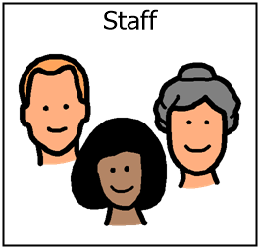
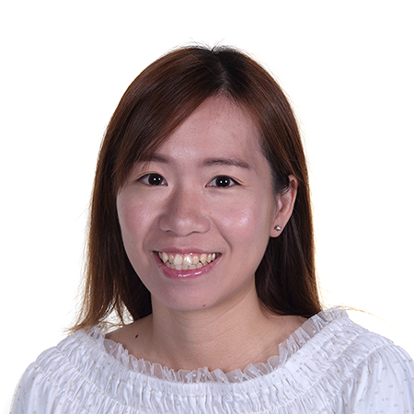
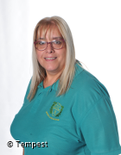
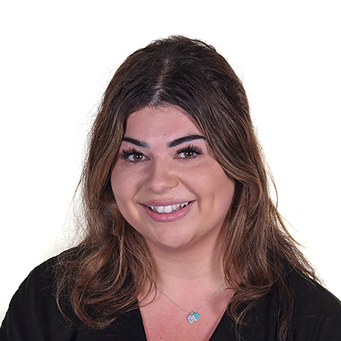
Staff team / Introductions
Miss Webster
Mrs Wong
Mrs Mckenna
Class Teacher
Teaching Assistant
Teaching Assistant
Other staff: Miss Chadwick (PPA cover), Miss Butler (PPA cover), Mr M Higham (Music), Warrington Wolves (PE)

Slide 3

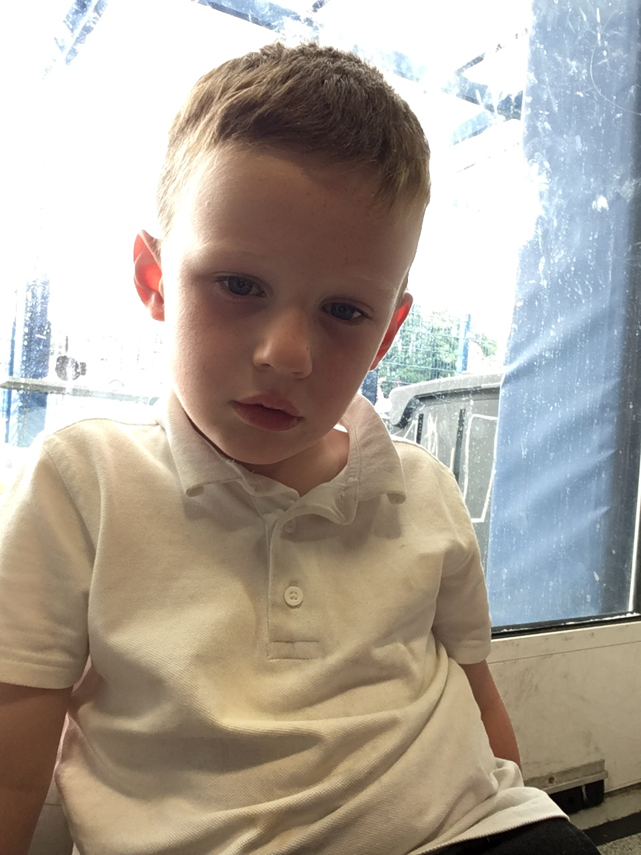
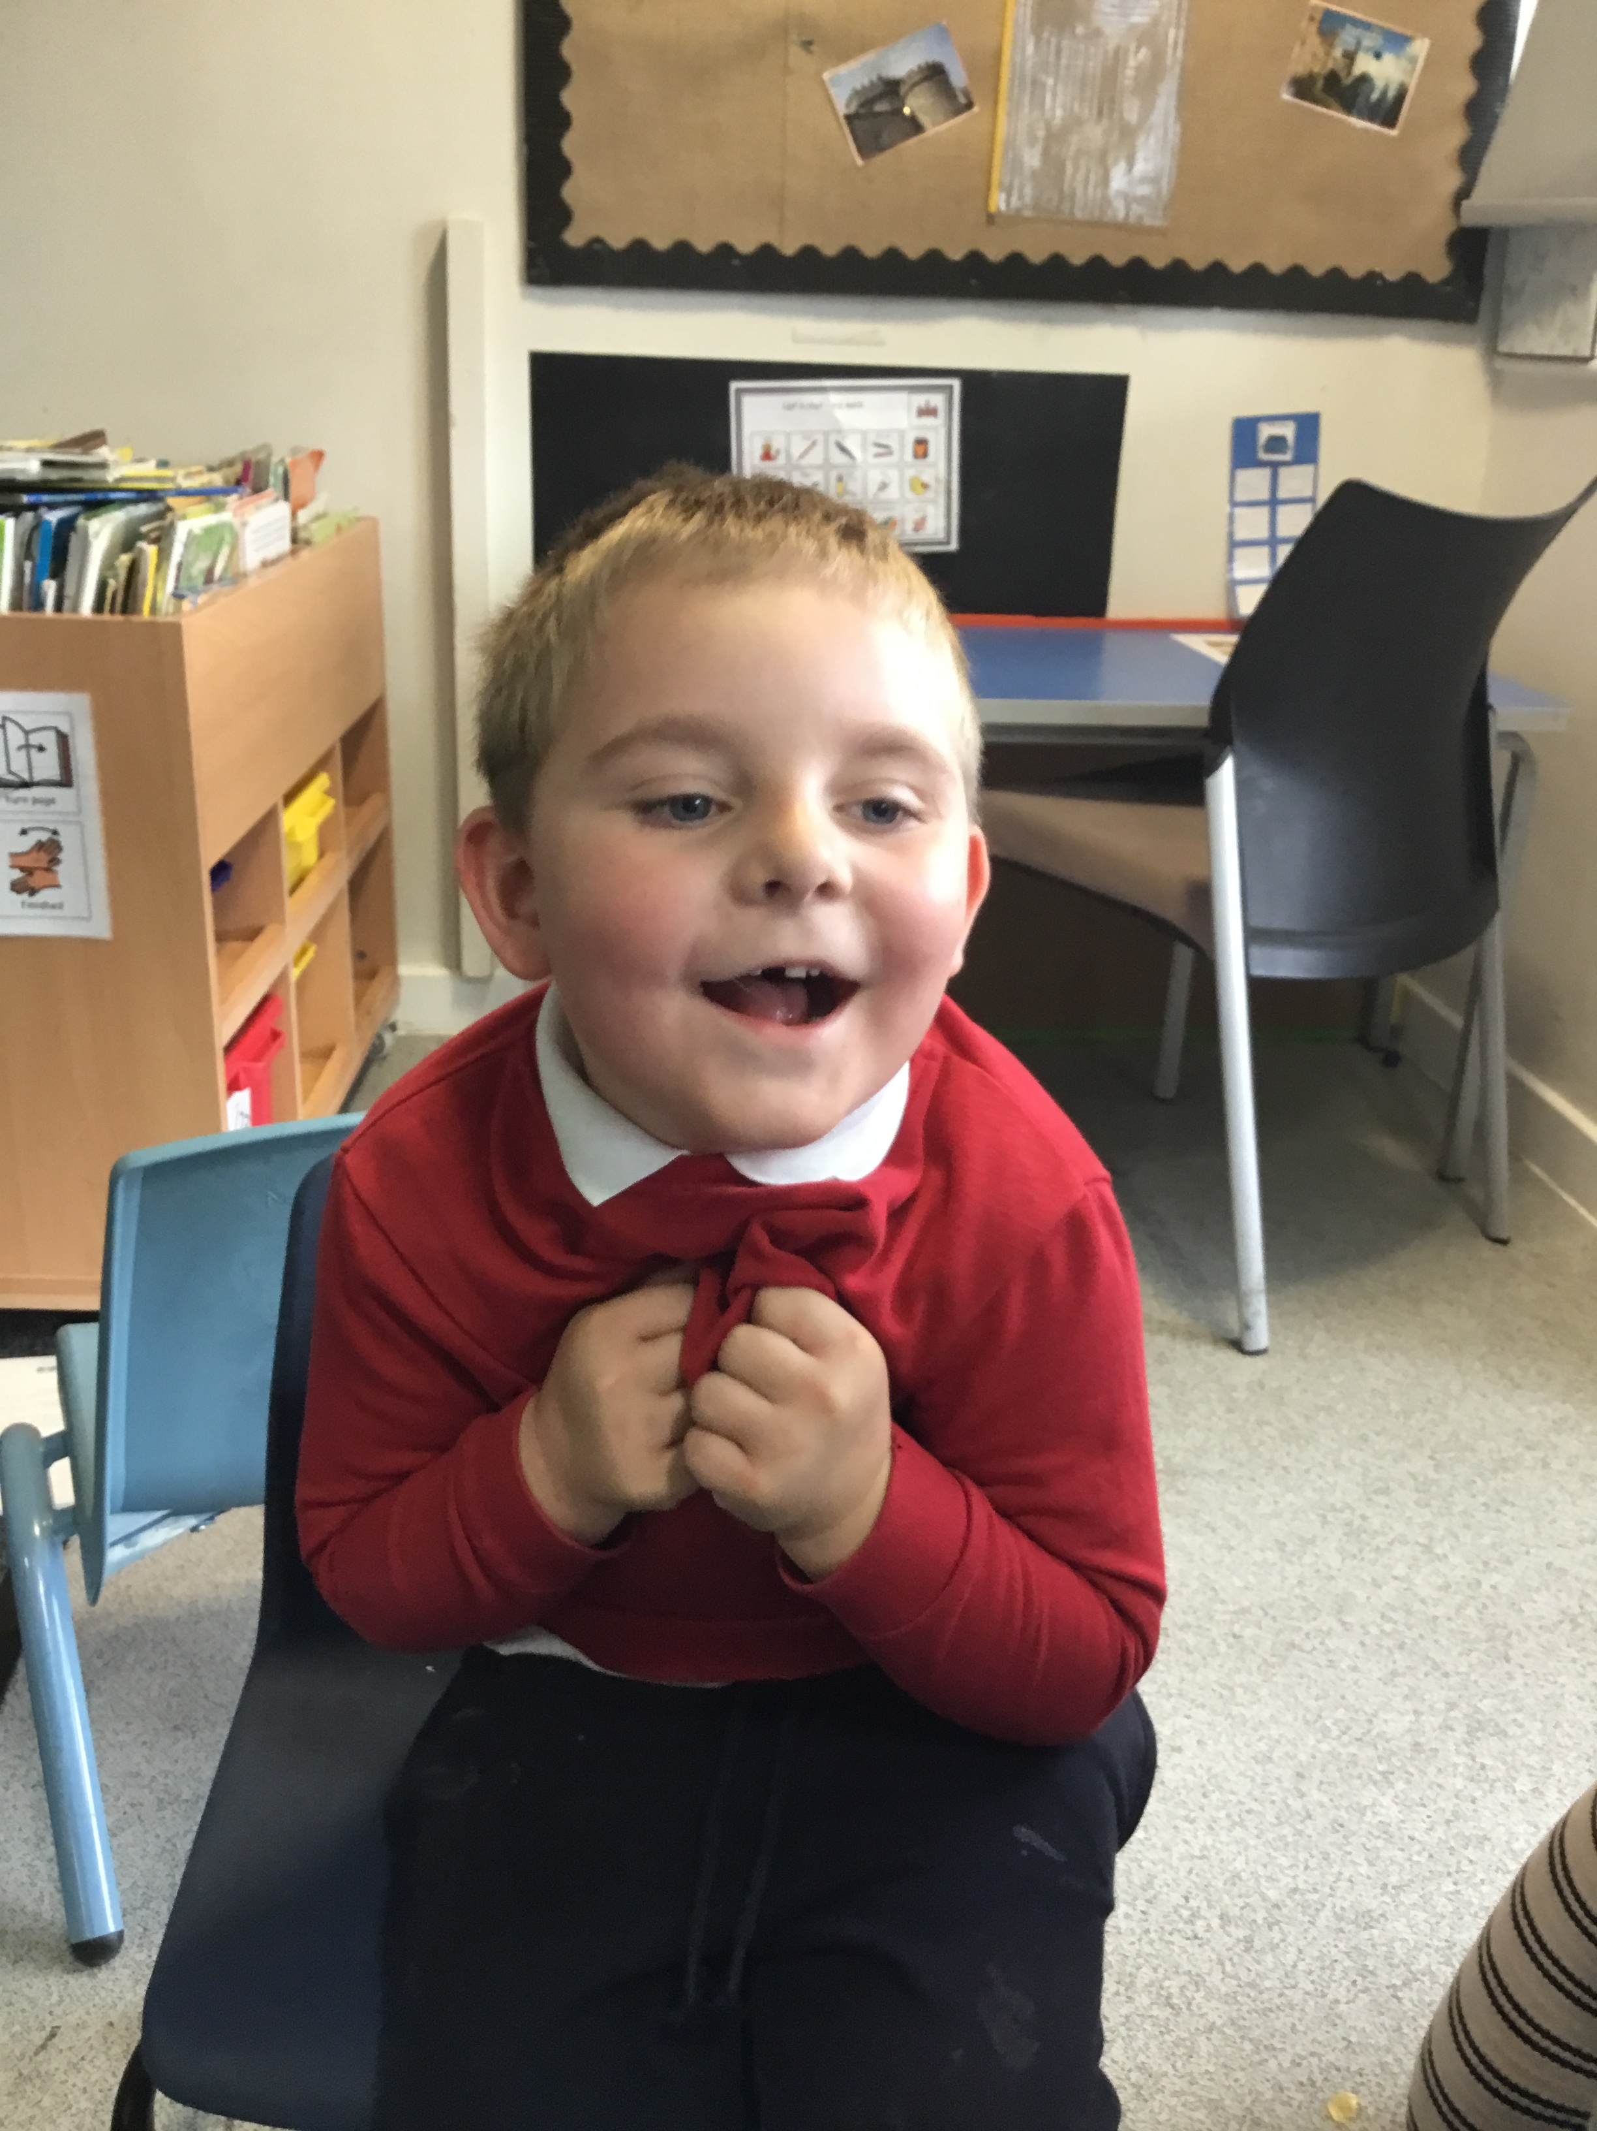
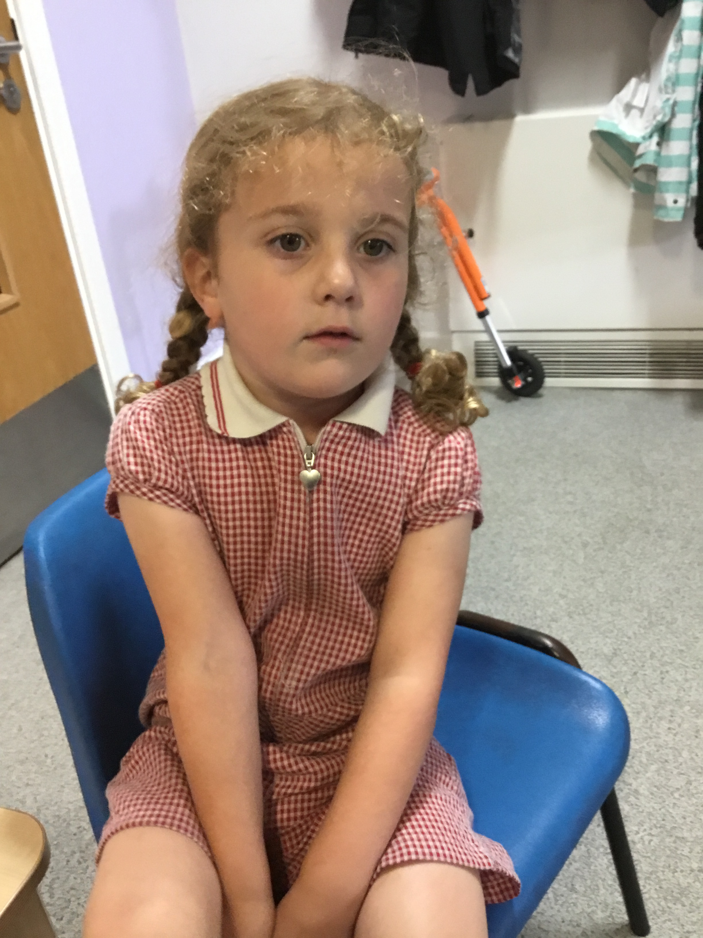
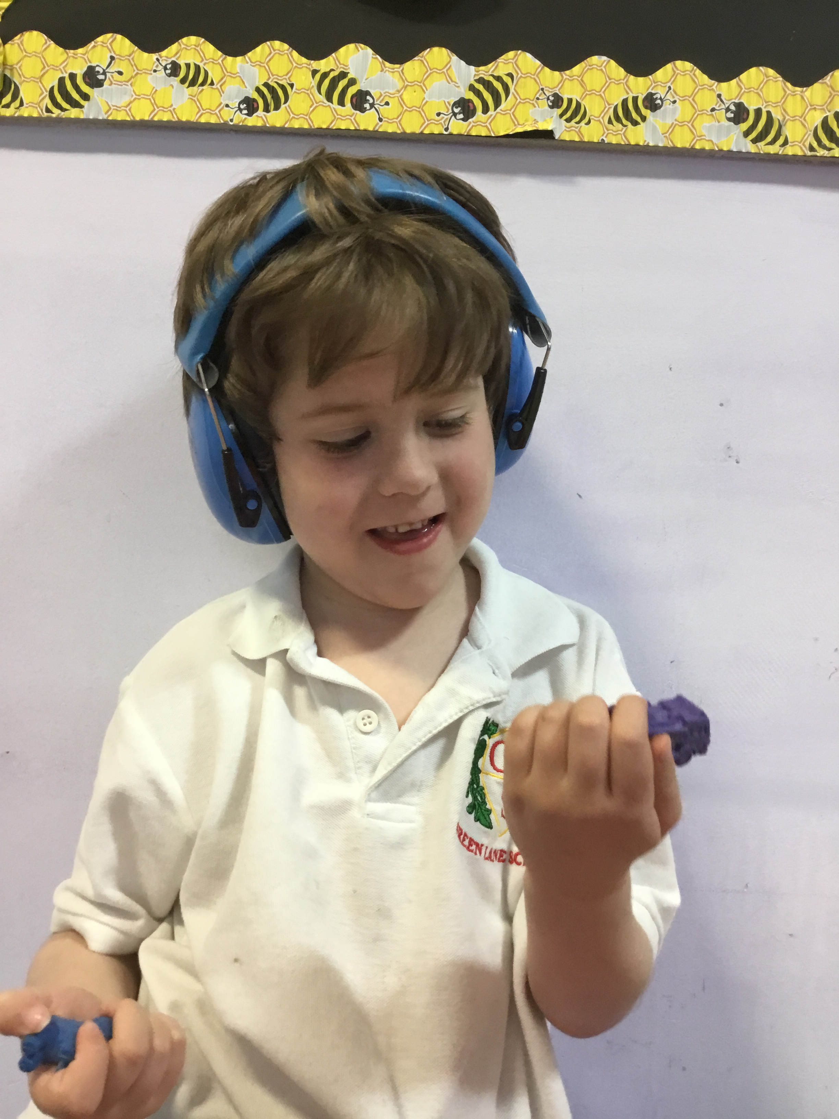
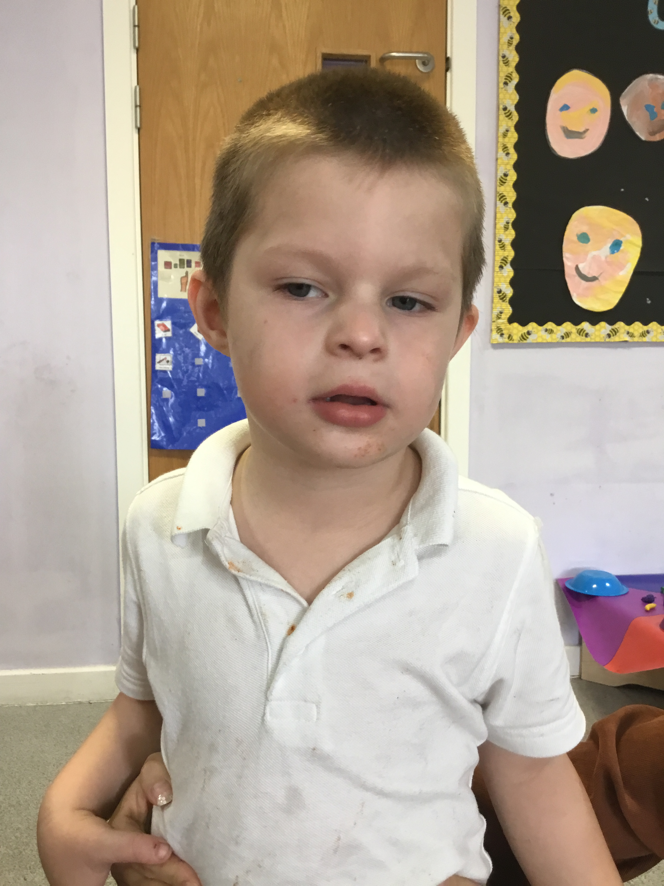
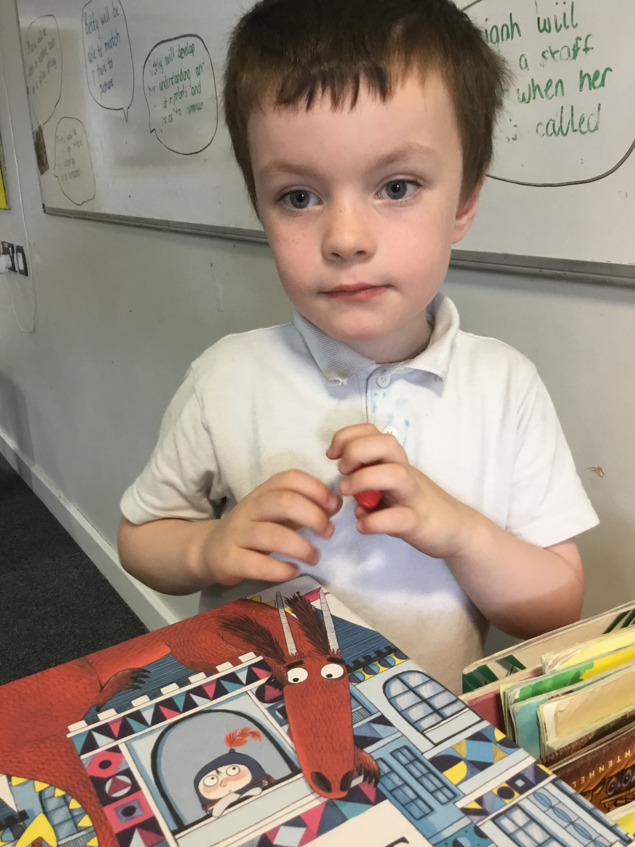
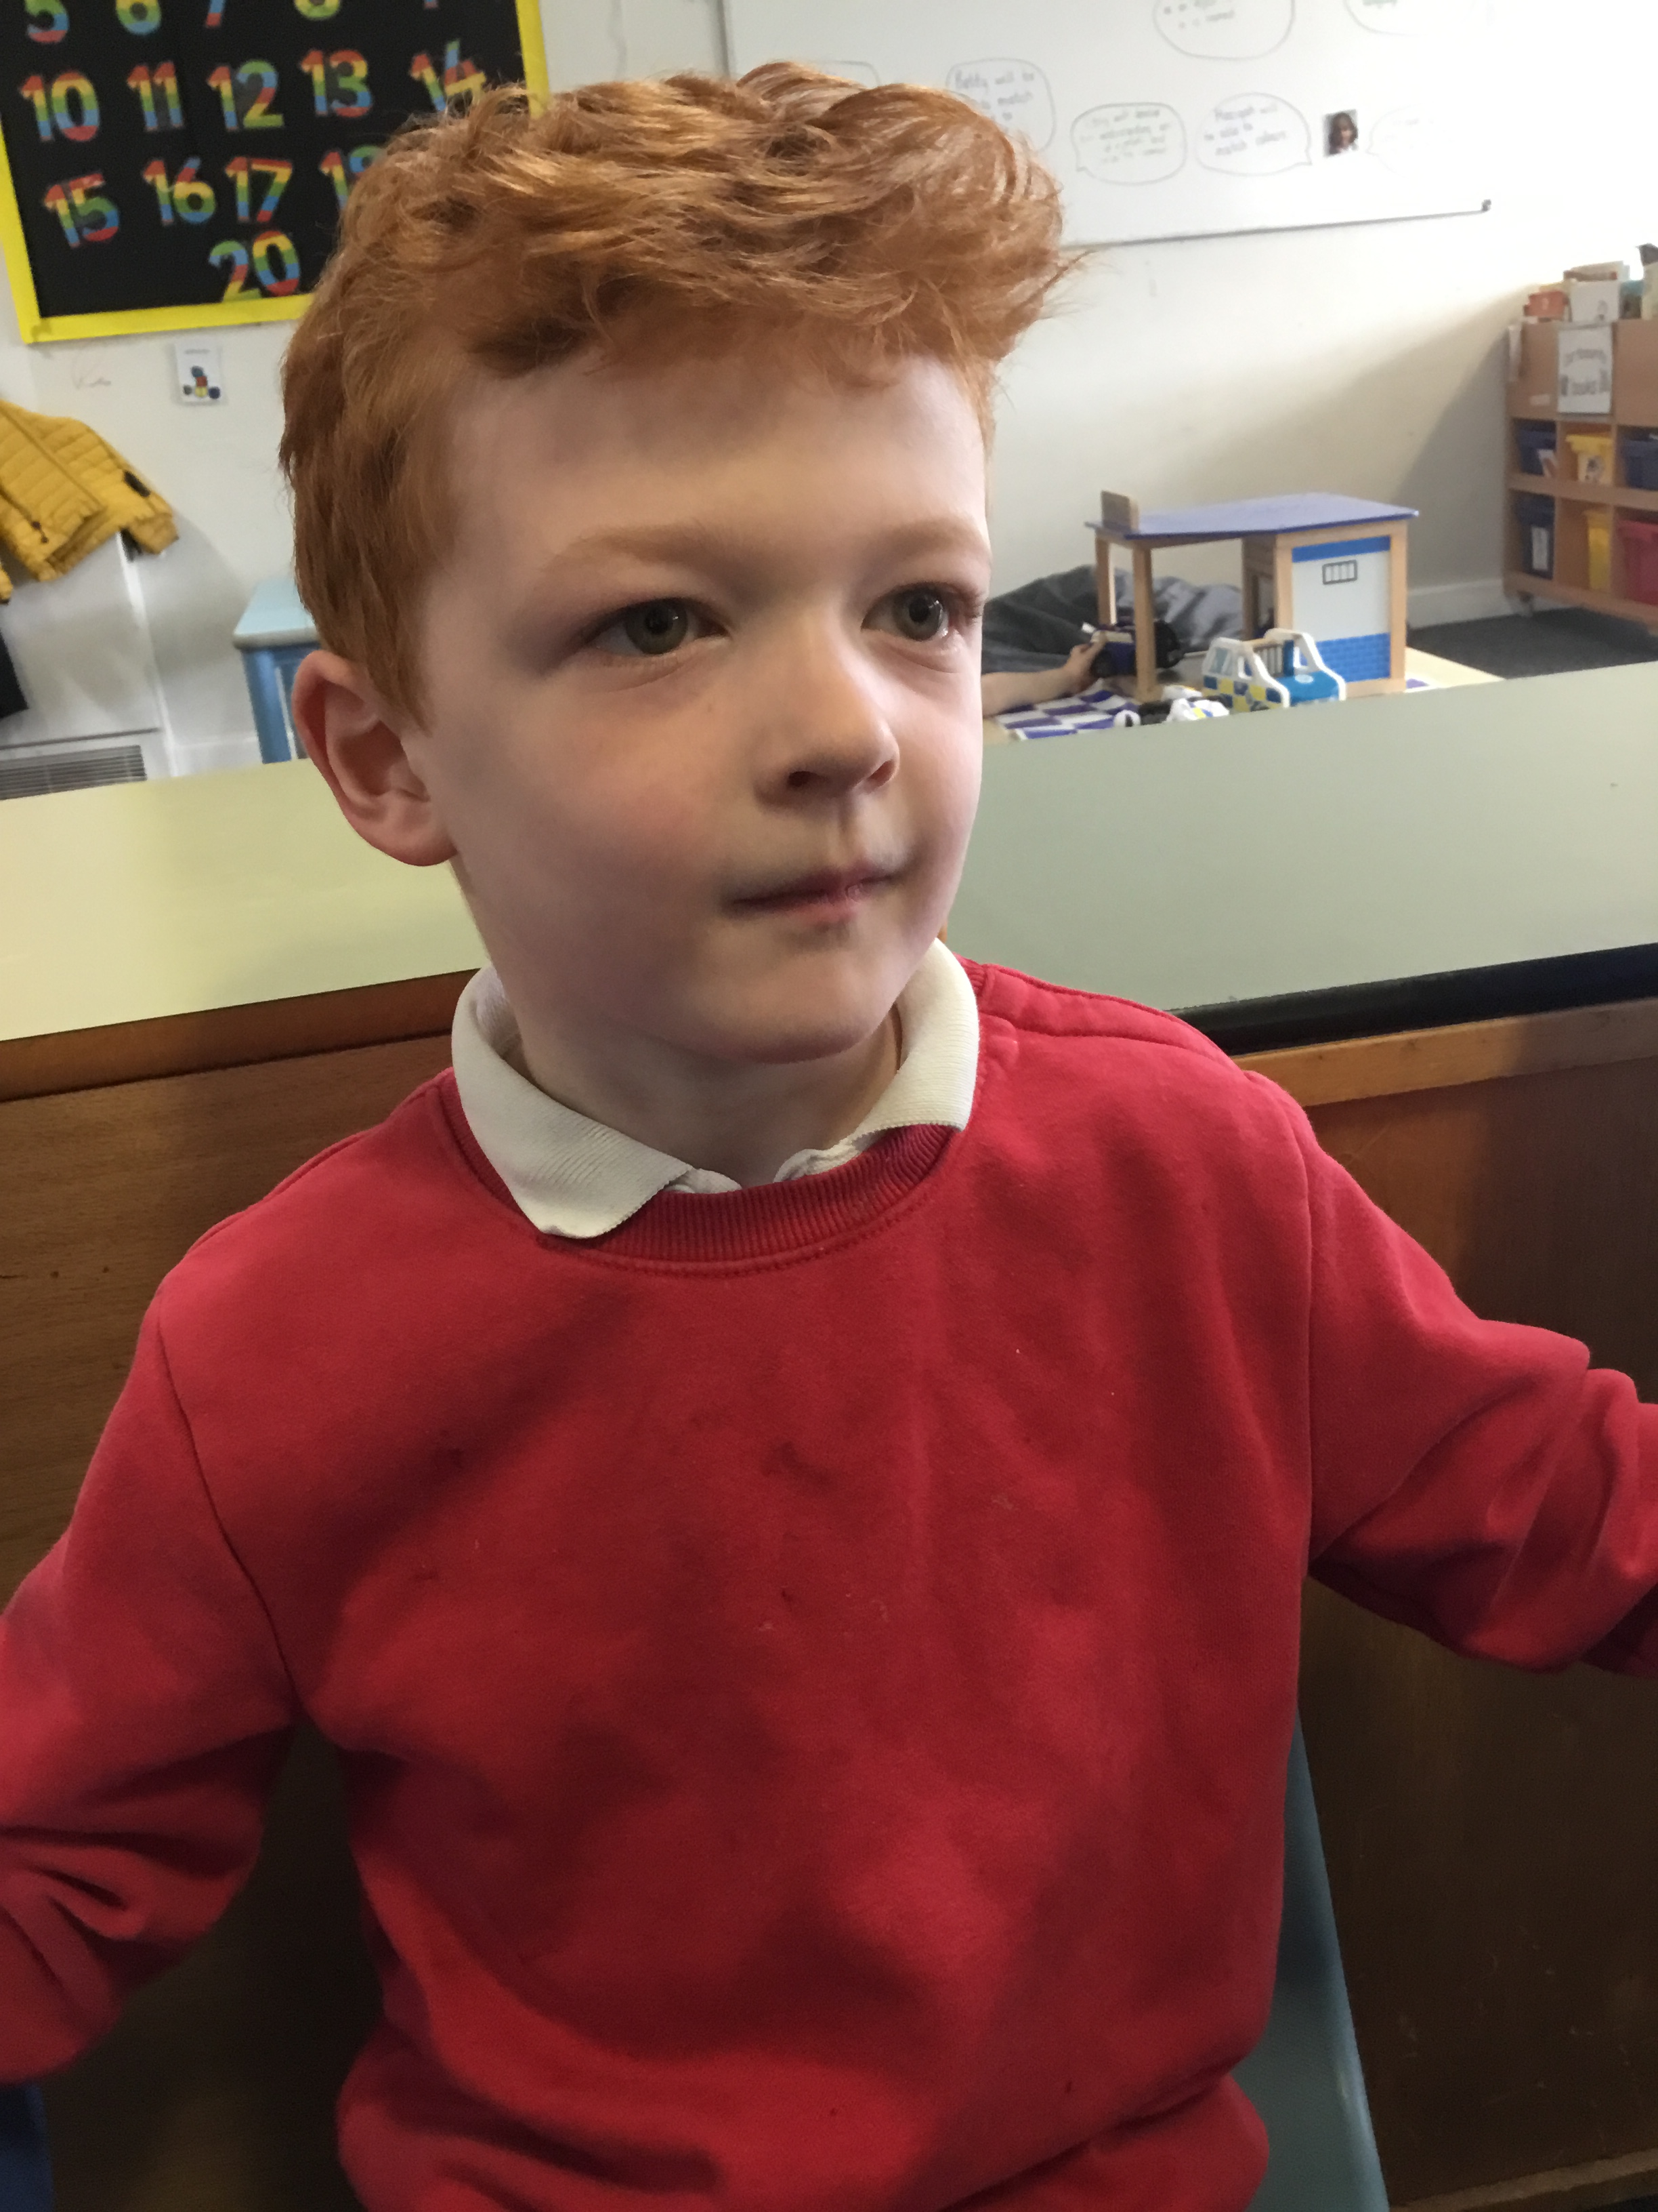
Bumblebee Class is a Willow Pathway, which means we have a creative approach to following the curriculum.
We have 7 students in our class this year!

Slide 4

Key information about Bumblebee Class
Our learning approach is creative which means children access their learning through adult led work based activities, group work, attention autism sessions and activities that are in their environment to enhance learning.
All lessons in Bumblebee Class involve practical and sensory aspects, including ranges of technologies to facilitate engagement and concentration.
Our activities and lessons take place both inside and outside and all pupils will develop independent work skills in their own workstations.

Slide 5

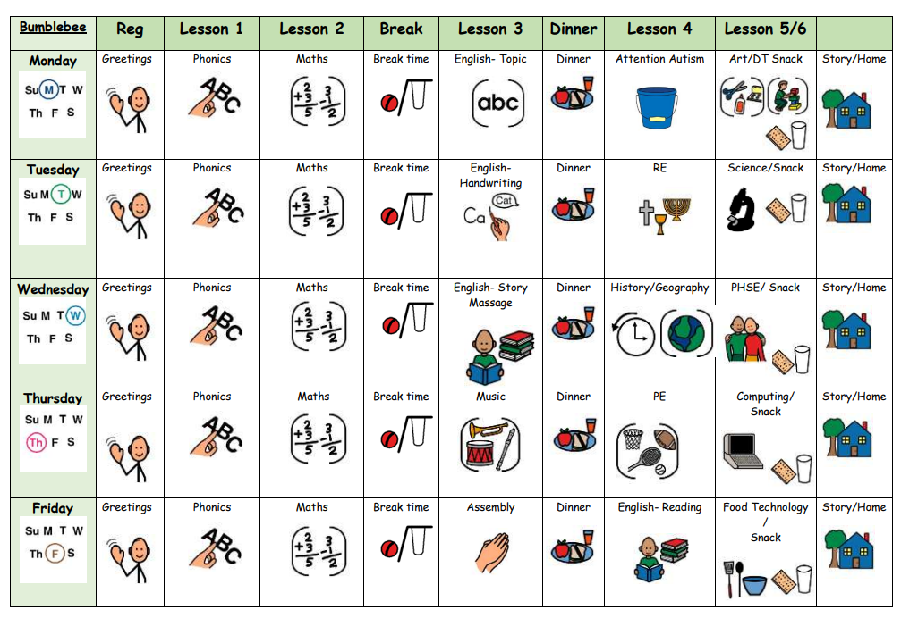
Our weekly timetable

Slide 6

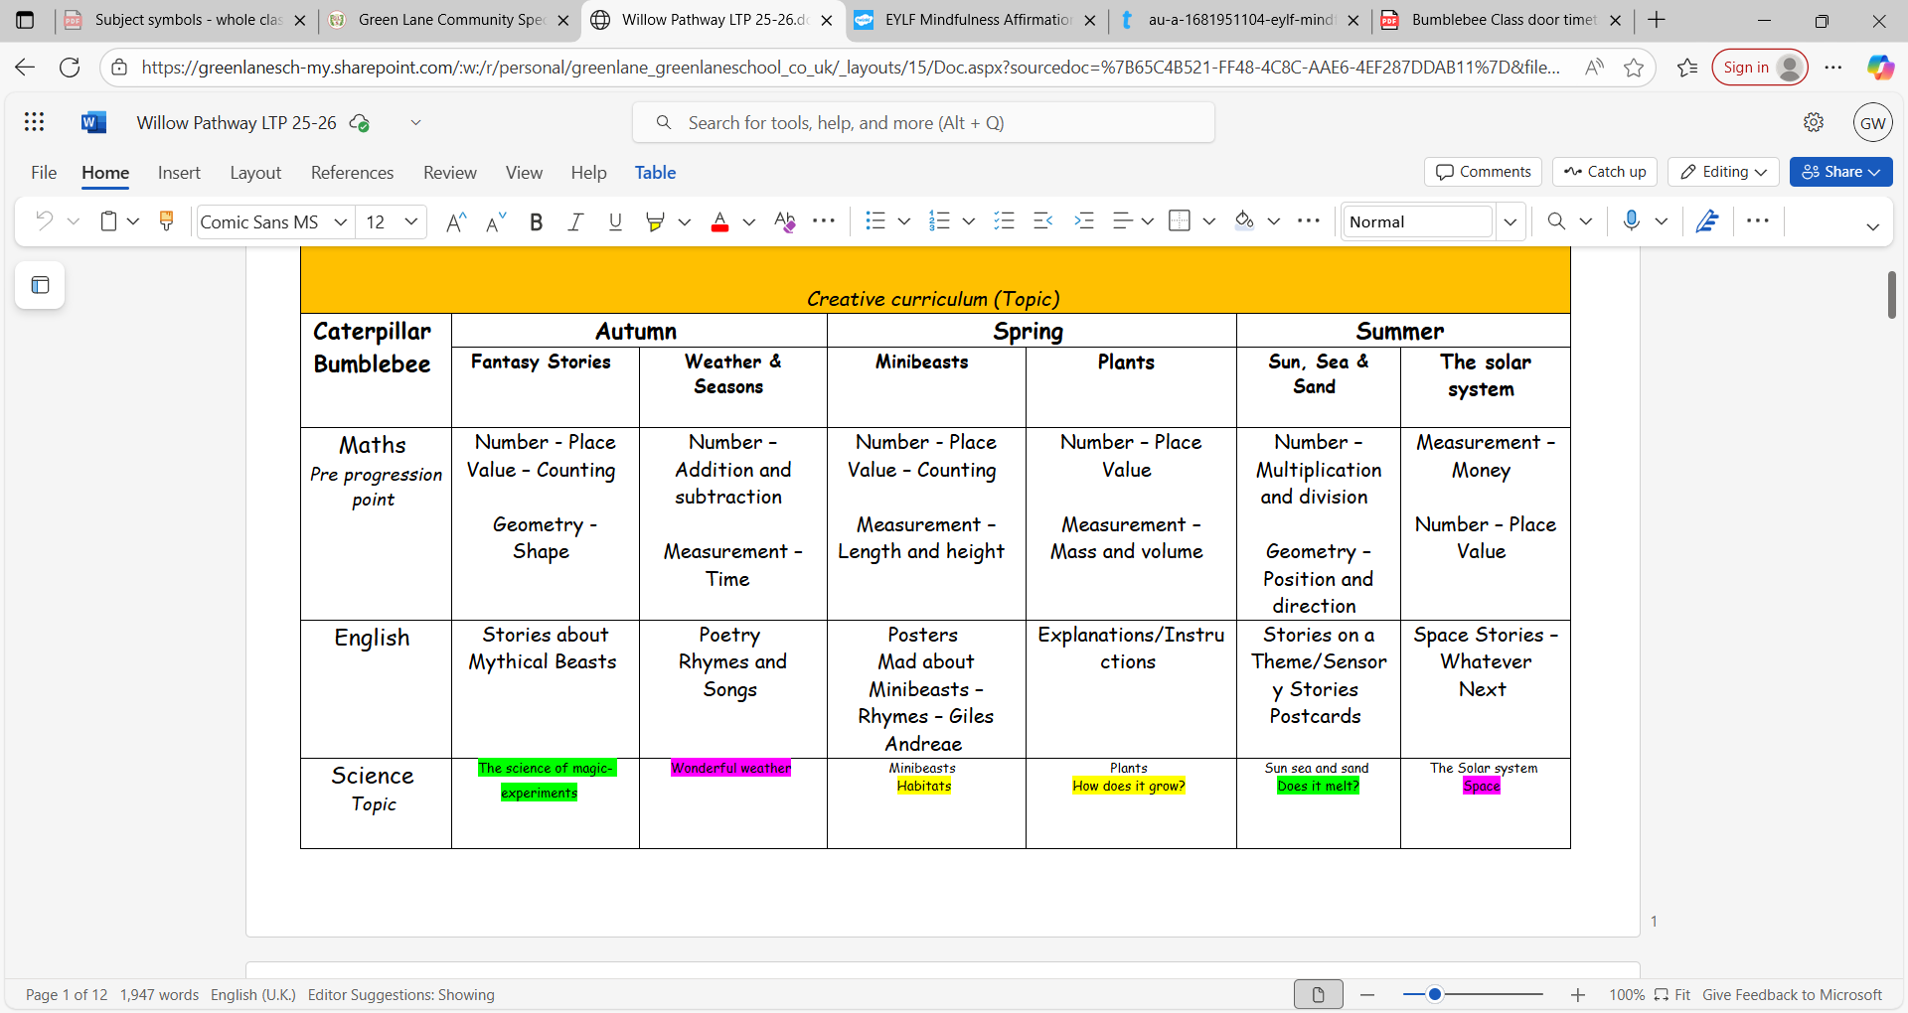
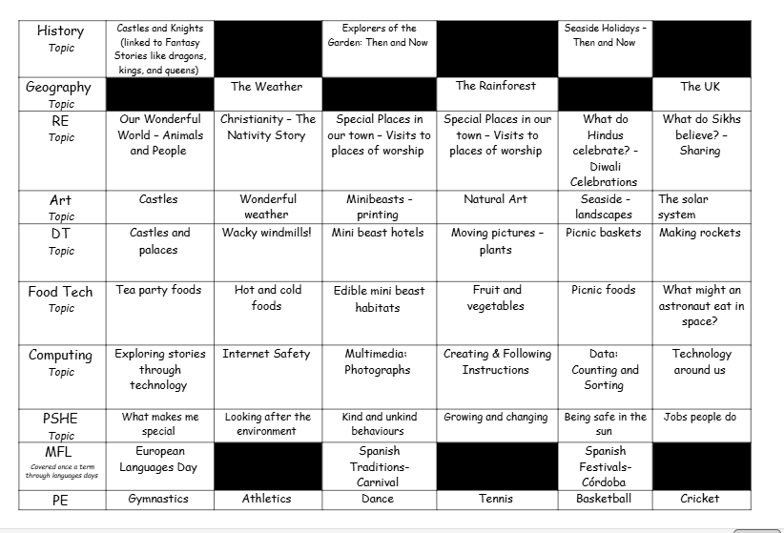
Yearly overview
The Bumblebee curriculum includes all statutory subjects at Key Stage 1 and 2. This includes Phonics, English, Maths, Science, Computing, RE, PSHE & Physical Education.

Slide 7
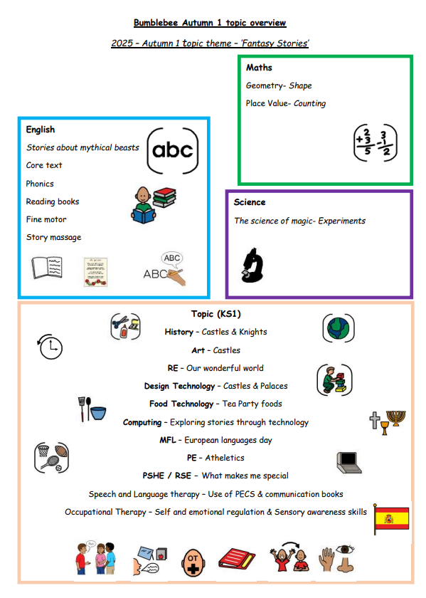
Termly overviews
Each term you will be sent an overview showing what topics are being taught in each subject for that term.

Slide 8
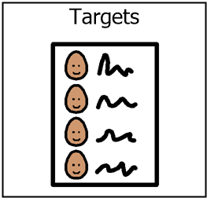
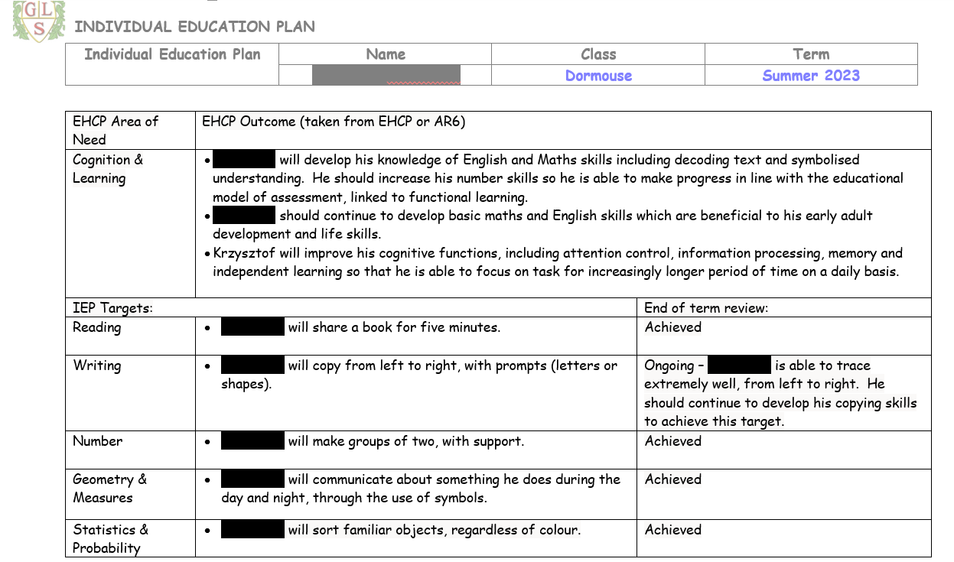
IEP targets

Slide 9
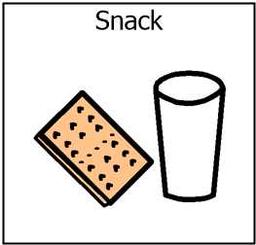
Snack
Snack times are important times during the school day in Bumblebee class!
We use snack time as a lesson itself, working on SALT targets / communication methods as well as other curriculum areas such as maths (number, counting and uses of money).
We have two snack times; the first is after greetings time and another before the end of the day.
If possible, we ask you contribute up to £1.50 a week for snack, this is voluntary. This helps to covers some of our Food Technology ingredients and contributes towards anything messy & fun we have out in class!
If pupils prefer to bring their own snack, this is also absolutely fine!

Slide 10
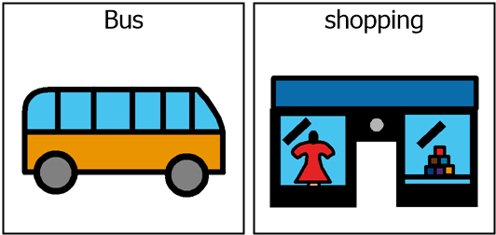
Out of school visits
Termly trips- we will be planning some trips out into the local community this year; CAFT, local sensory centre Preston space centre & more!
These are great community lessons and contribute to LOTS of learning and different experiences. It supports social understanding, life skills, communication, self-regulation and emotional regulation, all contributing to both academic learning skills and our curriculum.

Slide 11
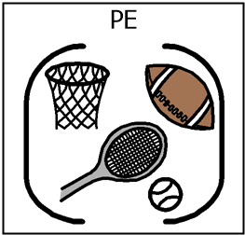
PE
PE will take place on Thursday afternoons - Wolves.
Please send a PE kit or a change or shoes / trainers.

Slide 12

Evidence for learning (EFL)
Keep up to date via EFL.
Evidence sent home each week.
End of Year report.
Homework.

Slide 13

Home school diaries
All pupils in Bumblebee Class will have a home school diary which will have information, daily, about what has taken place during in the day, which will enable conversations and communication at home about school.
Please also use this book to let the team know what they have been up to at home during the evenings or weekends and of course if there are any messages or question, please don’t hesitate to write these in.

Slide 14
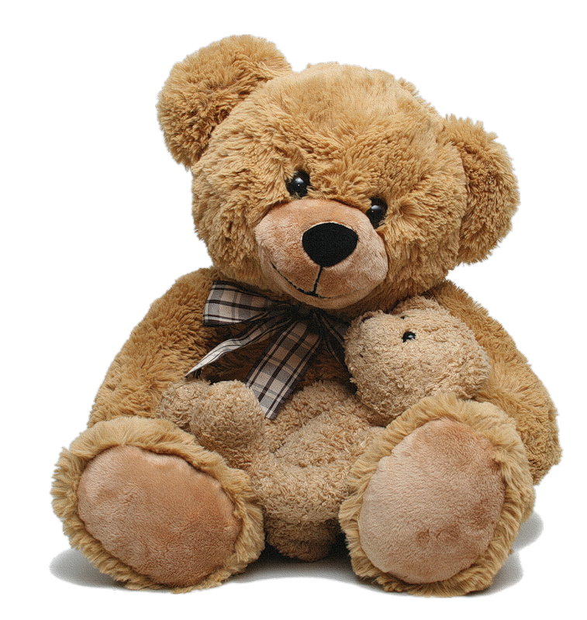
Buddy the Bear
In Bumblebee Class we have a class mascot ‘Buddy the Bear’
Buddy goes home from Friday-Monday

Slide 15

Any questions?

Slide 16

Thank you for taking the time to join us! As always your support is much appreciated.

