Slide 1
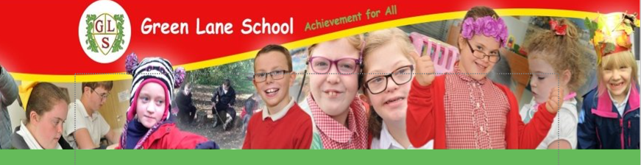
Welcome to Otter Class

Slide 2
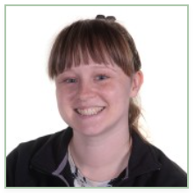
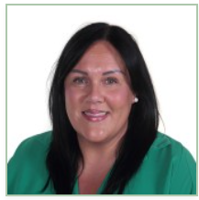
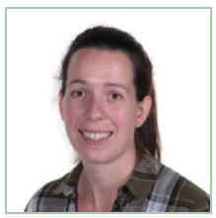
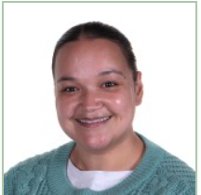
Introductions…
Mrs Green
Class Teacher
Mrs Kirwan
Class TA
Mrs Chapman
1:1 TA
Mrs Gray
1:1 TA

Slide 3
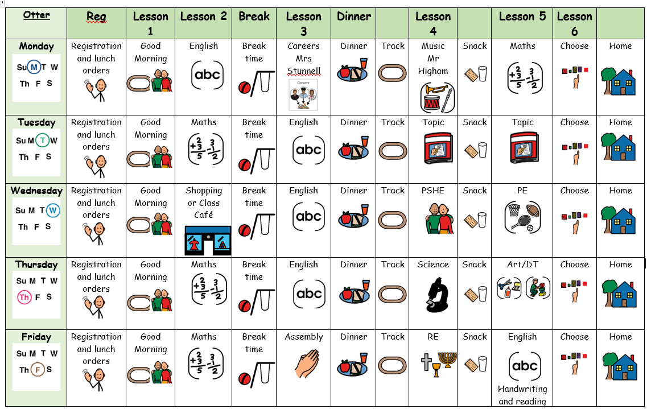
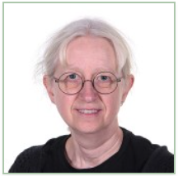
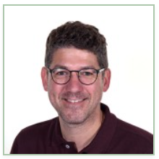
Our Timetable…
Mrs Stunnell teaches us 1 English lesson and our careers lesson each week
Mr Higham teaches us Music

Slide 4
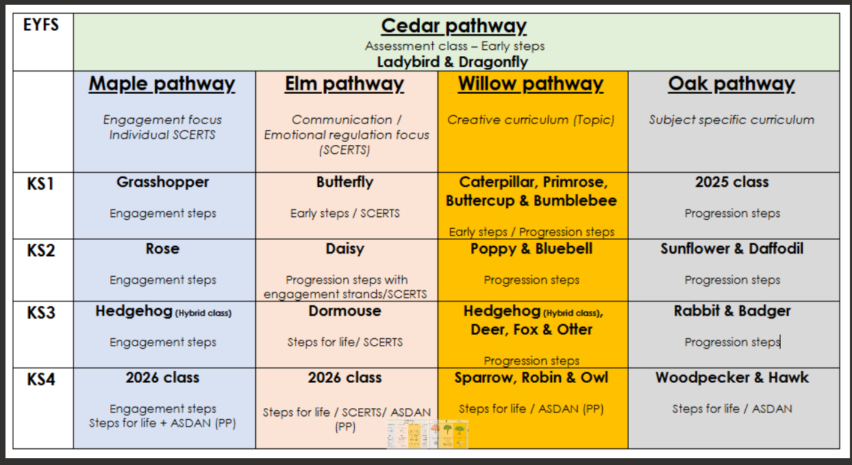
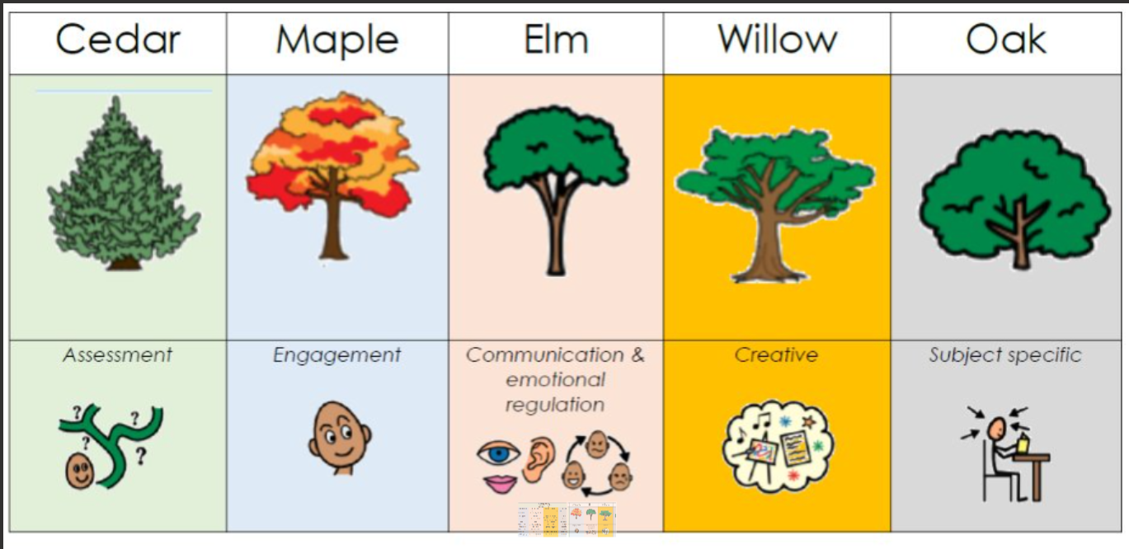
Pathways

Slide 5



What should pupils bring to school daily?
Students each have a home/school diary, which you have all been using so far. Anything you need us to know, pop in here!
Reading books and records are given in line with students Phonics assessments. We aim to read with your child on a 1:1 basis once a week and sometimes more when we can. Please record in the reading record when you have read with your child at home.
Books will be changed as required.
Water bottles – most of our students are bringing them in. We do have cups and offer juice to our students too.

Slide 6
Homework…
We like to know what our students get up to at the weekend. We will send homework home called ‘Weekend News’ which we encourage our students to complete, or to assist the completion of.
We may also be sending home some specific tasks for our students to complete at the weekend, such as ‘go for a walk’ or ‘play a game with a friend or member of your family’. This will be a fantastic opportunity to develop independence skills whilst spending quality time with family and friends. We encourage photos to be taken and uploaded to EfL where possible please!

Slide 7

Any questions?

Slide 8
The Classroom…
Let's have a look!

Slide 9

Thank you for taking the time to join us this afternoon! As always, your support is much appreciated.

