Slide 1
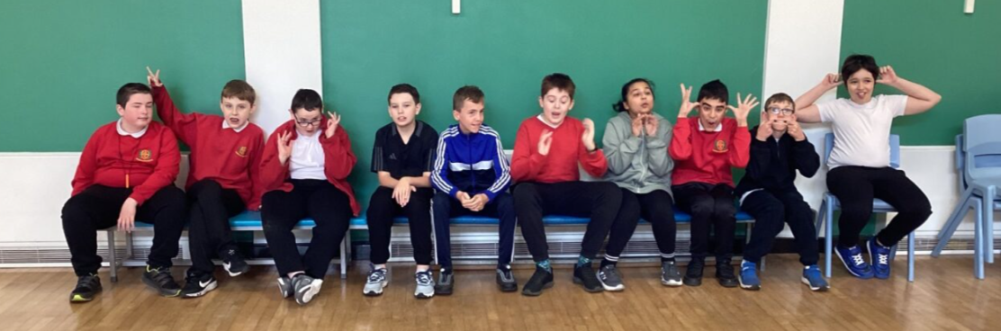
Welcome to Fox Class
2025-2026

Slide 2
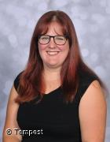
Introductions…
Miss Taylor
Class Teacher

Slide 3
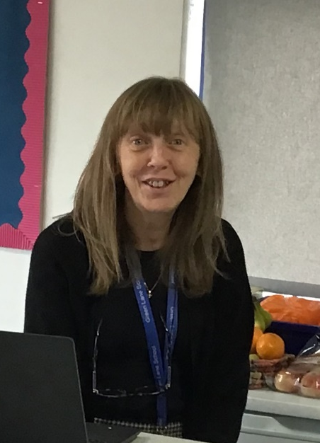
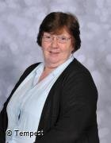
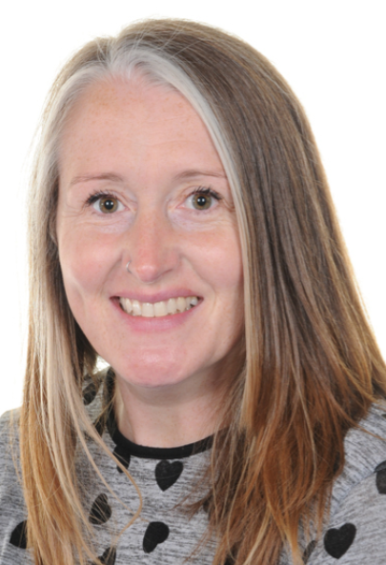
Introductions…
Mrs Dey
Mon-Wed
Mrs T
Mon-Fri
Mrs Davies
Thurs-Fri

Slide 4
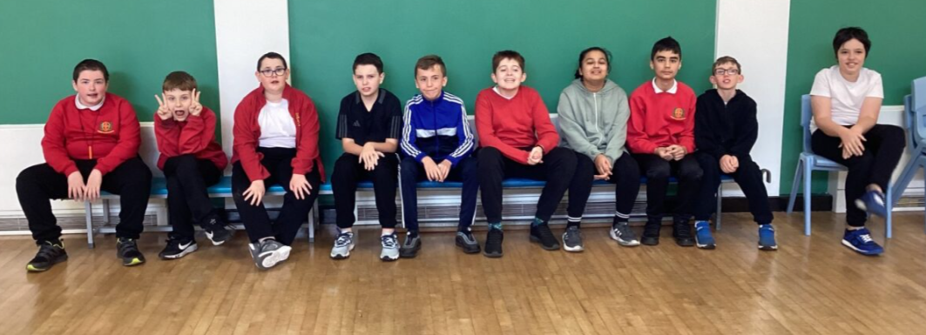
Fox Class is a Key Stage 3 class made up of 12 pupils from Years 7, 8 and 9.

Slide 5


On arrival…
Water and toast are available on arrival each morning.
A contribution of £1 per week towards this cost is received with thanks as school do not fund this.

Slide 6

Equipment
All equipment is provided by school. Pupils each have their own pencil case which contains everything that they could possibly need in class.
They do not need to bring in any stationary equipment from home.
Pupils should come to school in their PE kit every Wednesday.

Slide 7



What should pupils bring to school daily?
Every pupil in Fox Class is given a home-school book. This is a way of communicating any important messages and information. If there are no messages in the book this means that there is nothing additional to mention for that day. Please check this book each day. Please use this book to communicate anything we need to know.
Reading books and records are given in line with pupils phonics assessments. Please aim to read with your child on a 1:1 basis 3x each week. Please record in the reading record when you have read with your child at home.
Books will be changed as required. Please write in the home school book if you feel your child’s book needs to be changed.
Water bottles. We encourage pupils to bring in water bottles each day. We will refill them for them as needed and we will send them home each night to be cleaned..

Slide 8
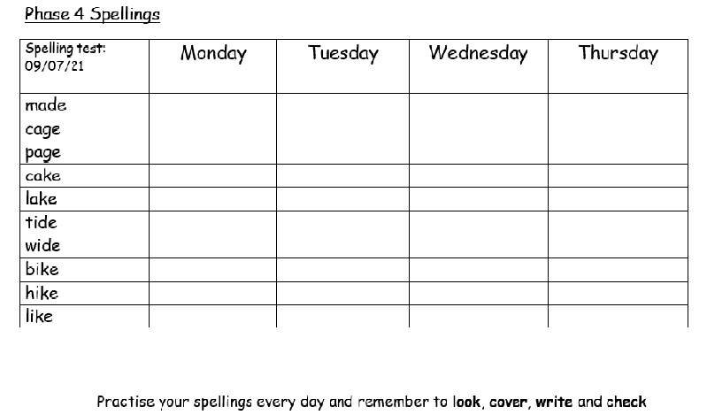
Spellings and homework
Weekly spellings will be sent home on a Friday. There is a weekly spelling test each Friday.
Pupils will have the opportunity to practise these in class each morning but should also practise at home using look, cover, write and check.
English and Maths (alternate) homework is sent home every Friday. Pupils should return this by Wednesday morning.

Slide 9
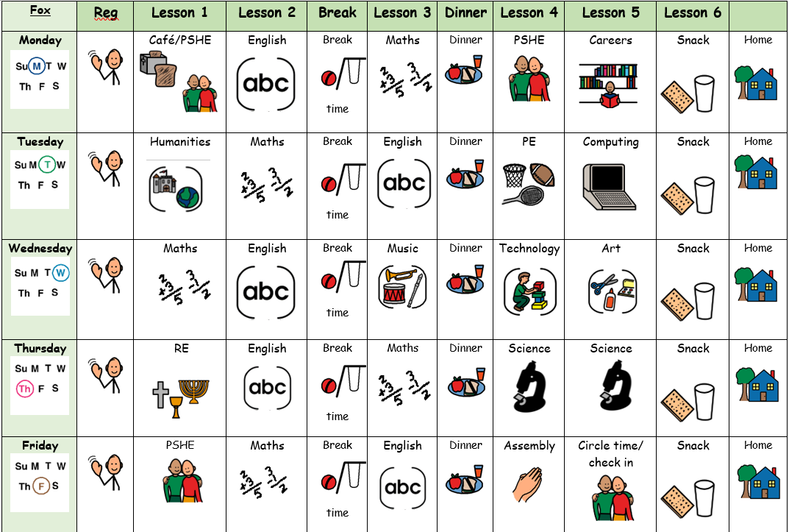
Fox Curriculum
The Fox curriculum includes all statutory subjects at Key Stage 3. This includes English, Maths, Science, Computing, Physical Education and Citizenship.

Slide 10
Termly overviews
 | Autumn 1 | Autumn 2
Maths | Number Addition and subtraction | Addition and subtraction Geometry and Measure
English | Instructions | Magazine/Newspaper articles
Science | Parts of plants | Seasonal changes
History | The Stone Age to the Iron Age (significant changes)
Geography |  | Alaska / Cuba
RE | Various religions​ What makes a community?​ Harvest festival​ | Christianity​ Celebrations: The Christmas Story ​ ​
Art | Introduction to the formal elements Exploring Drawing | Spanish Tiles
DT | Textiles: Making a bag (joining and combining techniques)
Food Tech |  | Basic food hygiene: Food handling, preparation and storage One pot cooking
Computing | Key skills | E-safety
PSHE | Personal hygiene | Relationships and friendships:
MFL Covered once a half term through languages days | European languages day | Spanish Christmas - Three Kings Day (main gift-giving holiday)
PE | Football | Dance
Music | Baseline: Performance Skills Blues Christmas Performances
Careers | Fabulous Fashion
At the beginning of each term you will be sent an overview showing what topics are being taught in each subject for that term..

Slide 11

Any questions?

Slide 12

Thank you for taking the time to join us!
As always your support is much appreciated.

