Slide 1
Welcome to Butterfly class

Slide 2
About us
We are a KS1 class with a mixture of Year 2 and Year 3 pupils.
We are a class of 7 and follow the Elm Pathway curriculum.
All children have an ASD diagnosis.

Slide 3
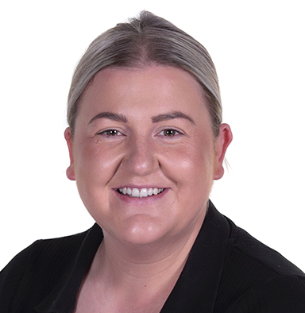
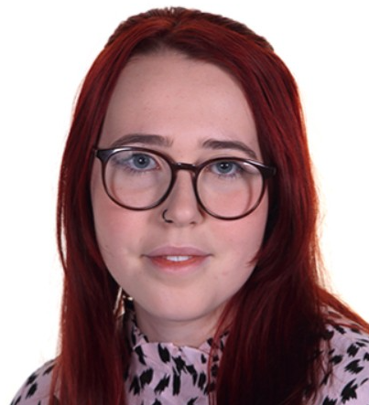
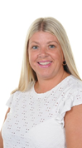
Meet the team
Class teacher: Miss Rimmer
Teaching Assistants: Mrs Hockenhull and Miss Quirk
assistant:

Slide 4
Home/School diaries
School provides children with a Home School Diary.
The diaries should be used to put any important information in that both your child's teachers and you should be aware of.

Slide 5
EFL
Please can everybody make sure they are set up on Evidence For Learning (EFL for short).
We will use this to post pictures, Record of Achievements and reports at the end of the year.

Slide 6
PE
PE takes place on a Monday afternoon with Warrington Wolves.
PE kit is a white t-shirt, black shorts and comfortable shoes.
We will always endeavour to change children into their PE kit, however on some days this may not be possible.
PE kits should be left in school and will be sent home every half-term.

Slide 7
A plea!
Please can you ensure that your child’s uniform and belongings are labelled.
This makes it much easier for us to ensure that your belongings will always come home!

Slide 8
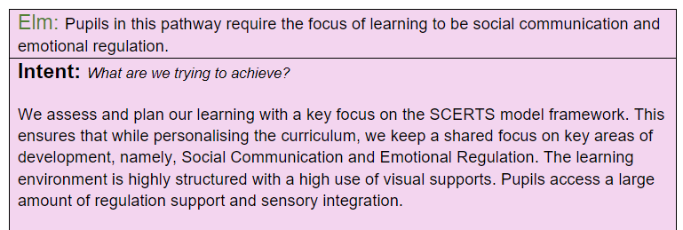
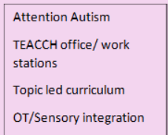
The Elm Pathway

Slide 9
SCERTS
Alongside the EYFS curriculum we also follow a SCERTS programme.
S ocial
C ommunication
E motional
R egulation
T ransactional
S upport

Slide 10
SCERTS
SC - Social Communication; Supporting a learner’s ability to communicate, comprehend, and collaborate with others.
ER – Emotional Regulation; Supporting a learner’s ability to cope, make transitions, and actively engage with others.
TS – Transactional Support; interpersonal supports and
learning supports embedded in the natural environment to foster SC and ER

Slide 11


Transactional support
SCERTS
Transactional Support; interpersonal supports and learning supports embedded in the natural environment to foster SC and ER
E.g. use of PECS.

Slide 12
And finally… the classroom
The classroom is zoned into ‘work’ and ‘choose’ areas.
2 main work areas:
Work base
TEACCH baskets
Let’s have a look!

Slide 13
Questions
Thank you for coming!
We hope you have found this
meeting helpful and informative.
We are always grateful for the support
you give your children and if you require any further clarification on anything in this PowerPoint then please feel free to ask!

