Slide 1
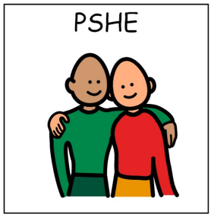

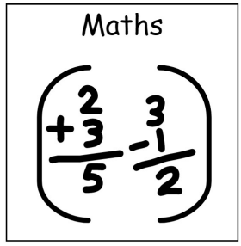

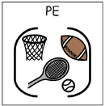




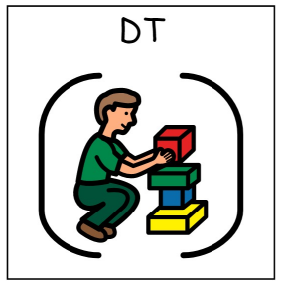

Butterfly Class 2025/26
Spring Term Topics: Poetry + Plants and Flowers
SCERTS: targets are set and reviewed termly based on joint attention, symbol use, and mutual regulation and self-regulation goals. Our SCERTS work focusses on Social Communication, Emotional Regulation and Transactional Supports. We plan our activities around pupil’s SCERTS targets and support our pupil’s in becoming confident and competent social communicators and active learners.
PSHE
Communication and language.
Maths
Literacy
Making choices.
Learning to cooperate.
Learning to communicate.
Feeling a sense of belonging.
Building friendships
Number- Number recognition- number matching, songs and ordering.
Measurement – Height and length
Mark making skills/tracing over letters and writing.
Accessing and showing more interest in books. Recognising peer’s names.
Exploring nursery rhymes and rhyming words.
Using communication mats/books to make requests.
Following a total communication model in our environment.
Initiating and extending interactions.
Physical Development
Art
History
Geography
Developing fine motor skills. Developing gross motor skills.
Using the O.T. equipment to regulate. Using the sensory room. Exploring more physical games in P.E sessions.
Exploring the use of colour. Differentiating between primary and secondary colours. Mixing colours and observing the result. Using a variety of materials to create colourful art.
An exploration into ancient animals from under the sea. Exploring the concept of past and present and making comparisons.
Exploring a variety of plants found in the local area.
Exploring a variety of animals found in the local area.
Science
DT/ Food Tech
Exploring bending, stretching and squashing different materials. Beginning to explore and understand properties.
Focussing on different food groups. Using step by step instructions to create a variety of recipes with a use of different food groups.

