Slide 1
Welcome to Poppy Class 25-26

Slide 2
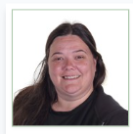
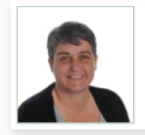
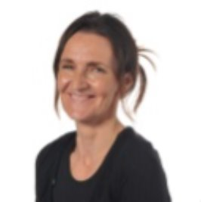
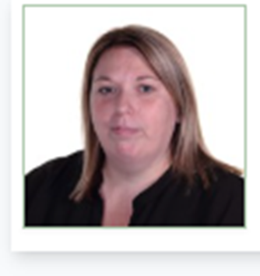
Introductions…
Miss Olver
Miss Chadwick
Mrs Moorcroft
Mrs Grimes
Miss Trainor

Slide 3
Poppy Class is a KS2 class made up of Year 3,4,5 and 6 pupils.

Slide 4
Willow Pathway
Pupils in this pathway require a curriculum which has topic led focuses with cross-curricular links. Phonics and maths lessons are taught discretely.
In the Willow Pathway, we take a creative approach to delivering the curriculum. Children will have access to both practical learning and workbook learning.
Please check EFL regularly as we will keep you updated with many exciting activities that we have done in Poppy class!

Slide 5
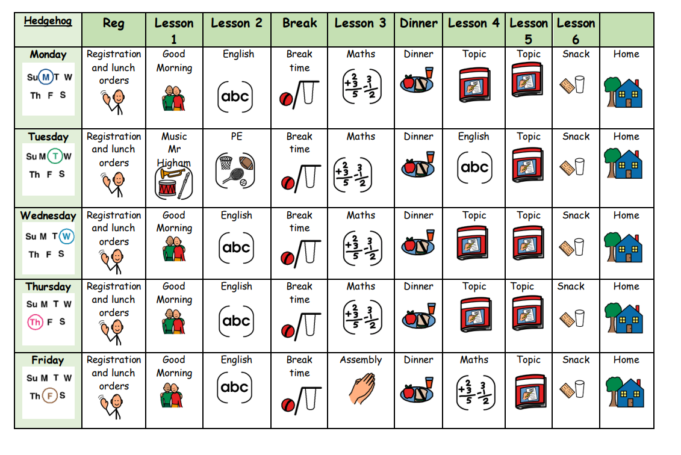
Our Weekly Timetable

Slide 6
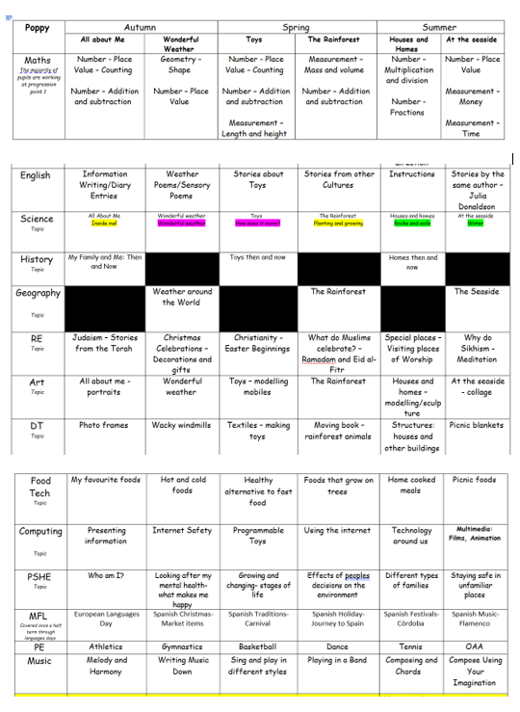
Yearly Overview

Slide 7

On arrival…
Toast, juice and water are available on arrival for the children to enjoy! Snack at the end of the day is also offered for children to have.
Pupils can bring a bottle to leave in school, however we do have cups.
A contribution of £1.50 per week towards toast is received with thanks to school and a 50p contribution for snack is appreciated as school do not fund this.

Slide 8

Forest School
Mrs Williams runs Forest School sessions. We are taking part in Forest School in Spring 1.
Forest School will be on a Wednesday and we ask if the children can bring suitable clothes and wellies.

Slide 9

PE
PE is on a Tuesday morning and delivered by Warrington Wolves.

Slide 10
Enrichment
Sensory Centre – Thursday’s, to the 9th October
Sensory room – every Tuesday and Friday
Karate – Wednesday’s, Autumn 1
Live music – Spring 1
Swimming – Summer 2

Slide 11

Equipment
All equipment is provided by school. Pupils each have access to equipment within the classroom.

Slide 12


What should pupils bring to school daily?
Pupils have all been given a home-school diary.
These are used for school/home communication. Please feel free to write any notes to class staff in here. Staff will also use the diary to pass on any messages home, please check these daily.
If you would like any specific information regarding their day please let us know.
Please bring a water bottle to school.

Slide 13

Homework and reading
Reading books and records are given in line with pupils phonics assessments. We aim to read with your child on a 1:1 basis 3x each week. Please record in the reading record when you have read with your child at home.
Books will be changed as required.
Homework will be sent home on a Friday in a homework book. Each week it will be English or maths and spellings.

Slide 14

Any questions?

Slide 15
Thank you for taking the time to join us this afternoon! As always your support is much appreciated.

