Slide 1
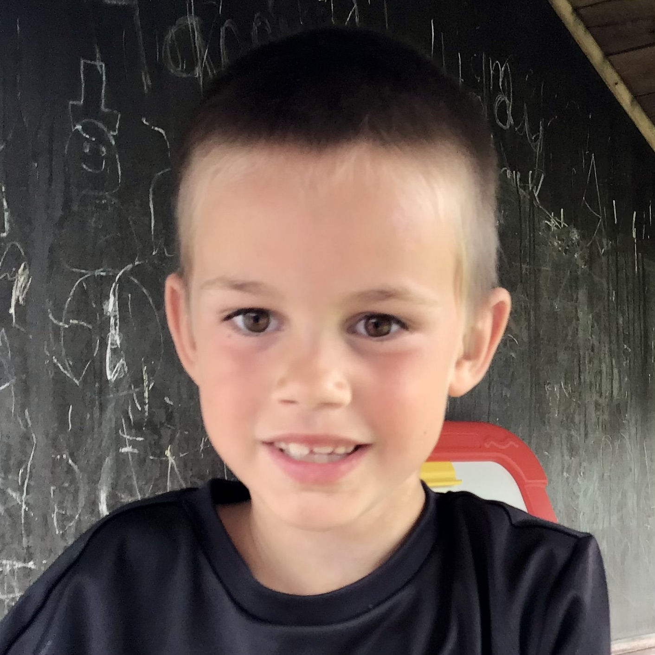
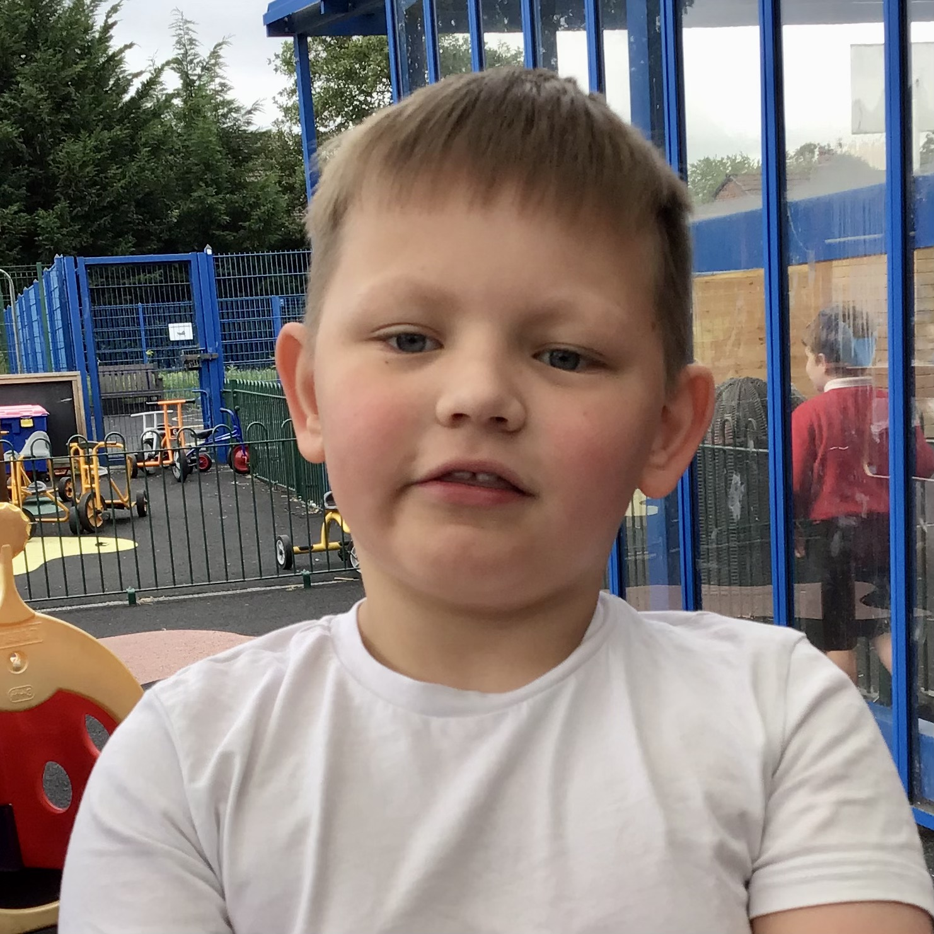
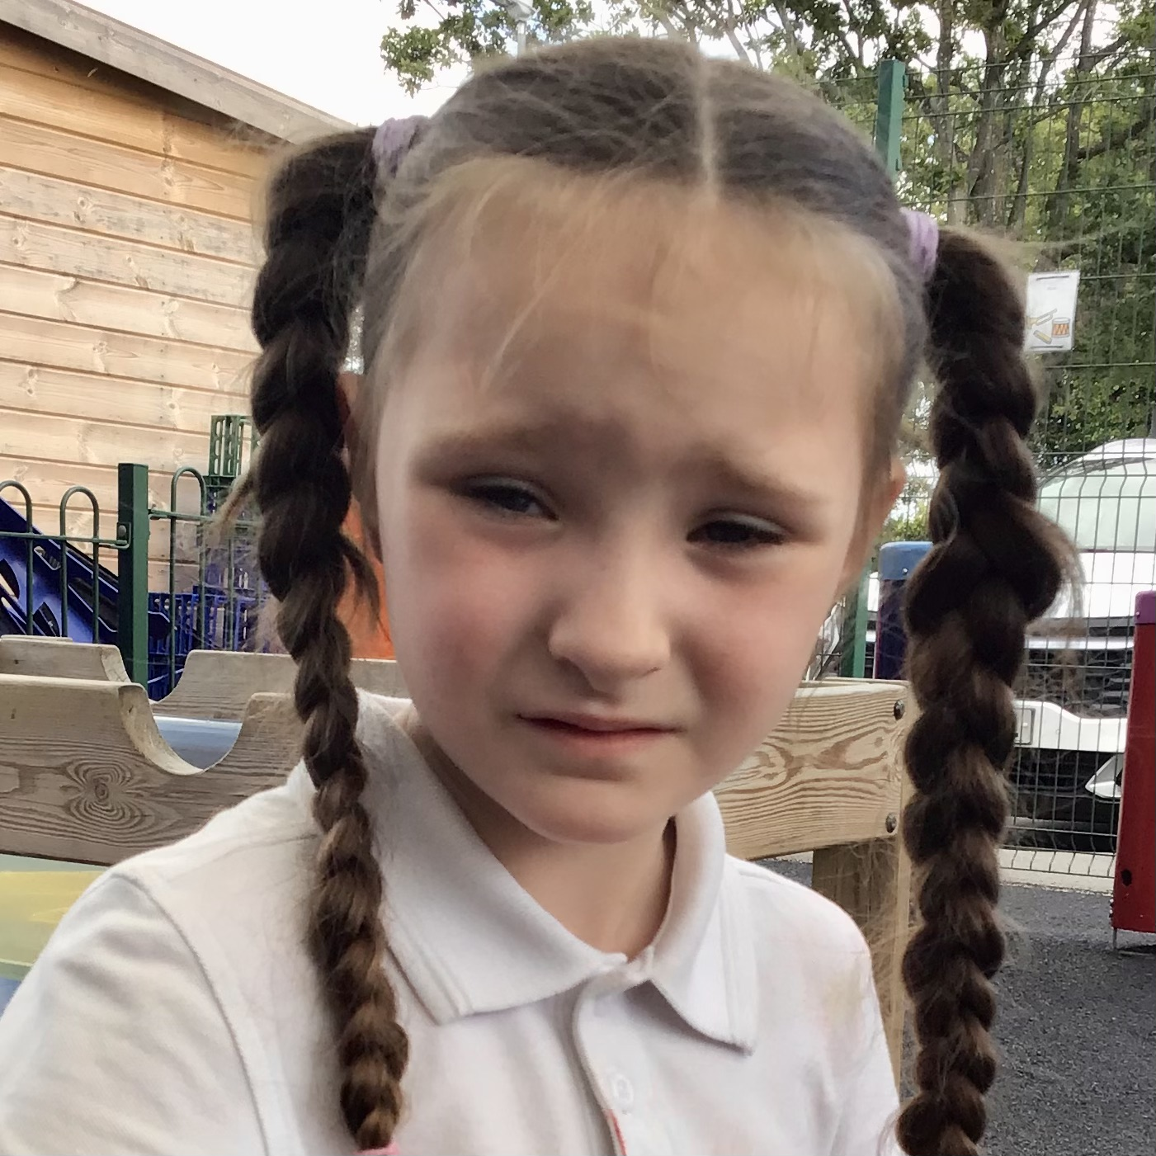
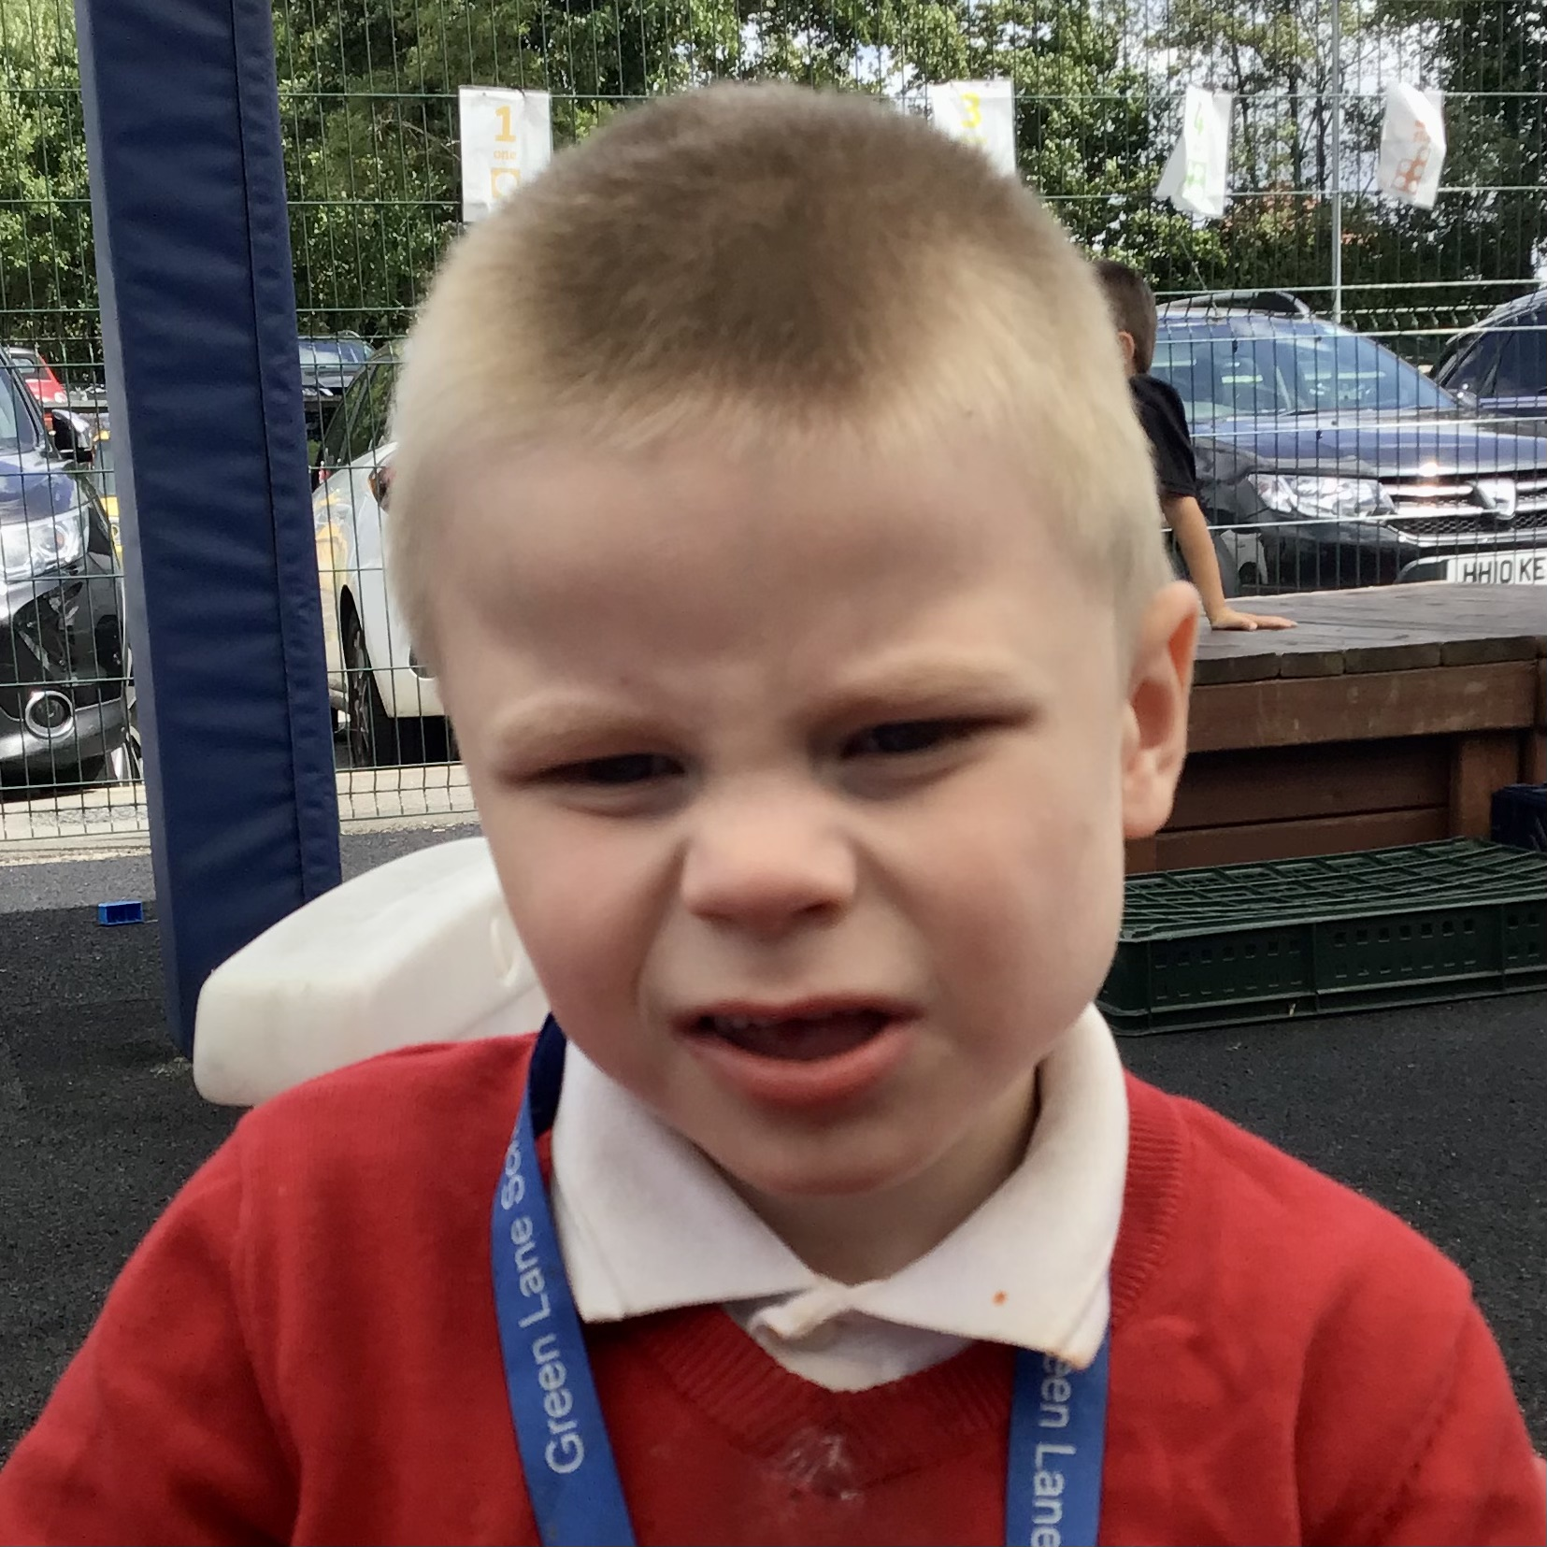
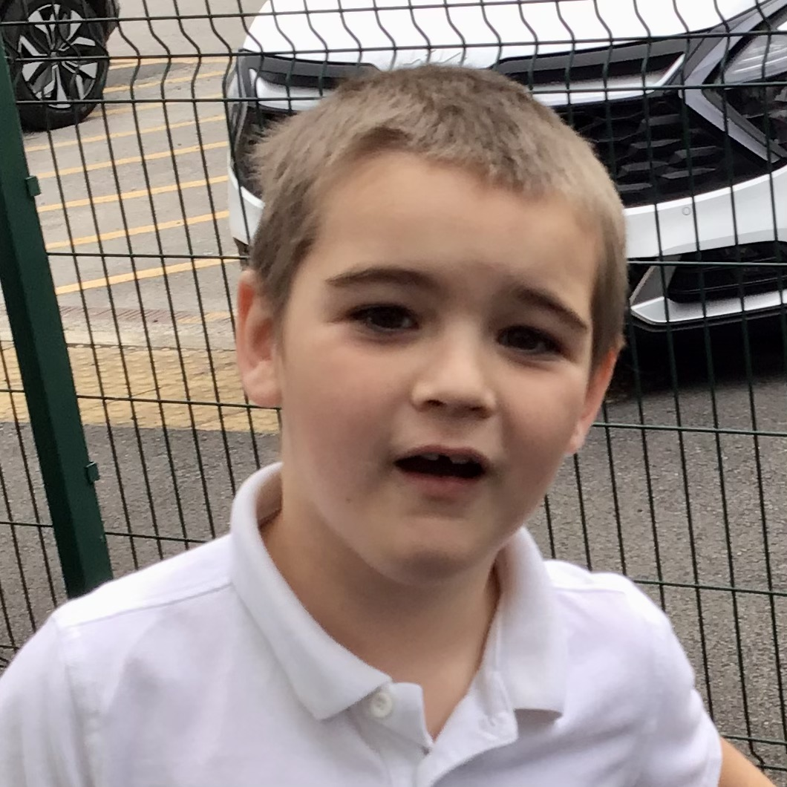
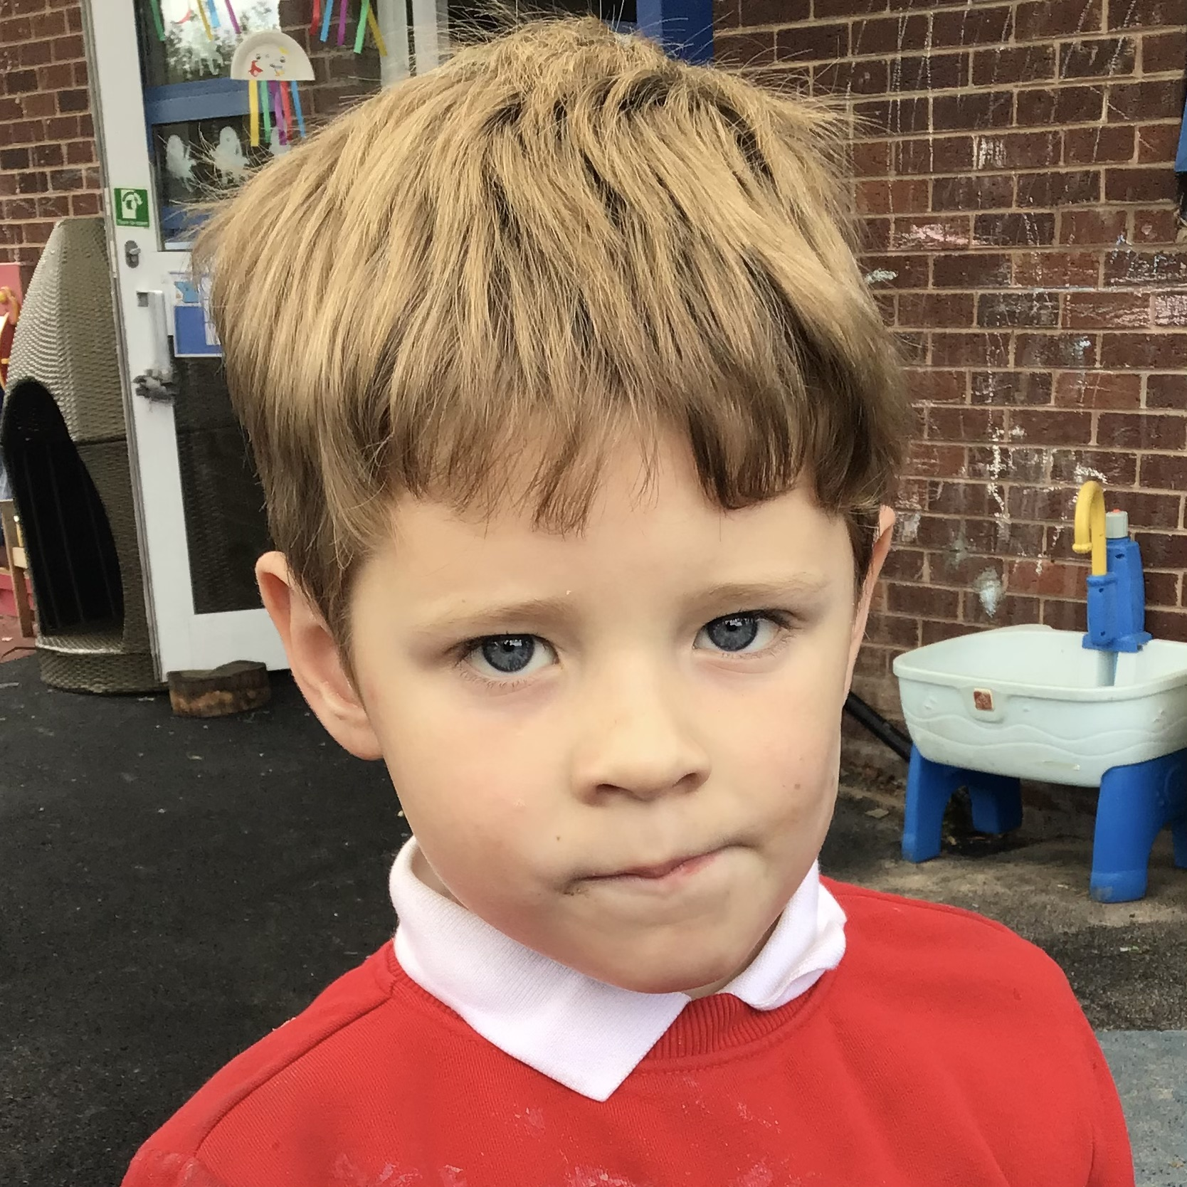
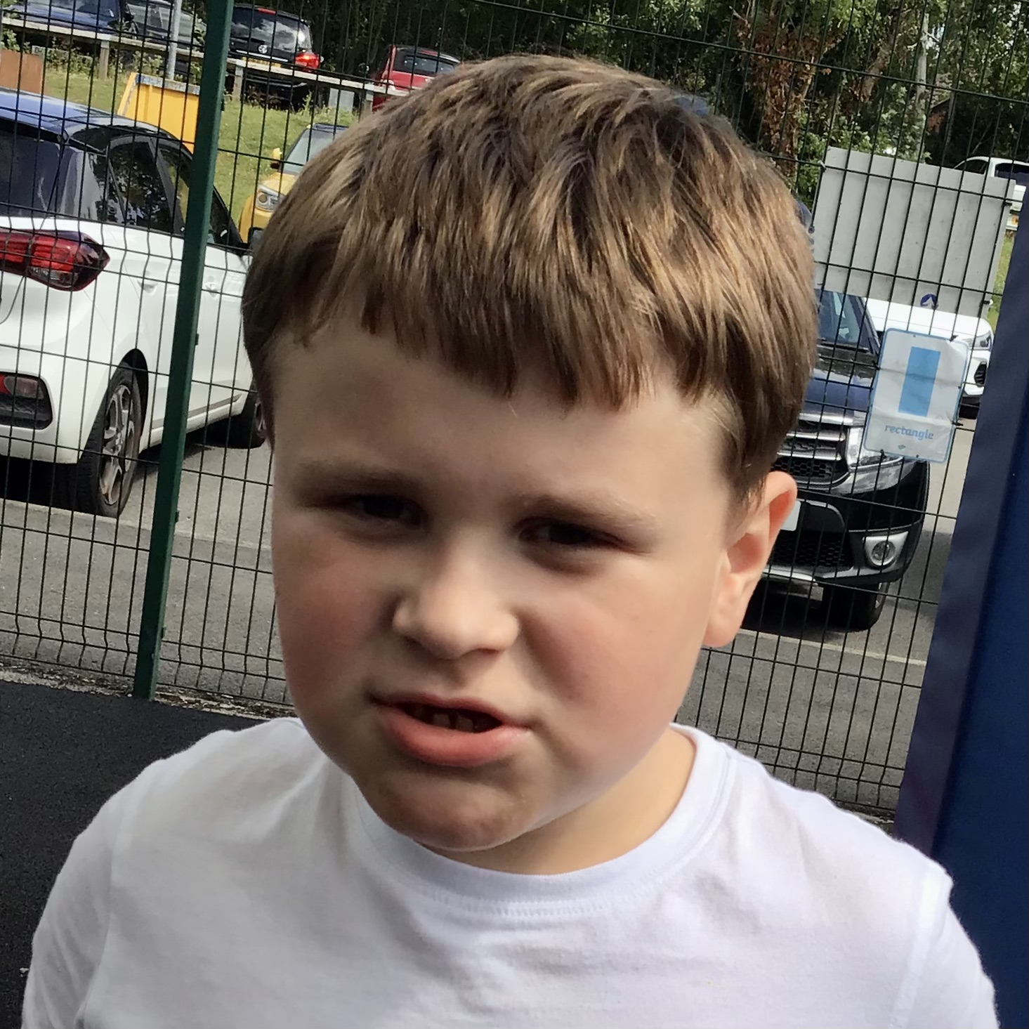
Welcome to Buttercup class

Slide 2
About us
We are a KS1/KS2 class with a mixture of Year 2 and Year 3 pupils.
We are a class of 7 and follow a creative curriculum.
Our pathway is Willow.

Slide 3
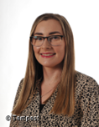
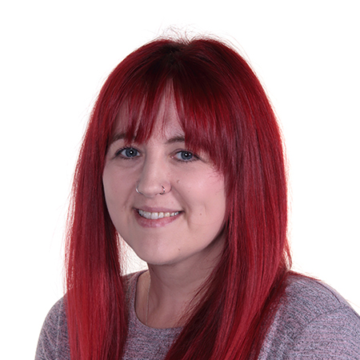
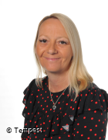
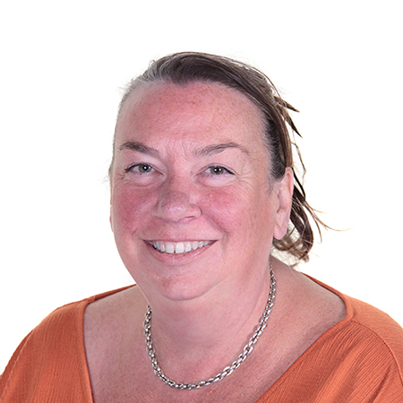
Meet the team
Class teacher: Miss Blinco
Teaching
assistants: Miss Muir
Mrs Burgess
Mrs Glindon (1:1)

Slide 4
Home/School diaries
School provides children with a Home School Diary.
The diaries should be used to put any important information in that both your child's teachers and you should be aware of.

Slide 5
EFL
Please can everybody make sure they are set up on Evidence For Learning (EFL for short).
We will use this to post pictures, Record of Achievements and reports at the end of the year.

Slide 6
PE
PE takes place on a Monday morning with Warrington Wolves.
PE kit is a white t-shirt, black shorts and comfortable shoes.

Slide 7
A plea!
Please can you ensure that your child’s uniform and belongings are labelled.
This makes it much easier for us to ensure that your belongings will always come home!

Slide 8
And finally… the classroom
The classroom is zoned into ‘work’ and ‘choose’ areas.
Let’s have a look!

Slide 9
Questions
Thank you for coming!
We hope you have found this
meeting helpful and informative.
We are always grateful for the support
you give your children and if you require any further clarification on anything in this PowerPoint then please feel free to ask!

