Slide 1
Welcome to Deer Class
2025-2026

Slide 2
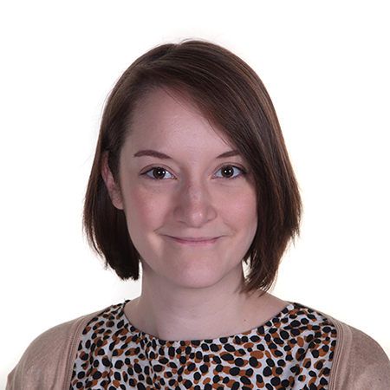
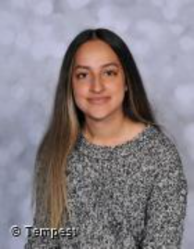
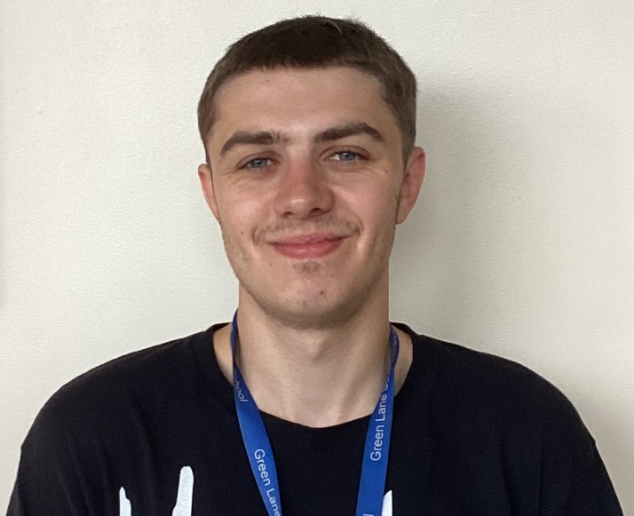
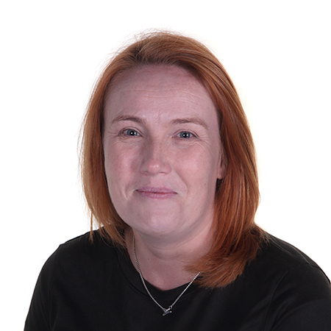
Meet the Team
Mrs Barker – Teacher
Miss Bhalla – TA
Mr Lomax - 1:1
Mrs Burton – HLTA

Slide 3
Deer class is a Key Stage 3 class made up of pupils from years 7,8 and 9

Slide 4
A tour of Deer classroom

Slide 5
All equipment is provided by school.
Pupils have a stationary pots at 1:1 desks.
We kindly request that stationary and personal items are not brought from home to minimise any upset.

Slide 6
What do pupils need to bring?
Water bottle
Home communication book (purple)
Reading Book
Reading Record
Snack for morning break
Suncream/Sunhat when sunny
Coats when cold
Dress in PE kit on Wednesday

Slide 7
Homework
Spellings are sent home each Monday and will be tested on a Friday morning
Reading books are sent home each day – please read with your child at home and record in their reading record. We will change their books when needed.
Homework will be sent home on a Monday in their homework book. This is to be completed ready for Friday.

Slide 8
PE
PE is on a Wednesday afternoon. Pupils are to come to school dressed in their PE kit.
I know it can be sometimes challenging for children to wear different clothes – however if you could please ensure they have trainers on for safety, this would be a great help!
PE will take place in the small hall.

Slide 9
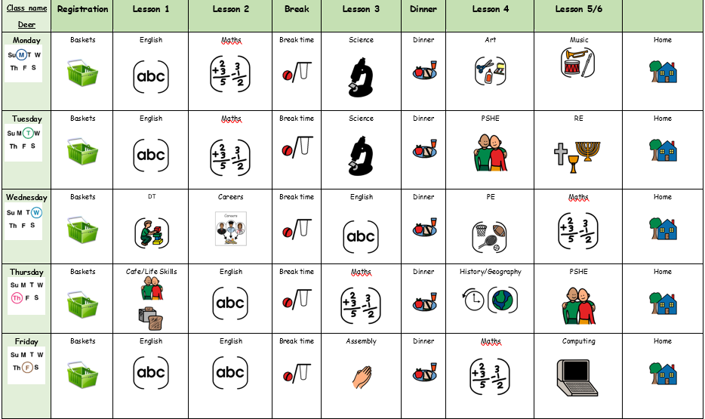
Our timetable

Slide 10
Weekly Merits and WOW moments

Slide 11

Any Questions?

Slide 12

Thank you for taking the time to join us! As always your support is much appreciated.

