Slide 1



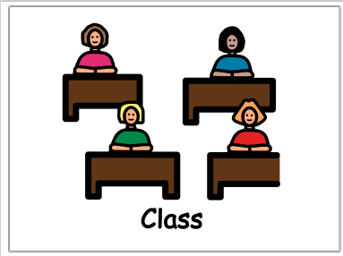

Slide 2
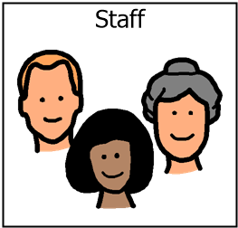
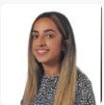
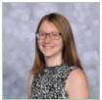


Introductions…
Mrs Van Rooy
Mr Quansah
Miss Bhalla
Mr Murty
Other staff: Mrs Davies and Mr Higham

Slide 3

Sunflower class is on the Oak pathway (subject specific). We are a Key Stage 2 class, made up of pupils from Year 3,4 and 5.

Slide 4



On arrival…
Toast, juice and water are available on arrival for the children to enjoy! Snack at the end of the day is also offered for children to have.
Pupils can bring a bottle to leave in school however we do have cups.
A contribution of £1.50per week towards the cost of toast is received with thanks as to school and a 50p contribution for snack is appreciated as school do not fund this.

Slide 5

PE
PE is on a Thursday morning and delivered by Warrington Wolves.

Slide 6



What should pupils bring to school daily?
Pupils have all been given a home-school diary.
These are used for school/home communication. Please feel free to write any notes to class staff in here. Staff will also use planners to pass on any messages home, please check these daily.
Reading books and records are given in line with pupils phonics assessments. We aim to read with your child on a 1:1 basis once a week. Please record in the reading record when you have read with your child at home.
Books will be changed as required.
Water bottles.

Slide 7
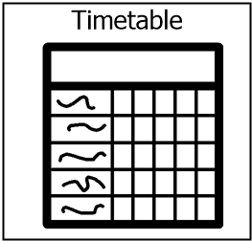
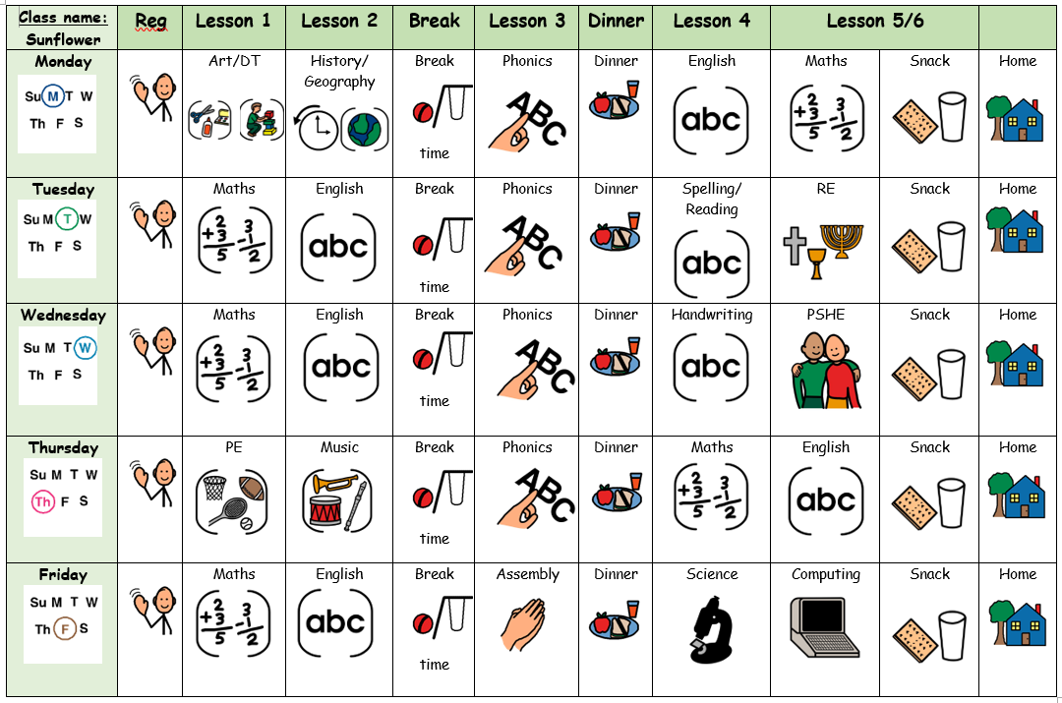
Our weekly timetable

Slide 8
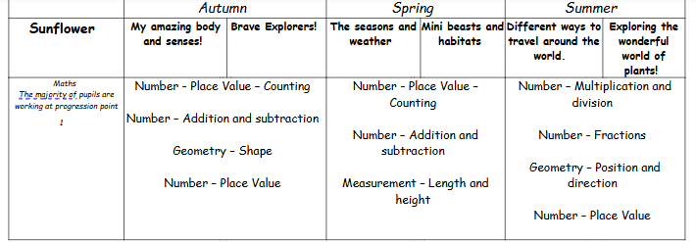
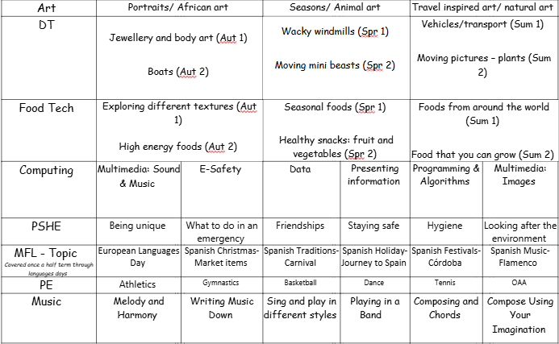
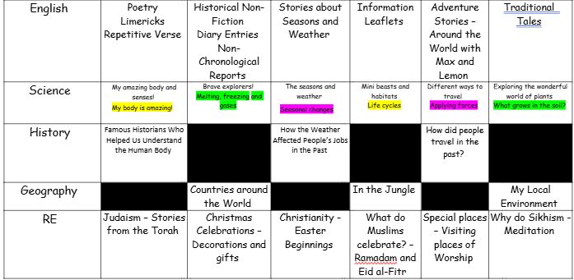
Yearly overview

Slide 9
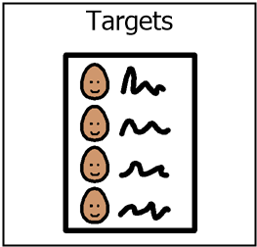
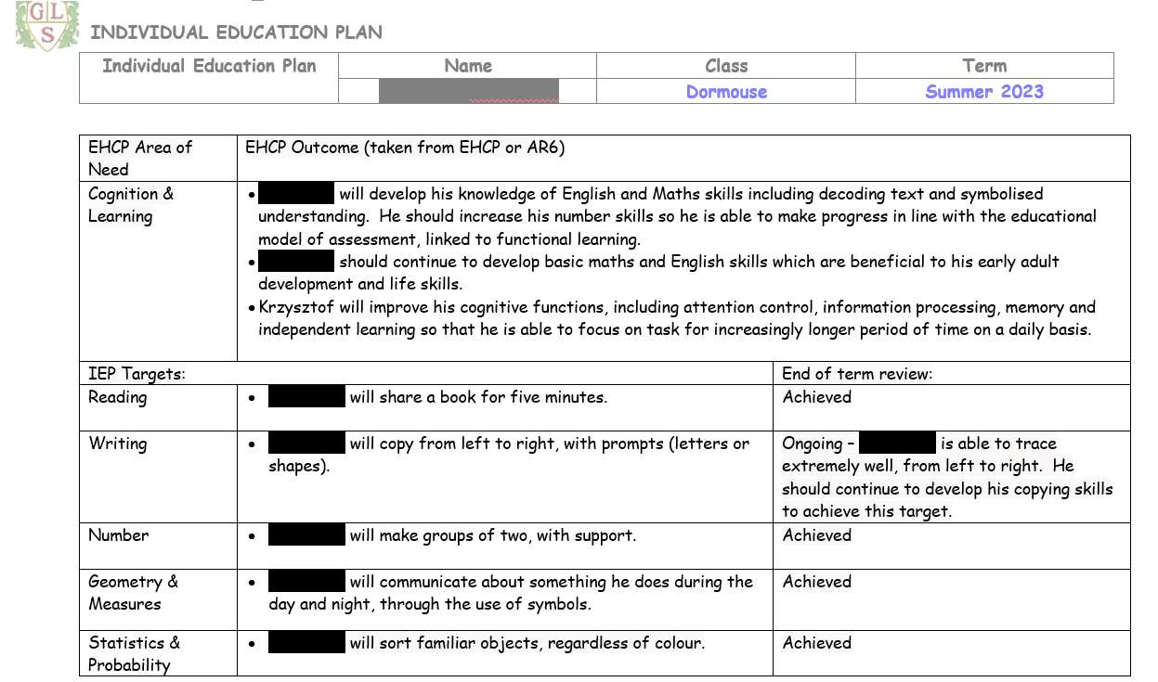
IEP targets

Slide 10
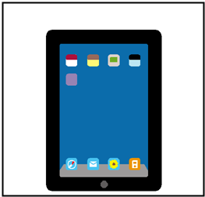
EFL
Keep up to date via EFL.
Evidence sent home each week.
End of Year report.
Homework.

Slide 11

Any questions?

Slide 12

Thank you for taking the time to join us this afternoon! As always your support is much appreciated.

