Slide 1
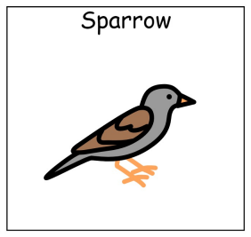
Welcome to KS4 sParrow Class

Slide 2

Class Team
Mrs Fernyhough (Class teacher)
Mr Lipovan (Teaching Assistant)
Mrs Mrena (Teaching Assistant)
Miss Ellis (Teaching Assisstant)
Gabriel (class support animal)

Slide 3
We are group of 12, Key Stage 4 students,all in Year 10.
Mrs. F is our teacher five days a week
Mr Lipovan provides our classroom support
and
we have 2 other members of staff available that provide other students in our class with specific support.

Slide 4
We are the only KS4 class in the main building however we are still very much part of KS4
We will be ability streamed for Maths and English according to our baseline assessments and stay in our form group Sparrow for the rest of our lessons.
We will be working towards the following accreditation qualifications.
Entry Level Certificates in Maths, English, ICT, Art . (working towards entry one)
Asdan PSD Entry Level Certificate Entry Level 1
Asdan Personal Development Program Bronze/Silver/Gold Award
Asdan Science Short Course
Asdan Food Wise Short Course
Asdan Personal Progress @ Entry Level 1 (Certificate or Extended Certificate)
(ASDANAward Scheme Development and Accreditation Network,the is an education charity and awarding organisation providing courses, accredited curriculum programmes and regulated national qualifications.)

Slide 5
Business as usual
PE takes place on a Wednesday and students should continue to come to school in an appropriate PE kit.
Students are welcome to bring a water bottle with them every day – This is recommended.
Students do not need to bring their own stationary as everything that they will need is provided.
We do not have a timetabled snacktime but, students are welcome to bring their own snack for break and if anyone forgets there is always something in Effs cupboard

Slide 6
Next Steps/College
Sparrow will have many opportunities to go to career event with school to find out about college providers and employers
Towards the end of year 10 and through year 11 the students will have taster days at various colleges so they can make an informed d3ecision
But
Please feel free to visit college open evenings independently of school you can never have too much information

Slide 7
Expectations
We do have a very busy schedule and lots of work to complete before receiving our accreditation (qualifications) at the end of year 11.
However we do try very hard to have fun and we will be trying to get out into the community as often as we can.

Slide 8
Thank you
Thank you for your ongoing support.
And please if there is anything you need we are only ever a phone call away

