Slide 1

Welcome to Bluebell
2026-2027

Slide 2
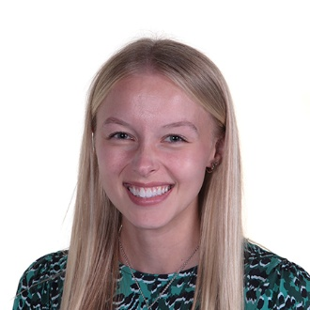
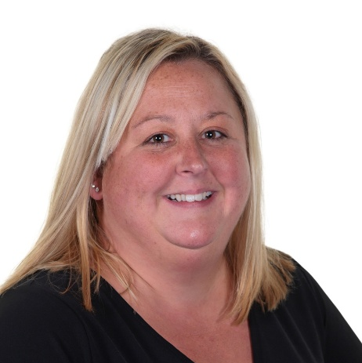
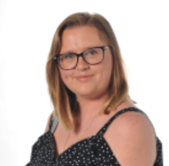
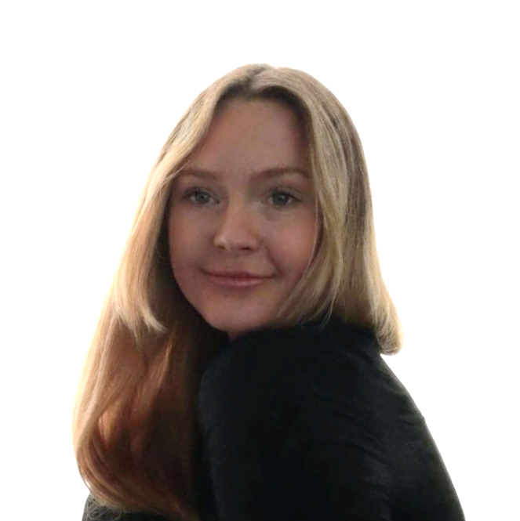
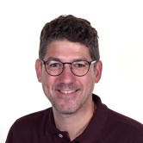
Class Team
Mrs Monteiro
Mrs Pucill
Mrs Hogden
Miss Ball
Teacher
TA
TA
TA
We are also joined by Mr Higham (Music) and Miss Fox (PPA cover).

Slide 3
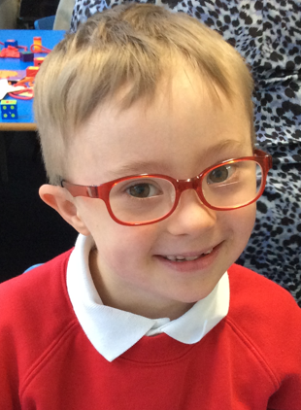
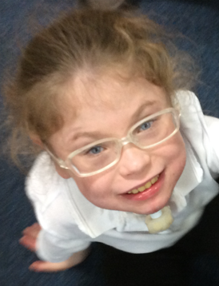
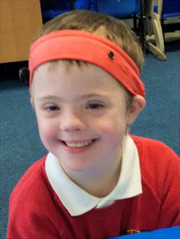
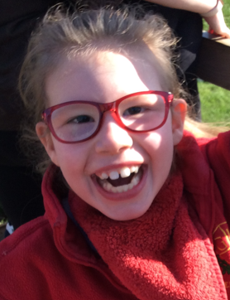
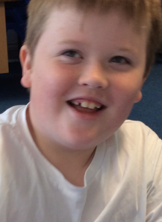
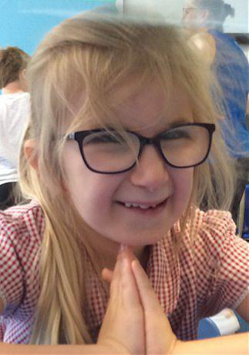
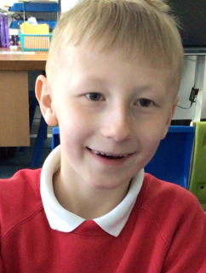
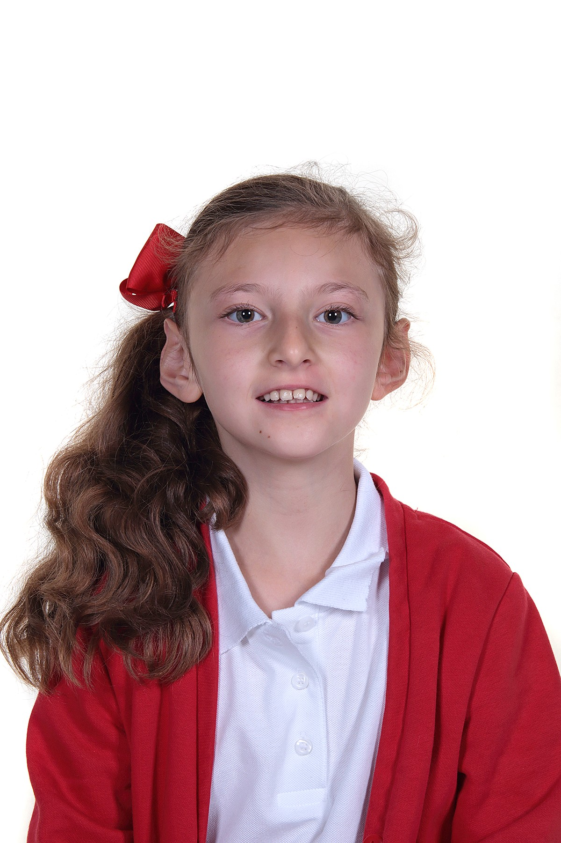
Bluebell is a KS2 class made up of pupils in Year 4, Year 5 and Year 6.

Slide 4

Our Curriculum
In Bluebell Class, we follow the Willow pathway. This is a creative curriculum, following a topic-based approach with cross-curricular links. ​
This includes one-to-one activities, child-led choice sessions and sensory activities.
Phonics and Maths lessons are taught discretely.

Slide 5

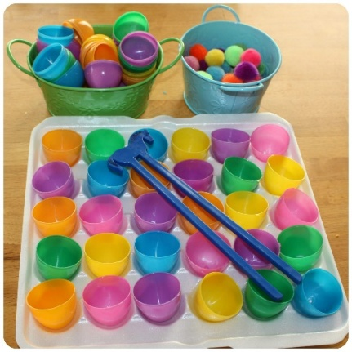


Arrival
When the children arrive, they take part in fine motor and provision activities.
We then carry out Occupational Therapy (OT) and a ‘Good Morning’ routine, including the timetable for the day.

Slide 6
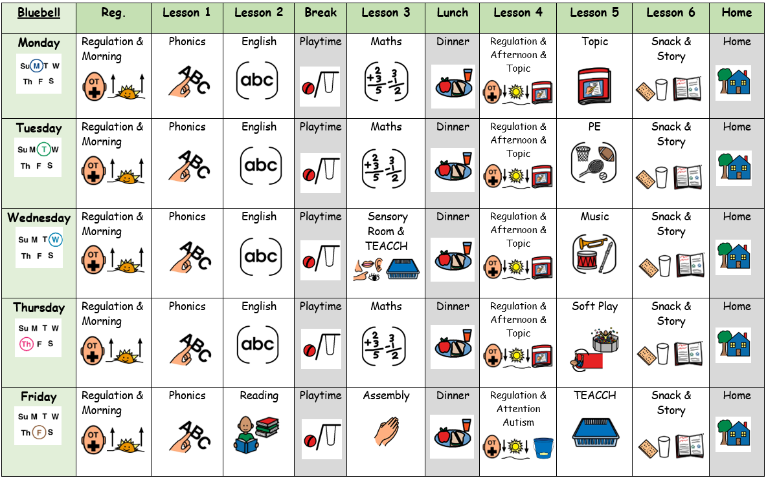
Timetable

Slide 7
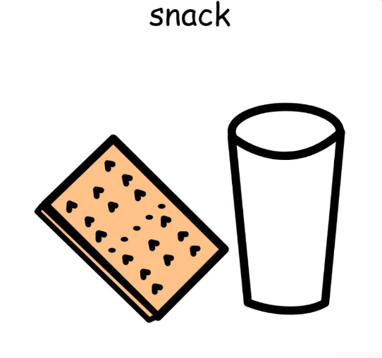
Snack
We have a snack during the morning and afternoon. Your child can have toast in the morning paid via Parent Pay, and fruit/other class snacks in the afternoon, or they can bring in their own snack if preferred.

Slide 8


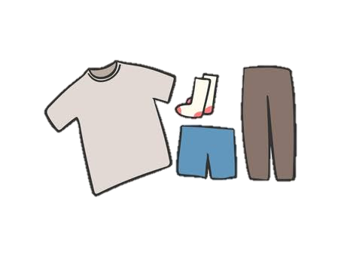
What should pupils bring to school daily?
Pupils have all been given a home-school book for communication. Please write any notes to class staff in here. Staff will also use them to pass on any messages home, please check these daily.
Water bottles should be brought into school.
We have lots of fun and can get a bit messy, so we would ask that your child brings in a complete set of spare clothes.

Slide 9
Homework
Reading books and records are given to take home. Please write in the reading record when you have read with your child at home. Books will be changed every Friday.
Homework is also given every Friday, due the following Friday.

Slide 10

Evidence for Learning
Please access EfL, as this is where we will share examples of the fun activities pupils have been enjoying in class!
We also encourage you to upload photos – we love to see what your child has been up to and celebrate them!

Slide 11

PE
Our PE lesson will be on a Tuesday.
Please ensure your child is dressed for PE before coming to school.

Slide 12
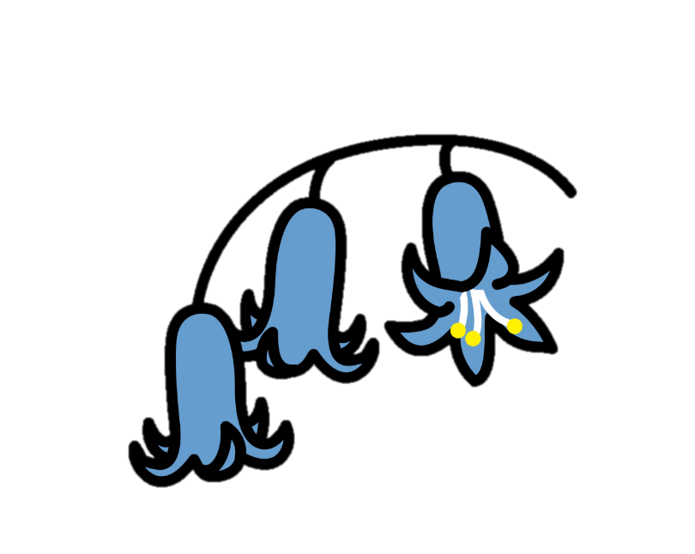

Thank you for taking the time to join us this afternoon! We really appreciate your support.
We look forward to a fun year ahead!

Slide 13

Any questions?

