Slide 1

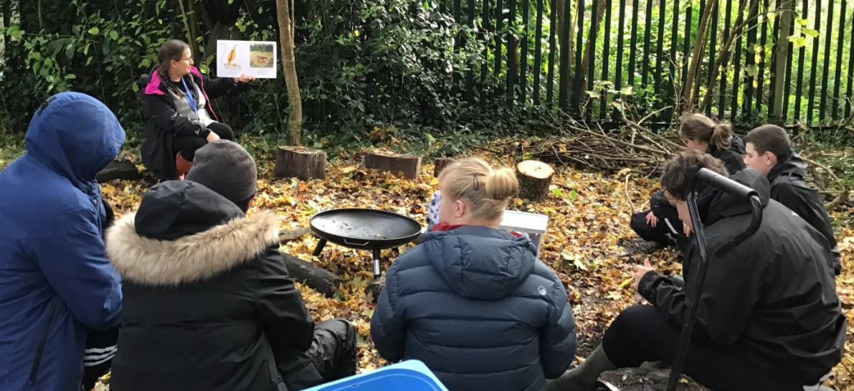
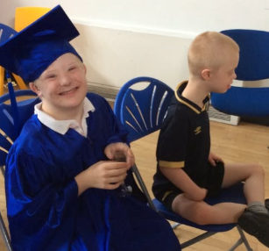
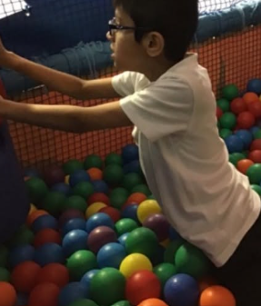
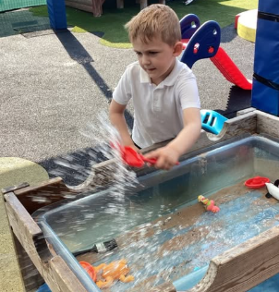
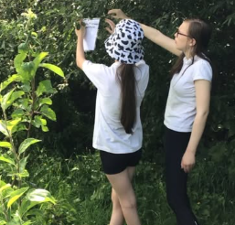
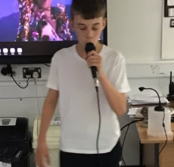
Welcome to Daisy Class

Slide 2
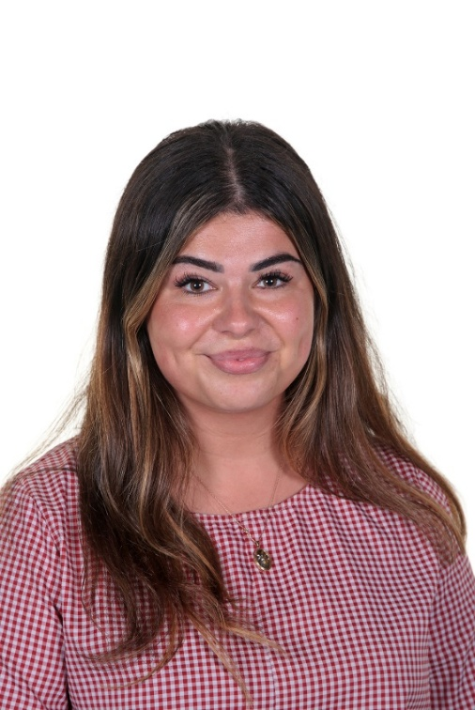
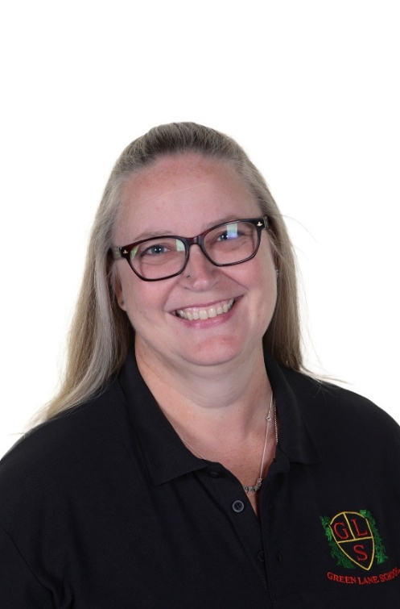
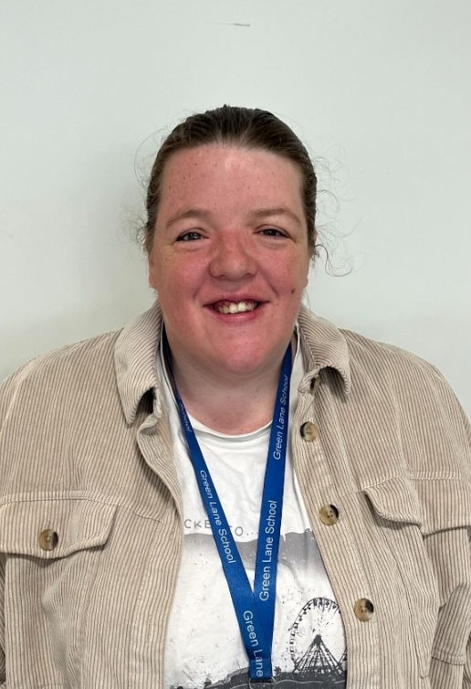
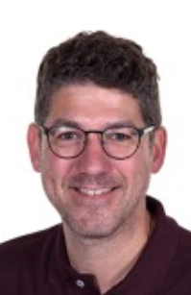
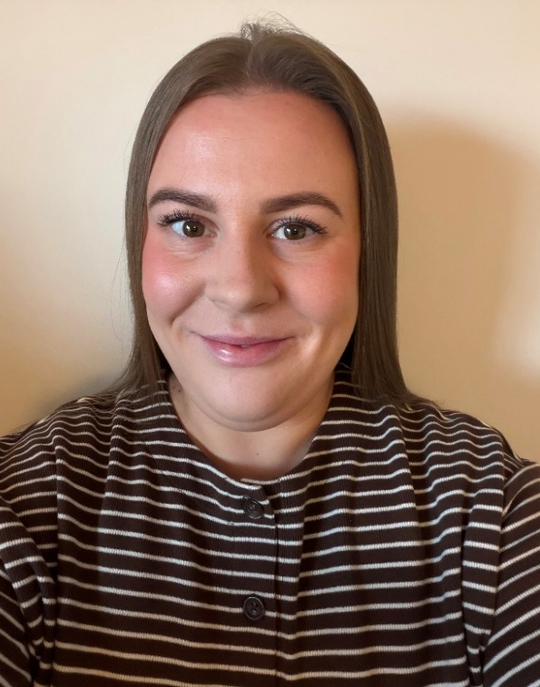
Daisy Class Team
Miss Webster Mrs Fitzpatrick Miss Blenkinsopp Mr Highham Miss Fox
Class Teacher Teaching Assistant Teaching Assistant PPA Cover- Music PPA Cover- Topic

Slide 3
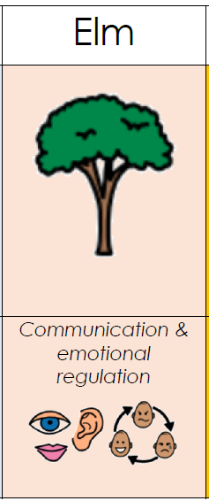
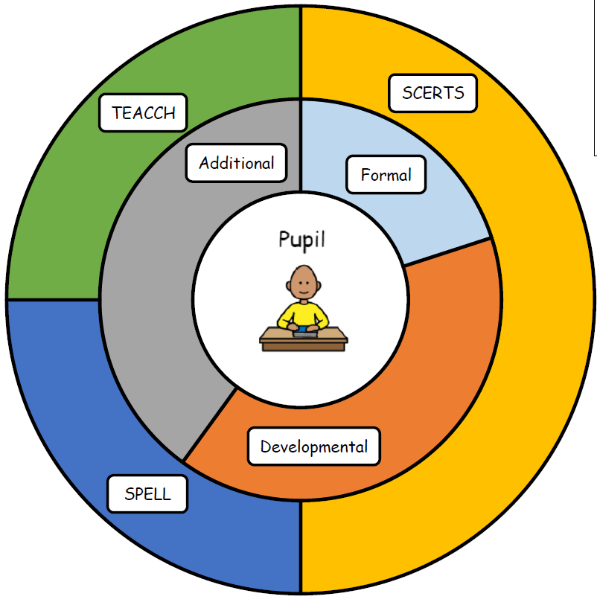
Pupils in this pathway require the focus of learning to be social communication and emotional regulation.
Implementation: How do we organise learning?
Attention Autism
TEACCH office/ work
stations
Topic led curriculum
OT/Sensory integration
Independent activities
(KS2-4)
SCERTS assessment
framework alongside
early years/progression
steps
Continuous provision
(KS1)
Trips and visits
PFA- Independence,
self help,
community focus.
Qualification in ASDAN
Personal development
programme in Bronze, Silver
or gold.
Emotional regulation support
Social communication focus
Total Communication approach
(SALT)
Use of visuals
High level of structure
Intent: What are we trying to achieve?
We assess and plan our learning with a key focus on the SCERTS model framework. This ensures that while personalising the curriculum, we keep a shared focus on key areas of development, namely, Social Communication and Emotional Regulation. The learning environment is highly structured with a high use of visual supports. Pupils access a large amount of regulation support and sensory integration.
Impact: How are we achieving our goals?
SCERTS assessment
Progress against EHCP outcomes
Communication and SALT targets
Assessments and Evidence
for learning
SCERTS clinics and
SCERTS parent
group feedback

Slide 4
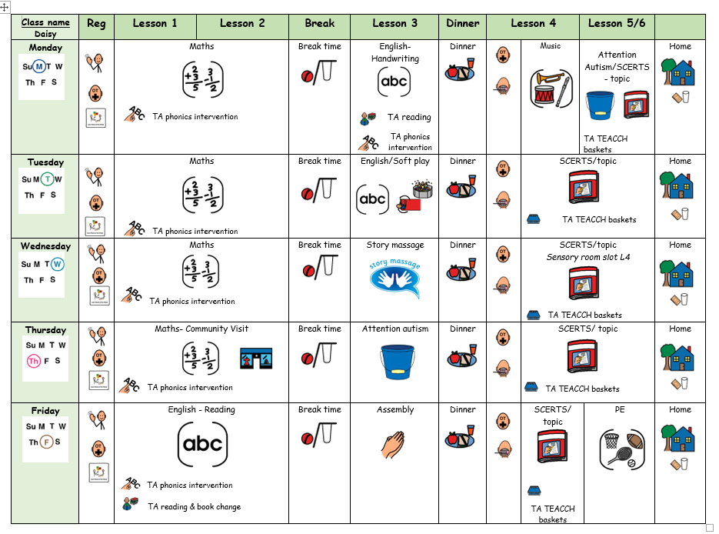
What Our Days Look Like

Slide 5
Curriculum Enhancements, Trips and Visits
Autumn –
Cheshire Fire service
Art sessions with a local artist
Forest school
Spring-
Live Music now
Summer-
Sensory centre
Trip ideas for the year ahead
Daisy - Gemma Webster | Oceans CAFT Halloween? | Jobs Imagine that CAFT Christmas? Gullivers World Christmas | Being outside Walton Hall and Gardens | Food High Legh Garden Centre | South America Chester Zoo Knowsley Safari Park | Castles Conway Castle/Beeston Castle

Slide 6

Evidence for Learning
Evidence for Learning (EfL) is a secure online platform we use at Green Lane to share photographs, videos and observations of your child’s learning, progress and achievements. It gives you a lovely insight into what your child has been learning and enjoying at school.
We also love it when parents and carers upload photographs of the things children have been doing at home, so that we can celebrate and talk about these experiences in school too.
If you have any trouble logging in, please let your child’s class team know and they can ask Miss Taylor to reset your password.

Slide 7



What should pupils bring to school daily?
Their home school diary – This can be used for messages between class and home.
Reading books and records are given in line with students Phonics assessments. We aim to read with your child on a 1:1 basis 3x each week. Please record in the reading record when you have read with your child at home.
Books will be changed weekly, or as required.
Water bottles – These will be sent home after each school day. Alternatively, cups are available in school so if you do forget to send it please do not worry.

Slide 8
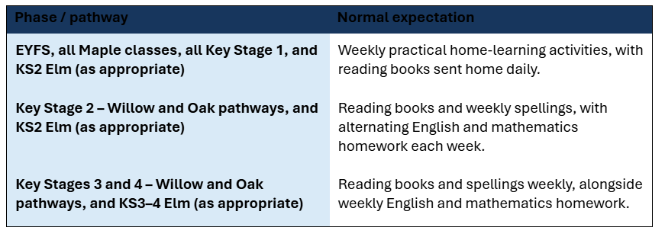
Homework…
Add about your class including when you expect it to be returned by and delete the table.

Slide 9

Any questions?

