Slide 1
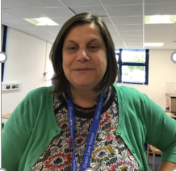
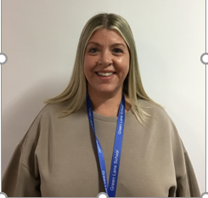
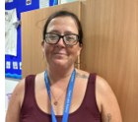
Introductions…
Miss Ward
Level 2 Teaching Assistant
Mrs Smith
Class Teacher
Mrs Hockenhull
Level 3 Teaching Assistant

Slide 2

On arrival…
Children are greeted by a member of staff at their bus or taxi if arriving by school transport and brought to class.
If a parent/carer are dropping off, then a staff member will greet them at the pupil entrance and bring them to class.
On arrival children are going to be encouraged to hang their coats up before looking at their timetable and having the opportunity for OT and greeting time.

Slide 3



What should pupils bring to school daily?
Pupils have been given a home/school communication book.
Please feel free to write any notes to class staff in here. Staff will use this to send messages home about how your child's day has gone.
All children will be given a reading book. A reading record book will accompany this. This can be used to tell us if your child has engaged with the story. This will be changed weekly
Drinks bottles to be brought into school. Full for the day. We can top up with water or blackcurrant juice. If your child just prefers milk, then you will need to provide this. This can be stored in our fridge.

Slide 4

Snack and Lunches
Children will have access to water and juice.
A contribution of £2.00 can be made for toast on a weekly basis. Payable on parentpay
All children have access to a piece of fruit daily as part of the fruit for schools system.
All children in Year 1 and 2 are entitled to free school meals we can order for you or you can make a choice yourself. However, you can also provide them with a packed lunch and or safe foods that they can have for both lunch/snack.

Slide 5

SCERTS
Butterfly Class is on the ELM Pathway.
It is a SCERTS class.....
Social Communication
Emotional regulation
Transitional Support
A SCERTS clinics and SCERTS groups run during the year so you can learn how we use SCERTS in class and how it can be used at home.

Slide 6
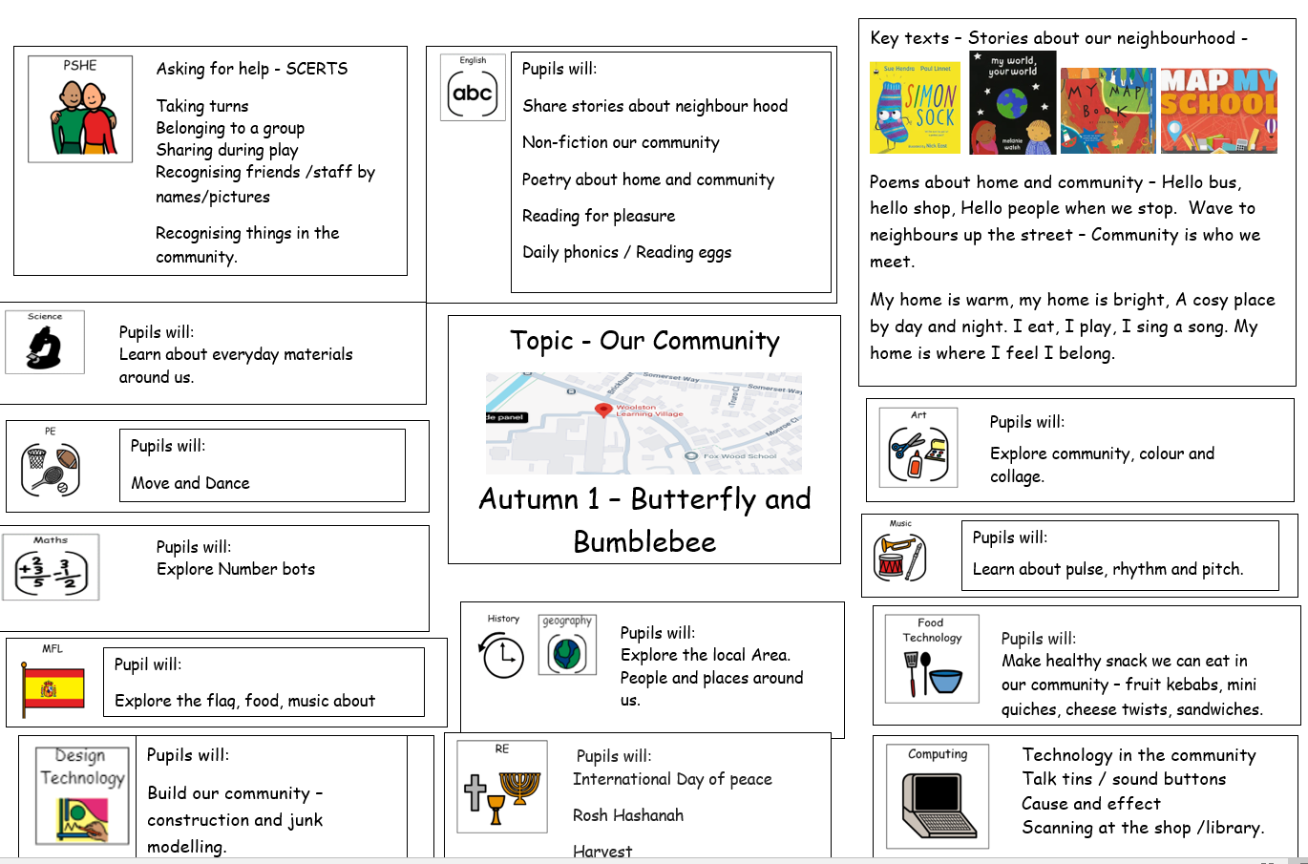
Termly overviews
Save
fromabcstoacts.com
At the beginning of each half term an overview of what we are covering will appear on the school website.
.

Slide 7
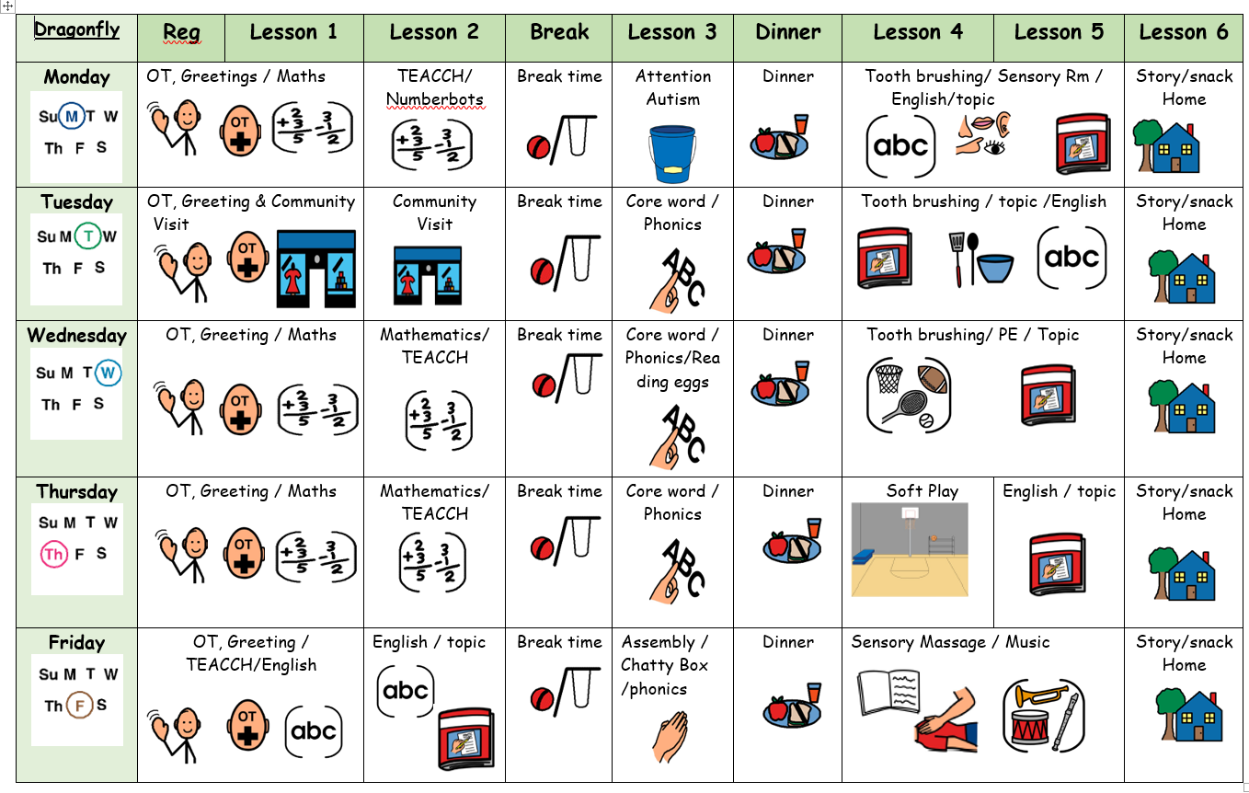
Autumn Term 1 Timetable

Slide 8
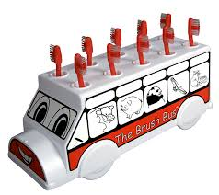
Brush Train
We will be taking part in the brush train scheme, whereby children are encouraged to clean their teeth daily after lunch.

Slide 9
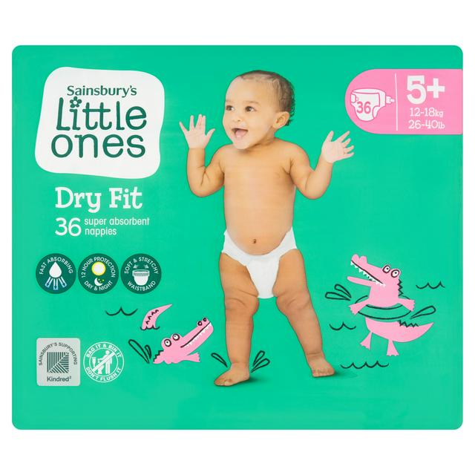
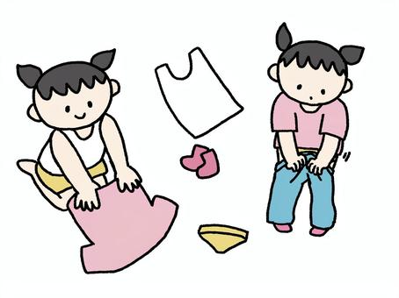
Additional Information
The children will need spare clothing in their school bags in case of accidents and messy play. Wellies and puddle suits would be helpful, when it is Forest School (Spring Term 1)
Nappies to be provided by yourself . As we are short on storage ideally 3 /4 per day, in their bag for the day.
We are encouraging the children to get themselves undressed and dressed as well as sitting on the toilet.

Slide 10
Support
The school have fantastic teams whereby support is given with Speech and Language and Occupational Therapy (Shine). These services are provided within the setting.
The safeguarding team are always available to support families, point you in the right direction and provide a variety of support.
No problem is too BIG or too small. If you are concerned or worried or have any queries, please reach out to the school.

Slide 11

Questions

Slide 12

Thank you for taking the time to join us this afternoon! Your support is much appreciated.

