Slide 1

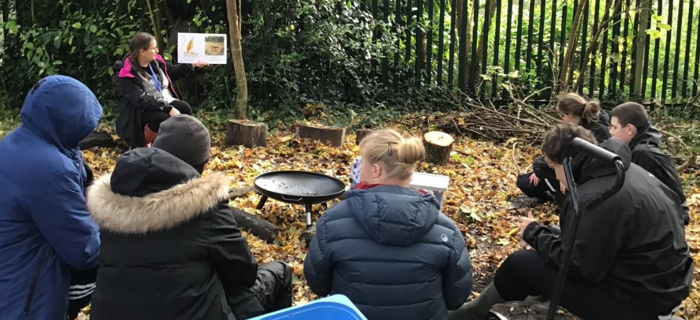
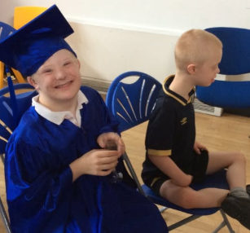
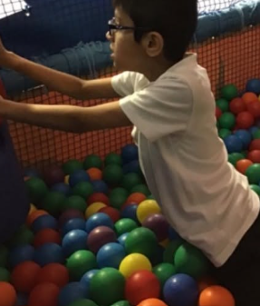
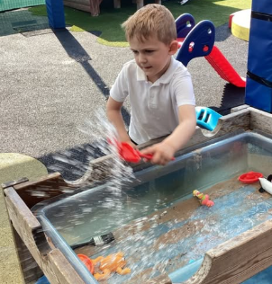
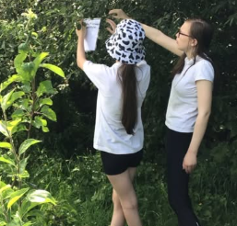
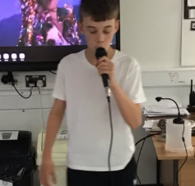
Welcome to Rose Class

Slide 2
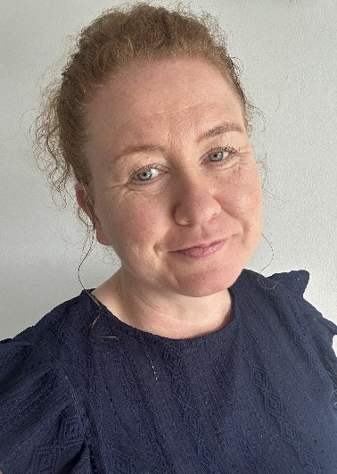





Rose Class Team
Miss Urry - Teacher
Mrs Golden – Level 3 TA
Miss Leigh – Level 2 TA
Mrs Stunnell – PPA Cover
Mr Higham - Music
Mrs Beasley – PPA Cover

Slide 3
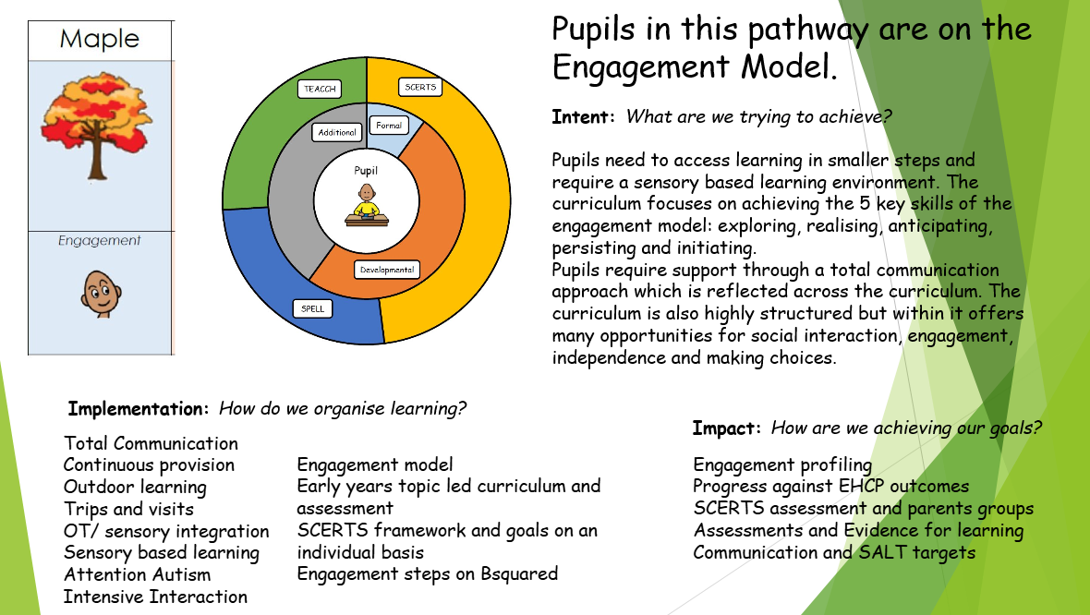
Our Curriculum

Slide 4
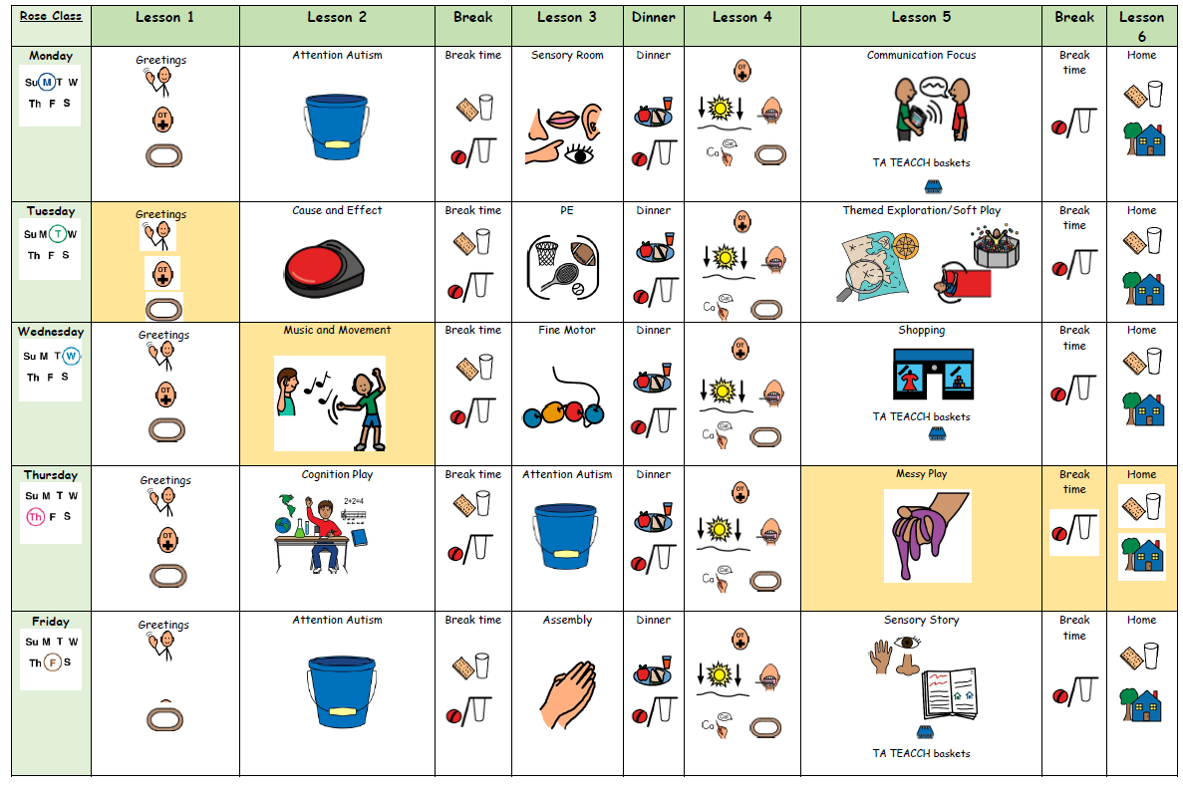
What Our Days Look Like

Slide 5
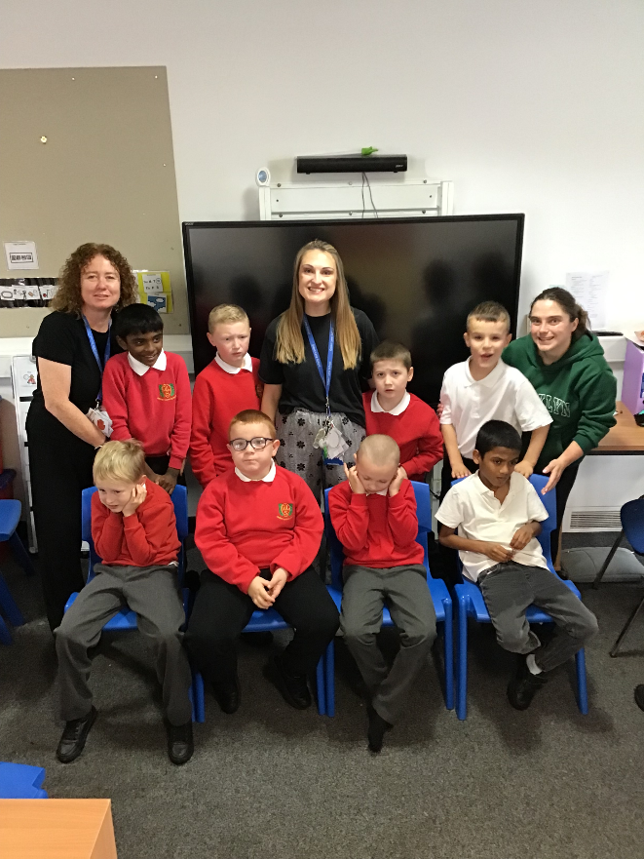
Rose Class is a Key Stage 2 class made up of pupils from years 3, 4, 5 and 6.

Slide 6

Our School Day
Pupils arrive at school
All pupils participate in individual OT circuits and Phonics activities
Good Morning Routine/Greetings
OT Walk
Lesson 1&2 - Teacher lead input – work based activities – TEACCH Baskets (intensive interactions)- Indoor and outdoor continuous provision.
Snack time
Break time
Lesson 3 - Teacher lead input – work based activities (Sensory Room Monday)
Lunch time
Break time
OT, Tooth brushing and OT Walk
Lesson 4&5 - Teacher lead input – work based activities – TEACCH Baskets Baskets (intensive interactions)- Indoor and outdoor continuous provision.
Playtime
Snack Time
Home Time

Slide 7
The Engagement Model
Engagement Model: 5 Areas
The 5 areas are not hierarchical, so there is no expectation that pupils need to demonstrate progress in all 5 areas. Instead, each of the areas represent what is necessary for pupils to fully engage in their learning and reach their full potential. The areas also provide the scaffolding to enable pupils to become independent in learning a new skill or concept.
Exploration
This shows whether a pupil can build on their initial reaction to a new stimulus or activity, for example, whether they display more than an involuntary or startled reaction to the activity. Additionally, the pupil may be interested in and curious about the stimulus or activity, for example, they may notice it or reach out to it.
Exploration becomes more established when the pupil is still responsive to the same stimulus or activity when it is presented in different contexts or environments, for example, a different time of day, a different place or with different people.
Exploration is important in identifying which stimuli or activities interest the pupil and motivate them to pay attention and investigate them further, so that they can develop new knowledge and skills.

Slide 8
The Engagement Model
Realisation
This shows how the pupil interacts with a new stimulus or activity or discovers a new aspect of a familiar stimulus or activity. They will display behaviours that show they want more control of the stimulus or activity, for example by stopping it or trying to make changes to it. The pupil will often show what familiar adults consider to be ‘surprise’, ‘excitement’, ‘delight’, ‘amazement’ or ‘fear’.
Realisation becomes more established when the pupil uses the newly developed skills or knowledge in new ways and in different contexts or environments. This is important as it can keep the pupil excited in their learning and prevents an activity from becoming routine.
Anticipation
This shows how much the pupil predicts, expects or associates a stimulus or activity with an event. They may anticipate that a familiar activity is about to start or finish by interpreting cues or prompts such as auditory (what they hear), tactile (what they feel) and visual (what they see).
Anticipation becomes more established when the pupil shows awareness that a familiar activity is about to start or finish, even when cues and prompts are reduced.
Anticipation is important in measuring the pupil’s understanding of cause and effect, for example if they do this, then something will happen. This prepares the brain for learning and helps with the pupil’s memory and sequencing.

Slide 9
The Engagement Model
Persistence
This shows whether the pupil can sustain their attention in a stimulus or activity for long enough that they can actively try to find out more and interact with it.
Persistence becomes more established when the pupil shows a determined effort to interact with the stimulus or activity. They will do this by showing intentional changes such as changes in their gaze, posture and hand movement.
Persistence is important so that the pupil maintains an activity long enough to develop and reinforce learning. It also helps the pupil apply their skills or knowledge so they can achieve their desired outcome.
Initiation
This shows how much, and the different ways, a pupil investigates a stimulus or activity in order to bring about a desired outcome. The pupil will act spontaneously and independently during a familiar activity without waiting for direction.
Initiation becomes more established when the pupil shows they understand how to create an impact on their environment in order to achieve a desired outcome.
Initiation is important to establish how well the pupil is developing independence, which is required for more advanced learning.

Slide 10

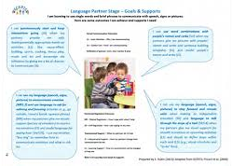
SCERTS
The first SCERTS clinic will be held during parents evening

Slide 11

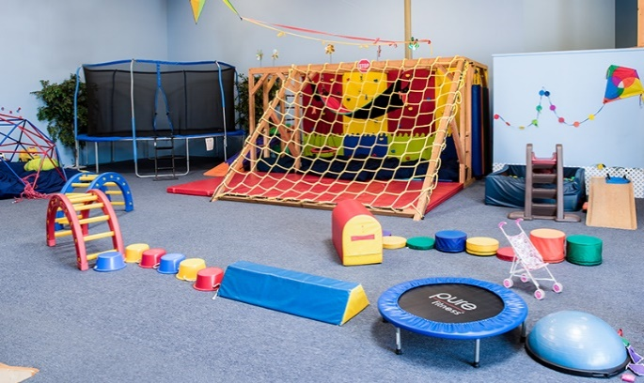
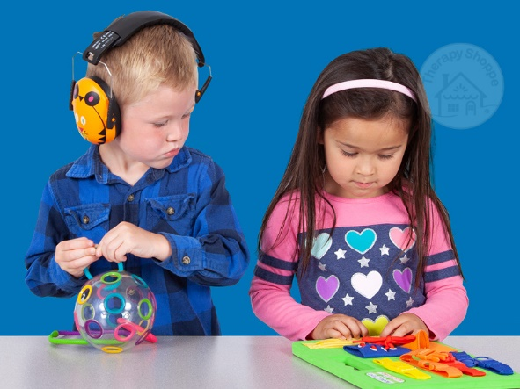
OT
Shine therapy are our new OT.
They are here twice a week to advise and write new OT plans for the children.

Slide 12

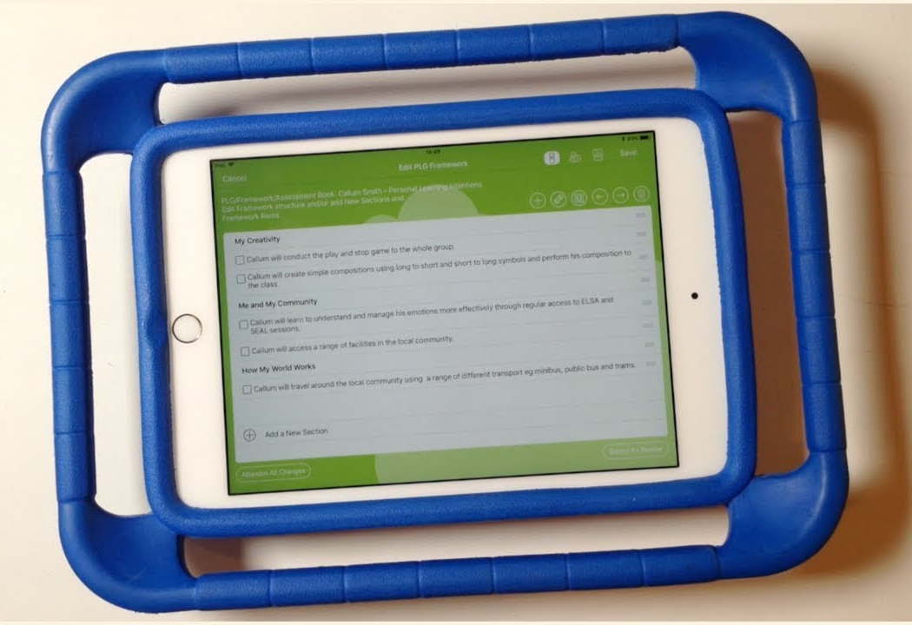
EFL
If you don’t know your log in details please
Let school know so you can access EFL.

Slide 13
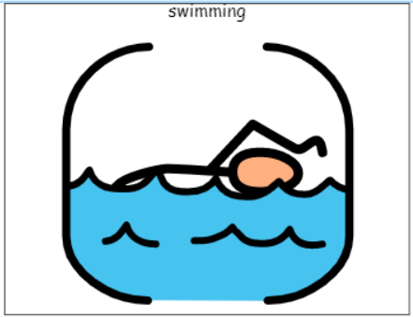
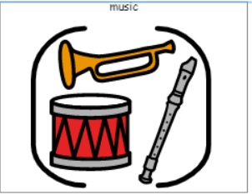
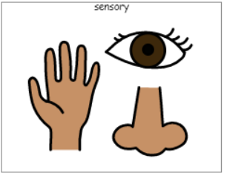
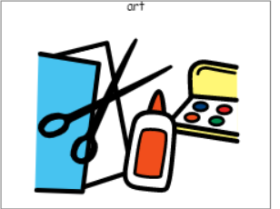
Curriculum Enhancements, Trips and Visits
Trips
Shopping
Blue Planet Aquarium
Manchester Airport
CAFT

Slide 14

Evidence for Learning
Evidence for Learning (EfL) is a secure online platform we use at Green Lane to share photographs, videos and observations of your child’s learning, progress and achievements. It gives you a lovely insight into what your child has been learning and enjoying at school.
We also love it when parents and carers upload photographs of the things children have been doing at home, so that we can celebrate and talk about these experiences in school too.
If you have any trouble logging in, please let your child’s class team know and they can ask Miss Taylor to reset your password.

Slide 15



What should pupils bring to school daily?
Their home school diary – This can be used for messages between class and home.
Reading books and records are given in line with students Phonics assessments. We aim to read with your child on a 1:1 basis 3x each week. Please record in the reading record when you have read with your child at home.
Books will be changed weekly, or as required.
Water bottles – These will be sent home after each school day. Alternatively, cups are available in school so if you do forget to send it please do not worry.

Slide 16
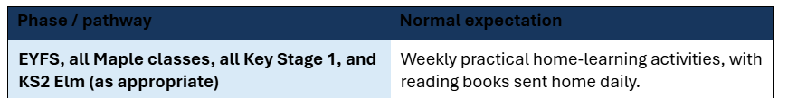
Homework…
Homework will be added to EFL on a Monday and will be checked the next Monday.
Reading books will be changed on a Thursday.

Slide 17

Any questions?

