Slide 1


Welcome to Daffodil Class

Slide 2

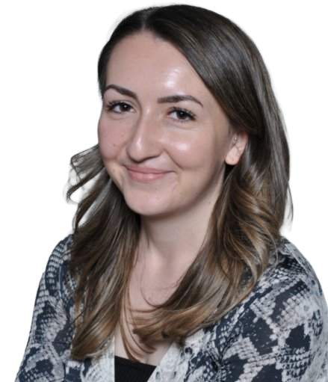
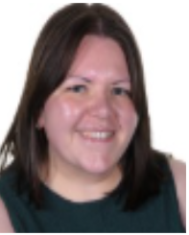

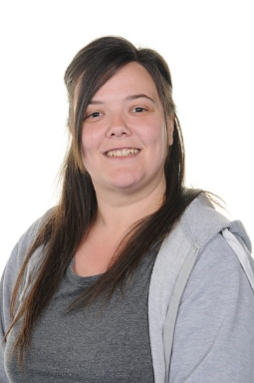


Daffodil Class Team
Miss Bhalla
Class Teacher
Mrs Maddox
Class Teacher – Maternity Cover
Mr Murty
Teaching Assistant
Mrs McKenna
Teaching Assistant
Miss Sudworth
Teaching Assistant
Mr Collopy
Teaching Assistant
Miss Chadwick
Weekly PPA Cover

Slide 3
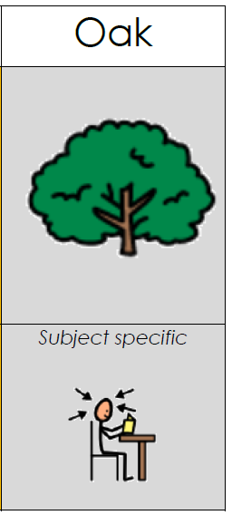
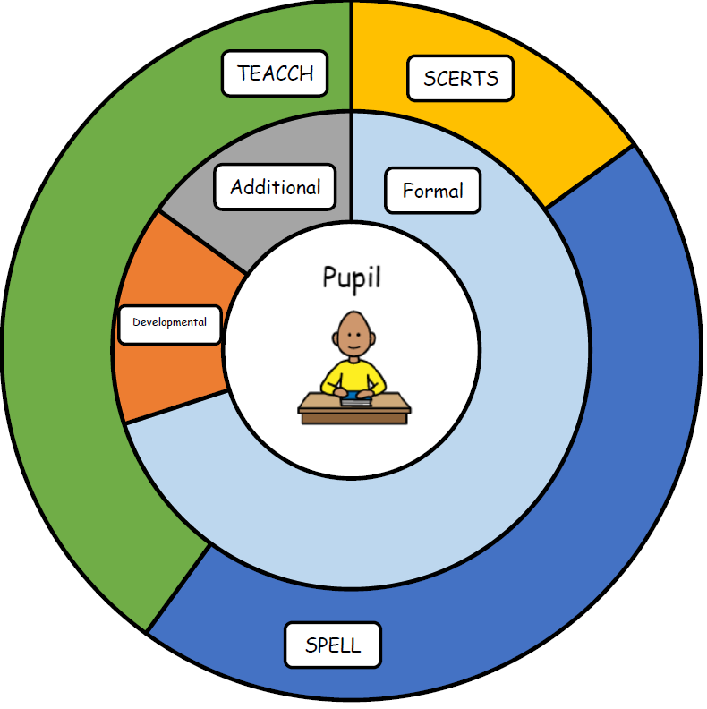
Our Curriculum
Implementation: How do we organise learning?
Discrete subject lessons
OT/Sensory integration
Progression steps
Assessment
Trips and visits
Pupils in this pathway require a subject specific curriculum.
Impact: How are we achieving our goals?
Progress against EHCP outcomes
Accreditation at Entry Level 1, 2 or 3, with some accessing Functional Skills in English.
PFA- Independence and skills for Employment
Communication and SALT targets
Intent: What are we trying to achieve?
Pupils in this pathway require a subject specific curriculum where subjects are taught discretely.

Slide 4
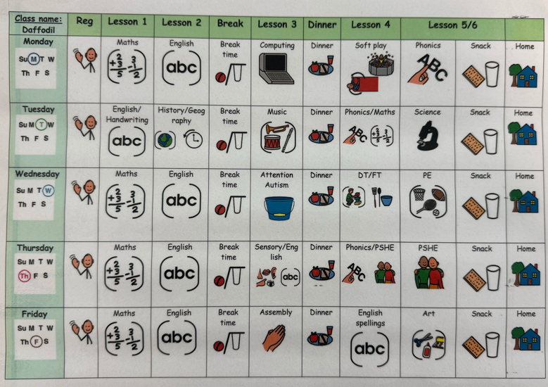
What Our Days Look Like

Slide 5
PE
Our PE day is Wednesday each week.
Children can come to school wearing their PE kit on this day. Please ensure they wear black shorts or black joggers and suitable trainers so they can take part comfortably and safely in PE activities.

Slide 6
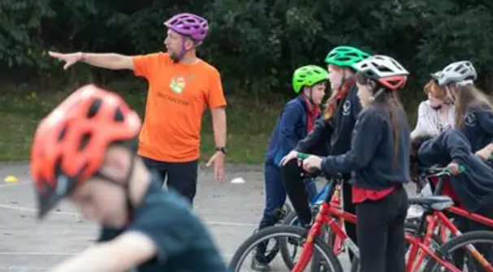
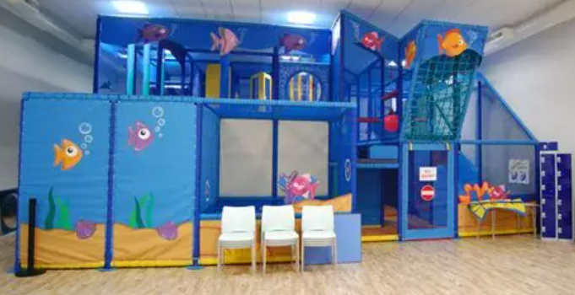
Curriculum Enhancements, Trips and Visits
Bikeability – 19th-20th October
Sensory Centre – 19th and 26th November, 3rd and 10th November, 7th January

Slide 7

Evidence for Learning
Evidence for Learning (EfL) is a secure online platform we use at Green Lane to share photographs, videos and observations of your child’s learning, progress and achievements. It gives you a lovely insight into what your child has been learning and enjoying at school.
We also love it when parents and carers upload photographs of the things children have been doing at home, so that we can celebrate and talk about these experiences in school too.
If you have any trouble logging in, please let your child’s class team know and they can ask Miss Taylor to reset your password.

Slide 8



What should pupils bring to school daily?
Their home school diary – This can be used for messages between class and home.
Reading books and records are given in line with students Phonics assessments. We aim to read with your child on a 1:1 basis 3x each week. Please record in the reading record when you have read with your child at home.
Books will be changed weekly, or as required.
Water bottles – These will be sent home after each school day. Alternatively, cups are available in school so if you do forget to send it please do not worry.

Slide 9
Homework…
Children will bring home a reading book and spellings each week. Reading books and spelling lists will be matched to each child's phonics phase and reading level to ensure they are appropriately challenging and support progress.
We will also send home English and Maths homework on alternate weeks.
Homework should be returned by Thursday so that it can be marked and new work sent out each Friday.

Slide 10

Any questions?

