Slide 1

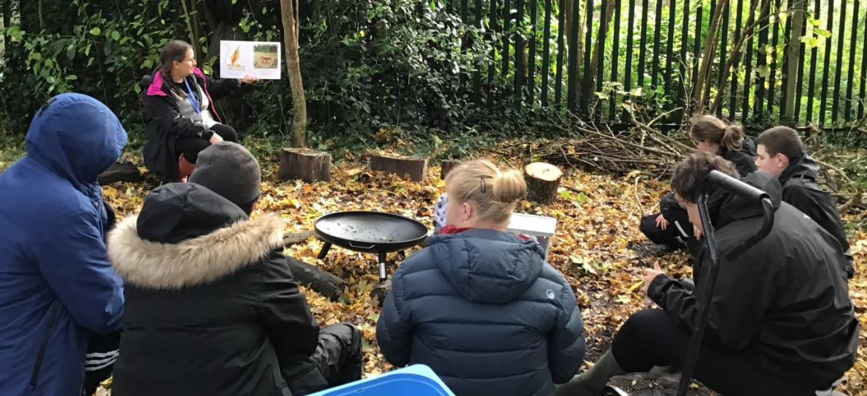
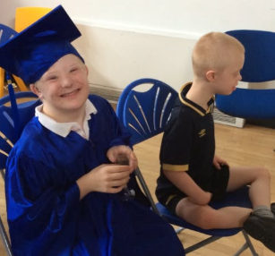
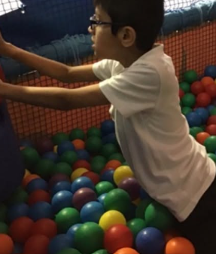
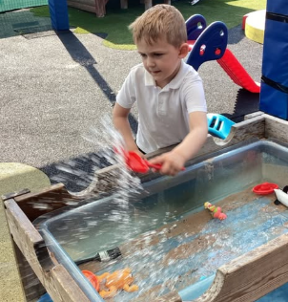
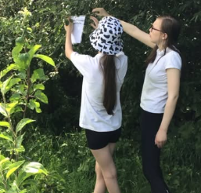
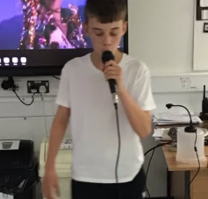
Welcome to Buttercup Class

Slide 2
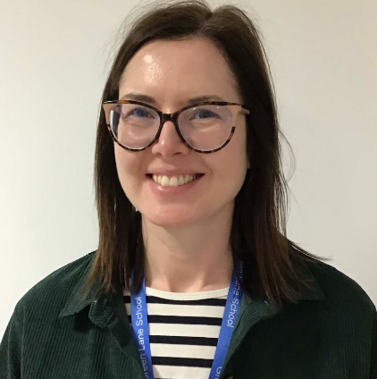
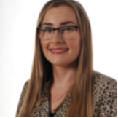
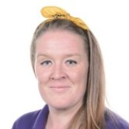
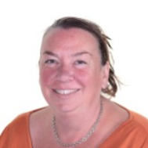
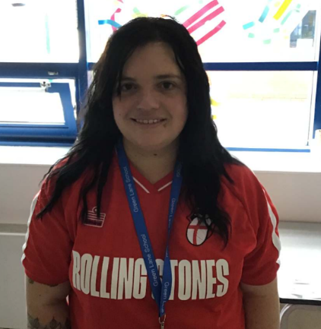
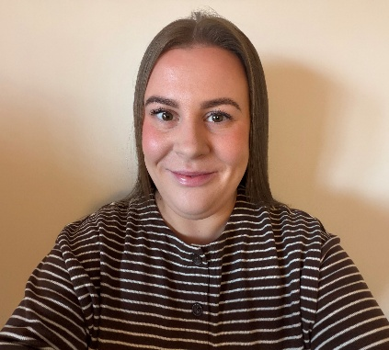
Buttercup Class Team
Miss Welburn until April 2027
Covering Miss Blinco
Miss Blinco maternity leave until April 2027
Miss Bourque
Mrs Glindon
Miss Appleton
Miss Fox covers Monday lesson 2 and all day Thursday

Slide 3
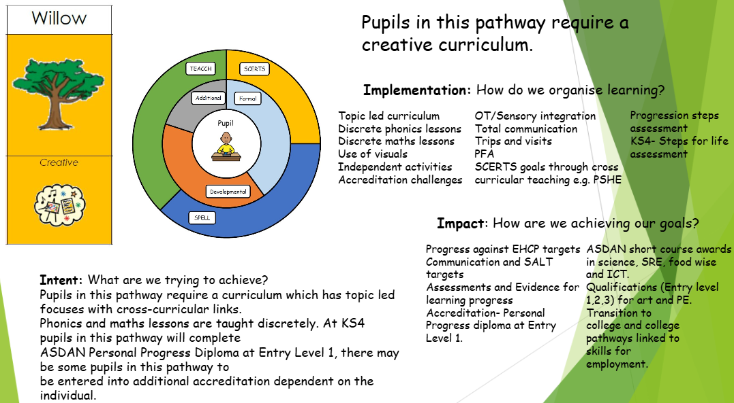
Our Curriculum
Pull key pathway information from the core offer document on the ydrive under 26/27, curriculum
Green Lane Shool Core Offer.pptx

Slide 4
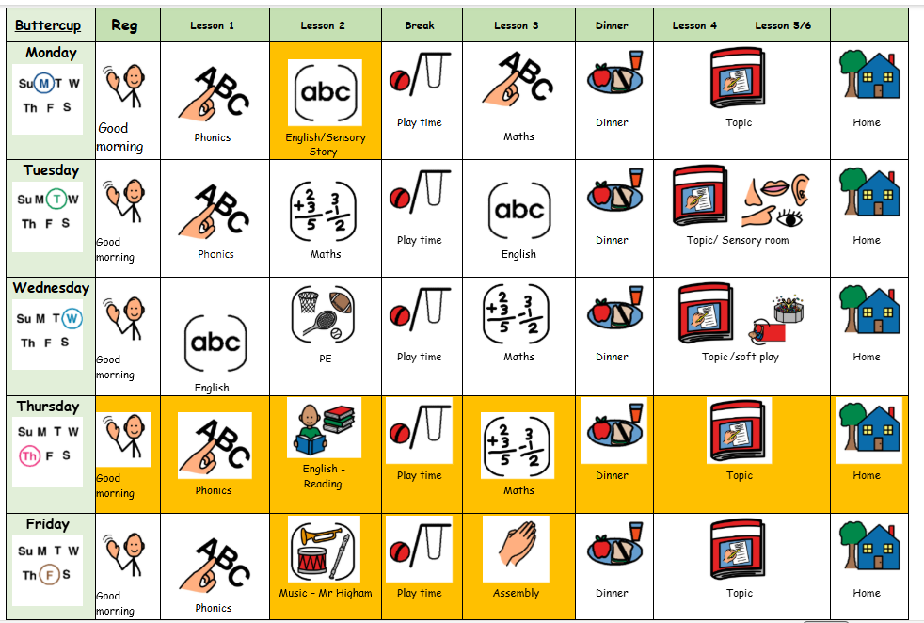
What Our Days Look Like

Slide 5

Curriculum Enhancements, Trips and Visits
Add planned curriculum enhancements (if you google the name you can get an image as well) and planned trips
Add planned curriculum trips across the year
Curriculum Enhancements 26-27.docx
Trips and Visits 26-27.docx

Slide 6

Evidence for Learning
Evidence for Learning (EfL) is a secure online platform we use at Green Lane to share photographs, videos and observations of your child’s learning, progress and achievements. It gives you a lovely insight into what your child has been learning and enjoying at school.
We also love it when parents and carers upload photographs of the things children have been doing at home, so that we can celebrate and talk about these experiences in school too.
If you have any trouble logging in, please let your child’s class team know and they can ask to reset your password.

Slide 7



What should pupils bring to school daily?
Their home school diary – This can be used for messages between class and home.
Reading books and records are given in line with students Phonics assessments. We aim to read with your child on a 1:1 basis 3x each week. Please record in the reading record when you have read with your child at home.
Books will be changed weekly, or as required.
Water bottles – These will be sent home after each school day. Alternatively, cups are available in school so if you do forget to send it please do not worry.

Slide 8
Homework…
Each week children will receive homework on a Friday. This is to be returned the following Friday. The homework reflects work we are doing in class and will be linked to Maths, English, Phonics or topic work.

Slide 9

Any questions?

