Slide 1

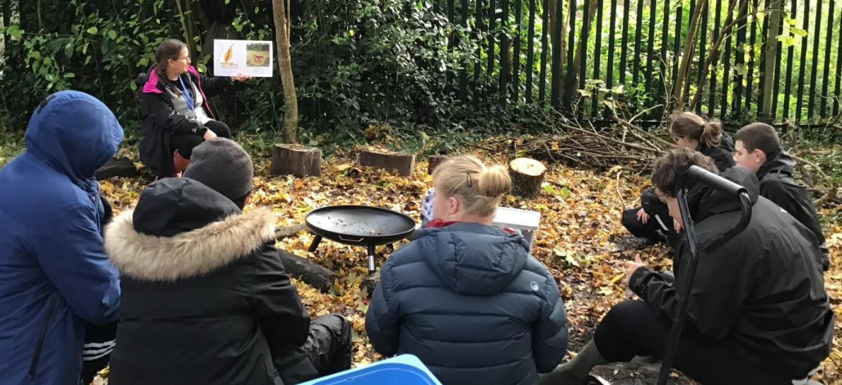
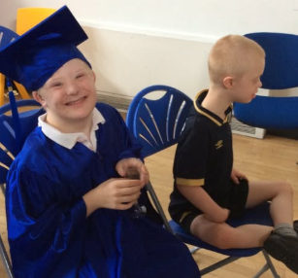
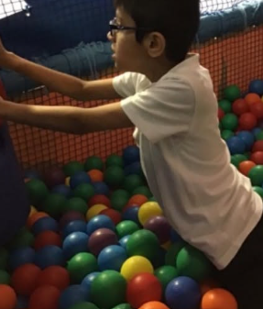
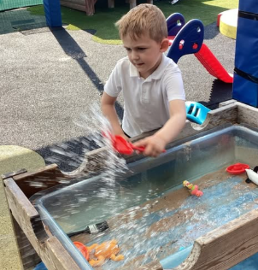
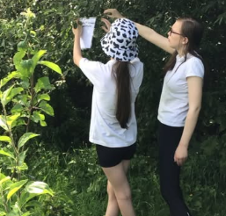
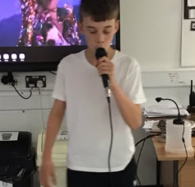
Welcome to Poppy Class

Slide 2
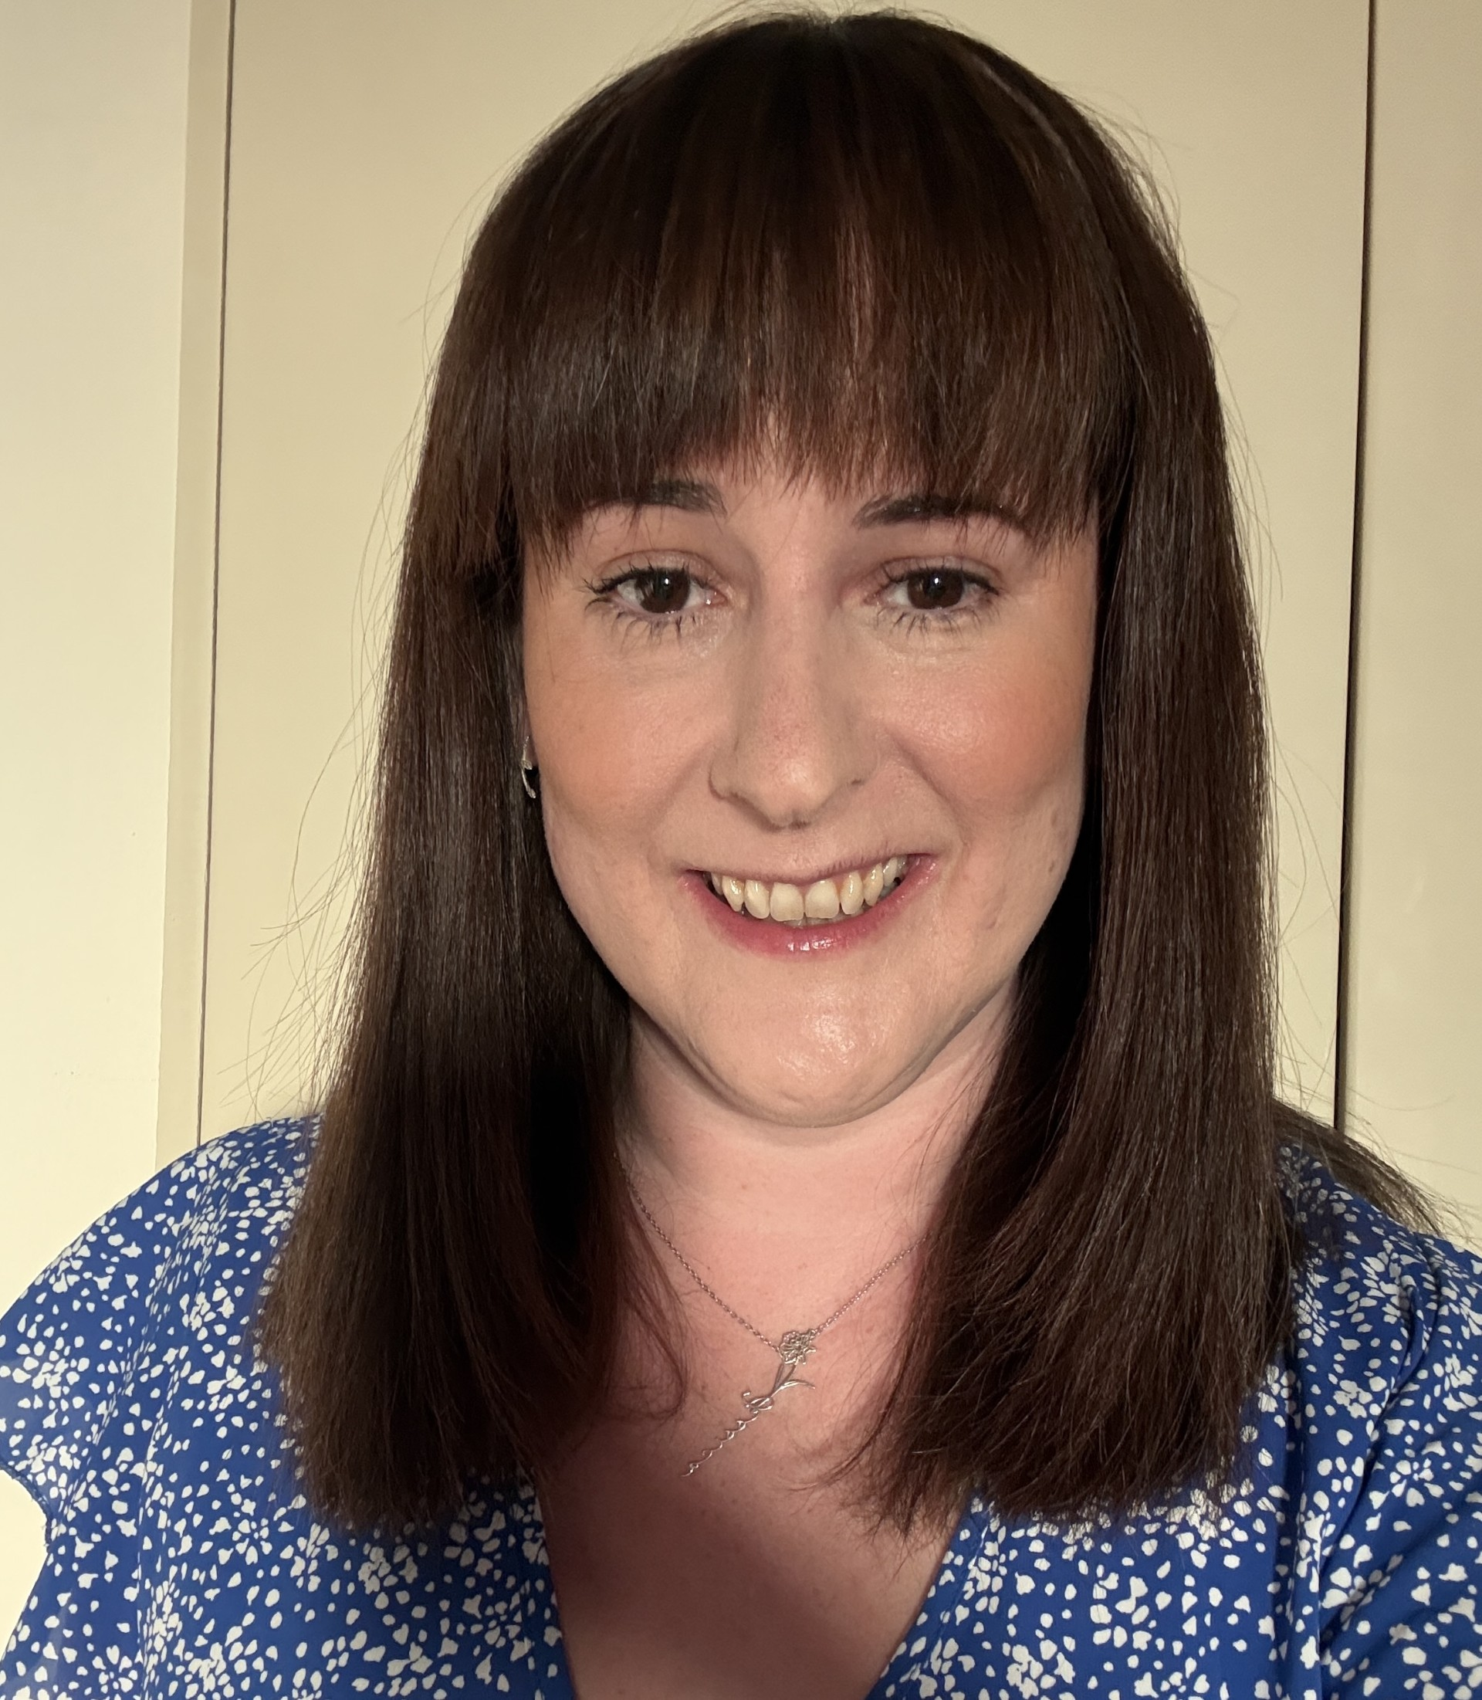
Poppy Class Team
Miss Allen
Miss Milnes
Miss Davies (Phonics and Topic, Wednesday morning)

Slide 3
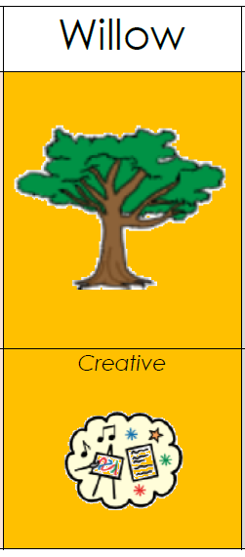
Our Curriculum
Implementation: How do we organise learning?
Topic led curriculum
Discrete phonics lessons
Discrete maths lessons
Use of visuals
Independent activities
Accreditation challenges
Impact: How are we achieving our goals?
Progress against EHCP targets
Communication and SALT
targets
Assessments and Evidence for
learning progress
Intent: What are we trying to achieve?
Pupils in this pathway require a curriculum which has topic led focuses with cross-curricular links.

Slide 4
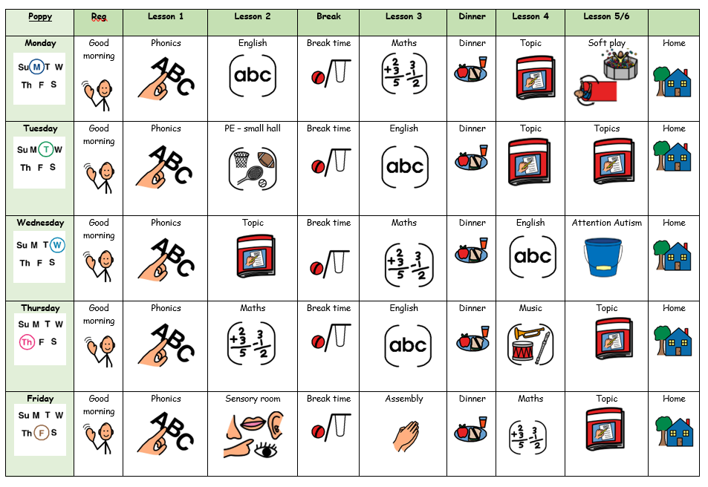
What Our Days Look Like

Slide 5
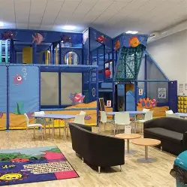
Curriculum Enhancements, Trips and Visits
Curriculum Enhancement
Live Music now
Art Sessions 20th October
Sensory Centre – June/July
We will also plan trips and visits to take place throughout the year.

Slide 6

Evidence for Learning
Evidence for Learning (EfL) is a secure online platform we use at Green Lane to share photographs, videos and observations of your child’s learning, progress and achievements. It gives you a lovely insight into what your child has been learning and enjoying at school.
We also love it when parents and carers upload photographs of the things children have been doing at home, so that we can celebrate and talk about these experiences in school too.
If you have any trouble logging in, please let your child’s class team know and they can ask Miss Taylor to reset your password.

Slide 7



What should pupils bring to school daily?
Their home school diary – This can be used for messages between class and home.
Reading books and records are given in line with students Phonics assessments. We aim to read with your child on a 1:1 basis 3x each week. Please record in the reading record when you have read with your child at home.
Books will be changed weekly, or as required.
Water bottles – These will be sent home after each school day. Alternatively, cups are available in school so if you do forget to send it please do not worry.

Slide 8
Homework…
In addition to a reading book, your child will begin receiving homework which will include spellings and alternating maths or English. We will give this out on a Tuesday to be returned the following Tuesday.

Slide 9

Any questions?

