Slide 1

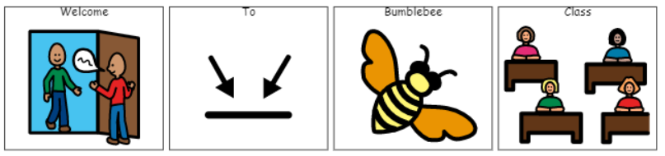
Welcome to Bumblebee Class

Slide 2
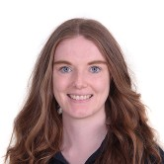
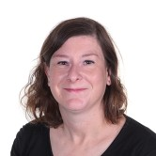
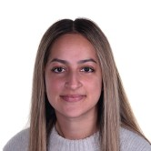
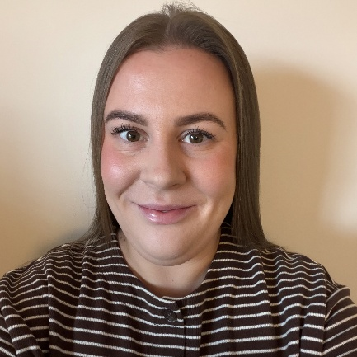
Bumblebee Class Team
Miss Brown
Class Teacher
Mrs Gorman
L3 Teaching Assistant
Miss Bhalla
L2 Teaching Assistant
Miss Fox
HLTA Cover - Fridays

Slide 3
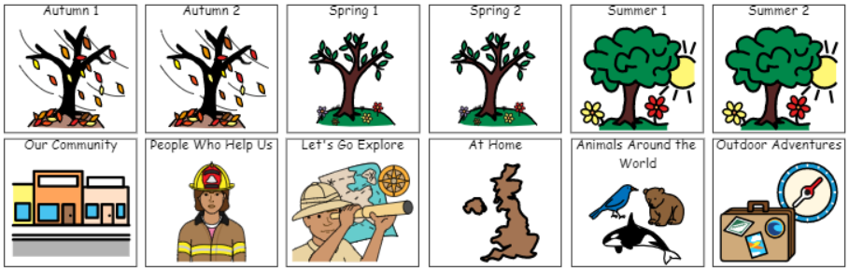
Our Curriculum
At the beginning of each half term an overview of what we are covering will appear on the school website.

Slide 4
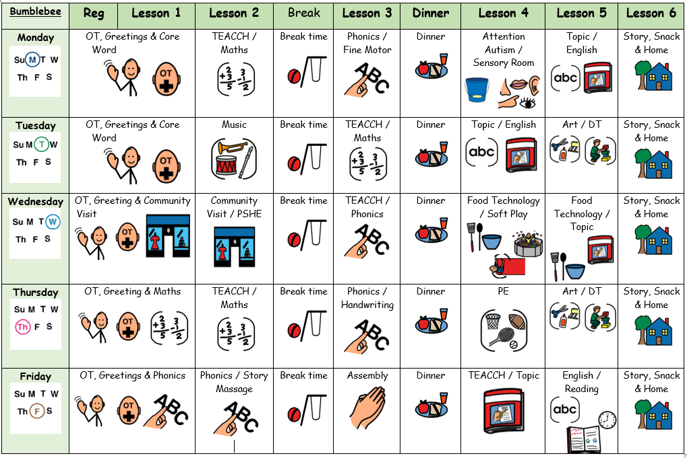
What Our Days Look Like

Slide 5

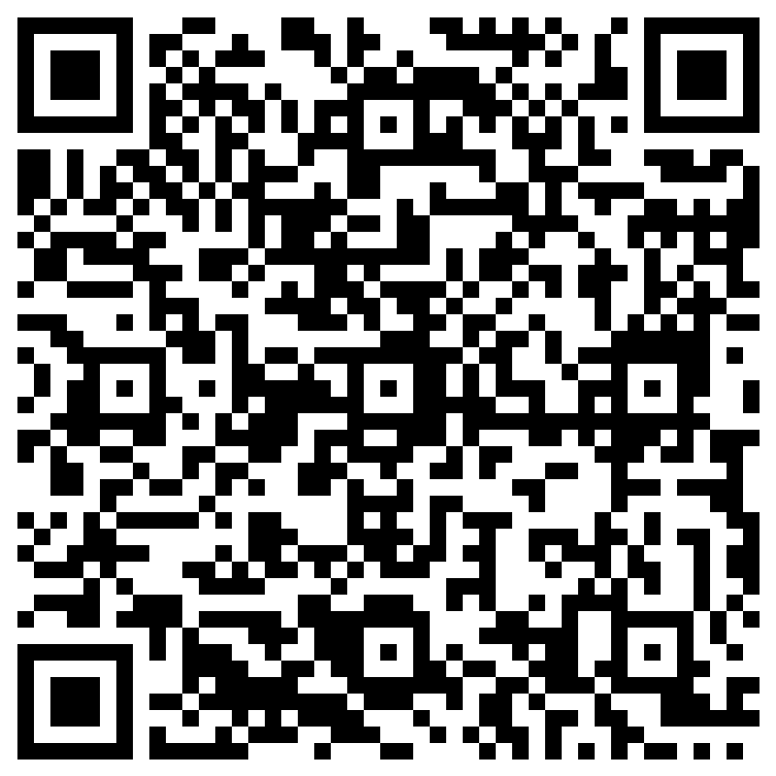
SCERTS
Bumblebee Class is on the Elm Pathway.
It is a SCERTS class.....
Social Communication
Emotional Regulation
Transitional Support
SCERTS clinics and SCERTS groups run during the year so you can learn how we use SCERTS in class and how it can be used at home.
Please scan the QR code and complete the questionnaire to help us best support your child with their SCERTS journey. Thank you.

Slide 6

Evidence for Learning
Evidence for Learning (EfL) is a secure online platform we use at Green Lane to share photographs, videos and observations of your child’s learning, progress and achievements. It gives you a lovely insight into what your child has been learning and enjoying at school.
We also love it when parents and carers upload photographs of the things children have been doing at home, so that we can celebrate and talk about these experiences in school too.
If you have any trouble logging in, please let your child’s class team know and they can ask Miss Taylor to reset your password.

Slide 7

Curriculum Enhancements, Trips and Visits

Slide 8
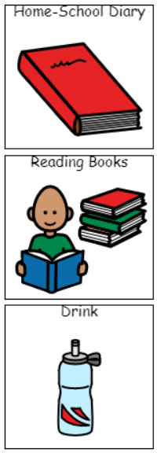
What should pupils bring to school daily?
Pupils have been given a home-school communication book.
Please feel free to write any notes to class staff in here. Staff will use this to send messages home about how your child's day.
All children will be given a reading book and a reading record to accompany this. This can be used to tell us if your child has engaged with the story. Reading books will be changed weekly. We will also read with your child in school.
Drinks bottles to be brought into school. We can top them up with water or juice.

Slide 9
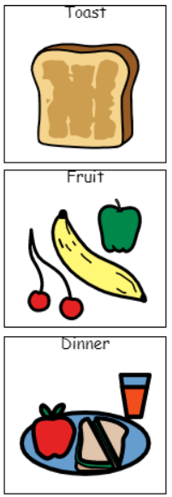
Snacks and Lunches
Children will have access to water and juice.
A contribution of £2.00 can be made for toast on a weekly basis. Payable on ParentPay.
All children have access to fruit daily as part of the fruit for schools system.
All children in Year 1 and 2 are entitled to free school meals which we can order for you or you can make a choice yourself. However, you can also provide them with a packed lunch and/or safe foods that they can have for both lunch and snack.

Slide 10
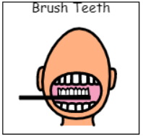
Tooth Brushing
We will be taking part in the tooth brushing scheme, whereby the children are encouraged to clean their teeth daily after lunch.

Slide 11
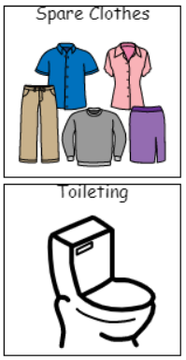
Additional Information
The children will need spare clothing in their school bags in case of accidents and messy play. Wellies and puddle suits would be helpful for Forest School (Spring Term 1).
Nappies to be provided by yourself, ideally 2-3 nappies per day. We are supporting and encouraging the children to get themselves undressed and dressed as well as sitting on the toilet, hand washing and drying, etc.

Slide 12

Support
The school have fantastic teams whereby support is given with Speech and Language and Occupational Therapy (Shine). These services are provided within the setting.
The safeguarding team are always available to support families, point you in the right direction and provide a variety of support.
No problem is too big or too small. If you are concerned or worried or have any queries, please reach out to the school.

Slide 13

Any questions?

