Slide 1

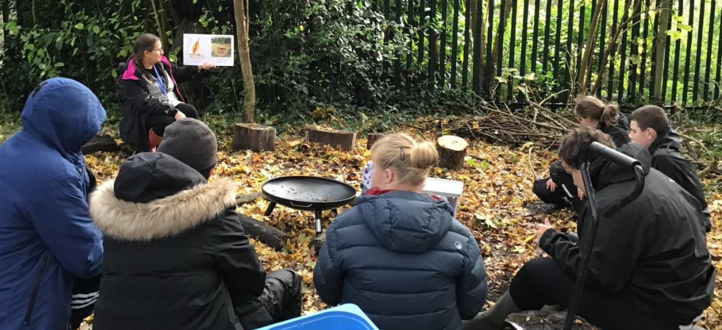
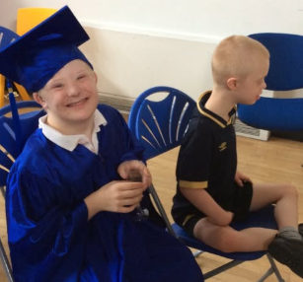
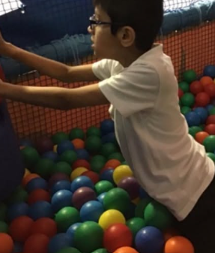
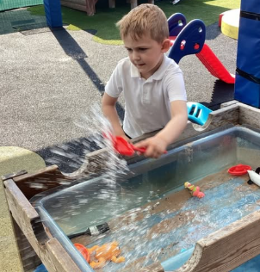
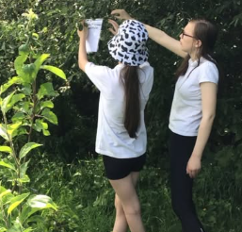
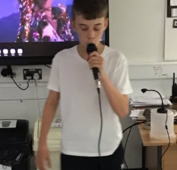
Welcome to Deer Class

Slide 2
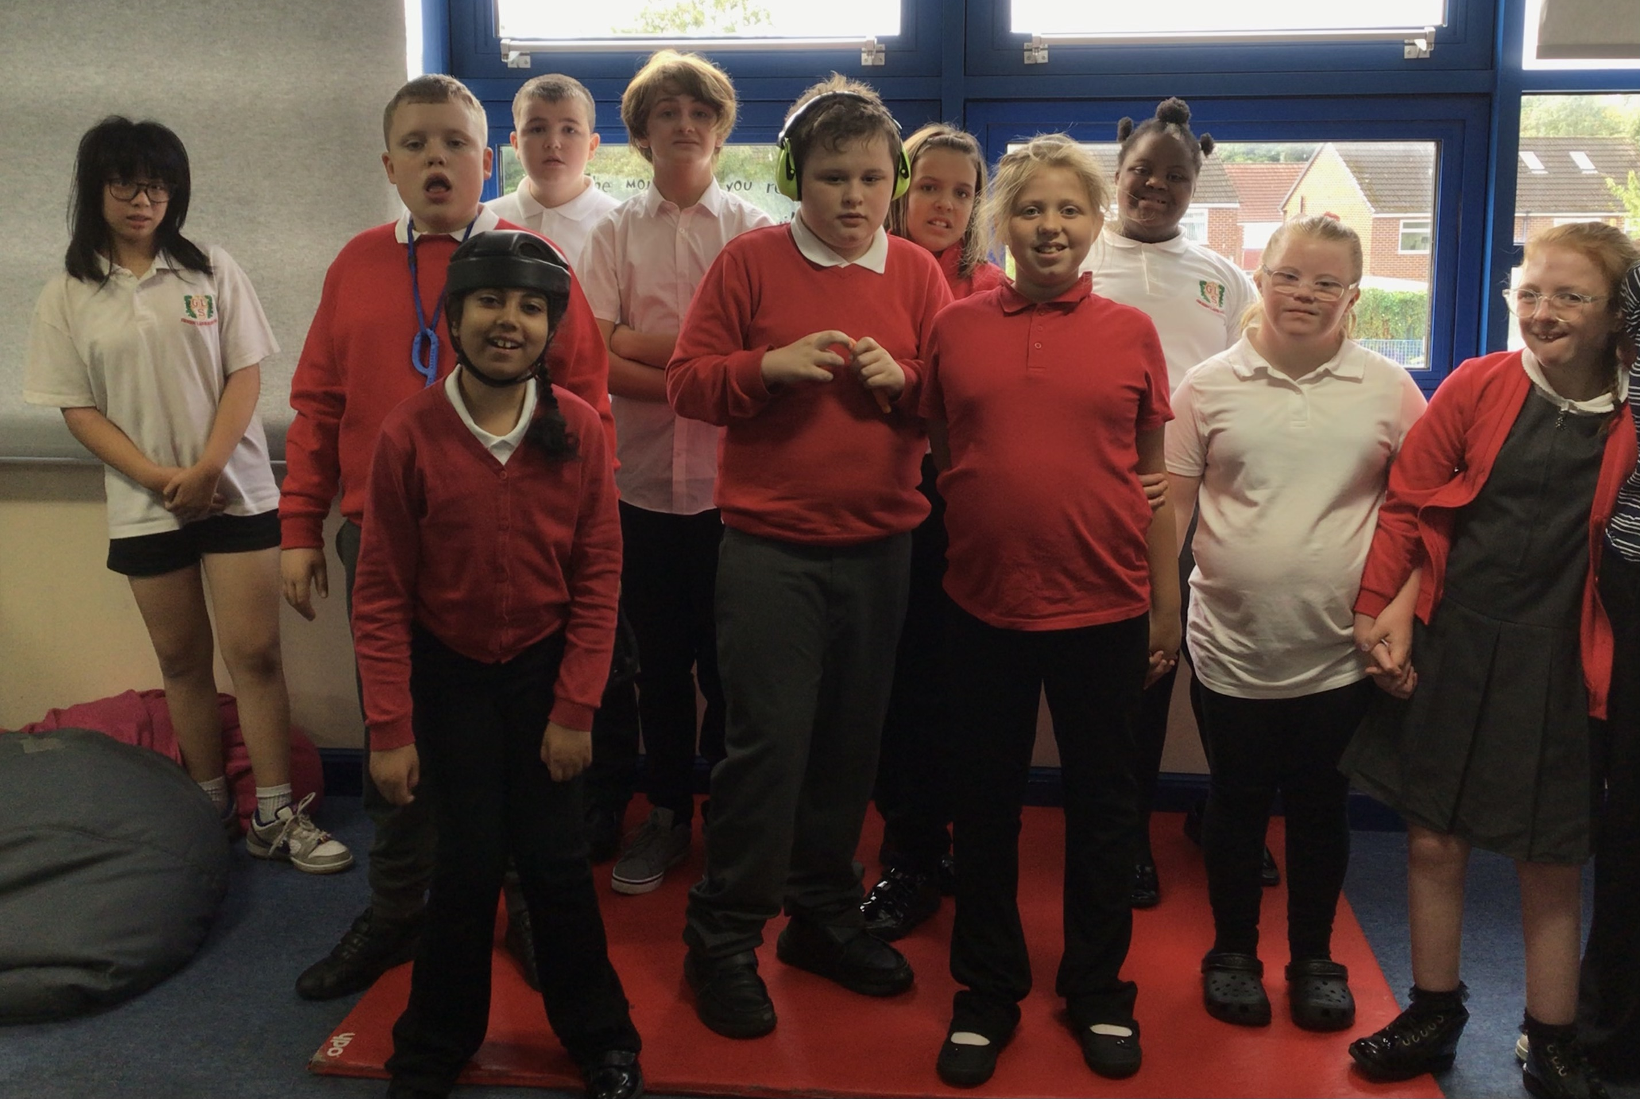
Deer Class
We are a Key Stage 3 class of 11 pupils in Years 7, 8 and 9.

Slide 3
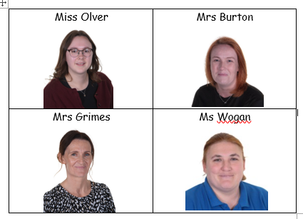
Deer Class Team
The class team are Miss Olver (teacher), Mrs Burton (HLTA), Mrs Grimes (1-1 TA) and Ms Wogan (1-1 TA)
If you have any question please speak to one of us.

Slide 4
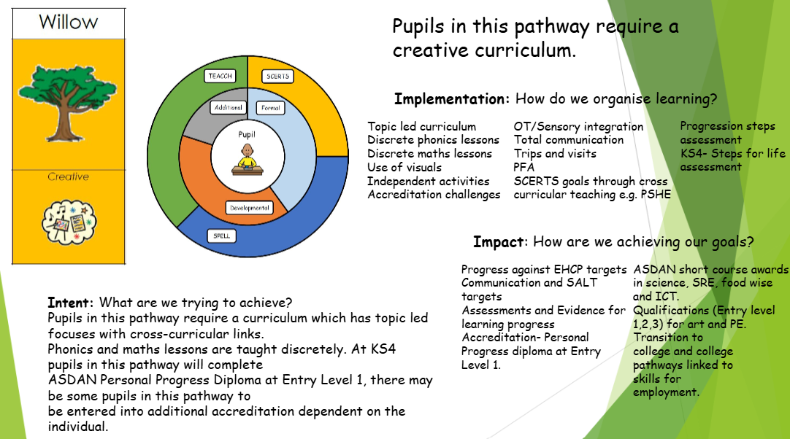
Our Curriculum

Slide 5
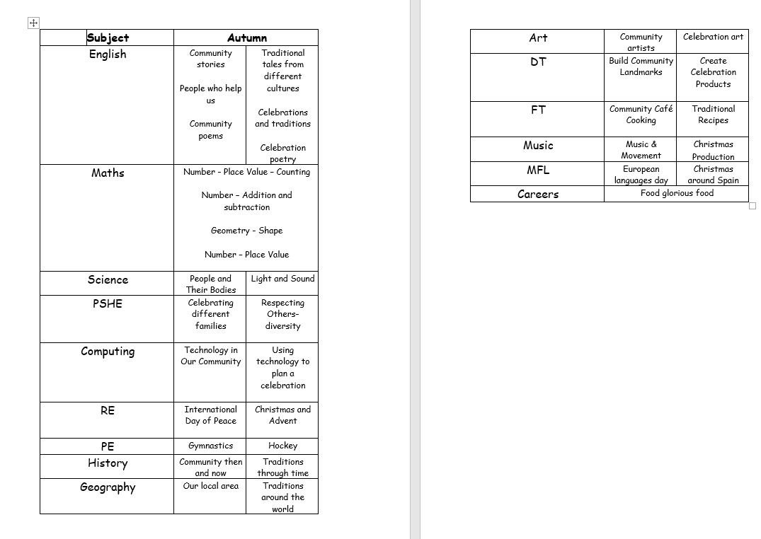
Our Topics

Slide 6
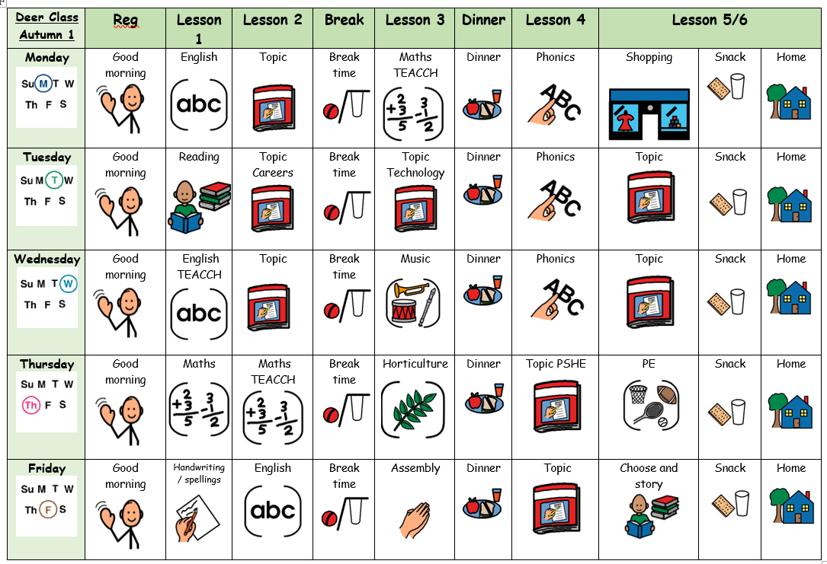
What Our Days Look Like

Slide 7
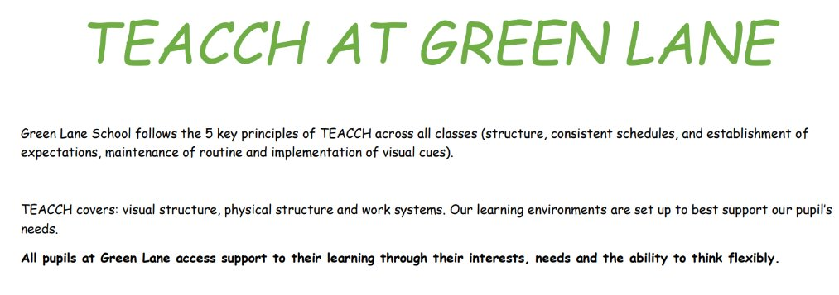
Our Learning
TEACCH – we used a TEACCH work system three times a week in our foundation lessons. This builds on fine motor, independence and key English and maths learning.

Slide 8
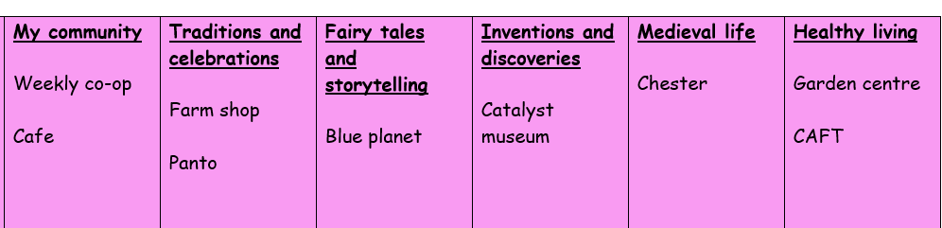
Curriculum Enhancements, Trips and Visits
Curriculum enhancements
Horticulture autumn 1
Guitar autumn 1
Forest School autumn 2
Livemusicnow! autumn 2
Karate summer 2
Curriculum enhancements
Cheshire fire and rescue
Cheshire Police
Sensory room
Soft play
M+M productions

Slide 9
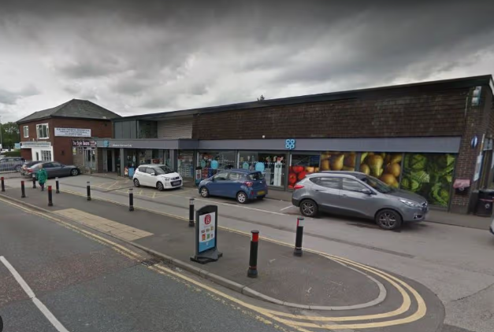
Curriculum Enhancements, Trips and Visits
Weekly walk to the co-op
Topic learning all about the community
Learning about money and spending
Writing lists of ingredients
Healthy and unhealthy food
Road safety
Buying healthy snacks and fruit to eat before home time
..the list continues!

Slide 10

Evidence for Learning
Evidence for Learning (EfL) is a secure online platform we use at Green Lane to share photographs, videos and observations of your child’s learning, progress and achievements. It gives you a lovely insight into what your child has been learning and enjoying at school.
We also love it when parents and carers upload photographs of the things children have been doing at home, so that we can celebrate and talk about these experiences in school too.
If you have any trouble logging in, please let us know.

Slide 11



What should pupils bring to school daily?
Their home school diary – This can be used for messages between class and home.
Reading books and records are given in line with students Phonics assessments. We aim to read with your child on a 1:1 basis 3x each week. Please record in the reading record when you have read with your child at home.
Books will be changed weekly as required.
Water bottles – These will be sent home after each school day. Alternatively, cups are available in school so if you do forget to send it please do not worry.
You are welcome to send it a snack for morning break.

Slide 12
Homework…
Spellings are sent home each Monday and will be tested on a Friday morning
Reading books are sent home each day – please read with your child at home and record in their reading record. We will change their books regularly.
Homework will be sent home on a Monday in their homework book. This will be English and maths.

Slide 13
Extra learning
We have a number of logins to access learning resources at home. They are available for you to explore with your child.
Reading Eggs – phonics learning, progressing through the sounds.
Numbots – maths learning, progressing through number skills.
Chatty toolbox – an open learning resource focusing on speech, language and communication.

Slide 14

PE
PE will be on a Thursday, please can pupils come into school in their kit.

Slide 15

Any questions?

